Slide 1
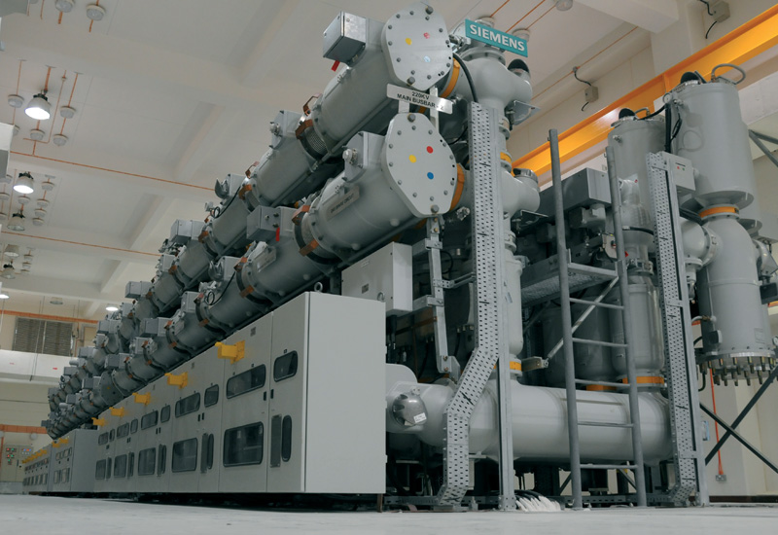
GAS INSULATED SUBSTATION

Slide 2
Contents:
Substation
Conventional substations (AIS)
Limitations of AIS
The need for GIS
Introduction to GIS
Properties of SF6
GIS assembly
Advantages of GIS
Design features
Drawbacks
SF₆ – Environmental concerns
SF₆ /N₂ mixtures
Future trends in GIS
Conclusion.

Slide 3
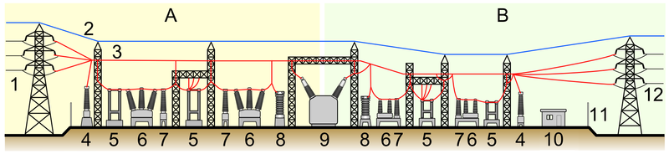
Substation:
An assembly of apparatus installed to control transmission and distribution of electric power.

Slide 4
Air Insulated Substation(AIS):
Air used as a dielectric.
Normally used for outdoor substations.
In very few cases used for indoor substations.
Easy to expand (in case that space is not an issue)
Excellent overview, simple handling and easy access.

Slide 5
Limitations of AIS:
Large dimensions due to statutory clearances and poor dielectric strength of air.
Insulation deterioration with ambient conditions and susceptibility to pollutants.
Wastage of space.
Life of steel structures degrades.
Seismic instability.
Large planning & execution time.
Regular maintenance of the substation required.

Slide 6
The need for G.I.S:
Non availability of sufficient space.
Difficult climatic and seismic conditions at site.
Urban site (high rise building).
High altitudes.
Limitations of AIS.

Slide 7
Gas Insulated Substation:
Introduction:
Compact, multi-component assembly.
Enclosed in a ground metallic housing.
Sulphur Hexaflouride (SF6) gas – the primary insulating medium.
(SF6) gas- superior dielectric properties used at moderate pressure for phase to phase and phase to ground insulation
Preferred for voltage ratings of 72.5 kV, 145 kV, 300 kV and 420 kV and above.
Various equipments like Circuit Breakers, Bus-Bars, Isolators, Load Break Switches, Current Transformers, Voltage Transformers, Earthing Switches, etc. housed in metal enclosed modules filled with SF6 gas.

Slide 8
Properties of SF6:
Non-toxic, very stable chemically.
Man-made.
Lifetime – Very long (800 to 3200 years!).
Insulating properties 3-times that of air.
Colorless & heavier than air.
Almost water insoluble.
Non inflammable.

Slide 9
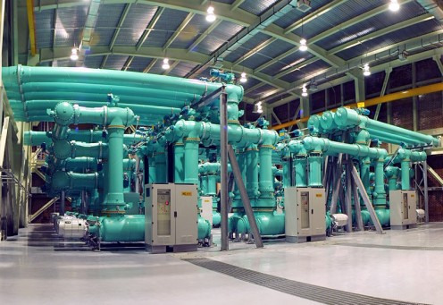
Gas insulated substation

Slide 10
GIS Assembly:
ESSENTIAL PARTS OF GIS:
1. Bus bar
2. Circuit Breaker
3. Disconnector (line or bus)
4. Earthing switch (line or bus)
5. Current transformer (feeder / bus)
6. Voltage transformer (feeder/ bus)
7. Feeder Disconnector
8. Feeder Earthing switch
9. Lightning / Surge Arrester
10. Cable termination
11. Control Panel.

Slide 11
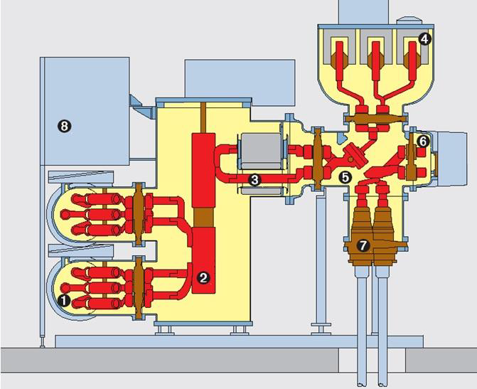
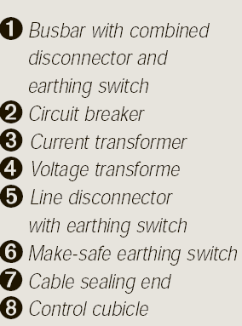

Slide 12
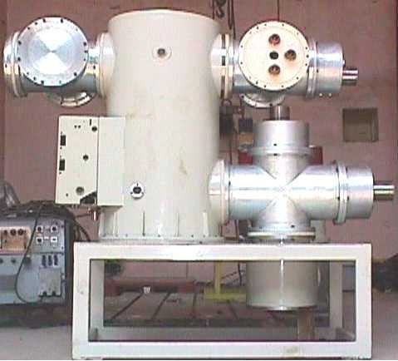
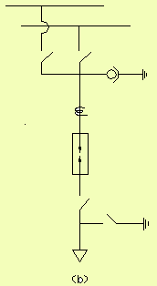

Slide 13
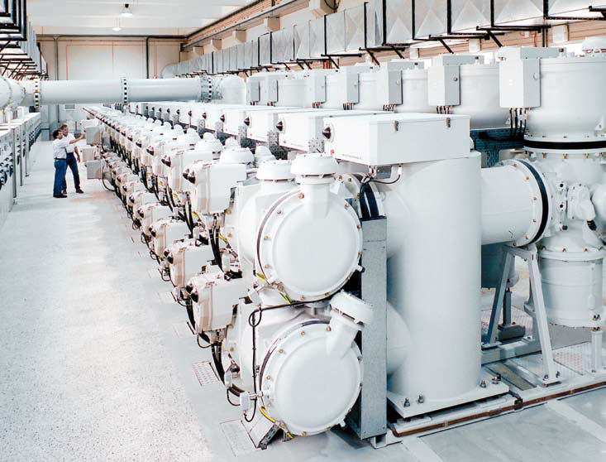

Slide 14
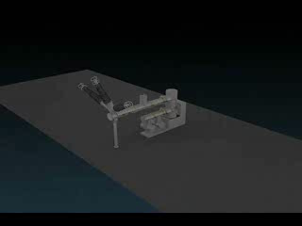
GIS assembly:

Slide 15
Advantages :
Occupies very less space (1/10th) compared to ordinary substations.
Hence, most preferred where area for substation is small (eg: Cities)
Most reliable compared to Air Insulated Substations.
Number of outages due to the fault is less
Maintenance Free.
Can be assembled at workshop and modules can be commissioned in the plant easily.

Slide 16
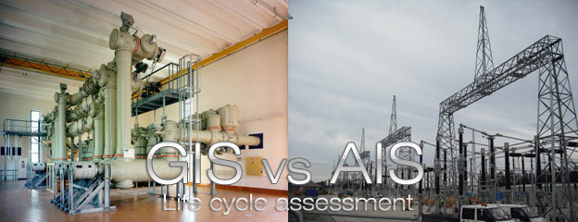

Slide 17
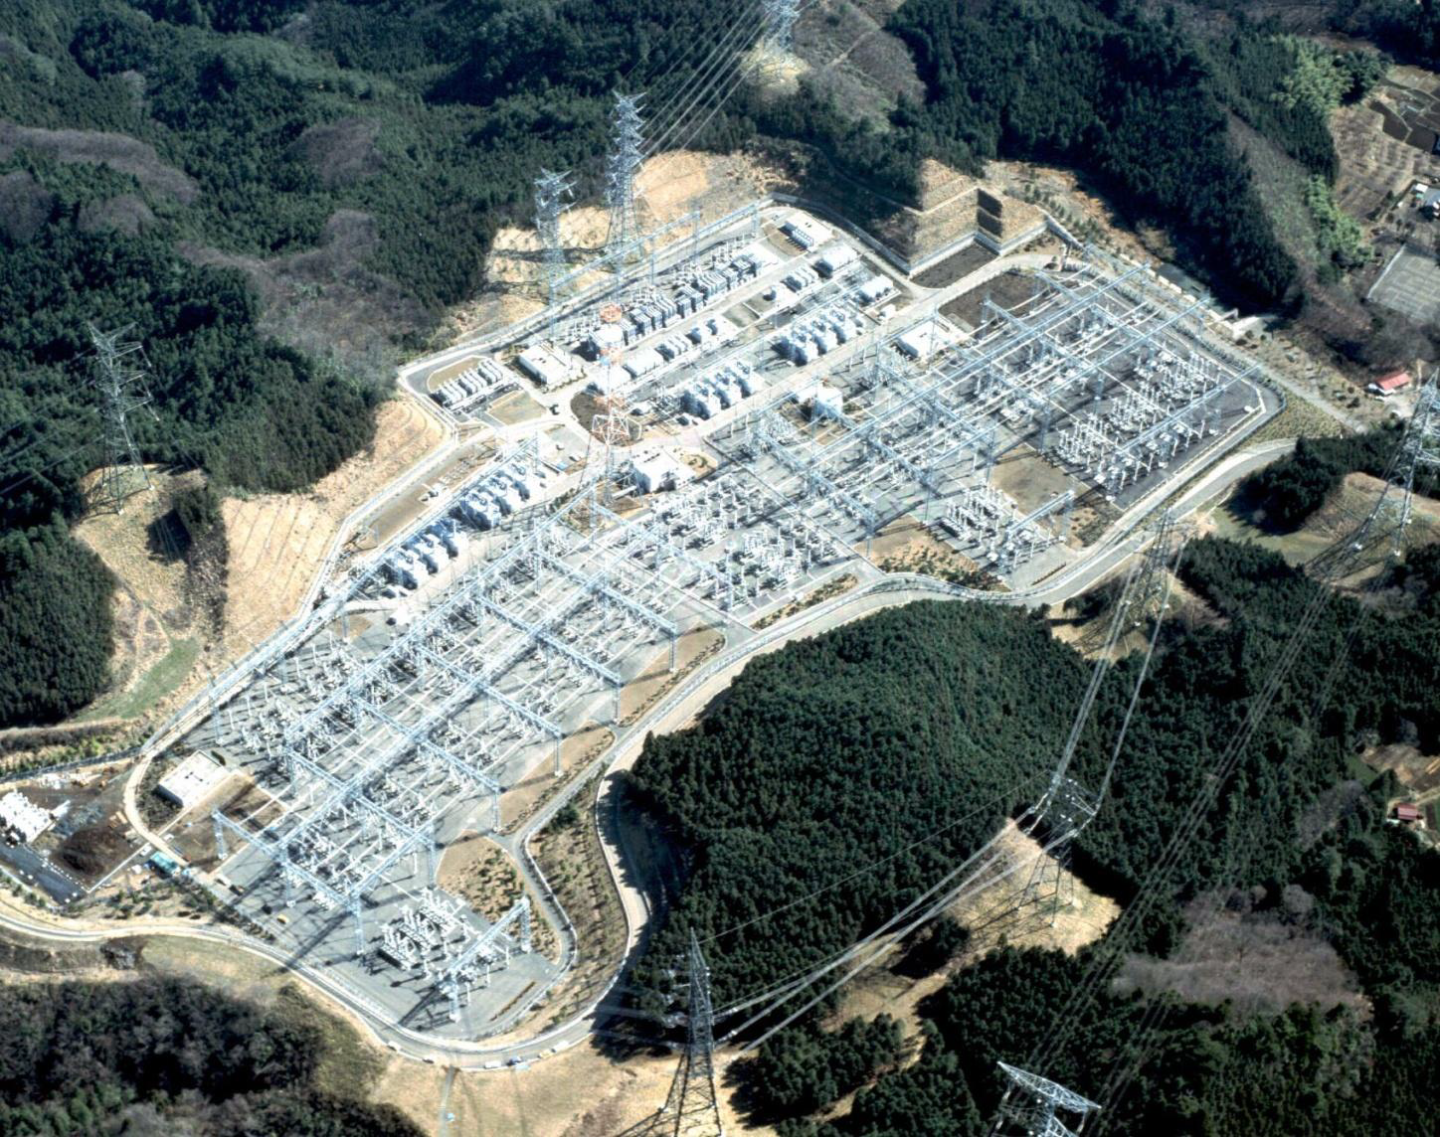

Slide 18
Design Challenges:
1. Safety:
Optimizing operating electrical stresses to safe levels by better inter electrode spacing .
Increasing the gas volume and the thermal inertia of the system to enhance cooling and retain insulation strength.
2. High reliability:
Superior contact systems for Circuit Breakers and
Disconnectors.
Multi-contact and friction free surfaces incorporated for long operating cycles.
Rugged, time proven operating drives used.

Slide 19
GIS Failure Statistics:

Slide 20
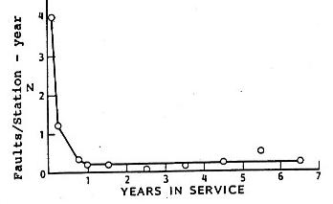
In-service fault rate (faults/station-year) vs.
years in service for 25 North American GIS

Slide 21
Main Drawbacks:
High cost compared to conventional substation(AIS).
Excessive damage in case of internal fault.
Diagnosis of internal fault and rectifying takes very long time (high outage time).
SF6 gas pressure must be monitored in each compartment.
Reduction in the pressure of the SF6 gas in any module results in flash over and faults.
SF6 causes ozone depletion and global warming.

Slide 22
SF6 – Environmental Concerns:
Currently, 80% used by Electrical Power industry.
Other Uses – micro-electronics; Al & Mg production.
7000 metric tons/yr in 1993.
Reached 10,000 metric tons/yr by 2010.
Two areas of Health and Environmental impact:
Through its normal use in a work place – Arcing byproducts.
Global Environmental impact - Ozone depletion and Global warming.

Slide 23
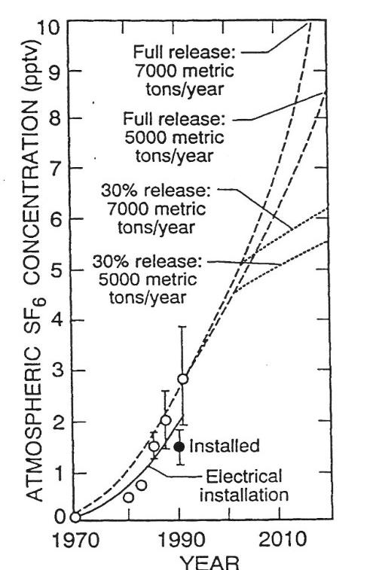

Slide 24
SF6/N2 Mixtures for GIS?
SF6 gas – specifically mentioned in Kyoto protocol.
Small quantities of SF6 in N2 can improve dielectric strength drastically.
All of the dielectric strength of SF6, nearly, can be achieved by adding less than 20% SF6 into N2.
SF6/N2 mixtures less susceptible to effects of field non uniformity than pure SF6.
Thus mitigating the effects of particles and surface protrusions.

Slide 25
Future trends:
Compact design of switch gear by using three phase modules.
Use of vacuum circuit breaker cells in the medium high voltage GIS.
Optimization of GIS design to allow easier maintenance.
Development of DC GIS for incorporating into expanding national/international HVDC systems.
Search for replacement gases for SF6.
The most promising - an 80%/20% N2/SF6 mixture.
Replacement of existing AIS by GIS will accelerate especially near urban centers.

Slide 26
CONCLUSION:
GIS – necessary for Extra HV & Ultra HV
Some important areas to be studied include:
More conservative design.
Improved gas handling.
Decomposition product management techniques.
Achieving & maintaining high levels of availability require – more integrated approach to quality control by both users and manufactures.

Slide 27
References:
G.F. Montillet, E. Mikes et al. "Underground transmission and distribution GIS solutions" IEEE/PES T&D Exposition and Conference, Dallas USA, 2003.
E. Mikes, Ch. Tschannen, et al. "GIS substation extensions and upgrades" CEPSI Paper T1-068, 2000, Manila, Philippines.
CIGRE WG 23.10; Paper 23-102, 1998, Report on the Second International Survey on High-Voltage Gas Insulated Substations (GIS) Service Experience, Paris, France 1998.
E. Mikes, H. Aeschbach et al. "Innovative GIS based solutions for substations" CIGRE SC23 Colloquium Venezuela, Paper 3.1, 2001.
D. Dufournet, C. Lindner et al. "Technical Trends in Circuit Breaker Switching Technologies" CIGRE SC A3 Colloquium paper, Sarajevo, Bosnia, 2003.
H. Aeschbach, E. Mikes, et al. "Space saving GIS based hybrid modules and innovative solutions influencing substation space and life cycle cost judgments" CEPSI Paper T2-A-7, 2002.

Slide 28
Thanks for your
Patience!
Queries please?

