Slide 1
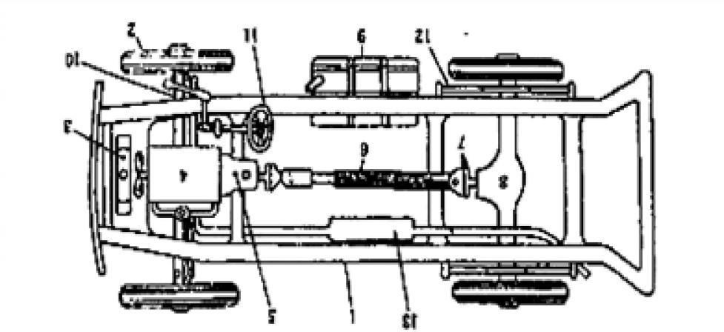
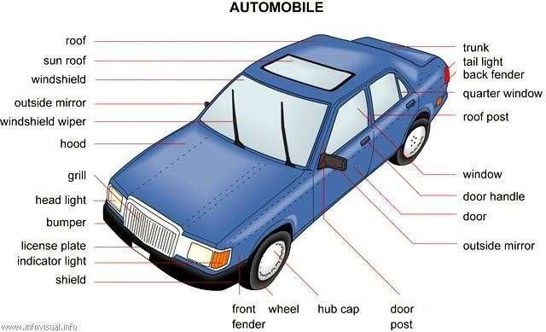
Automobile Engineering
UNIT- I
INTRODUCTION

Slide 2
Automobile Engineering
Introduction of Automobile or Vehicle:
An Automobile is a self propelled vehicle which contains the power source for its propulsion and is used for carrying passengers and goods on the ground, such as car, bus, trucks, etc.,,
Types of Automobile:
The automobiles are classified by the following ways,
On the Basis of Load:
  Heavy transport vehicle (HTV) or heavy motor vehicle (HMV),
  Light transport vehicle (LTV), Light motor vehicle (LMV),
On the Basis of Wheels :
  Two wheeler vehicle, for example : Scooter, motorcycle, scooty, etc.
  Three wheeler vehicle, for example : Autorickshaw,
  Three wheeler scooter for handicaps and tempo, etc.
  Four wheeler vehicle, for example : Car, jeep, trucks, buses, etc.
  Six wheeler vehicle, for example : Big trucks with two gear axles.
On the basis of Fuel Used:
  Petrol vehicle, e.g. motorcycle, scooter, cars, etc.
  Diesel vehicle, e.g. trucks, buses, etc.
  Electric vehicle which use battery to drive.
  Steam vehicle, e.g. an engine which uses steam engine.
  Gas vehicle, e.g. LPG and CNG vehicles, where LPG is liquefied
On the basis of body style:
  Sedan Hatchback car.
  Coupe car Station wagon Convertible.
  Van Special purpose vehicle, e.g. ambulance, milk van, etc.
On the basis of Transmission:
  Conventional vehicles with manual transmission, e.g. car with 5 gears.
  Semi-automatic
  Automatic : In automatic transmission, gears are not required to be changed manually.
On the basis of Drive:
  Left hand drive
  Right hand drive
On the basis of Driving Axle
  Front wheel drive
  Rear wheel drive
  All wheel drive
Position of Engine:
  Engine in Front - Most of the vehicles have engine in the front. Example : most of the cars,
  Engine in the Rear Side Very few vehicles have engine located in the rear. Example : Nano car.
Department of Mechanical Engineering
Page 4

Slide 3
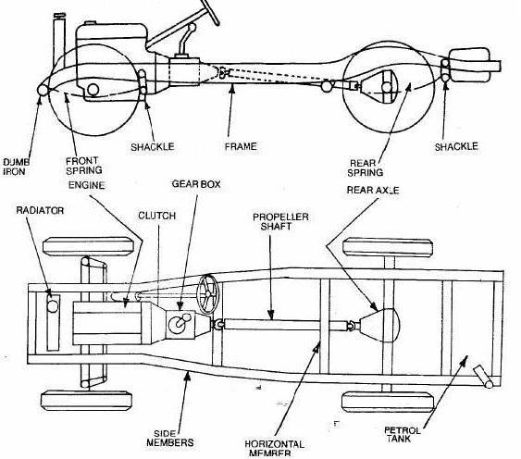
Automobile Engineering
Vehicle construction and Components;
The main components of an automobile refer to the following components;
Frame,
Chassis,
Body,
Power unit,
Transmission system.
An automobile is made up of mainly two units, these are Chassis and Body.
“Frame” + “Base components” = “Chassis” “Chassis” + “Body” = “Vehicle”
Department of Mechanical Engineering
Page 5

Slide 4
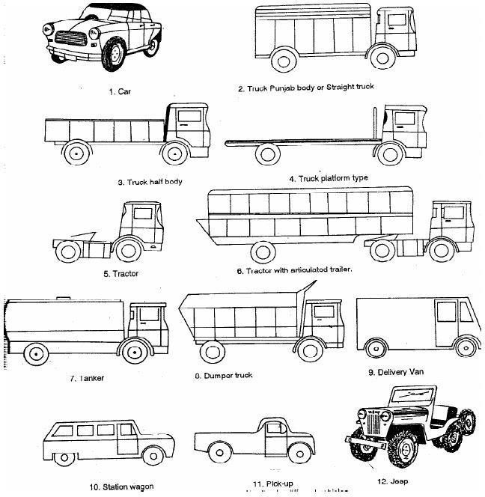
Automobile Engineering
Frame :
The frame is the skeleton of the vehicle. It servers as a main foundation and base for alignment for the chassis.
Types;
Conventional frame,
Semi integral frame;
Integral or untidiest frame.
Chassis;
If the frame contains the base components its called as chassis. The components are like Engine, radiator, clutch, gearbox, silencer, road wheels, fuel tank, wirings, differential units, etc..,
Bod:
Body is the superstructure of the vehicle and it is bolted to the chasis.
Types;
Car,
Truck,
Tractor,
Delivery van,
Jeep,
Bus, etc..,
Department of Mechanical Engineering
Page 6

Slide 5
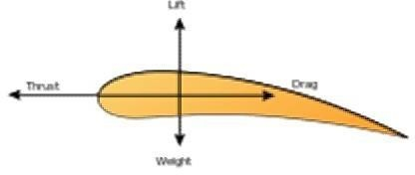
AUTOMOBILE ENGINEERING
Resistances to vehicle motion and need for a gearbox
Aerodynamics
Aerodynamics, from Greek ἀήρ aer (air) + δυναμική (dynamics), is a branch of dynamics concerned with studying the motion of air, particularly when it interacts with a solid object, such as an airplane wing.
Aerodynamics is a sub-field of fluid dynamics and gas dynamics, and many aspects of aerodynamics theory are common to these fields. The term aerodynamics is often used synonymously with gas dynamics, with the difference being that "gas dynamics" applies to the study of the motion of all gases, not limited to air.
Modern aerodynamics only dates back to the seventeenth century, but aerodynamic forces have been harnessed by humans for thousands of years in sailboats and windmills, and images and stories of flight appear throughout recorded history, such as the Ancient Greek legend of Icarus and Daedalus. Fundamental concepts of continuum, drag, and pressure gradients, appear in the work of Aristotle and Archimedes.
Forces of flight on an airfoil
Fundamental Concept
Understanding the motion of air around an object (often called a flow field) enables the calculation of forces and moments acting on the object. In many aerodynamics problems, the forces of interest are the fundamental forces of flight: lift, drag, thrust, and weight. Of these, lift and drag are aerodynamic forces, i.e. forces due to air flow over a solid body.
Calculation of these quantities is often founded upon the assumption that the flow field behaves as a continuum. Continuum flow fields are characterized by properties such as velocity, pressure, density and temperature, which may be functions of spatial position and time.
These properties may be directly or indirectly measured in aerodynamics experiments, or calculated from equations for the conservation of mass, momentum, and energy in air flows. Density, velocity, and an additional property, viscosity, are used to classify flow fields.
5
Department of Mechanical Engineering

Slide 6
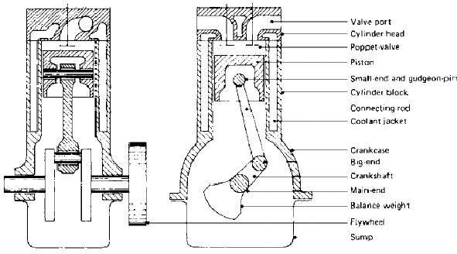
AUTOMOBILE ENGINEERING
Components of an Engine;
Even though reciprocating internal combustion engines look quite simple, they are highly complex machines. There are hundreds of components that have to perform their functions satisfactorily to produce output power. There are two types of engines, viz., spark ignition (S1) and compression-ignition (CI) engine. Let us now go through the important engine components and the nomenclature associated with an engine.
Terms connected with i.c. engines;
Bore: The inside diameter of the cylinder is called bore
Stroke: The linear distance along the cylinder axis between two limiting position s is called stroke.
Top Dead Center ( T.D.C.) : the top most position of the piston towards cover end side of the cylinder is called T.D.C.
Bottom dead Center ( B.D.C.) : The lowest position of the piston towards the crank end side of the cylinder is called B.D.C.
Clearance Volume : The volume contained in the cylinder above the top of the piston , when the piston is at top dead center , is called the clearance volume.
Swept Volume: The volume swept through by the piston in moving between
T.D.C. and B.D.C, is called swept volume or piston displacement.
Compression Ratio: It is the ratio of Total cylinder volume to clearance volume
Definition of ‘Engine’
An engine is a device, which transforms one form of energy into another form. Normally, most of the engines convert thermal energy into mechanical work and therefore they are called ‘heat engines’.
6
Department of Mechanical Engineering

Slide 7
AUTOMOBILE ENGINEERING
Engine Components
The major components of the engine and their functions are briefly described below.
Cylinder Block:
The cylinder block is the main supporting structure for the various components. The cylinder of a multicylinder engine is cast as a single unit, called cylinder block. The cylinder head is mounted on the cylinder block.
The cylinder head and cylinder block are provided with water jackets in the case of water- cooling with cooling fins in the case of air-cooling. Cylinder head gasket is incorporated between the cylinder block and cylinder head. The cylinder head is held tight to the cylinder block by number of bolts or studs. The bottom portion of the cylinder block is called crankcase. A cover called crankcase, which becomes a sump for lubricating oil is fastened to the bottom of the crankcase. The inner surface of the cylinder block, which is machined and finished accurately to cylindrical shape, is called bore or face.
Cylinder
As the name implies it is a cylindrical vessel or space in which the piston makes a reciprocating motion. The varying volume created in the cylinder during the operation of the engine is filled with the working fluid and subjected to different thermodynamic processes. The cylinder is supported in the cylinder block.
Piston
It is a cylindrical component fitted into the cylinder forming the moving boundary of the combustion system. It fits perfectly (snugly) into the cylinder providing a gas-tight space with the piston rings and the lubricant. It forms the first link in transmitting the gas forces to the output shaft.
Combustion Chamber
The space enclosed in the upper part of the cylinder, by the cylinder head and the piston top during the combustion process, is called the combustion chamber. The combustion of fuel and the consequent release of thermal energy results in the building up of pressure in this part of the cylinder.
Inlet Manifold
The pipe which connects the intake system to the inlet valve of the engine and through which air or air-fuel mixture is drawn into the cylinder is called the inlet manifold.
Gudgeon Pin
It forms the link between the small end of the connecting rod and the piston.
7
Department of Mechanical Engineering

Slide 8
AUTOMOBILE ENGINEERING
Exhaust Manifold
The pipe that connects the exhaust system to the exhaust valve of the engine and through which the products of combustion escape into the atmosphere is called the exhaust manifold.
Inlet and Exhaust Valves
Valves are commonly mushroom shaped poppet type. They are provided either on the cylinder head or on the side of the cylinder for regulating the charge coming into the cylinder (inlet valve) and for discharging the products of combustion (exhaust valve) from the cylinder.
Connecting Rod
It interconnects the piston and the crankshaft and transmits the gas forces from the piston to the crankshaft. The two ends of the connecting rod are called as small end and the big end. Small end is connected to the piston by gudgeon pin and the big end is connected to the crankshaft by crankpin.
Crankshaft
It converts the reciprocating motion of the piston into useful rotary motion of the output shaft. In the crankshaft of a single cylinder engine there is pair of crank arms and balance weights. The balance weights are provided for static and dynamic balancing of the rotating system. The crankshaft is enclosed in a crankcase.
Piston Rings
Piston rings, fitted into the slots around the piston, provide a tight seal between the piston and the cylinder wall thus preventing leakage of combustion gases
Camshaft
The camshaft and its associated parts control the opening and closing of the two valves. The associated parts are push rods, rocker arms, valve springs and tappets. This shaft also provides the drive to the ignition system. The camshaft is driven by the crankshaft through timing gears.
Cams
These are made as integral parts of the camshaft and are designed in such a way to open the valves at the correct timing and to keep them open for the necessary duration.
Fly Wheel
The net torque imparted to the crankshaft during one complete cycle of operation of the engine fluctuates causing a change in the angular velocity of the shaft. In order to achieve a uniform torque an inertia mass in the form of a wheel is attached to the output shaft and this wheel is called the flywheel.
9

Slide 9
AUTOMOBILE ENGINEERING
Basic Parts of the Gasoline Engine:
Basic Parts of the Gasoline Engine are listed below;
Cylinder block
Piston
Piston rings
Piston pin
Connecting rod
Crankshaft
Cylinder head
Intake valve
Exhaust valve
Camshaft
Timing gears
Spark plug
Cylinder Block:
Cylinder Block Basic frame of gasoline engine. Contains the cylinder.
Piston:
Piston A sliding plug that harnesses the force of the burning gases in the cylinder.
Piston Rings:
Piston rings seal the compression gases above the piston keep the oil below the piston
rings.
Piston Pins:
Piston Pins Also known as the wrist pin, it connects the piston to the small end of the connecting rod. It transfers the force and allows the rod to swing back and forth.
Connecting Rod:
Connecting Rod Connects the piston and piston pin to the crankshaft.
Crankshaft:
Crankshaft Along the the piston pin and connecting rod it converts the up and down motion (reciprocating) of the engine to spinning (rotary) motion.
Flywheel:
Flywheel Carries the inertia when there is no power stroke.
Cylinder Head:
Cylinder Head Forms the top of the combustion chamber. Contains the valves, the passageways for the fuel mixture to move in and out of the engine.
Intake and Exhaust Valves:
Intake and Exhaust Valves Doorway that lets the gases in and out of the engine.
10

Slide 10
AUTOMOBILE ENGINEERING
Camshaft:
Camshaft Through the use of an eccentric the cam lobes push the valves open. The valve springs close them.
Timing Gears:
Timing Gears These gears drive the camshaft from the crankshaft.

Slide 11
AUTOMOBILE ENGINEERING
Why not diesel engines are not preferred in commercial?
Diesel engines, because they have much higher compression ratios (20:1 for a typical diesel vs. 8:1 for a typical gasoline engine), tend to be heavier than an equivalent gasoline engine.
Diesel engines also tend to be more expensive.
Diesel engines, because of the weight and compression ratio, tend to have lower maximum RPM ranges than gasoline engines .This makes diesel engines high torque rather than high horsepower, and that tends to make diesel cars slow in terms of acceleration.
Diesel engines must be fuel injected, and in the past fuel injection was expensive and less reliable
Diesel engines tend to produce more smoke.
Diesel engines are harder to start in cold weather, and if they contain glow plugs, diesel engines can require you to wait before starting the engine so the glow plugs can heat up.
Diesel engines are much noisier and tend to vibrate.
Diesel fuel is less readily available than gasoline
Advantages diesel engines:
The two things working in favor of diesel engines are better fuel economy and longer engine life. Both of these advantages mean that, over the life of the engine, you will tend to save money with a diesel.
However, you also have to take the initial high cost of the engine into account. You have to own and operate a diesel engine for a fairly long time before the fuel economy overcomes the increased purchase price of the engine.
The equation works great in a big diesel tractor-trailer rig that is running 400 miles every
day, but it is not nearly so beneficial in a passenger car.
Fuel Injection system for SI engines;
Carburetion
Spark-ignition engines normally use volatile liquid fuels. Preparation of fuel-air mixture is done outside the engine cylinder and formation of a homogeneous mixture is normally not completed in the inlet manifold. Fuel droplets, which remain in suspension, continue to evaporate and mix with air even during suction and compression processes. The process of mixture preparation is extremely important for spark-ignition engines. The purpose of carburetion is to provide a combustible mixture of fuel and air in the required quantity and quality for efficient operation of the engine under all conditions.
Definition of Carburetion;
The process of formation of a combustible fuel-air mixture by mixing the proper amount of fuel with air before admission to engine cylinder is called carburetion and the device which does this job is called a carburetor.

Slide 12
AUTOMOBILE ENGINEERING
Definition of Carburetor;
The carburetor is a device used for atomizing and vaporizing the fuel and mixing it with the air in varying proportions to suit the changing operating conditions of vehicle engines.
Factors Affecting Carburetion
Of the various factors, the process of carburetion is influenced by
The engine speed
The vaporization characteristics of the fuel
The temperature of the incoming air and
The design of the carburetor

Slide 13
AUTOMOBILE ENGINEERING
Principle of Carburetion
Both air and gasoline are drawn through the carburetor and into the engine cylinders by the suction created by the downward movement of the piston. This suction is due to an increase in the volume of the cylinder and a consequent decrease in the gas pressure in this chamber.
It is the difference in pressure between the atmosphere and cylinder that causes the air to flow into the chamber. In the carburetor, air passing into the combustion chamber picks up
discharged from a tube. This tube has a fine orifice called carburetor jet that is exposed to the air path.
The rate at which fuel is discharged into the air depends on the pressure difference or pressure head between the float chamber and the throat of the venturi and on the area of the outlet of the tube. In order that the fuel drawn from the nozzle may be thoroughly atomized, the suction effect must be strong and the nozzle outlet comparatively small. In order to produce a strong suction, the pipe in the carburetor carrying air to the engine is made to have a restriction. At this restriction called throat due to increase in velocity of flow, a suction effect is created. The restriction is made in the form of a venturi to minimize throttling losses.
The end of the fuel jet is located at the venturi or throat of the carburetor. The geometry of venturi tube is as shown in Fig.16.6. It has a narrower path at the center so that the flow area through which the air must pass is considerably reduced. As the same amount of air must pass through every point in the tube, its velocity will be greatest at the narrowest point. The smaller the area, the greater will be the velocity of the air, and thereby the suction is proportionately increased
As mentioned earlier, the opening of the fuel discharge jet is usually loped where the suction is maximum. Normally, this is just below the narrowest section of the venturi tube. The spray of gasoline from the nozzle and the air entering through the venturi tube are mixed together in this region and a combustible mixture is formed which passes through the intake manifold into the cylinders. Most of the fuel gets atomized and simultaneously a small part will be vaporized. Increased air velocity at the throat of the venturi helps he rate of evaporation of fuel. The difficulty of obtaining a mixture of sufficiently high fuel vapour-air ratio for efficient starting of the engine and for uniform fuel-air ratio indifferent cylinders (in case of multi cylinder engine) cannot be fully met by the increased air velocity alone at the venturi throat.
20

Slide 14
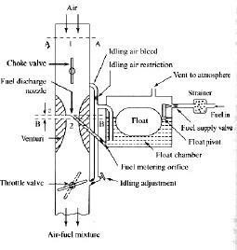
AUTOMOBILE ENGINEERING
The Simple Carburetor
Carburetors are highly complex. Let us first understand the working principle bf a simple or elementary carburetor that provides an air fuel mixture for cruising or normal range at a single speed. Later, other mechanisms to provide for the various special requirements like starting, idling, variable load and speed operation and acceleration will be included. Figure 3. shows the details of a simple carburetor.
The simple carburetor mainly consists of a float chamber, fuel discharge nozzle and a metering orifice, a venturi, a throttle valve and a choke. The float and a needle valve system maintain a constant level of gasoline in the float chamber. If the amount of fuel in the float chamber falls below the designed level, the float goes down, thereby opening the fuel supply valve and admitting fuel. When the designed level has been reached, the float closes the fuel supply valve thus stopping additional fuel flow from the supply system. Float chamber is vented either to the atmosphere or to the” upstream side of the venturi.During suction stroke air is drawn through the venturi.
As already described, venturi is a tube of decreasing cross-section with a minimum area at the throat, Venturi tube is also known as the choke tube and is so shaped that it offers minimum resistance to the air flow. As the air passes through the venturi the velocity increases reaching a maximum at the venturi throat. Correspondingly, the pressure decreases reaching a minimum. From the float chamber, the fuel is fed to a discharge jet, the tip of which is located in the throat of the venturi. Because of the differential pressure between the float chamber and the throat of the venturi, known as carburetor depression, fuel is discharged into the air stream.
Figure: 3 The Simple Carburetor

Slide 15
AUTOMOBILE ENGINEERING
The fuel discharge is affected by the size of the discharge jet and it is chosen to give the required air-fuel ratio. The pressure at the throat at the fully open throttle condition lies between 4 to 5 cm of Hg, below atmospheric and seldom exceeds8 cm Hg below atmospheric. To avoid overflow of fuel through the jet, the level of the liquid in the float chamber is maintained at a level slightly below the tip of the discharge jet. This is called the tip of the nozzle. The difference in the height between the top of the nozzle and the float chamber level is marked h in Fig.3.
The gasoline engine is quantity governed, which means that when power output is to be varied at a particular speed, the amount of charge delivered to the cylinder is varied. This is achieved by means of a throttle valve usually of the butterfly type that is situated after the venturi tube.
As the throttle is closed less air flows through the venturi tube and less is the quantity of air- fuel mixture delivered to the cylinder and hence power output is reduced. As the” throttle is opened, more air flows through the choke tube resulting in increased quantity of mixture being delivered to the engine. This increases the engine power output. A simple carburetor of the type described above suffers from a fundamental drawback in that it provides the required A/F ratio only at one throttle position.
At the other throttle positions the mixture is either leaner or richer depending on whether the throttle is opened less or more. As the throttle opening is varied, the air flow varies and creates a certain pressure differential between the float chamber and the venturi throat. The same pressure differential regulates the flow of fuel through the nozzle. Therefore, the velocity of flow of air II and fuel vary in a similar manner.
The Choke and the Throttle
When the vehicle is kept stationary for a long period during cool winter seasons, may be overnight, starting becomes more difficult. As already explained, at low cranking speeds and intake temperatures a very rich mixture is required to initiate combustion. Some times air-fuel ratio as rich as 9:1 is required. The main reason is that very large fraction of the fuel may remain as liquid suspended in air even in the cylinder. For initiating combustion, fuel-vapour and air in the form of mixture at a ratio that can sustain combustion is required.
It may be noted that at very low temperature vapour fraction of the fuel is also very small and this forms combustible mixture to initiate combustion. Hence, a very rich mixture must be supplied. The most popular method of providing such mixture is by the use of choke valve. This is simple butterfly valve located between the entrance to the carburetor and the venturi throat as shown in Fig.3.
When the choke is partly closed, large pressure drop occurs at the venturi throat that would normally result from the quantity of air passing through the venturi throat. The very large depression at the throat inducts large amount of fuel from the main nozzle and provides a very rich mixture so that the ratio of the evaporated fuel to air in the cylinder is within the combustible limits. Sometimes, the choke valves are spring loaded to ensure that large carburetor depression and excessive choking does not persist after the engine has started, and reached a desired speed.

Slide 16
AUTOMOBILE ENGINEERING
This choke can be made to operate automatically by means of a thermostat so that the choke is closed when engine is cold and goes out of operation when engine warms up after starting. The speed and the output of an engine is controlled by the use of the throttle valve, which is located on the downstream side of the venturi.
The more the throttle is closed the greater is the obstruction to the flow of the mixture placed in the passage and the less is the quantity of mixture delivered to .the cylinders. The decreased quantity of mixture gives a less powerful impulse to the pistons and the output of the engine is reduced accordingly. As the throttle is opened, the output of the engine increases. Opening the throttle usually increases the speed of the engine. But this is not always the case as the load on the engine is also a factor. For example, opening the throttle when the motor vehicle is starting to climb a hill may or may not increase the vehicle speed, depending upon the steepness of the hill and the extent of throttle opening. In short, the throttle is simply a means to regulate the output of the engine by varying the quantity of charge going into the cylinder.
Compensating Devices
An automobile on road has to run on different loads and speeds. The road conditions play a vital role. Especially on city roads, one may be able to operate the vehicle between 25 to 60% of the throttle only. During such conditions the carburetor must be able to supply nearly constant air-fuel ratio mixture that is economical (16:1).However, the tendency of a simple carburetor is to progressively richen the mixture as the throttle starts opening.
The main metering system alone will not be sufficient to take care of the needs of the engine. Therefore, certain compensating devices are usually added in the carburetor along with the main metering system so as to supply a mixture with the required air-fuel ratio. A number of compensating devices are in use. The important ones are
Air-bleed jet
Compensating jet
Emulsion tube
Back suction control mechanism
Auxiliary air valve
Auxiliary air port
As already mentioned, in modern carburetors automatic compensating devices are provided to maintain the desired mixture proportions at the higher speeds. The type of compensation mechanism used determines the metering system of the carburetor. The principle of operation of various compensating devices are discussed briefly in the following sections.

Slide 17
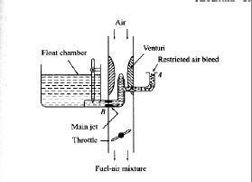
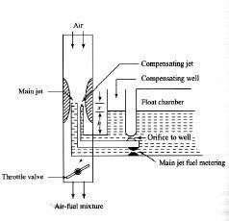
AUTOMOBILE ENGINEERING
Air-bleed jet
Figure: 4 Air bleed principle in a typical carburetor
Figure 4. illustrates a principle of an air-bleed system in atypical modern downdraught carburetor. As could be seen it contains an air-bleed into the main nozzle. An orifice restricts the flow of air through this bleed and therefore it is called restricted air-bleed jet that is very popular. When the engine is not operating the main jet and the air bleed jet will be filled with fuel. When the engine starts, initially the fuel starts coming through the main as well as the air bleed jet (A). As the engine picks up, only air starts coming through the air bleed and mixes with fuel at B making a air fuel emulsion.
Thus the fluid stream that has become an emulsion of air and liquid has negligible viscosity and surface tension. Thus the flow rate of fuel is augmented and more fuel is sucked at low suctions. ‘By proper design of hole size at B compatible with the entry hole at A, it is possible to maintain a fairly uniform mixture ratio for the entire power range of the operation of an engine. If the fuel flow nozzle of the air-bleed system is placed in the centre of the venturi, both the air-bleed nozzle and the venturi are subjected to same engine suction resulting approximately same fuel-air mixture for the entire power range of operation.
Compensating Jet
Figure: 5 Compensating Jet device

Slide 18
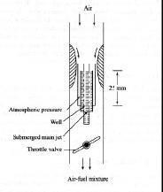
AUTOMOBILE ENGINEERING
The principle of compensating jet device is to make the mixture leaner as the throttle opens progressively. In this method, as can be seen from Fig.5 in addition to the main jet, a compensating jet is incorporated. The compensating jet is connected to the compensation well. The compensating well is also vented to atmosphere like the main float chamber.
The compensating well is supplied with fuel from the main float chamber through a restricting orifice. With the increase in airflow rate, there is decrease of fuel level in the compensating well, with the result that fuel supply through the compensating jet decreases. The compensating jet thus progressively makes the mixture leaner as the main jet progressively makes the mixture richer. The main jet curve and the compensating jet curve are more or less reciprocals of each other.
Emulsion Tube
The mixture correction is attempted by air bleeding in modern carburetor. In one such arrangement as shown in Fig.6, the main metering jet is kept at a level of about 25 mm below the fuel level in the float chamber. Therefore, it is also called submerged jet. The jet is located at the bottom of a well. The sides of the well have holes. As can be seen from the figure these holes are in communication with the atmosphere. In the beginning the level of petrol in the float chamber and the well is the same.
Figure: 6 Emulsion Tube
When the throttle is opened the pressure at the venturi throat decreases and petrol is drawn into the air stream. This results in progressively uncovering the holes in the central tube leading to increasing air-fuel ratios or decreasing richness of mixture when all holes have been uncovered. Normal flow takes place from the main jet. The air is drawn through these holes in the well, and the fuel is emulsified and the pressure differential across the column of fuel is not as high as that in simple carburetor.

Slide 19
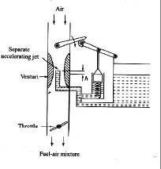
AUTOMOBILE ENGINEERING
Acceleration Pump System
Acceleration is a transient phenomenon. In order to accelerate the vehicle and consequently its engine, the mixture required is very rich and the richness of the mixture has to be obtained quickly and very rapidly. In automobile engines situations arise when it is necessary to accelerate the vehicle. This requires an increased output from the engine in a very short time.
If the throttle is suddenly opened there is a corresponding increase in the air flow. However, because of the inertia of the liquid fuel, the fuel flow does not increase in proportion to the increase in air flow. This results in a temporary lean mixture ca11singtheengine to misfire and a temporary reduction in power output.
To prevent this condition, all modern carburetors are equipped with an accelerating system. Figure 7. illustrates simplified sketch of one such device. The pump comprises of a spring loaded plunger that takes care of the situation with the rapid opening of the throttle valve. The plunger moves into the cylinder and forces an additional jet of fuel at the venturi throat.
When the throttle is partly open, the spring sets the plunger back. There is also an arrangement which ensures that fuel in the pump cylinder is not forced through the jet when valve is slowly opened or leaks past the plunger or some holes into the float chamber.
Mechanical linkage system, in some carburetor, is substituted by an arrangement where by the pump plunger is held up by manifold vacuum. When this vacuum is decreased by rapid opening of the throttle, a spring forces the plunger down pumping the fuel through the jet.
Figure: 7 Acceleration pump system

Slide 20
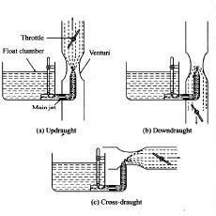
AUTOMOBILE ENGINEERING
Types of Carburetors
There are three general types of carburetors depending on the direction of flow of air. The first is the up draught type shown in Fig.8(a) in which the air enters at the bottom and leaves at the top so that the direction of its flow is upwards. The disadvantage of the up draught carburetor is that it must lift the sprayed fuel droplet by air friction. Hence, it must be designed for relatively small mixing tube and throat so that even at low engine speeds the air velocity is sufficient to lift and carry the fuel particles along. Otherwise, the fuel droplets tend to separate out providing only a lean mixture to the engine. On the other hand, the mixing tube is finite and small then it cannot supply mixture to the engine at a sufficiently rapid rate at high speeds.
Figure: 8 Types of Carburetors
In order to overcome this drawback the downdraught carburetor [Fig.8 (b)] is adopted. It is placed at a level higher than the inlet manifold and in which the air and mixture generally follow a downward course. Here the fuel does not have to be lifted by air friction as in the up draught carburetors but move into the cylinders by gravity even if the air velocity is low. Hence, the mixing tube and throat can be made large which makes high engine speeds and high specific outputs possible.
Constant Choke Carburetor:
In the constant choke carburetor, the air and fuel flow areas are always maintained to be constant. But the pressure difference or depression, which causes the flow of fuel and air, is being varied as per the demand on the engine. Solex and Zenith carburetors belong to this class.
Constant Vacuum Carburetor:
In the constant vacuum carburetor, (sometimes called variable choke carburetor) air and fuel flow areas are being varied as per the demand on the engine, while the vacuum is maintained to be always same. The S.U. and Carter carburetors belong to tills class.

Slide 21
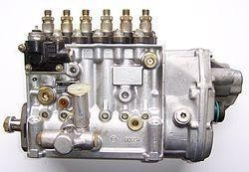
AUTOMOBILE ENGINEERING
Multiple Venturi Carburetor:
Multiple venturi system uses double or triple venturi. The boost venturi is located concentrically within the main venturi.The discharge edge of the boost venturi is located at the throat of the main venturi. The boost venturi is positioned upstream of the throat of the larger main venturi. Only a fraction of the total air flows though the boost venturi. Now the pressure at the boost venturi exit equals the pressure at the main venturi throat. The fuel nozzle is located at the throat of the boost venturi.
Fuel Injection system for C I engines;
Fuel system components FUEL INJECTION PUMP - Fuel injection pump sucks fuel from the tank , pressurizes the fuel to approx. 600 - 1000 bar and sends it to the injectors. Inline FIP - Has separate pumping chambers for each cylinder Rotary FIP (Distributor pump) - Has one pumping chamber and the pump distributes to each cylinder as per sequence- firing order INJECTORS - Inject the high pressure fuel in to each cylinder. FUEL FILTER - Filters the fuel from dirt & sediments, since the Fuel injection pump requires clean fuel.
Injection system In the C.I. engine the fuel is injected into the combustion chamber, it the has to mix thoroughly with the air, ignite and burn all at the same time. To insure this happens, two types of combustion chamber have been developed. Direct Injection Indirect Injection
Electronic Diesel Control
Electronic Diesel Control is a diesel engine fuel injection control system for the precise metering and delivery of fuel into the combustion chamber of modern diesel engines used in trucks and cars.
EDC injection inline pump

Slide 22
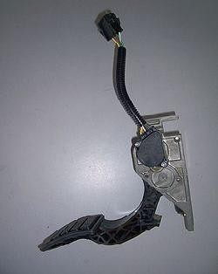
AUTOMOBILE ENGINEERING
The mechanical fly-weight governors of inline and distributor diesel fuel injection pumps used to control fuel delivery under a variety of engine loads and conditions could no longer deal with the ever increasing demands for efficiency, emission control, power and fuel consumption.
These demands are now primarily fulfilled by the Electronic Control, the system which provides greater ability for precise measuring, data processing, operating environment flexibility and analysis to ensure efficient diesel engine operation. The EDC replaces the mechanical control governor with an electro-magnetic control device.
Components in Electronically controlled Diesel Supply;
The EDC is divided into these main groups of components.
Electronic sensors for registering operating conditions and changes. A wide array of physical inputs is converted into electrical signal outputs.
Actuators or solenoids which convert the control unit's electrical output signal into mechanical control movement.
•
ECM (Electronic Control Module ) or Engine ECU (Electronic Control Unit) microprocessors which process information from various sensors in accordance programmed software and outputs required electrical signals into actuators and solenoids.
with with
EDC accelerator pedal assembly
1. Electronic sensors;
Injection pump speed sensor - monitors pump rotational speed
Fuel rack position sensor - monitors pump fuel rack position
Charge air pressure sensor - measures pressure side of the turbocharger
Fuel pressure sensor
Air cleaner vacuum pressure sensor
Engine position sensor
Temperature sensors - measure various operating temperatures

Slide 23

AUTOMOBILE ENGINEERING
•
•
•
•
•
•
Intake temperature Charge air temperature Coolant temperature Fuel temperature
Exhaust temperature (Pyrometer) Ambient temperature
Vehicle speed sensor - monitors vehicle speed
Brake pedal sensor - operates with cruise control, exhaust brake, idle control
Clutch pedal sensor - operates with cruise control, exhaust brake, idle control
Accelerator pedal sensor.
2.Electronic Control Unit;
EDC control unit
The ECU collects and processes signals from various on-board sensors. AnECU electronic module contains microprocessors, memory units, analog to digital converters and output interface units. Depending upon the parameters, a number of different maps can be stored in the onboard memory.
This allows the ECU to be tailored to the specific engine and vehicle requirements, depending on the application. The operating software of the ECU can be adapted for a wide variety of engines and vehicles without the necessity of hardware modification.
The ECU is usually located in the cab or in certain cases, in a suitable position in the engine bay where additional environmental conditions might require cooling of the ECU as well as a requirement for better dust, heatand vibrations insulation .

Slide 24
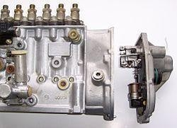
AUTOMOBILE ENGINEERING
3. Actuators and Solenoids
Electro-magnetic actuators are usually located on the fuel pump to transfer electrical signals into mechanical action in this case fuel rack actuator and or fuel stop solenoid which means that depending on requests from control unit full fuel or no fuel quantity.
EDC pump actuator
Injectors
Boost-pressure actuator
Intake-duct switchoff
Throttle-valve actuator
Exhaust-gas recirculation actuator
Auxiliary heating
A/C compressor
Radiator fan
Electronic shutoff valve
Rail-pressure control valve
Diagnosis lamp

Slide 25
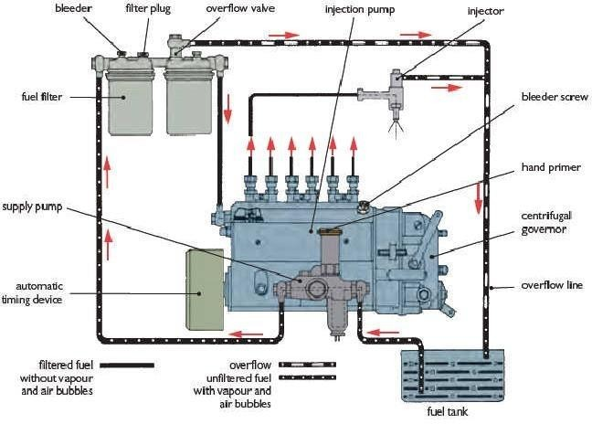
AUTOMOBILE ENGINEERING
Working Principle;
The injection of fuel or the quantity of injected fuel has a decisive influence on engine starting, idling, power and emissions. The engine ECU is programmed ("mapped") with relevant data to where the fuel rack position has an equivalent signal for the amount of fuel being injected.
The driver requests the torque or engine speed requirements via accelerator pedal potentiometer thereby sending a signal to the engine ECU which then, depending on its mapping and data collected from various sensors, calculates in real time the quantity of injected fuel required, thus altering the fuel rack to the required position. The driver can also input additional commands such as idle speed increase to compensate e.g. for PTO operation which can be either variably set or has a preset speed which can be recalled.
The road speed function can be used to evaluate vehicle speed and possibly activate a speed limiter (Heavy Vehicles), or maintain or restore a set speed (cruise control). Further functions can include exhaust brake operation which, when activated, will result in the fuel pump rack position being set to zero delivery or idle. The engine ECU can also interface with various other vehicle systems e.g. traction control and carries out self monitoring duties and self diagnostic functions to keep the system working at an optimal level. To ensure the safe operation in case of failure, the limp home mode functions are also integrated into the system, for e.g. should the pump speed sensor fail the ECU can use an alternator speed signal function for engine RPMs counter as a backup signal.

Slide 26
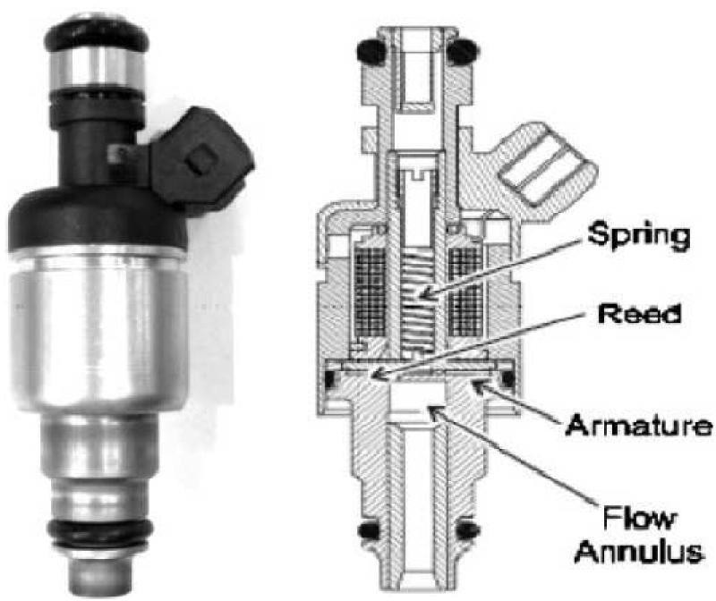
AUTOMOBILE ENGINEERING
Fuel Injector:
Fuel injection is a system for admitting fuel into an internal combustion engine. It has become the primary fuel delivery system used in automotive engines, having replaced carburetors during the 1980s and 1990s. A variety of injection systems have existed since the earliest usage of the internal combustion engine.
The primary difference between carburetors and fuel injection is that fuel injection atomizes the fuel by forcibly pumping it through a small nozzle under high pressure, while a carburetor relies on suction created by intake air accelerated through a Venturi tube to draw the fuel into the airstream.
Modern fuel injection systems are designed specifically for the type of fuel being used. Some systems are designed for multiple grades of fuel (using sensors to adapt the tuning for the fuel currently used). Most fuel injection systems are for gasoline or diesel applications.

Slide 27
AUTOMOBILE ENGINEERING
Turbocharger:
The turbo charger utilizes the wasted heat energy in the exhaust system, to run a compressor which compresses the intake air. Compressed intake air has more density and hence more fuel can be injected increasing the power of the engine. Turbo charging is an ideal way to increase the engine power without increasing the engine size.
A turbocharger, or turbo (colloquialism), from Greek "τύρβη" ("wake"), (also from Latin "turbo" ("spinning top"), is a turbine-driven forced induction device that increases an engine's efficiency and power by forcing extra air into the combustion chamber. This improvement over a naturally aspirated engine's output results because the turbine can force more air, and proportionately more fuel, into the combustion chamber than atmospheric pressure alone.
Turbochargers were originally known as turbosuperchargers when allforced induction devices were classified as superchargers. Nowadays the term "supercharger" is usually applied to only mechanically driven forced induction devices. The key difference between a turbocharger and a conventional supercharger is that the latter is mechanically driven by the engine, often through a belt connected to the crankshaft, whereas a turbocharger is powered by a turbine driven by the engine'sexhaust gas. Compared to a mechanically driven supercharger, turbochargers tend to be more efficient, but less responsive. Twincharger refers to an engine with both a supercharger and a turbocharger.
Turbochargers are commonly used on truck, car, train, aircraft, and construction equipment engines. They are most often used with Otto cycle and Diesel cycle internal combustion engines. They have also been found useful in automotive fuel cells.
SCE

Slide 28
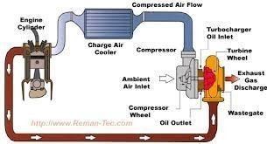
AUTOMOBILE ENGINEERING

Slide 29
AUTOMOBILE ENGINEERING
UNIT-II
COOLING SYSTEM
Introduction
We know that in case of Internal Combustion engines, combustion of air and fuel takes place inside the engine cylinder and hot gases are generated. The temperature of gases will be around 2300 -2500 C. This is a very high temperature and may result into burning of oil film between the moving parts and may result into seizing or welding of the same. So, this temperature must be reduced to about 150 -200 C at which the engine will work most efficiently. Too much cooling is also not desirable since it reduces the thermal efficiency. So, the object of cooling system is to keep the engine running at its most efficient operating temperature.
It is to be noted that the engine is quite inefficient when it is cold and hence the cooling system is designed in such a way that it prevents cooling when the engine is warming up and till it attains to maximum efficient operating temperature, then it starts cooling.
It is also to be noted that :
About 20-25% of total heat generated is used for producing brake power (useful work).
Cooling system is designed to remove 30-35% of total heat.
Remaining heat is lost in friction and carried away by exhaust gases.
Objectives
After studying this unit, you should be able to
understand the methods of cooling of IC engine,
•
•
explain the air cooling system, and
know the water cooling system of IC engine.
There are mainly two types of cooling systems :
Air cooled system, and
Water cooled system.
Air Cooled System
Air cooled system is generally used in small engines say up to 15-20 kW and in aero plane engines.In this system fins or extended surfaces are provided on the cylinder walls, cylinder head, etc. Heat generated due to combustion in the engine cylinder will be conducted to the fins and when the air flows over the fins, heat will be dissipated to air.

Slide 30
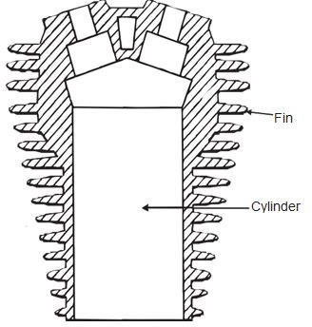
AUTOMOBILE ENGINEERING
The amount of heat dissipated to air depends upon :
Amount of air flowing through the fins.
Fin surface area.
Thermal conductivity of metal used for fins.
Cylinder with Fins
Advantages of Air Cooled System
Following are the advantages of air cooled system :
Radiator/pump is absent hence the system is light.
In case of water cooling system there are leakages, but in this case there are no leakages.
Coolant and antifreeze solutions are not required.
This system can be used in cold climates, where if water is used it may freeze.
Disadvantages of Air Cooled System
Comparatively it is less efficient.
It is used in aero planes and motorcycle engines where the engines are exposed to air directly.

Slide 31
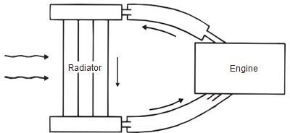
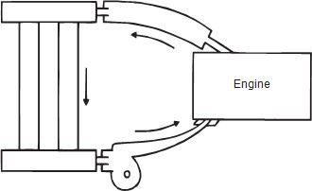
AUTOMOBILE ENGINEERING
WATER COOLING SYSTEM
In this method, cooling water jackets are provided around the cylinder, cylinder head, valve seats etc. The water when circulated through the jackets, it absorbs heat of combustion. This hot water will then be cooling in the radiator partially by a fan and partially by the flow developed by the forward motion of the vehicle. The cooled water is again recirculated through the water jackets.
Types of Water Cooling System
There are two types of water cooling system :
Thermo Siphon System
In this system the circulation of water is due to difference in temperature (i.e. difference in densities) of water. So in this system pump is not required but water is circulated because of density difference only.
Thermo Siphon System of Cooling
Pump Circulation System
In this system circulation of water is obtained by a pump. This pump is driven by means of engine output shaft through V-belts.
Pump Circulation System

Slide 32

Components of Water Cooling System
AUTOMOBILE ENGINEERING
Thermostat
Radiator
Engine
Pump
Fig:Water Cooling System using Thermostat Valve
fig:Water Cooling System of a 4-cylinder Engine
Water cooling system mainly consists of :
Radiator,
Thermostat valve,
Water pump,
Fan,
Water Jackets, and
Antifreeze mixtures.
Radiator
It mainly consists of an upper tank and lower tank and between them is a core. The upper tank is connected to the water outlets from the engines jackets by a hose pipe and the lover tank is connect to the jacket inlet through water pump by means of hose pipes.
There are 2-types of cores :
  Tubular
  Cellular as shown.
When the water is flowing down through the radiator core, it is cooled partially by the fan which blows air and partially by the air flow developed by the forward motion of the vehicle.
As shown through water passages and air passages, wafer and air will be flowing for cooling purpose.
It is to be noted that radiators are generally made out of copper and brass and their joints are made by soldering.

Slide 33
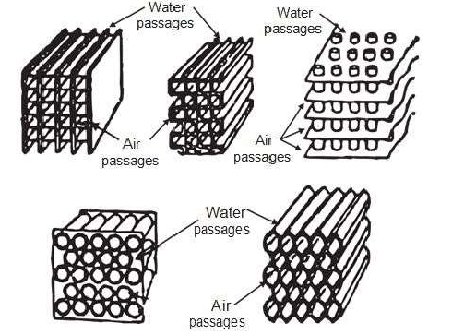
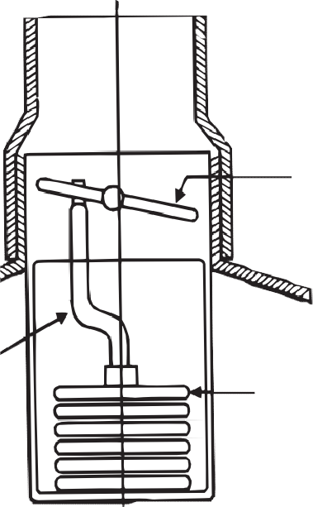

AUTOMOBILE ENGINEERING
Types of Cores (a) Tabullar Radiator Sections and (b) Circullar Radiator Sections Thermostat Valve
It is a valve which prevents flow of water from the engine to radiator, so that engine readily reaches to its maximum efficient operating temperature. After attaining maximum efficient operating temperature, it automatically begins functioning. Generally, it prevents the water below 70 C.
Thermostat Valve

Slide 34
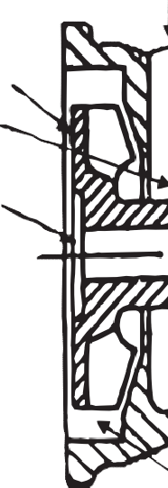
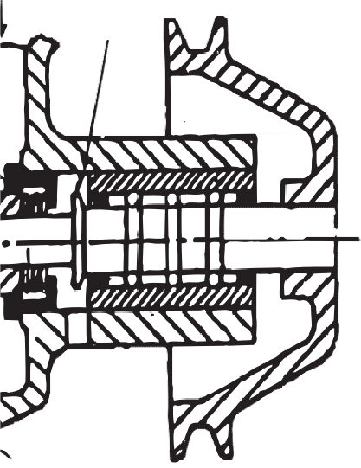
AUTOMOBILE ENGINEERING
Figure shows the Bellow type thermostat valve which is generally used. It contains a bronze bellow containing liquid alcohol. Bellow is connected to the butterfly valve disc through the link.
When the temperature of water increases, the liquid alcohol evaporates and the bellow expands and in turn opens the butterfly valve, and allows hot water to the radiator, where it is cooled.
Water Pump
It is used to pump the circulating water. Impeller type pump will be mounted at the front end.
Pump consists of an impeller mounted on a shaft and enclosed in the pump casing. The pump casing has inlet and outlet openings.
The pump is driven by means of engine output shaft only through belts. When it is driven water will be pumped.
Water Pump
Fan
It is driven by the engine output shaft through same belt that drives the pump. It is provided behind the radiator and it blows air over the radiator for cooling purpose.
Water Jackets
Cooling water jackets are provided around the cylinder, cylinder head, valve seats and any hot parts which are to be cooled. Heat generated in the engine cylinder, conducted through the cylinder walls to the jackets. The water flowing through the jackets absorbs this heat and gets hot. This hot water will then be cooled in the radiator (Referred Figure ).

Slide 35
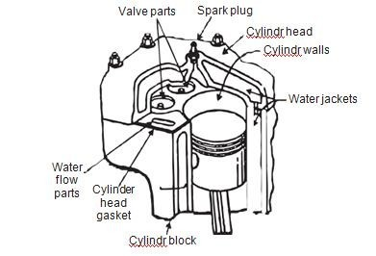
AUTOMOBILE ENGINEERING
Water Jackets
Antifreeze Mixture
In western countries if the water used in the radiator freezes because of cold climates, then ice formed has more volume and produces cracks in the cylinder blocks, pipes, and radiator. So, to prevent freezing antifreeze mixtures or solutions are added in the cooling water.
The ideal antifreeze solutions should have the following properties :
It should dissolve in water easily.
It should not evaporate.
It should not deposit any foreign matter in cooling system.
It should not have any harmful effect on any part of cooling system.
It should be cheap and easily available.
It should not corrode the system.
No single antifreeze satisfies all the requirements. Normally following are used as antifreeze solutions
:
Methyl, ethyl and isopropyl alcohols.
A solution of alcohol and water.
Ethylene Glycol.
A solution of water and Ethylene Glycol.
Glycerin along with water, etc
Advantages
Uniform cooling of cylinder, cylinder head and valves.

Slide 36
AUTOMOBILE ENGINEERING
Specific fuel consumption of engine improves by using water cooling system
If we employ water cooling system, then engine need not be provided at the front end of moving vehicle.
Engine is less noisy as compared with air cooled engines, as it has water for damping noise.
Disadvantages
It depends upon the supply of water.
The water pump which circulates water absorbs considerable power.
If the water cooling system fails then it will result in severe damage of engine.
The water cooling system is costlier as it has more number of parts. Also it requires more maintenance and care for its parts.
Introduction of Ignition System:
  For petrol engine - Battery ignition system , Magneto ignition system Injection system
  For diesel engine - Fuel supply system.
Battery ignition system:
Battery ignition system has the following elements
  Primary Ignition Circuit(low voltage)
  Battery
  Ignition switch
  Primary windings of coil
  Contact breaker
  capacitor
  Secondary Ignition Circuit ( high voltage)
  Secondary windings of coil
  Distributor cap and rotor (if the vehicle is so equipped)
  Spark plug wires &
  Spark plugs
IGNITION SYSTEM – Magneto System Ignition Switch Distribution Contact Breaker Coil Magneto Condenser Power Generation Spark Generation Magneto Unit Rotor Arm
IGNITION SYSTEM – Dynamo/Alternator System Dynamo/ Alternator Distributor Contact Breaker Coil Ignition Switch Secondary Windings Primary Windings Condenser Battery
Ignition Switch Coil Packs IGNITION SYSTEM – Electronic Systems Control Unit Timing Sensor Timing Disc Engine Speed Sensing Unit Alternator Battery
In all spark ignition engines which work on the Gasoline either 2-Stroke or 4-Stroke cycle principle and utilize a carburetor or fuel injection system, the combustion of the air-fuel mixture is initiated by an electric spark.

Slide 37
AUTOMOBILE ENGINEERING
The term ‘Spark Ignition’ means that a brief electric arc is produced between the electrodes of a spark plug, the energy for which is derived from an external power source. In most cases this power source is the vehicle battery, which is constantly being supplemented by the alternate while the vehicle is mobile.
A different method of ignition is employed in diesel engines. This is called ‘compression ignition’ and relies on the fact that when air compressed, its temperature rises. In diesel engines, compression ratio of between 16:1 and 25:1 are common, and at the end of a compression the temperature of the trapped air is sufficiently high to ignite the diesel fuel that is sprayed into the cylinder at the appropriate time.

Slide 38
AUTOMOBILE ENGINEERING
The functions of ignition system
The functions of the coil ignition systems in general use on motor vehicle may be divided into three areas. These are:
Production of the high voltage necessary to produce a spark at the plug gap.
Distribute the spark to all the cylinders at proper time based on the firing order.
Varying the timing of the spark depending on the various operating conditions of the engine like cranking time, varying speed and load, so that the best performance is obtained from the engine under all operating conditions.
Mechanism of Ignition
It must be remembered that vehicle battery voltages are usually 12 volt or 24 volt and this value is too low to produce a heavy spark at the plug gap in a cylinder under compression. For this reason one of the major functions of the battery ignition system is to raise the battery voltage to the required level and then apply it to spark plugs.
This process is correctly initiated in the primary circuit and completed in the secondary winding of the ignition coil. Depending on the type of engine and the conditions existing in the cylinders, a voltage of between 5,000 to 20,000 volts is required and this is called the ionizing voltage or firing voltage.
This firing voltage forces the electrons to jump between the electrodes of the spark plug in the gap to produce the required spark. The electric spark has sufficient heat energy to ignite the air- fuel mixture which later continues to burn itself.
The conventional coil ignition system
Inductive ignition systems: that uses an ignition coil to perform the step up transformer action and to increase the electrical voltage. The ignition coils of the inductive ignition systems operate on the principle of electromagnetic induction (EMI) irrespective of whether it is triggered by contact breakers or by electronic triggering units.
Note:
As a reminder of the principle of EMI, a voltage will be induced into a coil whenever the following factors are present:
a magnetic field
a set of conductors
a relative movement between the magnetic field and conductors.

Slide 39



AUTOMOBILE ENGINEERING
The factors affecting the operation of the Ignition system.
`
The factors that determine the value of the voltages induced into the ignition coil windings
during the ignition cycle are:
(a) The strength of the magnetic field.
The stronger the magnetic field produced in the coil primary winding, the greater the possibility of producing a high secondary voltage.
(b)
The number of conductors on the secondary winding being cut by the magnetic field. This isimportant when considering the voltages produced in both coil windings during the ignition cycle.
HT Outlet
(c) The speed of relative movement between the magnetic field and the conductors. The faster the magnetic field can be made to cut the conductors, the higher will be the value of voltage induced into the coil windings.
+
_
Primary winding
Secondary winding
Soft Iron core
Oil filled for Cooling
Soft iron Cover
Construction of the Ignition coil
Ignition Coil
The source of the high voltage pulses of current produced in the inductive ignition system is in the ignition coil. The coil stores the energy in the magnetic field around the primary winding and at the required instant of ignition, transforms it into a pulse of high voltage current in the secondary winding. From here it is delivered to the correct spark plug via the high tension (HT) cables. This ‘Inductive storage device’ may vary in design between certain manufacturers, but in general the most common construction is as shown in figure below.
This coil contains a rod shaped, laminated soft iron core at its centre, and the soft iron cover surrounds both primary and secondary windings. Both of these soft iron components are used to intensify and maximize the effect of the primary magnetic field and thus, the energy stored. The iron core must be laminated to minimize the effects of eddy currents that are produced during operation and so keep to a minimum the heat developed. The outer soft iron cover is slotted to allow circulation of the oil filling which is used for cooling purposes.

Slide 40
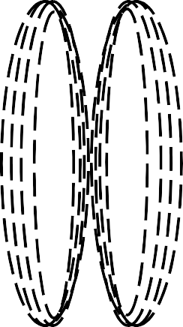
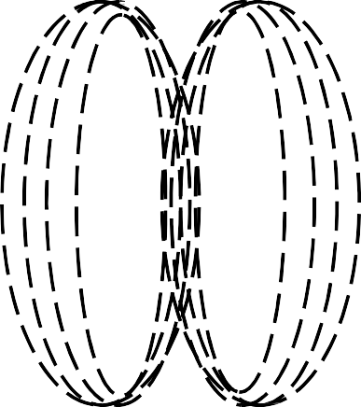
AUTOMOBILE ENGINEERING
Around the laminated core, the secondary winding is wounded. This consists of many turns of very fine insulated copper wire (generally in the vicinity of 20,000 turns). One end of this winding is connected to the HT outlet of the coil via the laminated iron core which it used as the pick-up point for this connection. The other end is connected to the positive (+) low tension primary terminal.
Over the top of the secondary winding the primary winding is wounded with the insulation. The primary winding consisting of a few hundred turns of relatively heavy insulated copper wire. The ends of the primary winding are connected to the two low tension, or primary terminals. A reason for placing the primary winding over the secondary is that it is in this coil, which caries the full primary circuit current (approximately 2 ampere in standard systems), the secondary winding generates the heat and by placing it thus, the cooling oil is given ready access to it.
A ceramic insulator at the base of the coil supports the core and winding and at the top is a plastic-type insulator which provides a location point for the high-tension and primary terminals. This top insulator is sealed into the outer case to prevent the loss of coolant oil or the energy of moisture.
Operation of an Ignition coil
Electromagnetic induction is the effect of creating the voltage in a conductor by means of relative movement between the conductor and a magnetic field. In the ignition coil the conductors remain stationary and the magnetic field is moved across them. To develop these necessary conditions, the first requirement in the ignition oil is the production of a magnetic field. This is the function of the primary winding.
When the ignition switch is closed, the primary winding of the coil is connected to the positive terminal of the vehicle battery. Now, if the primary circuit is completed through the contact breaker points a current will flow in the circuit, creating a magnetic field in the coil around the soft iron core. This magnetic field grows outwards from the core until it has reached maximum value and the core is fully magnetized and ceases to grow further.
37
Growing Magnetic field
Department of Mechanical Engineering

Slide 41
AUTOMOBILE ENGINEERING
To provide the very high voltage necessary to create a spark across the plug gap, the secondary winding has a very large number of turns. NOTE: The ratio of the number of secondary turns to the number of primary turns is very large – approximately 100:1. The effect of this high ration is to produce a very high voltage in the secondary winding when the magnetic field is collapsed rapidly across it as the contact breaker points are opened.
To understand the operation of the ignition coil, it is necessary to have the knowledge of the effect of winding insulated wire into the form of a coil and then passing a current through it. In earlier chapters of this course, an explanation was given of how a magnetic field forms around a wire when current flows through it.
Construction
The construction of a capacitor is quite simple. It is made of two strips of metallised paper, separated by a thin dielectric (insulator), generally of waxed paper or plastic, both rolled tightly together and fitted into a metal container. An insulated flexible lead is attached to one of the metallised plates and brought out for connection to the insulated side of the contacts. The other metallised plate is attached to the metal container which has facilities for connecting it to a good earth either inside or outside the distributor, thus effectively connecting the capacitor across, or in parallel, with the points.
As a general statement it can be said that a capacitor is a device which has the ability to store an electrical charge. When a capacitor is ‘charged’, each plate will hold an equal but opposite charge. That is the plate connected to the negative side of the circuit will acquire a negative charge, and the plate connected to the positive side of the circuit, a positive charge. Once these opposite charges are stored on the plates, they will attract each other through the separating dielectric, and thus tend to prevent the charge escaping or leaking away.
+
_
NOTE: The loss of electrical charge from a capacitor is termed the capacitor’s leakage. Among the tests applied to a capacitor is a test for leakage, which must be below a certain rate of loss.
Removing the charge from a capacitor is called discharging it. This is accomplished by connecting a conductor across its plates. The excess electrons are attracted from the negatively charged plate to the positively electrons are attracted from the negatively charged plate to the positively charged plate. The electron flow continues until such time as both charges equalize, i.e. there is no potential difference between the plates.

Slide 42





AUTOMOBILE ENGINEERING
The factors affecting the capacity of a capacitor:
(a)
(b)
The area of the plates holding the charges and the number of plates used.
The distance the plates are separated, i.e. the thinner the dielectric, the greater the attractive force between the charges, and therefore the higher the capacity. The type of dielectric, e.g. plastic, mica, paper, air, etc.
(c)
Unit of Capacitor
The amount of charge a capacitor can hold is termed its capacitance (symbol C) which is measured in a unit called the farad (symbol F). Since the farad is a large quantity and it is difficult to have such a big capacitor in real time, the capacitors are generally measured by micro farad (Symbol µF)
Automotive capacitors are in the vicinity of 0.20 to 0.30 microfarads (one microfarad = 10⁻⁶ farads, or 1 millionth of a farad).
The operation of a capacitor in an ignition circuit is relatively simple, but tends to appear complex because of the number of events, or changes, that occur simultaneously. The following explanation presents these changes as a logical, sequential set of events.
CIRCUIT OF THE IGNITION CIRCUIT
Distributor Cap
Ignition
Switch
Ballast
Resistor
Spark plug
Battery
Coil
Starter
Contact
Motor
Breaker

Slide 43
AUTOMOBILE ENGINEERING
A simple circuit shown above can illustrate the position of the major components of an ignition system. With the ignition switch ‘on’: when the breaker contacts initially close, a current commences to flow in the primary circuit and the magnetic field builds up relatively slowly, due to the self induced voltage that is developed at this time
During this ‘closed circuit period’ of the ignition cycle, the capacitor is in parallel with the breaker contacts which are closed at this time. As the distributor shaft continues its rotation the cam lobe lift the breaker gently to open the contacts.
It takes a certain number of degrees of distributor shaft rotation and therefore a measurable period of time for this to occur.
When the contacts are open and instantly a resistance is presented to the primary circuit because of this contact gap. The primary current is interrupted and the magnetic field is starting to collapse. The current produced by the self induced voltage has to enter the plates of the capacitor. Since the high resistance will be induced across the contacts due to their separation and it will naturally take the low resistance path.
Capacitor function
When the contacts gap is slowly widening and the self induced voltage is rapidly rising towards the 200-300 volt level. The capacitor is rapidly charging up. As the capacitor reaches the fully charged state, the contacts have opened to such a degree that even this high voltage cannot jump the gap and so the primary circuit currents comes to an ‘instant halt’.
This sudden stopping of the primary current, produced by the action of the capacitor, gives an extremely fast collapse of the magnetic field. The mutually induced voltage, generated in the secondary winding at this instant will be very high. Since the secondary winding has about 100 times as many turns as the primary winding, the secondary voltage will be about 100 times higher than the primary voltage (200 to 300 volts).
The secondary voltage at this instant is fed out through the HT circuit to the correct spark plug where it ionizes the plug gap and forms a spark which ignites the air-fuel mixture. For the period of time of spark duration the capacitor remains fully charged. After the energy of the secondary circuit has been expended in the HT spark, the capacitor discharges back through the battery, ignition switch and coil primary to the opposite plate of the capacitor, thus recharging it in the reverse direction. The capacitor then discharges back again to recharge itself in the original direction – but at a lower value. It continues this oscillating cycle of charge and discharge until all of the stored energy is dissipated across the resistance of the primary circuit. The distributor cam continues its rotation, the points close again and the whole cycle is repeated.
40

Slide 44
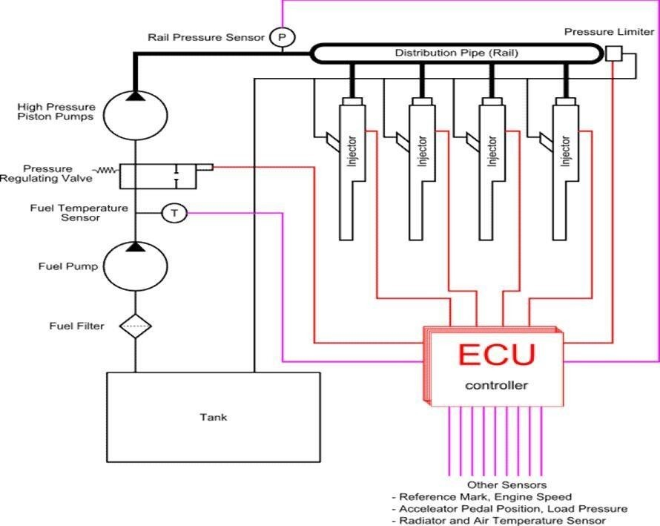
AUTOMOBILE ENGINEERING
In common rail systems, a high-pressure pump stores a reservoir of fuel at high pressure — up to and above 2,000 bars (200 MPa; 29,000 psi). The term "common rail" refers to the fact that all of the fuel injectors are supplied by a common fuel rail which is nothing more than a pressure accumulator where the fuel is stored at high pressure.
This accumulator supplies multiple fuel injectors with high-pressure fuel. This simplifies the purpose of the high-pressure pump in that it only needs to maintain a commanded pressure at a target (either mechanically or electronically controlled). The fuel injectors are typically ECU- controlled. When the fuel injectors are electrically activated, a hydraulic valve (consisting of a nozzle and plunger) is mechanically or hydraulically opened and fuel is sprayed into the cylinders at the desired pressure.
Since the fuel pressure energy is stored remotely and the injectors are electrically actuated, the injection pressure at the start and end of injection is very near the pressure in the accumulator (rail), thus producing a square injection rate. If the accumulator, pump and plumbing are sized properly, the injection pressure and rate will be the same for each of the multiple injection events.

