Slide 1

INTERNAL COMBUSTION ENGINE
BY
D.Simahna Devi,

Slide 2
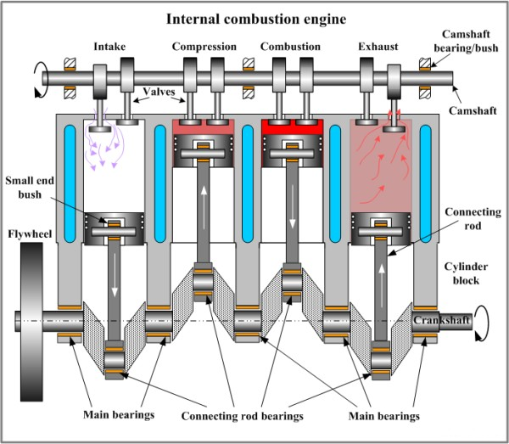

Slide 3
CASSIFICATION OF IC ENGINE
Type of Fuel
Method of ignition
Number of storkes
Cycle of operation
Speed of engine
Cooling system
Number of cylinders

Slide 4
Components of IC Engine
Cylinder :
withstand 50 bar pressure and 2000 centigrade temperature.
Material : cast iron , steel alloy , aluminium alloy
Cylinder Head :
Contain Spark plug for petrol engine and nozzle for Diesel Engine.
Material : cast iron , steel alloy , aluminium alloy
Gasket : copper or asbestos for air tight seal.

Slide 5
Components of IC Engine
Piston :
Function : Transmit force to connecting rod.
Material : Aluminium
Connecting rod :
Function : Transmit force from piston to crankshaft
Material : Special steel alloy or Aluminium alloy

Slide 6
Components of IC Engine
Piston rings :
Construction : Two sets of rings
Function : To provide air tight seal to prevent leakage of burnt gases or oil
Material : Special steel alloy.
Crankshaft :
Power is developed during working stroke.
Material : Special steel alloy.

Slide 7
Components of IC Engine
7. Crankcase :
Act as a sump for lubricating oil.
Material : cast iron
Flywheel :
Function : It stores excess energy during power stroke and return energy during other stroke
It maintain the speed of crankshaft constant.

Slide 8
Four stroke Engine
Petrol or Spark Ignition Engine
( S.I. Engine )

Slide 9
Construction
It consists of
Cylinder piston assembly
Connecting rod
Crankshaft
Cylinder head
Crank case
Inlet and Exhaust valve.
Fins ( for cooling purpose )

Slide 10
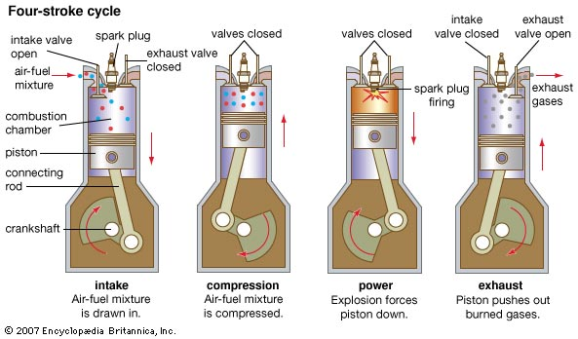

Slide 11
Working
Suction stroke :
Due to pressure difference inlet valve opens and charge is sucked into the cylinder
Piston moves from TDC to BDC.
Crankshaft rotates through 180 degree.
Compression stroke :
Inlet and Exhaust valve are closed
Piston moves from BDC to TDC.

Slide 12
Working
Pressure and temperature of charge increases.
Crankshaft rotates through 360 degree i.e. one complete revolution.
Expansion stroke :
Charge is ignited by spark plug before the piston reaches TDC.
Sudden increase in the temperature and pressure but volume remains constant.

Slide 13
Working
Combustion products pushes the piston in the downward direction due to high pressure.
Heat energy transform to mechanical energy.
Piston moves from TDC to BDC
Crankshaft rotates through 540 degree.
Both inlet and exhaust valves are closed.
Exhaust stroke :
Exhaust valve opens as the piston moves
from BDC to TDC

Slide 14
Working
Piston pushes the product of combustion through exhaust valve into atmosphere.
Examples of Four stroke engines:
For Light vehicles:
Cars
Jeep
Aeroplanes.

Slide 15
Four stroke Engine
Diesel or Compression Ignition
( C.I. Engine )

Slide 16
Construction
It consists of
Cylinder piston assembly
Connecting rod
Crankshaft
Cylinder head
Crank case
Inlet and Exhaust valve.
Fins ( for cooling purpose )

Slide 17
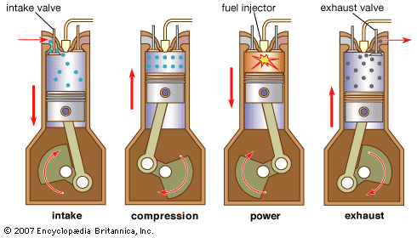

Slide 18
Working
Suction stroke :
Due to pressure difference inlet valve opens and air is sucked into the cylinder
Piston moves from TDC to BDC.
Crankshaft rotates through 180 degree.
Compression stroke :
Inlet and Exhaust valve are closed
Piston moves from BDC to TDC.

Slide 19
Working
Pressure and temperature of charge increases.
Crankshaft rotates through 360 degree i.e. one complete revolution.
Expansion stroke :
Fuel is injected through fuel injector before the piston reaches TDC.
Temperature of air is high enough to ignite the Fuel.
Sudden increase in the temp. and pressure.

Slide 20
Working
Combustion products pushes the piston in the downward direction due to high pressure.
Heat energy transform to mechanical energy.
Piston moves from TDC to BDC
Crankshaft rotates through 540 degree.
Both inlet and exhaust valves are closed.
Exhaust stroke :
Exhaust valve opens as the piston moves
from BDC to TDC

Slide 21
Working
Piston pushes the product of combustion through exhaust valve into atmosphere.
Examples of Four stroke engines:
For Heavy vehicles:
Buses
Trucks
Tractors.
Earth moving machines.

Slide 22
Valve Timing Diagram
Petrol & Diesel Engine

Slide 23
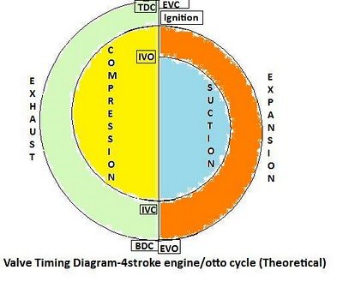

Slide 24
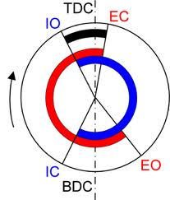

Slide 25
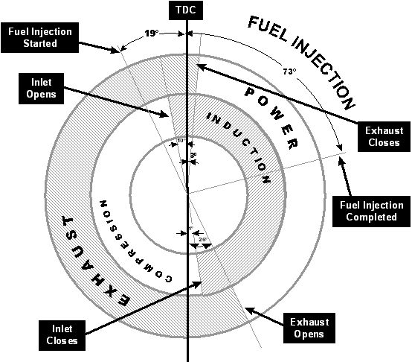

Slide 26
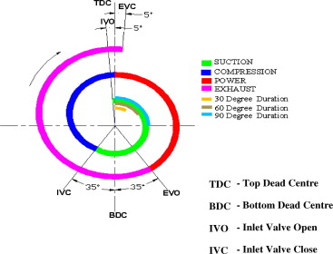

Slide 27
Four stroke Petrol Engine
IVO : 10 to 20 Deg. Before TDC
IVC : 30 to 40 Deg. After BDC
IGN : 20 to 30 Deg. Before TDC
EVO : 30 to 50 Deg. Before TDC
EVC : 10 to 15 Deg. After TDC

Slide 28
Four stroke Diesel cycle
IVO : 10 to 20 Deg. Before TDC
IVC : 25 to 40 Deg. After BDC
FVO : 10 to 15 Deg. Before TDC
FVO : 15 to 20 Deg. After TDC
EVO : 39 to 50 Deg. Before TDC
EVC : 10 to 15 Deg. After TDC

Slide 29
Two stroke Petrol engine
EPO : 35 to 50 Deg. before BDC
TPO : 30 to 40 Deg. before BDC
TPC : 30 to 40Deg. after BDC
EPC : 35 to 50 Deg. after BDC
IGN : 15 to 20 Deg. before TDC

Slide 30
Two stroke Diesel engine
EPO : 30 to 45 Deg. before BDC
TPO : 30 to 40 Deg. before BDC
TPC : 30 to 40 Deg. after BDC
EPC : 35 to 50 Deg. after BDC
FVO : 10 to 15 Deg. before TDC
FVO : 15 to 20 Deg. After TDC

Slide 31
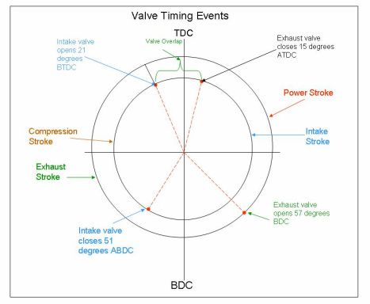

Slide 32
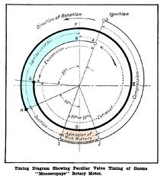

Slide 33
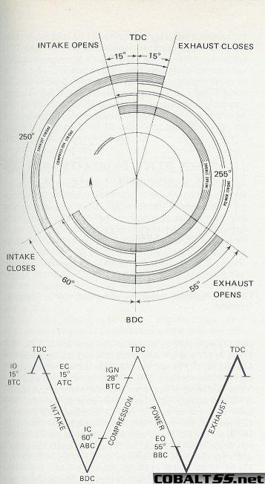

Slide 34
Combustion in SI engine

Slide 35
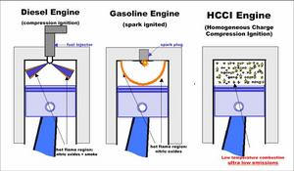

Slide 36
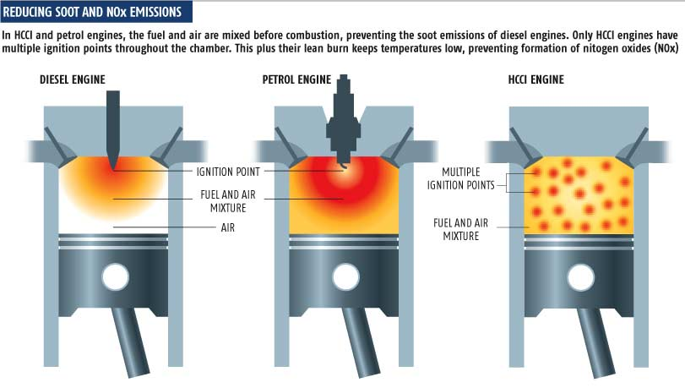

Slide 37
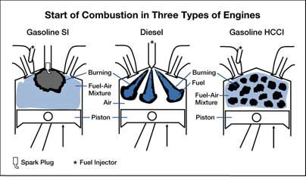
SI –Spark ignition,CI – compression Ignition,
HCCI –Homogeneous charge compression ignition

Slide 38
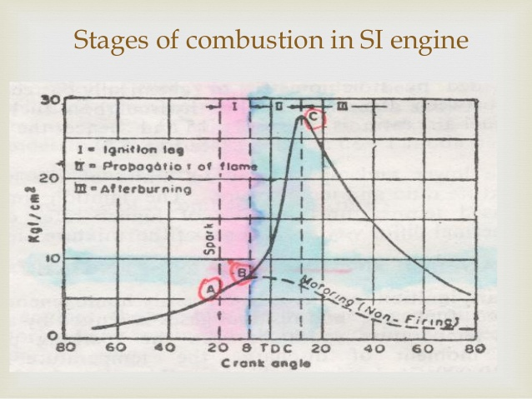

Slide 39
Combustion phenomenon in SI engine
In SI Engine homogeneous mixture of air and fuel is formed by the carburetor.
Air – fuel mixture is compressed upto compression ratio 8 to 12.
Mixture is ignited by spark plug.
A turbulent flame is developed which propagates through the charge.

Slide 40
Three stages of combustion
Ignition Lag :
It consists of growth and development of propagated flame.
It depends on temperature,pressure and nature of fuel.
It also depends on propagation of exhaust gas residue.
Propagation of flame :
In this stage there is sudden rise in pressure and temperature.

Slide 41
Velocity of flame is constant.
Heat release rate depends on reaction rate of charge.
heat transfer to cylinder wall is low.
After burning :
In this stage highest pressure is reached.
Velocity of flame decrease.
Combustion rate also decrease.

Slide 42
Combustion in SI engine

Slide 45
SI –Spark ignition,CI – compression Ignition,
HCCI –Homogeneous charge compression ignition

Slide 47
Combustion phenomenon in SI engine
In SI Engine homogeneous mixture of air and fuel is formed by the carburetor.
Air – fuel mixture is compressed upto compression ratio 8 to 12.
Mixture is ignited by spark plug.
A turbulent flame is developed which propagates through the charge.

Slide 48
Three stages of combustion
Ignition Lag :
It consists of growth and development of propagated flame.
It depends on temperature,pressure and nature of fuel.
It also depends on propagation of exhaust gas residue.
Propagation of flame :
In this stage there is sudden rise in pressure and temperature.

Slide 49
Velocity of flame is constant.
Heat release rate depends on reaction rate of charge.
heat transfer to cylinder wall is low.
After burning :
In this stage highest pressure is reached.
Velocity of flame decrease.
Combustion rate also decrease.

Slide 50
Supercharging

Slide 51
What is supercharging ?
It is the process of increasing the mass or density of air fuel mixture in S.I.engine or air in C.I. engine sucked into the engine cylinder.
It is done with the help of compressor or blower called as supercharger.
In S.I. engine it is mounted before carburetor which reduce the size of carburator.

Slide 52
Effect of Supercharging
To maintain power o/p of an engine working at high altitude, where less oxygen is available for combustion.
To reduce the space occupied by the engine.
To reduce the consumption of lubricating oil.
To reduce the mass of engine per B.P.
To increase mechanical and thermal efficiency.
To increase volumetric efficiency.
Specific fuel consumption is less.
Chances of detonation due to high pressure.

Slide 53
Turbocharging

Slide 54
What is Turbocharging
It is the process in which energy extracted from the exhaust gases by the turbine is utilized to drive the supercharger i.e. centrifugal compressor.
About 30 % of heat goes out through the exhaust gas.It depends on type of engine and operating conditions.
This gas turbine is directly coupled to the centrifugal compressor.

Slide 55
Advantages of Turbocharger
Reduce pollution from exhaust gases.
Reduce fuel consumption.
Reduction in power loss due to decrease in air density at higher altitude.
Increase power o/p of engine.
More power to weight ratio.
Better torque characteristics.

Slide 56
Detonation in IC Engine
Knocking or pinking

Slide 57
What is Detonation
The loud pulsating noise heard within the engine cylinder.
Due to auto-ignition of unburnt fuel high pressure waves are created.
These high pressure waves may break the piston.

Slide 58
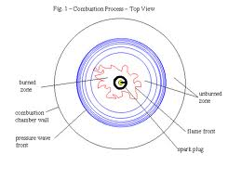

Slide 59
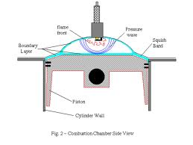

Slide 60
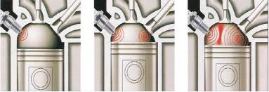

Slide 61
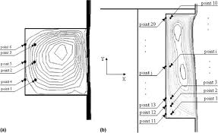

Slide 62
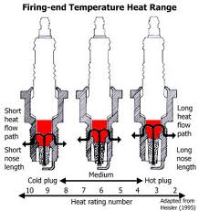

Slide 63
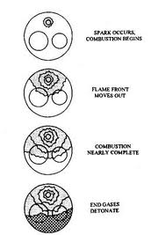

Slide 64
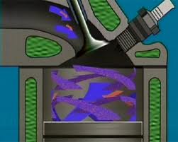

Slide 65
Factors for Detonation
The shape of combustion chamber.
Relative position of spark plug.
Chemical nature of fuel.
Initial temperature and pressure of fuel.

Slide 66
Effects of Detonation
Noise : Due to detonation sound intensity increases.
Pre-ignition : Due to overheating of spark plug.
Increase heat transfer : Due to high temperature increases heat trasfer.
Mechanical damage : High pressure shock waves may damage piston
Decrease in power o/p : Due to abnormal combustion decreases power o/p.

Slide 67
Remedies or Detonation is controlled by
By increasing engine r.p.m.
Retarding ( decelerating ) spark.
Reducing pressure in inlet manifold.

Slide 68
Turning moment diagram
For fou stroke I.C. Engine

Slide 69
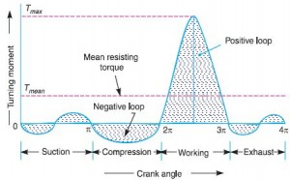

Slide 70
In four stroke there is one working stroke after the crank has turned through 720 degree or 4 Π radian.
Suction stroke : As the pressure is less than atmospheric pressure therefore negative loop is obtained.
Compression stroke : As work is done on the gases due to compression therefore higher negative loop is obtained.
Expansion stroke : As work is done by the gases due to expansion therefore positive loop is obtained.
Exhaust stroke : As work is done on the gases therefore negative loop is obtained.

Slide 71
Actual Indicator Diagram

Slide 72
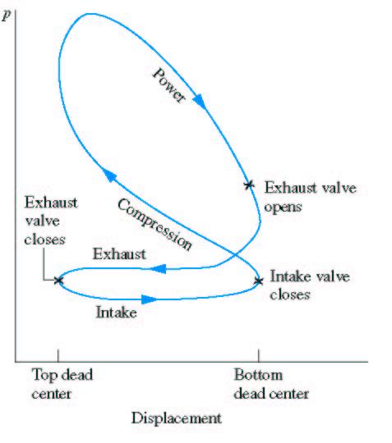

Slide 73
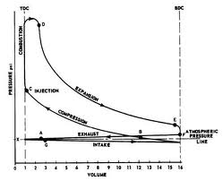

Slide 74
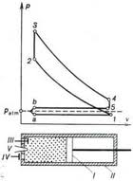

Slide 75
Actual Indicator diagram for Four stroke Petrol engine
Line 1-2 : Suction stroke :
It is shown below atmospheric pressure line.
Inlet valve offers some resistance to the incoming charge. Therefore pressure inside the cylinder is below atmospheric pressure.
Due to pressure difference inlet valve opens and suction of charge takes place.
Line 2-3 : Compression stroke :
It indicates inlet valve closes a little beyond point 2 i.e after piston reaches BDC.
Before the end of this stroke i. e. before piston reaches TDC fuel is ignited by spark plug and combustion at constant volume takes place.
Line 4-5: Expansion stroke :
It indicates exhaust valve opens a little before 5 i.e. before
the piston reaches BDC.

Slide 76
Burnt gases escapes through the exhaust valve.
Line 5 – 1 : Exhaust stroke :
It lies above atmospheric line.
Due to pressure difference burnt gases flow outside the cylinder.

Slide 77
Simple Carburettor

Slide 78
Function of carburettor
To form a mixer of air and fuel

Slide 79
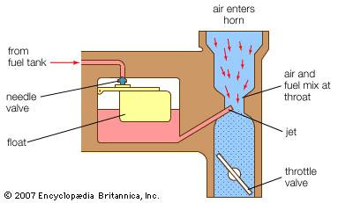

Slide 80
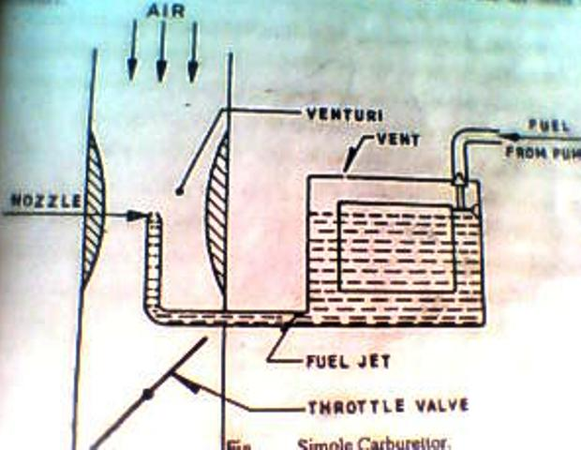

Slide 81
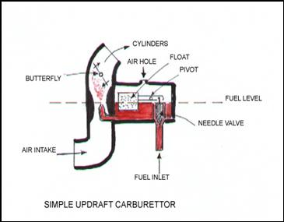

Slide 82
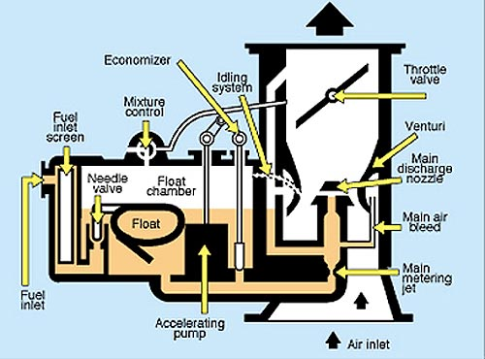

Slide 83
Construction of simple carburetor
It consists of
Float chamber , nozzle with metering orifice,
venturi and throttle valve.
Float chamber and needle valve system maintains a constant level of petrol in the float chamber
If fuel level lowers then float lowers thereby opens the fuel supply valve till the designed level reach in the float chamber.
Float chamber is vented to the atmosphere.
3. Venturi tube gives minimum resistance to air flow.

Slide 84
Working
During suction stroke air is drawn through the venturi , which has minimum cross section at throat.
Velocity of the air passing through venturi increases and its pressure decreases.
Due to pressure difference in throat and float chamber the fuel from float chamber is discharged at throat.
This pressure difference is called carburetor depression

Slide 85
The rate of flow is controlled by discharge jet or nozzle.
To avoid overflow of the fuel the level of the fuel in the float chamber is kept below the tip of the nozzle.
Throttle valve regulate the quantity of fuel discharged.
If load is partial throttle valve is partialy open and less air-fuel mixture is provided to the engine.
If load is full throttle valve is fully open and more air-fuel mixture is provided to the engine.

Slide 86
Fuel Pump

Slide 87
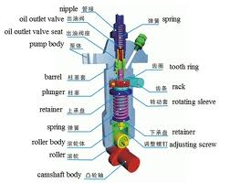

Slide 88
Construction of Fuel Pump
It consist of :
Tappet which is in contact with cam shaft.
Barrel
Plunger ( single acting )and plunger spring.
Inlet port and spill port.

Slide 89
Working of Fuel Pump
When the plunger is at bootom of its stroke , fuel flows through the inlet port and fill the fuel chamber, vertical groove,helix.
When the plunger starts moving up , a certain amount of fuel goes out through the ports until the plunger close the ports.
Then plunger compress the fuel and forced out through the delivery valve to the pipe leading to the injector.
Injection process continues till the lower end of the helix uncovers the spill port.

Slide 90
Multi Point Fuel Injection

Slide 91
MPFI
It supply the proper ratio of air and fuel to the engine cylinder.
There are two types :
Port injection.
Throttle body injection.

Slide 92
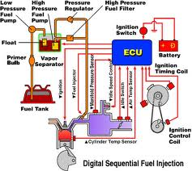

Slide 93
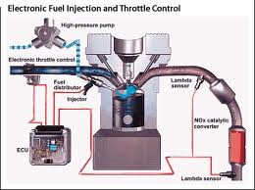

Slide 94
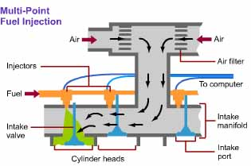

Slide 95
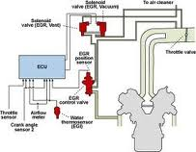

Slide 96
Port injection System
Injector is placed on the side of intake manifold.
Injector sprays petrol into the air.
Mixture of air and fuel through the intake valve enters into the cylinder.
Every cylinder is Provided with an injector.

Slide 97
Throttle Body Injection
( Single point Injection )
Throttle valve control the amount of air.
Injector is placed above the throttle body.
Injector sprays petrol into the air.
This mixture then passes trough the throttle valve and then enters into the intake manifold.

Slide 98
D - MPFI
Pressure sensor in the intake manifold detects the intake manifold vacuum and sends the signal to ECU.
Speed sensor also send the signal about speed of engine to ECU.
ECU processes the information received sends the proper signal to injector.
Injector regulate the amount of petrol supply for injection.

Slide 99
D - MPFI
After injection the petrol mixes with the air in the intake manifold and the mixture enters in the cylinder.

Slide 100
L - MPFI
It consists of air flow meter which regulate the amount of air entering into cylinder.
Air flow sensor measures the amount of air enters in the intake manifold.
Air flow sensor sends the signal to ECU.
Speed sensor also send the signal about speed of engine to ECU.
ECU processes the information received sends the proper signal to injector.
Injector regulate the amount of petrol supply for injection.

Slide 101
L - MPFI
After injection the petrol mixes with the air in the intake manifold and the mixture enters in the cylinder.

Slide 102
List of fuels

Slide 103
Classification of fuels
Liquid fuels :
Natural : Petroleum
Artificial :
a) Petroleum based : Gasoline ( Petrol ), Diesel , Kerosene.
b) Non Petroleum based : Benzol , Alcohols,Acetones

