Slide 1

KINEMATICS OF MACHINERY
( ME2202PC)
2 ND YEAR B .TECH II - S E M
DEPARTMENT OF MECHANICAL ENGINEERING

Slide 2
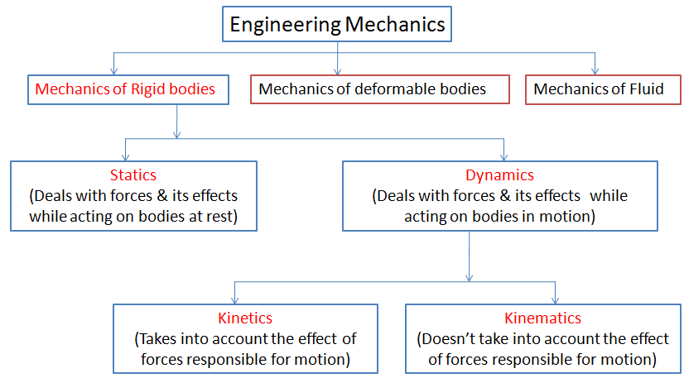


Slide 3
UNIT-I

Slide 4
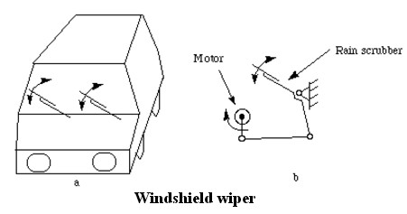

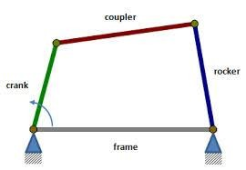
BASICS
Mechanism:
A number of bodies are assembled in such a way that the motion of one causes constrained and predictable motion to the others.
A mechanism transmits and modifies a motion.
4 bar
mechanism,
Slider crank
Example:
mechanism

Slide 5
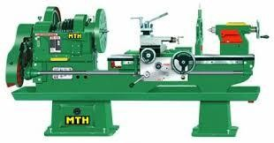
BASICS
Machine: (Combinations of Mechanisms)
Transforms energy available in one form to another to do certain type
of desired useful work.
Lathe Machine

Slide 6
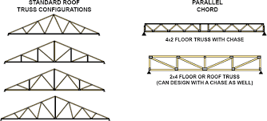

BASICS
Structure:
Assembly of a number of resistant bodies meant to take up loads.
No relative motion between the members
Bridge (Location: Howrah)
Truss

Slide 7
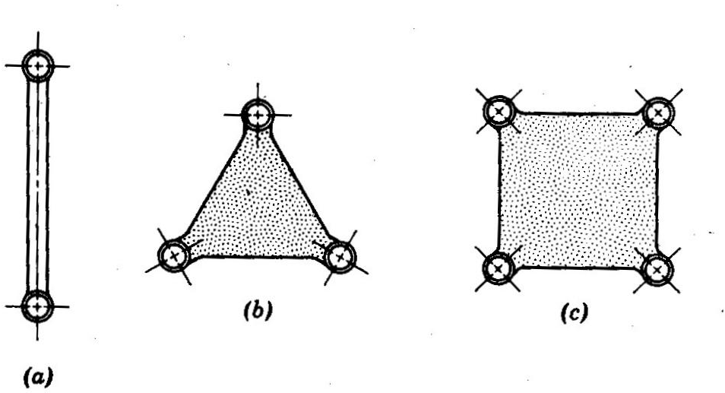
BASICS
Kinematic Link (element): It is a Resistant body i.e. transmitting the required forces with negligible deformation.
Types of Links
Rigid Link
Doesn’t undergo deformation. Example: Connecting rod, crank
Flexible Link
Partially deformed link. Example: belts, Ropes, chains
Fluid Link
Formed by having a fluid in a receptacle Binary link
and the motion is transmitted through the ^{(2 vertices)}
Ternary link (3 vertices)
Quaternary link (4 vertices)
fluid by pressure or compression only. Example: Jacks, Brakes

Slide 8
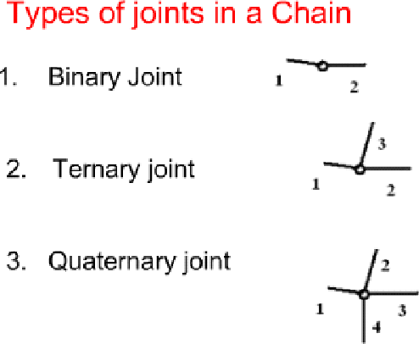
BASICS
Kinematic Joint: Connection between two links by a pin
Types of Joints:
Binary
Joint (2 links are
connected at the joint)
Ternary Joint
connected)
(3 links are
Quaternary Joint. (4 links are connected)
Note: if ‘l’ number of links are connected at a joint, it is equivalent to (l-1) binary joints.

Slide 9
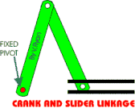
BASICS
Kinematic Pair:
The two links (or elements) of a machine, when in contact with each
other, are said to form a pair.
If the relative motion between them is completely or successfully constrained (i.e. in a definite direction), the pair is known as kinematic pair

Slide 10
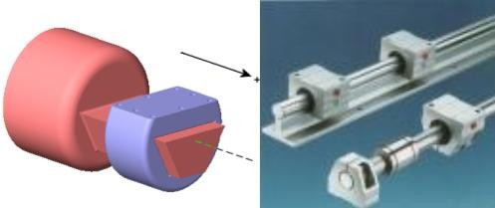


1. Sliding Pair
KINEMATIC PAIRS ACCORDING TO THE
RELATIVE MOTION
Rectangular bar in a rectangular hole
2. Turning or Revolving Pair
Collared shaft revolving in a circular hole

Slide 11
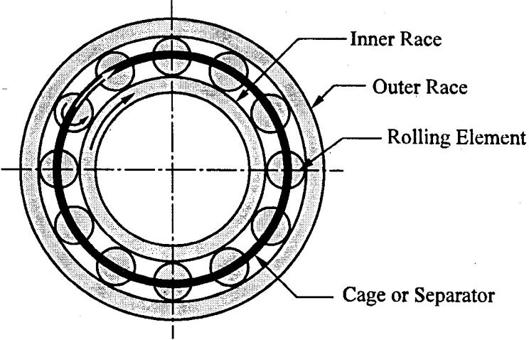
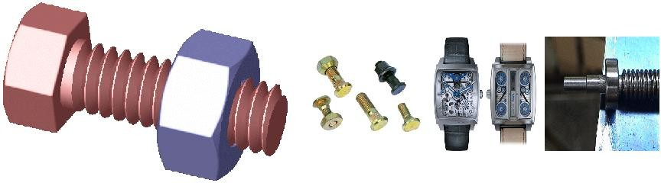
3. Rolling Pair
KINEMATIC PAIRS ACCORDING TO THE RELATIVE MOTION
Links of pairs have a rolling motion relative to each other.
4. Screw or Helical Pair
if two mating links have a turning as well as sliding motion between them.

Slide 12
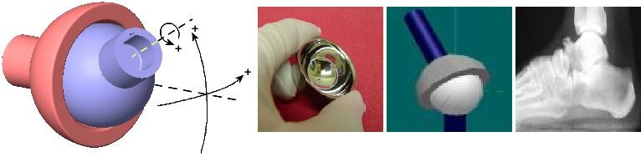
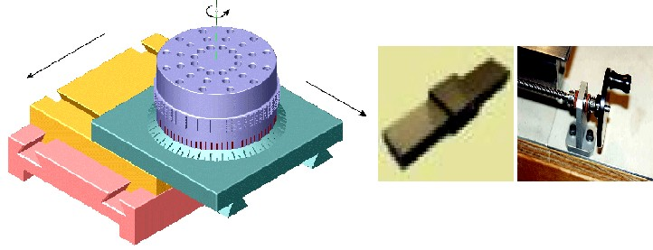
KINEMATIC PAIRS ACCORDING TO THE RELATIVE MOTION
5. Spherical Pair
When one link in the form of a sphere turns inside a fixed link
6. Planar Pair

Slide 13
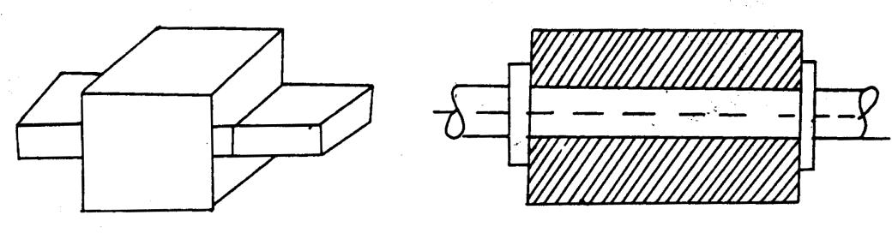
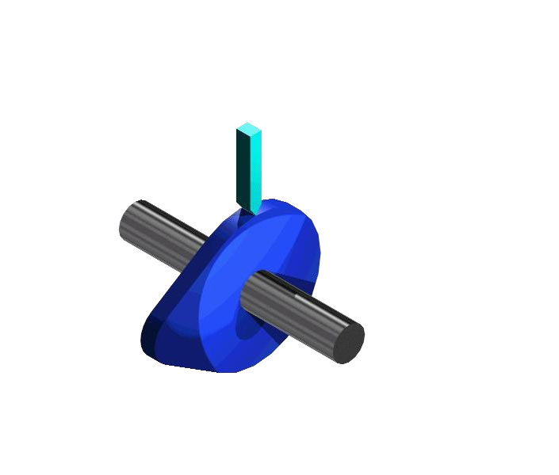

1. Lower Pair
KINEMATIC PAIRS ACCORDING TO TYPE OF CONTACT
The joint by which two members are connected has surface (Area) contact
2. Higher Pair
The contact between the pairing elements takes place at a point or along a line.
Toothed gearing, belt and rope drives, ball and roller bearings and cam and follower are the examples of higher pairs

Slide 14
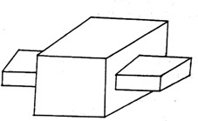
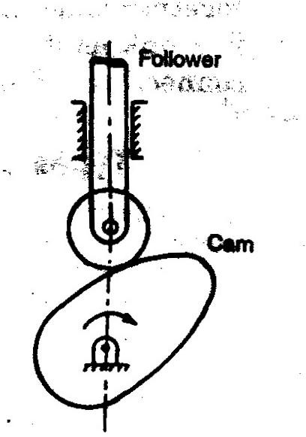
KINEMATIC PAIRS ACCORDING TO TYPE OF CONSTRAINT
1. Closed Pair
Two elements of pair are held
together mechanically required relative motion. Eg. All lower pairs
2. Unclosed Pair
Elements are not held mechanically.
Held in contact by the action of external forces.
Eg. Cam and spring loaded follower pair
to get

Slide 15
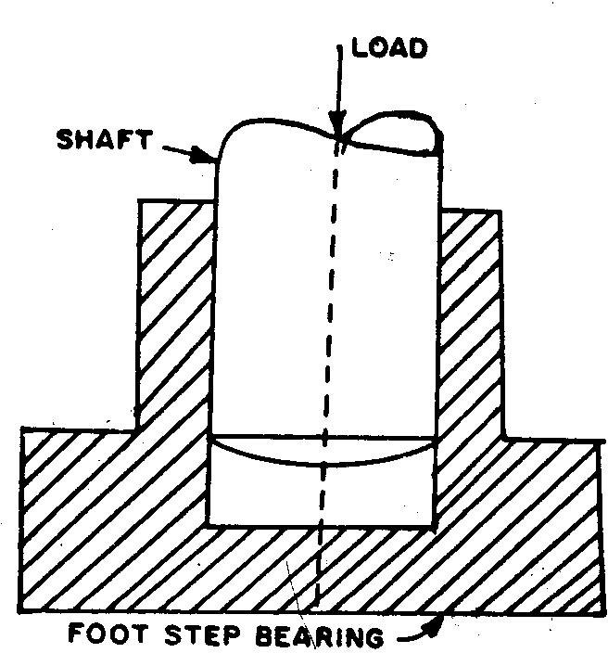
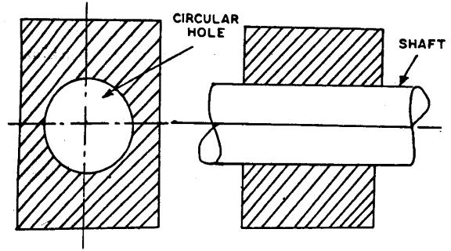
CONSTRAINED MOTION
Completely constrained Motion:
Motion in definite direction irrespective of the direction of the force applied.
Successfully (partially) constrained Motion:
Constrained motion is not completed by itself
but by some other means.
Constrained motion is successful when compressive load is applied on the shaft of the foot step bearing
3. Incompletely constrained motion:
Motion between a pair can take place in more than one direction.
Circular shaft in a circular hole may have rotary
and reciprocating motion. Both are independent of each other.

Slide 16


KINEMATIC CHAIN
Group of links either joined together or arranged in a manner that permits them to move relative (i.e. completely or successfully constrained motion) to one another.
Example: 4 bar chain
The following relationship holds for kinematic chain
Where
p = number of lower pairs
l = number of links
j = Number of binary joints

Slide 17
KINEMATIC CHAIN
If LHS > RHS, Locked chain or redundant chain; no relative motion possible.
LHS = RHS, Constrained chain .i.e. motion is completely constrained
LHS < RHS, unconstrained chain. i.e. the relative motion is not completely constrained.

Slide 18
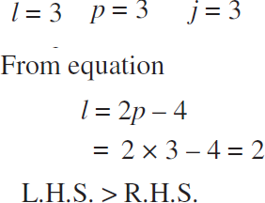
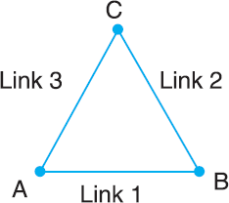
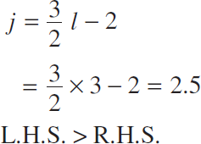
NUMERICAL EXAMPLE-1
Determine the nature of the chain
(K2:U)
Therefore it is a locked Chain

Slide 19

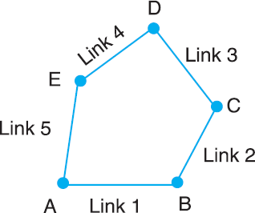
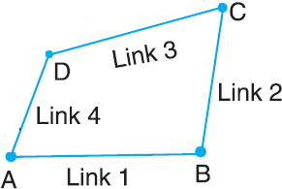
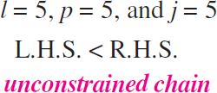

EXERCISE
Determine the nature of the chains given below (K2:U)
Hint: Check equations
constrained kinematic chain

Slide 20
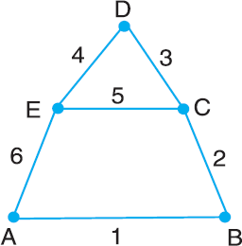
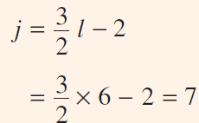
NUMERICAL EXAMPLE-2
Determine the nature of the chain (K2:U)
l = 6
j = 3 Binary joints (A, B & D) + 2 ternary joints (E & C)
We know that, 1 ternary joint = (3-1) = 2 Binary Joints
Therefore, j = 3 + (2*2) = 7
Therefore, the given chain is a kinematic chain or constrained chain.

Slide 21
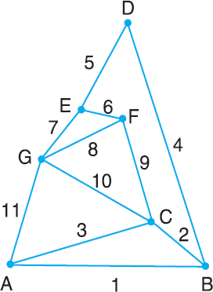
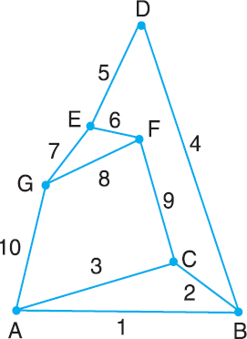
EXERCISE
Determine the number of joints (equivalent binary) in the given chains (K2:U)
Number of Binary Joints = 1 ( D)
No. of ternary joints = 4 (A, B, E,
F)
No. of Binary Joints = 1 ( D)
No. of ternary joints = 6 (A, B, C, E,F, G)
j = 1 + 6 (2) = 13
No. of quaternary joints = 2 (C & G)
Therefore, j = 1 + 4 (2) + 2 (3)
= 15

Slide 22
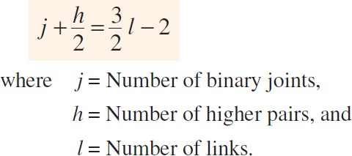
KINEMATIC CHAIN
For a kinematic chain having higher pairs, each higher pair is taken equivalent to two lower pairs and an additional link.
In this case to determine the nature of chain, the relation given by A.W. Klein, may be used

Slide 23
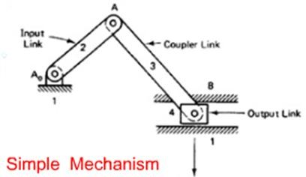
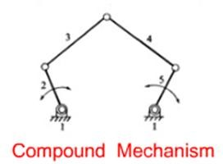
Mechanism:
CLASSIFICATION OF MECHANISMS
When one of the links of a kinematic chain is fixed, the chain is called Mechanism.
Types:
Simple - 4 Links
Compound - More than 4 links

Slide 24
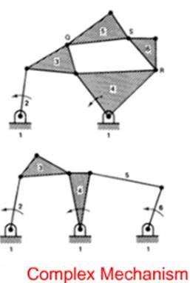
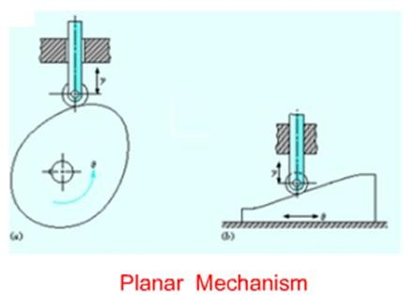
Classification of mechanisms
Complex - Ternary or Higher order f Links
  Planar - All links lie in the same plane
loating

Slide 25
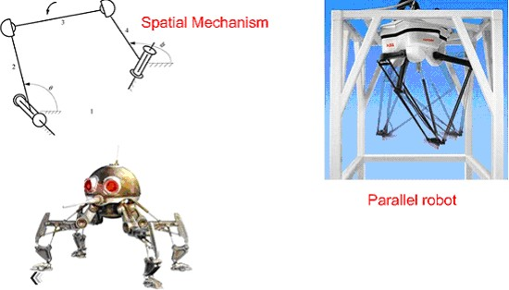
Classification of mechanisms
Spatial - Links of a mechanism lie in different planes

Slide 26
When a mechanism is required to
Machine
transmit power or to do some particular
type of work, it
then becomes a cases, the
machine. In such
various
links or elements have to be designed to withstand the forces (both static and kinetic) safely.

Slide 27
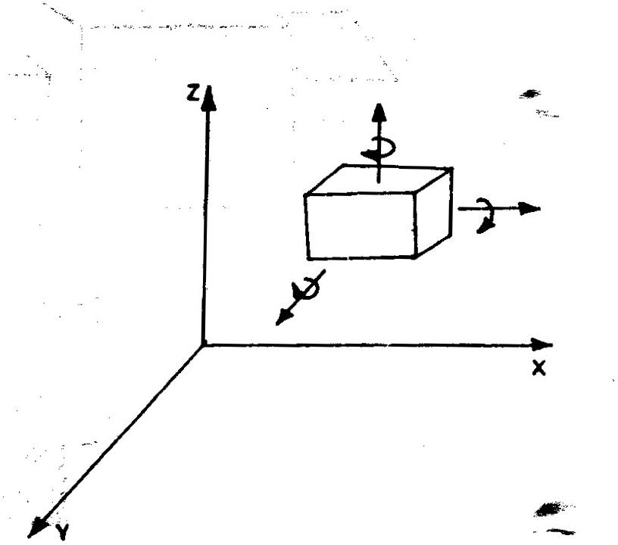
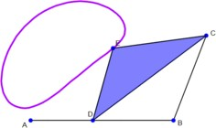
DEGREES OF FREEDOM (DOF) / MOBILITY
It is the number of independent coordinates required to describe the position of a body.
4 bar Mechanism has 1 DoF as the angle turned by the crank AD is fully describing the position of the every link of the mechanism

Slide 28
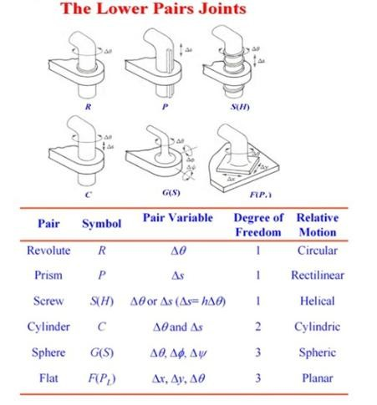
DOF

Slide 29
DEGREES OF FREEDOM/MOBILITY OF A
MECHANISM
It is the number of inputs (number of independent coordinates) required to describe the configuration or position of all the links of the mechanism, with respect to the fixed link at any given instant.

Slide 30

KUTZBACH CRITERION
For mechanism having plane motion
DoF =
l = number of links
j = number of binary joints or lower pairs (1 DoF pairs) h = number of higher pairs (i.e. 2 DoF pairs)

Slide 31
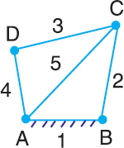

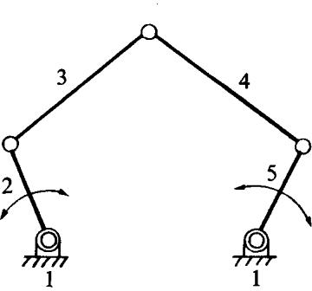
NUMERICAL EXAMPLE -1 &2
Determine the DoF of the mechanism shown below:
Kutzbach Criterion
l = 5 ; j = 2+ 2* (3-1) = 6 ; h = 0
DoF = 0, means that the mechanism forms a structure
l = 5 ; j = 5; h = 0
n = 3 (5-1) – 2*5 – 0 = 2
Two inputs to any two links are required to yield definite motions in all the links.

Slide 32
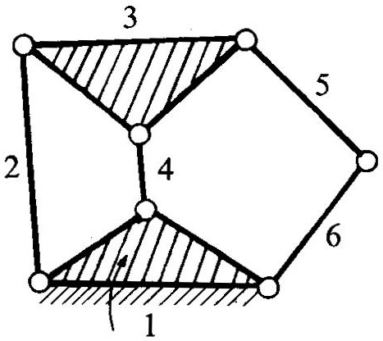
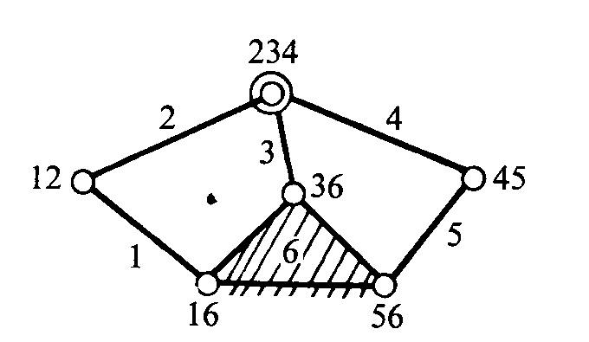
NUMERICAL EXAMPLE -3 &4
Determine the Dof for the links shown below:
Kutzbach Criterion
l = 6 ; j = 7 ; h = 0
n = 3 (6-1) – 2 (7) – 0 = 1
Dof = 1
i.e., one input to any one link will result in definite motion of all the links.
Note: at the intersection of 2, 3 and 4,
two lower pairs are to be considered
l = 6 ; j = 5 + 1 (3-1) = 7 ; h = 0
n = 3 (6-1) – 2 (7) – 0 = 1
Dof = 1

Slide 33
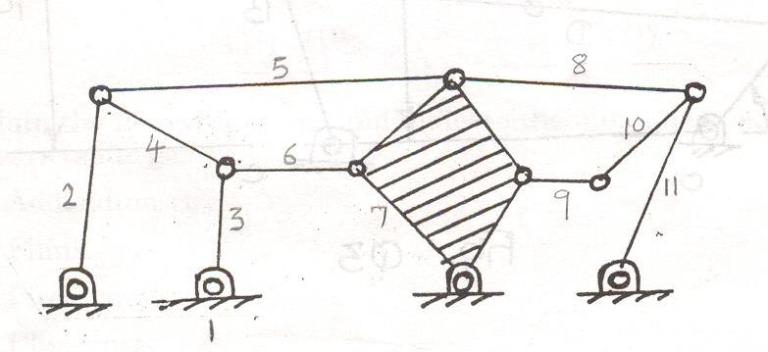
NUMERICAL EXAMPLE - 5
Kutzbach Criterion
l = 11 ; j = 7 + 4 (3-1) = 15 ; h = 0
n = 3 (11-1) – 2 (15) – 0 = 0
Dof = 0
Here, j= 15 (two lower pairs at the intersection of 3, 4, 6; 2, 4, 5;
5, 7, 8; 8, 10, 11) and h = 0.
Summary
Dof = 0, Structure
Dof = 1, mechanism can be driven by a single input motion Dof = 2, two separate input motions are necessary to produce constrained motion for the mechanism
Dof = -1 or less, redundant constraints in the chain and it forms
a statically indeterminate structure

Slide 34
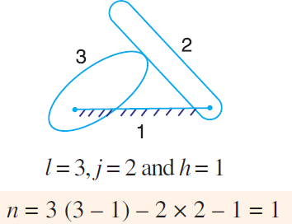
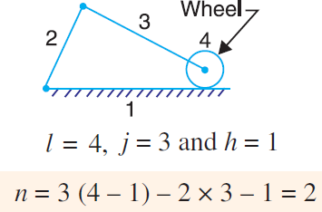
KUTZBACH CRITERION FOR HIGHER
PAIRS

Slide 35
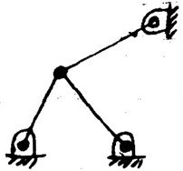
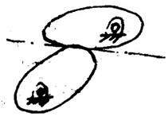
KUTZBACH CRITERION
l = 4, j = 5, h=0
n = 3 (4-1) – 2 (5) – 0 = -
1
Indeterminate structure
l = 3, j = 2, h=1
n = 3 (3-1) – 2 (2) – 1 =
1

Slide 36
GRUBLER’S CRITERION FOR PLANE
MECHANISMS
Kutzbach Criterion
Grubler’s criterion applies to mechanisms having 1 DoF.
Substituting n = 1 and h=0 in Kutzbatch equation, we can have Grubler’s equation.

Slide 37
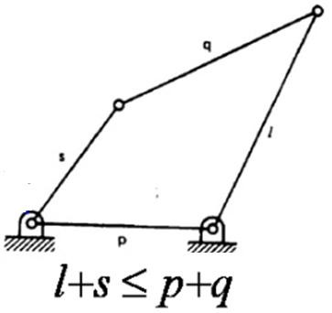
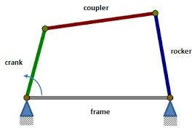
GRASHOF’S LAW
According to Grashof ’s law for a four bar mechanism, the sum of the shortest and longest link lengths should not be greater than the sum of the remaining two link lengths if there is to be continuous relative motion between the two links.

Slide 38
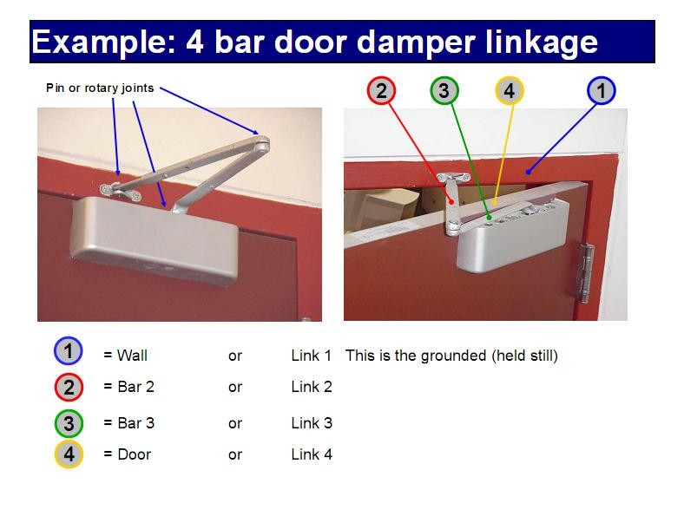

Slide 39
INVERSIONS OF MECHANISM
A mechanism is one in which one of the links of a kinematic chain is fixed.
Different mechanisms can be obtained by fixing different links of the same kinematic chain.
It is known as inversions of the mechanism.

Slide 40
INVERSIONS OF FOUR BAR CHAIN
Beam engine (crank and lever mechanism)
Coupling rod of a locomotive (Double crank mechanism)
Watt’s indicator mechanism (Double lever mechanism)

Slide 41


INVERSIONS OF FOUR BAR CHAIN
1. Beam engine (crank and lever mechanism)
[Source: R S Khurmi]
The purpose of this mechanism is to convert rotary motion into reciprocating motion.

Slide 42

INVERSIONS OF FOUR BAR CHAIN
2. Coupling rod of a locomotive (Double crank mechanism).
[Source: R S Khurmi]
links AD and BC (having equal length) act as cranks and
are connected to the respective wheels.
The link CD acts as a coupling rod and the link AB is fixed in order to maintain a constant centre to centre distance between them.
This mechanism is meant for transmitting rotary motion from one wheel to the other wheel.

Slide 43


INVERSIONS OF FOUR BAR CHAIN
3.Watt’s indicator mechanism (Double lever mechanism)
[Source: R S Khurmi]
On any small displacement of the mechanism, the tracing point E at the end
of the link CE traces out approximately a straight line

Slide 44

SINGLE SLIDER CRANK CHAIN
Links 1-2, 2-3, 3-4 = Turning pairs;
Link 4-1 = Sliding pair

Slide 45



INVERSIONS OF SINGLE SLIDER CRANK
CHAIN
crank fixed
connecting rod fixed
slider fixed

Slide 46
INVERSIONS OF SINGLE SLIDER CRANK CHAIN
Pendulum pump or Bull engine
Oscillating cylinder engine
Rotary internal combustion engine (or) Gnome engine
Crank and slotted lever quick return motion mechanism
Whitworth quick return motion mechanism

Slide 47

PENDULUM PUMP OR BULL ENGINE

Slide 48

PENDULUM PUMP OR BULL ENGINE
This inversion is obtained by fixing the cylinder or link 4 (i.e. sliding pair)
when the crank (link 2) rocks, the connecting rod (link 3) oscillates about a pin pivoted to the fixed link 4 at A.
The piston attached to the piston rod (link 1) reciprocates.
[Source: R S Khurmi]
It supplies water to a boiler.

Slide 49

OSCILLATING CYLINDER ENGINE

Slide 50

OSCILLATING CYLINDER ENGINE
[Source: R S Khurmi]
used to convert reciprocating motion into rotary motion
the link 3 (Connecting Rod ) forming the turning pair is fixed.

Slide 51

MULTI-CYLINDER RADIAL IC ENGINE

Slide 52


ROTARY INTERNAL COMBUSTION ENGINE (OR)
GNOME ENGINE
D
[Source: R S Khurmi]
Crank is fixed at center D
Cylinder reciprocates
Engine rotates in the same plane

Slide 53

CRANK AND SLOTTED LEVER QUICK RETURN
MOTION MECHANISM

Slide 54


CRANK AND SLOTTED LEVER QUICK RETURN
MOTION MECHANISM
The line of stroke of the ram (i.e.
R1R2) is perpendicular to AC
In the extreme positions, AP1 and
AP2 are tangential to the circle
[Source: R S Khurmi]

Slide 55



CRANK AND SLOTTED LEVER QUICK RETURN MOTION MECHANISM
[Source: R S Khurmi]

Slide 56

Crank and slotted lever quick return mechanism is mostly used in shaping machines & slotting machines

Slide 57



WHITWORTH QUICK RETURN MOTION MECHANISM
[Source: R S Khurmi]

Slide 58


INVERSIONS OF DOUBLE SLIDER CRANK
CHAIN
(1. ELLIPTICAL TRAMMELS)

Slide 59


INVERSIONS OF DOUBLE SLIDER CRANK CHAIN
(1. ELLIPTICAL TRAMMELS)
[Source: R S Khurmi]
used for drawing ellipses
any point on the link 2 such as P traces
out an ellipse on the surface of link 4
AP - semi-major axis;
BP - semi-minor axis

Slide 60

INVERSIONS OF DOUBLE SLIDER
CRANK CHAIN (2. SCOTCH YOKE MECHANISM)
This mechanism is used for converting rotary motion into a reciprocating motion.
Link 1 is fixed.
when the rotates
link
2 (crank) as centre,
taking
about B
reciprocation place.
motion
[Source: R S Khurmi]

Slide 61

INVERSIONS OF DOUBLE SLIDER CRANK CHAIN
(3. OLDHAM’S COUPLING)

Slide 62

(3. OLDHAM’S COUPLING)
INVERSIONS OF DOUBLE SLIDER CRANK CHAIN
[Source: R S Khurmi]
used for connecting two parallel shafts whose axes are at a
small distance apart.

Slide 63

SOME COMMON MECHANISMS : TOGGLE
MECHANISM

Slide 64

TOGGLE MECHANISM
If α approaches to zero, for a given F, P approaches infinity.
A stone crusher utilizes this mechanism to overcome a large resistance with a small force.
It is used in numerous toggle clamping devices for holding work pieces.
Other applications are: Clutches, Pneumatic riveters etc.,

Slide 65

INTERMEDIATE MOTION MECHANISM
RATCHET AND PAWL MECH
ANISM
There are many different forms of ratchets and escapements which are used in:
locks, jacks, clockwork, and other applications requiring some form
of intermittent motion.

Slide 66

APPLICATION OF RATCHET PAWL MECHANISM
Used in Hoisting Machines as safety measure

Slide 67

INTERMEDIATE MOTION MECHANISM
GENEVA MECHANISM (INDEXING MECHANISM)

Slide 68


INTERMEDIATE MOTION MECHANISM
GENEVA MECHANISM
Animation showing a six- position external Geneva drive in operation
Animation showing an internal
Geneva drive in operation.

Slide 69


INTERMITTENT MOTION MECHANISMS
GENEVA WHEEL MECHANISM

Slide 70

APPLICATIONS OF GENEVA MECHANISM
Locating and locking mechanism
Indexing system of a multi-spindle machine tool

Slide 71
UNIT-II

Slide 72

INTRODUCTION
Motion of link AB to A1B1 is an example of combined motion of rotation and translation, it being immaterial whether the motion of rotation takes first, or the motion of translation.

Slide 73
METHODS FOR DETERMINING THE VELOCITY
OF A POINT ON A LINK
1. Relative velocity method
Can be used in any configuration
2. Instantaneous centre method
convenient and easy to apply mechanisms
in simple

Slide 74


RELATIVE VELOCITY METHOD
Source : R. S. Khurmi

Slide 75




RELATIVE VELOCITY
Source : R. S. Khurmi

Slide 76

MOTION OF A LINK
Source : R. S. Khurmi
Let one of the extremities (B) of the link move relative to A, in a clockwise direction.
No relative motion between A and B, along the line AB
relative motion of B with respect to A must be
perpendicular to AB.
Hence velocity of any point on a link with respect to another point on the same link is always perpendicular to the line joining these points on the configuration (or space) diagram.

Slide 77

MOTION OF A LINK
Source : R. S. Khurmi

Slide 78


VELOCITY OF A POINT ON A LINK BY
RELATIVE VELOCITY METHOD
Source : R. S. Khurmi
VA is known in magnitude and direction
absolute velocity of the point B i.e. VB is known in direction only
VB be determined by drawing the velocity diagram
With suitable scale, Draw oa = VA
Through a, draw a line perpendicular to AB
Through o, draw a line parallel to VB intersecting
the line of VBA at b
Measure ob, which gives the required velocity of point B (VB), to the scale
ab = velocity of the link AB

Slide 79


VELOCITY OF A POINT ON A LINK BY
RELATIVE VELOCITY METHOD
Source : R. S. Khurmi
How to find Vc ?
Fix ‘c’ on the velocity diagram, using
oc = Vc = Absolute velocity of C
the vector ac represents the velocity of C with respect to A i.e. VCA.

Slide 80


VELOCITY OF A POINT ON A LINK BY RELATIVE VELOCITY METHOD
How to find the absolute velocity of any other point D outside AB?
Source : R. S. Khurmi
Construct triangle ABD in the space diagram
Completing the velocity triangle abd:
Draw VDA perpendicular to AD;
Draw VDB perpendicular to BD, intersection is ‘d’.
od = absolute velocity of D.

Slide 81



VELOCITIES IN SLIDER CRANK MECHANISM
Source : R. S. Khurmi
b
OB
A
B
a
O
Fix ‘e’, based on the ratio
VE = length ‘oe’ = absolute vel. Of E

Slide 82



RUBBING VELOCITY AT A PIN JOINT
The rubbing velocity is defined as the algebraic sum between the angular velocities of the two links which are connected by pin joints, multiplied by the radius of the pin.
Source : R. S. Khurmi

Slide 83

NUMERICAL EXAMPLE-1
In a four bar chain ABCD, AD is fixed and is 150 mm long. The crank AB is 40 mm long and rotates at 120 r.p.m. clockwise, while the link CD = 80 mm oscillates about D. BC and AD are of equal length. Find the angular velocity of link CD when angle BAD = 60°.
Step-2 : Identify Given data
Step-1 : Draw Space diagram & convert it into SI units with suitable scale
AB = 0.04 m ; BC = 0.15 m; CD = 0.08 m; AD =
0.15 m
Step-3 : Calculate VB

Slide 84


NUMERICAL EXAMPLE-1
Scale 1:100; i.e. VB mm
CD
a,d
= 0.503 m/s = 50.3
Source : R. S. Khurmi
c
AB
ab = 50.3
mm
Question: Find the angular velocity of link CD
VCD = cd = 38.5 mm (by measurement) = 0.385 m/s ,
BC
b
CD = 0.08 m

Slide 85


NUMERICAL EXAMPLE -2
In the given Fig., the angular velocity of the crank OA is 600 r.p.m. Determine the linear velocity of the slider D and the angular velocity of the link BD, when the crank is inclined at an angle of 75° to the vertical. The dimensions of various links are : OA = 28 mm ; AB = 44 mm ; BC 49 mm ; and BD = 46 mm. The centre distance between the centres of rotation O and C is 65 mm. The path of travel of the slider is 11 mm below the fixed point C. The slider m
oves along a horizontal
path and OC is vertical.
Find: VD,
Source : R. S. Khurmi

Slide 86



NUMERICAL EXAMPLE -2
Find: VD,
_{VD} o,c
d
Source : R. S. Khurmi
DB
VD
B
OA
VA = 1.76
m/s
_{BC} VB
VBA AB
b
a
Velocity diagram
Velocity diagram
By measurement, cd = od = VD = 1.6 m/s

Slide 87

NUMERICAL EXAMPLE -3
A quick return mechanism of the crank and slotted lever type shaping machine is shown in the Fig. The dimensions of the various links are as follows :
O1O2 = 800 mm ; O1B = 300 mm ; O2D
= 1300 mm ; DR = 400 mm.
The crank O1B makes an angle of 45° with the vertical and rotates at 40 r.p.m. in the counter clockwise direction.
Find : 1. velocity of the ram R, or the velocity of the cutting tool, and 2. angular velocity of link O2D.

Slide 88



NUMERICAL EXAMPLE -3
Source : R. S. Khurmi

Slide 89


CAL EXAMPLE -3
NUMERI
b
O2 D
Source : R. S. Khurmi
VC
B
O1
^{B}VB = 1.26
m/s
O2
C
o1,o2
d
RD
c
r
VR
Draw bc parallel to O2D, to intersect at 'c‘
Fix ‘d’ using the ratio
Find VR &
cd cd +
CD
=
O2D
co2

Slide 90

TUTORIAL PROBLEM
Source : R. S. Khurmi

Slide 91



TUTORIAL PROBLEM (SOLUTION)
Source : R. S. Khurmi

Slide 92

INSTANTANEOUS CENTRE METHOD
Translation of the link AB may be assumed to be a motion of pure rotation about some centre I, known as the instantaneous centre of rotation (also called centro or virtual centre).
The position of the centre of rotation must lie on the intersection of the right bisectors of chords AA1 and BB1. these bisectors intersect at I as shown in Fig., which is the instantaneous centre of rotation or virtual centre of the link AB.
(also called centro or virtual centre).
Source : R. S. Khurmi

Slide 93

VELOCITY OF A POINT ON A LINK BY
INSTANTANEOUS CENTRE METHOD
VA is known in Magnitude and
direction VB direction alone known
How to calculate Magnitude of VB
Source : R. S. Khurmi
using instantaneous centre method ?
Draw AI and BI perpendiculars to the directions VA and VB respectively to intersect at I, which is known as instantaneous centre of the link.

Slide 94

VELOCITY OF A POINT ON A LINK BY
INSTANTANEOUS CENTRE METHOD
Since A and B are the points on a rigid link, there cannot be
any relative motion between them along the line AB.
Source : R. S. Khurmi

Slide 95

VELOCITY OF A POINT ON A LINK BY
INSTANTANEOUS CENTRE METHOD
Source : R. S. Khurmi
If VA is known in magnitude and direction and VB in direction only, then velocity of point B or any other point C lying on the same link may be determined (Using iv) in magnitude and direction.

Slide 96



TYPES OF INSTANTANEOUS CENTRES
Source : R. S. Khurmi
Number of Instantaneous Centres = N
= 6

Slide 97




LOCATION OF INSTANTANEOUS CENTRES
Source : R. S. Khurmi
When the two links are connected by a pin joint (or pivot joint), the instantaneous centre lies on the centre of the pin
Pure rolling contact (i.e. link 2 rolls without slipping), the instantaneous centre lies on their point of contact.
When the two links have a sliding contact, the instantaneous centre lies on the common normal at the point of contact.
The instantaneous centre lies at infinity and each point on the
slider have the same velocity.

Slide 98


LOCATION OF INSTANTANEOUS CENTRES
When the two links have a sliding contact, the instantaneous centre lies on the common normal at the point of contact.
The instantaneous centre lies on the centre of curvature of the curvilinear path in the configuration at that instant.
Source : R. S. Khurmi
When the link 2 (slider) moves on fixed link 1 having constant radius of curvature, the instantaneous centre lies at the centre of curvature i.e. the centre of the circle, for all configuration of the links.

Slide 99


ARONHOLD KENNEDY (OR THREE CENTRES IN LINE) THEOREM
It states that if three bodies move relatively to each other, they have three instantaneous centres and lie on a straight line.
Source : R. S. Khurmi

Slide 100



NUMERICAL EXAMPLE-1
In a pin jointed four bar mechanism, as shown in Fig. AB = 300 mm, BC = CD = 360 mm, and AD = 600 mm. The angle BAD = 60°. The crank AB rotates uniformly at 100 r.p.m. Locate all the instantaneous centres and find the angular velocity of the link BC
Source : R. S. Khurmi
Location of instantaneous centres:
1. Find number of Instantaneous centres

Slide 101

NUMERICAL EXAMPLE-1
2. List the Ins. centres
Links 1 2 3 4
Ins. Centres 12 13 14 23 24 34
3. Draw configuration (space) diagram with suitable scale. And, Locate the fixed and permanent instantaneous centres by inspection
I12, I14 – Fixed centres;
I23, I34 – Permanent
centres
How to locate I13, I24 – Neither fixed nor Permanent centres
Source : R. S. Khurmi

Slide 102
NUMERICAL EXAMPLE-1
4. Locate the neither fixed nor permanent instantaneous centres by Aronhold Kennedy’s theorem.
2
Draw a circle with any arbitrary radius
At equal distance locate Links 1, 2, 3 &
4 as points on the circle.
1
3
4
Source : R. S. Khurmi

Slide 103

NUMERICAL EXAMPLE-1
Locating I13
2
13 is common side to Triangle 134 & 123
I 14 I34
I 12 I23
Therefore, I13 lies on the intersection of the lines joining the points I14I34 & I12 I23
3
I13
1
4
Source : R. S. Khurmi

Slide 104

NUMERICAL EXAMPLE-1
Locating I24
2
24 is common side to Triangle 124 & 234
I 12 I14
I 34 I23
Therefore, I24 lies on the intersection of the lines joining the points I12I14 & I34 I23
3
I24
1
4
Source : R. S. Khurmi
Thus all the six instantaneous centres are located.

Slide 105

NUMERICAL EXAMPLE-1
Find Angular velocity of the link BC
We know that:
Source : R. S. Khurmi

Slide 106


NUMERICAL EXAMPLE-2
Locate all the instantaneous centres of the slider crank mechanism as shown in the Fig. The lengths of crank OB and connecting rod AB are 100 mm and 400 mm respectively. If the crank rotates clockwise with an angular velocity of 10 rad/s, find: 1. Velocity of the slider A, and 2. Angular velocity
of the connecting rod AB.
Source : R. S. Khurmi

Slide 107


NUMERICAL EXAMPLE-2
Draw configuration diagram with suitable scale.
Locate Ins. Centres (Here, n = 4; No. of Ins. Centres N = 6)
Ins. Centers are I12, I13, I14, I23, I24, I34.
Source : R. S. Khurmi
By inspection Locate I12, I23 & I34.
Since the slider (link 4) moves on a straight surface (link 1), I14, will be at infinity.

Slide 108

NUMERICAL EXAMPLE-2
Ins. Centers are I12, I13, I14, I23, I24, I34.
Fixing I13…… ?
Source : R. S. Khurmi
2
I14 I34
I13
1
3
I12 I23
4

Slide 109

NUMERICAL EXAMPLE-2
Ins. Centers are I12, I13, I14, I23, I24, I34.
Fixing I24…… ?
2
I12 I14
1
3
I24
I34 I23
Source : R. S. Khurmi
4
I14 can be moved to any convenient
joint

Slide 110



NUMERICAL EXAMPLE-2
Solution:
Source : R. S. Khurmi

Slide 111
VISIT THE FOLLOWING VIDEOS IN YOUTUBE
https://www.youtube.com/watch?v=-tgruur8O0Q
https://www.youtube.com/watch?v=WNh5Hp0lg ms
https://www.youtube.com/watch?v=ha2PzDt5Sb E

Slide 112

EXERCISE-1
Source : R. S. Khurmi

Slide 113


EXERCISE-1: SOLUTION
Source : R. S. Khurmi

Slide 114

EXERCISE-1: ANSWER

Slide 115

ACCELERATION IN MECHANISMS
Acceleration analysis plays a very important role in the development of machines and mechanisms
Let the point B moves with respect to A, with an
angular velocity of ω rad/s and let α rad/s² be the
angular acceleration of the link AB.
Source : R. S. Khurmi
The centripetal or radial component of acceleration, which is perpendicular to the velocity (i.e. parallel to link AB) of the particle at the given instant.
The tangential component, which is parallel to the velocity (i.e. Perpendicular to Link AB) of the particle at the given i
nstant.

Slide 116



ACCELERATION DIAGRAM FOR A LINK
b’
AB
a’
x
Source : R. S. Khurmi
Total acceleration of B with respect to A is the vector sum of radial component and tangential component of acceleration
+

Slide 117




ACCELERATION OF A POINT ON A LINK
Let the acceleration of the point A i.e. aA is known in magnitude and direction and the direction of path of B is given.
How to determine aB ? Draw acceleration diagram.
b'
Source : R. S. Khurmi
o'
a'
AB
x

Slide 118


ACCELERATION OF A POINT ON A LINK
For any other point C on the link, draw triangle a'b'c' similar to triangle ABC.
Source : R. S. Khurmi

Slide 119


ACCELERATION IN SLIDER CRANK MECHANISM
Source : R. S. Khurmi
A point at the end of a link which moves with constant angular velocity has no tangential component of acceleration.

Slide 120






ACCELERATION IN SLIDER CRANK MECHANISM
o’
a’
Source : R. S. Khurmi
e’
x
BA
b’
Point e’ can be fixed using

Slide 121
NUMERICAL EXAMPLE -1
The crank of a slider crank mechanism rotates clockwise at a constant speed of 300 r.p.m. The crank is 150 mm and the connecting rod is 600 mm long. Determine : 1. linear velocity and acceleration of the midpoint of the connecting rod, and 2. angular velocity and angular acceleration of the connecting rod, at a crank angle of 45° from inner dead centre position.

Slide 122





NUMERICAL EXAMPLE -1
Source : R. S. Khurmi

Slide 123





NUMERICAL EXAMPLE -1
Source : R. S. Khurmi

Slide 124





NUMERICAL EXAMPLE -1
Source : R. S. Khurmi

Slide 125



TUTORIAL PROBLEM-1
Source : R. S. Khurmi

Slide 126



TUTORIAL PROBLEM-1
Source : R. S. Khurmi

Slide 127






TUTO
RIAL PROBLEM-1
Source : R. S. Khurmi

Slide 128


EXERCISE-1
Source : R. S. Khurmi

Slide 129


ANSWER
Source : R. S. Khurmi

Slide 130



CORIOLIS COMPONENT OF ACCELERATION
Where?
When a point on one link is sliding along another rotating link, such as
in quick return motion mechanism
Source : R. S. Khurmi

Slide 131


CORIOLIS COMPONENT OF ACCELERATION
The tangential acceleration of the
component of slider B with
respect to the coincident point C on
the link is known as
of acceleration
coriolis and is
component
always perpendicular to the link.
Source : R. S. Khurmi

Slide 132

CORIOLIS COMPONENT OF ACCELERATION
Source : R. S. Khurmi

Slide 133

NUMERICAL EXAMPLE -1
Source : R. S. Khurmi
A mechanism of a crank and slotted lever quick return motion is shown in the Fig. If the crank rotates counter clockwise at 120 r.p.m., determine for the configuration shown, the velocity and acceleration of the ram D. Also determine the angular acceleration of the slotted lever.
Crank, AB = 150 mm ; Slotted arm, OC = 700 mm and link CD = 200 mm.

Slide 134


NUMERICAL EXAMPLE -1 (CONSTRUCTION OF
VELOCITY DIAGRAM)
Source : R. S. Khurmi
CD
v
d D
o,a
b'
^{v}BB’
OC _{v}
B’O
^{v}DC
c Using ratio fix ‘c’
AB
v_{AB}= 1.9 m/s
OC
v
B’B
b

Slide 135

NUMERICAL EXAMPLE -1
From velocity diagram by measurement
:

Slide 136







NUMERICAL EXAMPLE -1 (CONSTRUCTION OF ACCELERATION DIAGRAM)
 | Link | Radial accel. | Tangen. accel. | Coriolis Accel.
 | AB |  | Zero | Nil
 | BB’ | Direction wn. | -
 | DC |  | Direction known | Nil
 | B’O |  | Direction known. | Nil
kno
Source : R. S. Khurmi

Slide 137


NUMERICAL EXAMPLE -1 (CONSTRUCTION OF
ACCELERATION DIAGRAM)
Source : R. S. Khurmi
a’ o’
B’O
d'
b‘’
c'
_{a}r
=a =23.7
AB b
B’O
b’

Slide 138

TUTORIAL PROBLEM
In a Whitworth quick return motion, as shown in the Fig., OA is a crank rotating at 30 r.p.m. in a clockwise direction. The dimensions of various links are : OA = 150 mm; OC = 100 mm; CD = 125 mm; and DR = 500 mm. Determine the acceleration of the sliding block R and the angular acceleration of the slotted lever CA.
Source : R. S. Khurmi

Slide 139





TUTORIAL
Source : R. S. Khurmi

Slide 140
UNIT-III

Slide 141
STRAIGHT LINE MOTION MECHANISMS
One of the most common forms of the constraint mechanisms is that it permits only relative motion of an oscillatory nature along a straight line.
The mechanisms used for this purpose are called straight line mechanisms. These mechanisms are of the following two types:
  in which only turning pairs are used, an
    in which one sliding pair is used.
These two types of mechanisms may produce exact straight line motion or approximate straight line motion, as discussed in the following articles.

Slide 142



EXACT STRAIGHT LINE MOTION MECHANISMS MADE UP OF TURNING PAIRS
Let O be a point on the circumference of a circle of diameter OP.
Let OA be any chord and B is a point on OA produced, such that,
Exact straight line motion mechanism
But OP is constant as it is the diameter of a circle, therefore, if OA×OB is constant, then OQ will be constant.
Hence the point B moves along the straight path BQ which is perpendicular to OP.

Slide 143


PEAUCELLIER MECHANISM
It consists of a fixed link OO1 and the other straight links O1A , OC, OD, AD, DB, BC and CA are connected by turning pairs at their intersections, as shown in Fig.
The pin at A is constrained to move along the circumference of a
circle with the fixed diameter OP, by means of the link O1A .

Slide 144
HART’S MECHANISM
This mechanism requires only six links as compared with the eight
links required by the Peaucellier mechanism.
It consists of a fixed link OO1 and other straight links O1A , FC, CD, DE and EF are connected by turning pairs at their points of intersection, as shown in Fig.
The links FC and DE are equal in length and the lengths of the links CD and EF are also equal. The points O, A and B divide the links FC, CD and EF in the same ratio.
A little consideration will show that BOCE is a trapezium and OA
and OB are respectively parallel to *FD and CE.
Hence OAB is a straight line. It may be proved now that the
product OA× OB is constant.

Slide 145


HART’S MECHANISM
It therefore follows that if the mechanism is pivoted about O as a fixed point and the point A is constrained to move on a circle with centre O1, then the point B will trace a straight line perpendicular to the diameter OP produced.

Slide 146

HART’S MECHANISM

Slide 147


APPROXIMATE STRAIGHT LINE MOTION
MECHANISMS
The approximate straight line motion mechanisms are the modifications of the four-bar chain mechanisms. Following mechanisms to give approximate straight line motion, are important from the subject point of view:
Watt’s mechanism: It is a crossed four bar chain mechanism and was used by Watt for his early steam engines to guide the piston rod in a cylinder to have an approximate straight line motion.

Slide 148

MODIFIED SCOTT-RUSSEL MECHANISM
This mechanism is similar to Scott-Russel mechanism but in this case AP is not equal to AQ and the points P and Q are constrained to move in the horizontal and vertical directions.
A little consideration will show that it forms an elliptical trammel, so that any point A on PQ traces an ellipse with semi-major axis AQ and semi-minor axis AP.
If the point A moves in a circle,
then for point Q to move along
an approximate straight line, the length OA must be equal (AP)2/AQ. This is limited to only small displacement of P.
Modified Scott-Russel mechanism

Slide 149

GRASSHOPPER MECHANISM
This mechanism is a modification of modified Scott-Russel’s mechanism with the difference that the point P does not slide along a straight line, but moves in a circular arc with centre O.
It is a four bar mechanism and all the pairs are turning pairs as shown in Fig. In this mechanism, the centres O and O1 are fixed. The link OA oscillates about O through an angle AOA1 which causes the pin P to move along a circular arc with O1 as centre and O1P as radius. OA= (AP)2/ AQ.

Slide 150

TCHEBICHEFF’S MECHANISM
It is a four bar mechanism in which the crossed links OA and O1B are of equal length, as shown in Fig. The point P, which is the mid-point of AB traces out an approximately straight line parallel to OO1.
The proportions of the links are, usually, such that point P is exactly above O or O1 in the extreme positions of the mechanism i.e. when BA lies along OA or when BA lies along BO1.
It may be noted that the point P will lie on a straight line parallel to OO1, in the two extreme positions and in the mid position, if the lengths of the links are in proportions AB: OO1: OA= 1 : 2 : 2.5.

Slide 151

ROBERTS MECHANISM
It is also a four bar chain mechanism, which, in its mean
position, has the form of a trapezium.
The links OA and O1 Bare of equal length and OO1 is fixed. A bar
PQ is rigidly attached to the link AB at its middle point P.

Slide 152


PANTOGRAPH
A pantograph is an instrument used to reproduce to an enlarged or a reduced scale and as exactly as possible the path described by a given point.
It consists of a jointed parallelogram ABCD as shown in Fig. It is made up of bars connected by turning pairs.
The bars BA and
BC are extended to O and E
respectively, such that
Thus, for all relative positions of the
bars, the triangles OAD and OBE are similar and the points O, D and E are in one straight line.
It may be proved that point E traces out the same path as described by point D.

Slide 153



PANTOGRAPH
From similar triangles OAD and OBE, we find that,
Let point O be fixed and the points D and E move to some new positions D′ and E′. Then
A pantograph is mostly used for the reproduction of plane areas and figures such as maps, plans etc., on enlarged or reduced scales.
It is, sometimes, used as an indicator rig in order to reproduce to a small scale the displacement of the crosshead and therefore of the piston of a reciprocating steam engine. It is also used to guide cutting tools.
A modified form of pantograph is used to collect power at the top of an electric locomotive.

Slide 154


PANTOGRAPH

Slide 155

TRANSMISSION ANGLE
For a 4 R linkage, the transmission angle ( μ ) is defined as the acute angle between the coupler (AB) and the follower
For a given force in the coupler link, the torque transmitted to the output bar (about point O4) is maximum when the angle µ between coupler bar AB and output bar BO4 is π/2. Therefore, angle ABO4 is called transmission angle.

Slide 156

STEERING GEAR MECHANISM
The steering gear mechanism is used for changing the direction of two or more of the wheel axles with reference to the chassis, so as to move the automobile in any desired path.
Usually the two back wheels have a common axis, which is fixed in direction with reference to the chassis and the steering is done by means of the front wheels.

Slide 157


STEERING GEAR MECHANISM
Thus, the condition for correct steering is that all the four wheels must turn about the same instantaneous centre. The axis of the inner wheel makes a larger turning angle θ than the angle φ subtended by the axis of outer wheel.
This is the fundamental equation for correct steering. If this condition is satisfied, there will be no skidding of the wheels, when the vehicle takes a turn.

Slide 158

DAVIS STEERING GEAR
It is an exact steering gear mechanism. The slotted links AM and BH are attached to the front wheel axle, which turn on pivots A and B respectively.
The rod CD is constrained to move in the direction of its length, by the sliding members at P and Q. These constraints are connected to the slotted link AM and BH by a sliding and a turning pair at each end.

Slide 159




DAVIS STEERING GEAR

Slide 160


DAVIS STEERING GEAR

Slide 161
ACKERMAN’S STEERING GEAR MECHANISM
The Ackerman steering gear mechanism is much simpler than Davis gear. The difference between the Ackerman and Davis steering gears are:
The whole mechanism of the Ackerman steering gear is on back of the front wheels; whereas in Davis steering gear, it is in front of the wheels.
The Ackerman steering gear consists of turning pairs, whereas Davis steering gear consists of sliding members.
The shorter links BC and AD are of equal length and are connected by hinge joints with front wheel axles.
The longer links AB and CD are of unequal length.

Slide 162

ACKERMAN’S STEERING GEAR MECHANISM
When the vehicle moves along a straight path, the longer links AB and CD are parallel and the shorter links BC and AD are equally inclined to the longitudinal axis of the vehicle, as shown by firm lines in Fig.
When the vehicle is steering to the left, the position of the gear is shown by dotted lines in Fig. In this position, the lines of the front wheel axle intersect on the back wheel axle at I, for correct steering.
When the vehicle is steering to the right, the similar position may be obtained.

Slide 163
UNIVERSAL OR HOOKE’S JOINT
A Hooke’s joint is used to connect two shafts, which are intersecting at a small angle, as shown in Fig.
The end of each shaft is forked to U-type and each fork provides two bearings for the arms of a cross. The arms of the cross are perpendicular to each other.
The motion is transmitted from the driving shaft to driven shaft through a cross. The inclination of the two shafts may be constant, but in actual practice it varies, when the motion is transmitted.
The main application of the Universal or Hooke’s joint is found in the transmission from the gear box to the differential or back axle of the automobiles.
It is also used for transmission of power to different spindles of multiple drilling machine. It is also used as a knee joint in milling machines.

Slide 164


UNIVERSAL OR HOOKE’S JOINT

Slide 165

UNIVERSAL OR HOOKE’S JOINT
The arms of the cross are perpendicular to each other. The motion is transmitted from the driving shaft to driven shaft through a cross. The inclination of the two shafts may be constant, but in actual practice it varies, when the motion is transmitted.
The main application of the Universal or Hooke’s joint is found in the transmission from the gear box to the differential or back axle of the automobiles.
It is also used for transmission of power to different spindles of multiple drilling machine. It is also used as a knee joint in milling machines.

Slide 166

RATIO OF SHAFT VELOCITIES
The top and front views connecting the two shafts by a universal joint are shown in Fig. Let the initial position of the cross be such that both arms lie in the plane of the paper in front view, while the arm AB attached to the driving shaft lies in the plane containing the axes of the two shafts.
Let the driving shaft rotates through an angle θ, so that the arm AB moves in a circle to a new position A1B1 as shown in front view.
A little consideration will show that the arm CD will also move in a circle of the same size. This circle when projected in the plane of paper appears to be an ellipse.

Slide 167

RATIO OF SHAFT VELOCITIES
Therefore the arm CD takes new position C1D1 on the ellipse, at
an angle θ. But the true angle must be on the circular path.
To find the true angle, project the point C1 horizontally to intersect the circle at C2.
Thus when the driving shaft turns through an angle θ, the driven
shaft turns through an angle φ.

Slide 168

RATIO OF SHAFT VELOCITIES

Slide 169

RATIO OF SHAFT VELOCITIES

Slide 170
UNIT-IV

Slide 171
CAMS
Cam - A mechanical device used to transmit motion to a
follower by direct contact.
Cam – driver; Follower - driven
In a cam - follower pair, the cam normally rotates while the follower may translate or oscillate.

Slide 172
CLASSIFICATION OF CAMS
(BASED ON SHAPE)
Disk or plate cams
Cylindrical Cam
Translating cam

Slide 173
CLASSIFICATION OF CAMS
(BASED ON SURFACE IN CONTACT )
Knife edge follower
Roller follower
Flat faced follower
Spherical follower

Slide 174

CAM NOMENCLATURE
Base circle : smallest circle of the cam profile.
Trace point :
Reference point on the follower Which generates the pitch curve.
Pressure angle:
Angle between the direction of
the follower motion and a normal to the pitch curve

Slide 175
CAM NOMENCLATURE
Pitch point: Point on the pitch curve having the maximum
pressure angle.
Pitch circle: circle drawn through the pitch points. Pitch curve: curve generated by the trace point Prime circle: It is tangent to the pitch curve.
Lift or stroke: maximum travel of the follower from its lowest position to the Top most position.

Slide 176
1. Uniform velocity
MOTION OF THE FOLLOWER
Simple harmonic motion
Uniform acceleration and retardation,
Cycloidal motion

Slide 177

UNIFORM VELOCITY
The sharp corners at the beginning and at the end of each stroke are rounded off by the parabolic curves in the displacement diagram.
The parabolic motion results in a very low acceleration of the follower for a given stroke and cam speed.
[ This Figure is taken from Book authored by R S Khurmi ]

Slide 178

FOLLOWER MOVES WITH SIMPLE HARMONIC MOTION (SHM)
Draw a
semi-circle
on the follower stroke as diameter.
Divide the semi-circle into any number of even equal parts (say eight).
[ This Figure is taken from Book authored by R S Khurmi ]

Slide 179

FOLLOWER MOVES WITH SIMPLE HARMONIC MOTION (SHM)
Outward stroke in SHM is equivalent to π ; Meanwhile CAM is making θ
At any instant of time ‘t’, angular disp. = θ = ωt

Slide 180

FOLLOWER MOVES WITH SIMPLE HARMONIC MOTION (SHM)

Slide 181



FOLLOWER MOVES WITH UNIFORM
ACCELERATION AND RETARDATION
[ This Figure is taken from Book authored by R S Khurmi ]

Slide 182



FOLLOWER MOVES WITH CYCLOIDAL MOTION
cycloid is a curve traced by a point on a circle when the circle rolls without slipping on a straight line
Radius of the circle r = S / 2π
Where S = stroke
Max. Velocity of the follower during outward stroke
=
Max. Velocity of the follower during return stroke
=
[ This Figure is taken from Book authored by R S Khurmi ]

Slide 183

FOLLOWER MOVES WITH CYCLOIDAL MOTION

Slide 184

SUMMARY

Slide 185
NUMERICAL EXAMPLE -1
A cam is to be designed for a knife edge follower with the following data :
Cam lift = 40 mm during 90° of cam rotation with simple harmonic motion.
Dwell for the next 30°.
During the next 60° of cam rotation, the follower returns to its original position with simple harmonic motion.
Dwell during the remaining 180°.
Draw the profile of the cam when
the line of stroke of the follower passes through the axis of the cam shaft,
and
the line of stroke is offset 20 mm from the axis of the cam shaft.
The radius of the base circle of the cam is 40 mm. Determine the maximum velocity and acceleration of the follower during its ascent and descent, if the cam rotates at 240 r.p.m.

Slide 186

NUMERICAL EXAMPLE -1
[ This Figure is taken from Book authored by R S Khurmi ]
Draw horizontal line AX = 360° to any convenient scale

Slide 187
NUMERICAL EXAMPLE -1
(a) line of stroke of the follower passes through the axis of the cam shaft
1
A
Point
A = Trace
2
90°
6
30°
O
0’
1’
60°
Base circle Radius 40 mm
6’

Slide 188

NUMERICAL EXAMPLE -1
Line of stroke of the follower passes through the axis of the cam shaft
[ This Figure is taken from Book authored by R S Khurmi ]

Slide 189
NUMERICAL EXAMPLE -1
(b) line of stroke is offset 20 mm from the axis of the cam shaft
Divide outstroke and return stroke in to same number of equal parts as in displacement diagram
2
1
A
Through 1, 2, .. & 6, Draw tangent to offset circle.
6
90°
30°
O
60°
Repeat the same for the return stroke.
Base circle Radius 40
mm
Mark the salient points (i.e. A, B, C .. G) by referring disp. diagram
20 mm

Slide 190

NUMERICAL EXAMPLE -1
line of stroke is offset 20 mm from the axis of the cam shaft
[ This Figure is taken from Book authored by R S Khurmi ]

Slide 191


NUMERICAL EXAMPLE -1

Slide 192
NUMERICAL EXAMPLE-2
A cam, with a minimum radius of 25 mm, rotating clockwise at a uniform speed is to be designed to give a roller follower, at the end of a valve rod, motion described below :
To raise the valve through 50 mm during 120° rotation of the cam ;
To keep the valve fully raised through next 30°;
To lower the valve during next 60°; and
To keep the valve closed during rest of the revolution i.e. 150° ;
The diameter of the roller is 20 mm and the diameter of the cam shaft is 25 mm. Draw the profile of the cam when (a) the line of stroke of the valve rod passes through the axis of the cam shaft, and (b) the line of the stroke is offset 15 mm from the axis of the cam shaft. The displacement of the valve, while being raised and lowered, is to take place with simple harmonic motion. Determine the maximum acceleration of the valve rod when the cam shaft rotates at 100 r.p.m.
Draw the displacement, the velocity and the acceleration diagrams for one complete revolution of the cam.

Slide 193

NUMERICAL EXAMPLE-2
[ This Figure is taken from Book authored by R S Khurmi ]

Slide 194
NUMERICAL EXAMPLE-2
Draw circle by keeping B as center &
r = roller radius
Similarly from C, D, .. G.
Join the bottoms of the
circles with a smooth
curve to get CAM profile
B
A
C
1
120
°
2
Prime circle R =25 + .5(20) = 35mm
30°
O
6
60°
Base circle R =25 mm
G
CAM Profile Pitch curve

Slide 195

NUMERICAL EXAMPLE-2
[ This Figure is taken from Book authored by R S Khurmi ]

Slide 196

NUMERICAL EXAMPLE-2
When the line of the stroke is offset 15 mm from the axis of the cam shaft
[ This Figure is taken from Book authored by R S Khurmi ]

Slide 197

NUMERICAL EXAMPLE-2

Slide 198
NUMERICAL EXAMPLE -3
A cam drives a flat reciprocating follower in the following manner :
During first 120° rotation of the cam, follower moves outwards through a distance of 20 mm with simple harmonic motion. The follower dwells during next 30° of cam rotation. During next 120° of cam rotation, the follower moves inwards with simple harmonic motion. The follower dwells for the next 90° of cam rotation. The minimum radius of the cam is 25 mm. Draw the profile of the cam.

Slide 199


NUMERICAL EXAMPLE -3
[ This Figure is taken from Book authored by R S Khurmi ]
Construction procedure is Similar to knife edge / roller follower.
Pitch circle is drawn by transferring distances 1B, 2C, 3D etc., from displacement diagram to the profile construction.
Now at points B, C, D . . . M, N, P, draw the position of the flat-faced follower. The axis of the follower at all these positions passes through the cam centre.
CAM profile is the curve drawn tangentially to the flat side of the follower .
[ This Figure is taken from Book authored by R S Khurmi ]

Slide 200

NUMERICAL EXAMPLE -4
Draw a cam profile to drive an oscillating roller follower
to the specifications given below :
(a).Follower to move outwards through an angular displacement of 20° during the first 120° rotation of the cam ;
(b).Follower to return to its initial position during next
120° rotation of the cam ;
(c) Follower to dwell during the next 120° of cam rotation.
The distance between pivot centre and roller centre =
120 mm ; distance between pivot centre and cam axis
= 130 mm; minimum radius of cam = 40 mm ; radius of roller = 10 mm ; inward and outward strokes take place with simple harmonic motion.

Slide 201


NUMERICAL EXAMPLE -4
[ This Figure is taken from Book authored by R S Khurmi ]

Slide 202


NUMERICAL EXAMPLE -4
Pivot circle
R = OA1
Pivot point AA1 = 120 A1 mm A
Prime circle R = 50 mm
OA1 = 130 mm
O
120
°
120
°
Base circle R = 40 mm

Slide 203


1 as center, AA1 = 120 mm as radius, make an arc to intersect Prime
6’
circle at 1 Similarly fix 2 & other
points
5’
A1 A
1
2
4’
1
O
2
3’
3
2’
1’
6

Slide 204

NUMERICAL EXAMPLE -4
[ This Figure is taken from Book authored by R S Khurmi ]
Set off the distances 1B, 2C, 3D... 4L, 5M along the arcs drawn equal
to the distances as measured from the displacement diagram

Slide 205
NUMERICAL EXAMPLE -4
The curve passing through the points A, B, C....L, M, N is known as
pitch curve.
Now draw circles with A, B, C, D....L, M, N as centre and radius
equal to the radius of roller.
Join the bottoms of the circles with a smooth curve as shown in Fig.
This is the required CAM profile.

Slide 206
CAMS WITH SPECIFIED CONTOURS
In the previous sessions, we have discussed the design of the profile of a cam when the follower moves with the specified motion - the shape of the cam profile obtained may be difficult and costly to manufacture.
In actual practice, the cams with specified contours (cam profiles consisting of circular arcs and straight lines are preferred) are assumed and then motion of the follower is determined.

Slide 207

CAMS WITH SPECIFIED CONTOURS
When the flanks of the cam are straight and tangential to the base circle and nose circle, then the cam is known as a tangent cam.
Used for operating the inlet and
exhaust valves of IC engines
[ This Figure is taken from Book authored by R S Khurmi ]

Slide 208
RADIUS OF CURVATURE
It is a mathematical property of a function. No matter how complicated the a curve’s shape may be, nor how high the degree of the function, it will have always an instantaneous radius of curvature at every point of the curve.
When they are wrapped around their prime or base circle, they may
be concave, convex or flat portions.
Both, the pressure angle and the radius of curvature will dictate the
minimum size of the cam and they must be checked.

Slide 209

RADIUS OF CURVATURE
Undercutting: The roller follower radius Rf is larger than the smallest positive (convex) local radius. No sharp corners for an acceptable cam design.
The golden rule is to keep the absolute value of the minimum radius of curvature of the cam pitch curve at least 2 or 3 times large as the radius of the follower.
Radius of curvature can not be negative for a flat-faced follower.

Slide 210
MANUFACTURING CONSIDERATIONS
Materials: Hard materials as high carbon Sometimes made of brass, bronze and plastic low speed applications).
steels, cast iron.
cams (low load and
Production process: rotating cutters. Numerical control machinery. For better finishing, the cam can be ground after milling away most of the unneeded material. Heat treatments are usually required to get sufficient hardness to prevent rapid wear.
Geometric generation: actual geometries are far from been perfect. Cycloidal function can be generated. Very few other curves can.

Slide 211
UNIT-V

Slide 212
POWER TRANSMISSION SYSTEMS
Belt/Rope Drives
shafts
- Large center distance of the
Chain Drives
the shafts
- Medium center distance of
Gear Drives
shafts
- Small center distance of the

Slide 213





GEARS
Source: R. S. Khurmi
when the tangential force (P) exceeds the frictional resistance (F), slipping will take place between the two wheels. Thus the friction drive is not a positive drive.

Slide 214

ADVANTAGES AND DISADVANTAGES OF GEAR
DRIVE

Slide 215





CLASSIFICATION OF TOOTHED WHEELS
1. According to the position of axes of the shafts
(a) Parallel
Heringbone gears (Double Helical gears)
External contact
Internal contact
Parallel Helical gears

Slide 216





CLASSIFICATION OF TOOTHED WHEELS
1. According to the position of axes of the shafts (b) Intersecting
(Bevel Gears)
Spiral bevel gears
Straight bevel gears

Slide 217





CLASSIFICATION OF TOOTHED WHEELS
1. According to the position of axes of the shafts (c) Non-intersecting and non-parallel
Worm & Worm Wheel
Crossed-helical gears

Slide 218
2. According to the peripheral velocity of the gears
CLASSIFICATION OF TOOTHED WHEELS
Low velocity (velocity less than 3 m/s)
Medium velocity (between 3 to 15 m/s)
High velocity (More than 15 m/s)

Slide 219

CLASSIFICATION OF TOOTHED WHEELS
3. According to the type of gearing
External gearing
Internal gearing
Rack and pinion
Rack and pinion
External gearing
Internal gearing

Slide 220

TERMINOLOGY : SPUR GEAR
Source: R. S. Khurmi

Slide 221

TERMINOLOGY : SPUR GEAR
Pressure angle or angle of obliquity:
It is the angle between the common normal to two gear teeth at the point of contact and the common tangent at the pitch point. It is usually denoted by ø. The standard pressure angles are 14.5° and 20° .
Source: R. S. Khurmi
Common normal to the tooth
surface
Tangent at pitch point

Slide 222


TERMINOLOGY : SPUR GEAR
Circular pitch: It is the distance measured on the circumference of the pitch circle from a point of one tooth to the corresponding point on the next tooth. It is usually denoted by pc .
Note: Two gears will mesh together correctly, if the two wheels have the same circular pitch.

Slide 223


TERMINOLOGY : SPUR GEAR

Slide 224
TERMINOLOGY : SPUR GEAR
Backlash: It is the difference between the tooth space and the tooth
thickness, as measured along the pitch circle.
Theoretically, the backlash should be zero, but in actual practice some backlash must be allowed to prevent jamming of the teeth due to tooth errors and thermal expansion

Slide 225
FORMULAE
⎛Teeth on pinion ⎞
⎟ Circular pitch
Center dis tan ce =⎜ +
⎜
⎟
⎟
2 ×π
⎜Teeth on Gear
⎝ ⎠
₌ (Teeth on pinion + Teeth on Gear)
2 × Diametral pitch
Base Circle Diameter = Pitch Diameter × Cos φ

Slide 226
FORMULAE SPECIFIC TO GEARS
WITH STANDARD TEETH
Addendum
= 1 ÷ Diametral Pitch
= 0.3183 × Circular Pitch
Dedendum
= 1.157 ÷ Diametral Pitch
= 0.3683 × Circular Pitch
Working Depth = 2 ÷ Diametral Pitch
= 0.6366 × Circular Pitch
Whole Depth
= 2.157 ÷ Diametral Pitch
= 0.6866 × Circular Pitch

Slide 227
FORMULAE SPECIFIC TO GEARS
WITH STANDARD TEETH
Clearance
= 0.157 ÷ Diametral Pitch
= 0.05 × Circular Pitch
Outside Diameter = (Teeth + 2) ÷ Diametral Pitch
= (Teeth + 2) × Circular Pitch ÷ π
Diametral Pitch
= (Teeth + 2) ÷ Outside Diameter

Slide 228
GEAR MATERIALS
Selection of materials depends upon strength and service conditions
like wear, noise etc.,
Metallic materials (cast iron, steel (plain carbon steel or alloy steel) and bronze)
Non- Metallic materials – reduces noise (wood, compressed paper and synthetic resins like nylon)
Note: phosphor bronze is widely used for worm gears in order to reduce wear of the worms

Slide 229

LAW OF GEARING
Involute Gear
The point.
moving point ‘P’ is Pitch
The profiles which give constant Velocity ratio & Positive drive is known as Conjugate profiles
K
Driven
Driver
P
KL – Length of path of contact
KP – Path of approach PL – Path of recess
L

Slide 230



LAW OF GEARING
Source: R. S. Khurmi
Angular velocity Ratio is constant
D – pitch circle diameter ; T – Number of Teeth
(Driver)
In order to have a constant angular velocity ratio for all positions of the wheels, the point P must be the fixed point (called pitch point) for the two wheels. i.e. the common normal at the point of contact between a pair of teeth must always pass through the pitch point.
This is the fundamental condition which must be satisfied while designing the profiles for the teeth of gear wheels. It is also known as law of gearing

Slide 231

INVOLUTE TOOTH PROFILE
[https://www.youtube.com/watch?v=4QM0juVXW54]

Slide 232
COMPARISON BETWEEN INVOLUTE AND CYCLOIDAL GEARS
S. N o | Involute Gears | Cycloidal Gears
1. | Advantage of the involute gears is that the centre distance for a pair of involute gears can be varied within limits without affecting velocity ratio | Not true
2. | Pressure angle, from the start of the engagement of teeth to the end of the engagement, remains constant (smooth running and less wear of gears) | pressure angle is maximum at the beginning of engagement, reduces to zero at pitch point, starts decreasing and again becomes maximum at the end of engagement (less smooth running of gears)
3. | The face and flank of Involute teeth are generated by a single curve. Hence, easy to manufacture. | double curves (i.e. epi-cycloid and hypo-cycloid) . Hence, difficult to manufacture.

Slide 233
COMPARISON BETWEEN INVOLUTE AND CYCLOIDAL GEARS
S.No | Involute Gears | Cycloidal Gears
4. | Less strong | Cycloidal teeth have wider flanks, therefore the cycloidal gears are stronger than the involute gears, for the same pitch
5. | Occurs | Interference does not occur
6. | Less weighted | outweighed

Slide 234

STANDARD PROPORTIONS OF GEAR SYSTEMS

Slide 235
LENGTH OF PATH OF CONTACT
K
Driven
Driver
KL – Length of path of
contact
KP – Path of approach PL – Path of recess
P
L

Slide 236

LENGTH OF PATH OF CONTACT
Source: R. S. Khurmi
contact between a pair of involute teeth begins at K ends at L
MN is the common normal at the point of contact
MN is also the common tangent to the base circles
KP – Path of approach PL – Path of recess
KL – Length of path of contact

Slide 237




LENGTH OF PATH OF CONTACT
Source: R. S. Khurmi

Slide 238



LENGTH OF PATH OF CONTACT
Source: R. S. Khurmi

Slide 239
LENGTH OF ARC OF CONTACT
Source: R. S. Khurmi
arc of contact is the path traced by a point on the pitch circle from the beginning to the end of engagement of a given pair of teeth
Arc of contact is EPF or GPH.
The arc GP is known as arc of approach
The arc PH is called arc of recess

Slide 240



LENGTH OF ARC OF CONTACT

Slide 241

CONTACT RATIO
(NUMBER OF PAIRS OF TEETH IN
CONTACT)
It is defined as the ratio of the length of the arc of contact to the circular pitch.
The contact ratio, usually, is not a whole number. For example, if the contact ratio is 1.6, it does not mean that there are 1.6 pairs of teeth in contact. It means that there are alternately one pair and two pairs of teeth in contact and on a time basis the average is 1.6
Larger the contact ratio, more quietly the gears will operate

Slide 242


NUMERICAL EXAMPLE -1
The number of teeth on each of the two equal spur gears in mesh are
40. The teeth have 20° involute profile and the module is 6 mm. If the arc of contact is 1.75 times the circular pitch, find the addendum.

Slide 243


NUMERICAL EXAMPLE -1

Slide 244
NUMERICAL EXAMPLE -2
A pair of gears, having 40 and 20 teeth respectively, are rotating in mesh, the speed of the smaller being 2000 r.p.m.
Determine the velocity of sliding between the gear teeth faces at the point of engagement, at the pitch point, and at the point of disengagement if the smaller gear is the driver. Assume that the gear teeth are 20° involute form, addendum length is 5 mm and the module is 5 mm.
Also find the angle through which the pinion turns while any pairs of
teeth are in contact.

Slide 245



NUMERICAL EXAMPLE -2

Slide 246



NUMERICAL EXAMPLE -2

Slide 247



INTERFERENCE AND UNDERCUTTING
Source: R. S. Khurmi
Full fit involute ( Conjugate Profile)
Full fit involute ( Conjugate Profile)

Slide 248

INTERFERENCE AND UNDERCUTTING
if the radius of the addendum circle of pinion is increased to O1N, the
point of contact L will move from L to N.
When this radius is further increased, the point of contact L will be on the inside of base circle of wheel and not on the involute profile of tooth on wheel
The tip of tooth on the pinion will then undercut the tooth on the wheel at the root and remove part of the involute profile of tooth on the wheel. This effect is known as interference
The phenomenon when the tip of tooth undercuts the root on
Source: R. S. Khurmi
its mating gear is known as
interference.

Slide 249
INTERFERENCE AND UNDERCUTTING
Similarly, if the radius of the addendum circle of the wheel increases beyond O2M, the tip of tooth on wheel will cause interference with the tooth on pinion.
The points M and N are called interference points.
Obviously, interference may be avoided if the path of contact does not extend beyond interference points.
The limiting value of the radius of the addendum circle of the pinion is O1N and of the wheel is O2M.
Source: R. S. Khurmi

Slide 250



INTERFERENCE AND UNDERCUTTING
To avoid interference:
Source: R. S. Khurmi

Slide 251




NUMERICAL EXAMPLE -3
Two mating gears have 20 and 40 involute teeth of module 10 mm and 20° pressure angle. The addendum on each wheel is to be made of such a length that the line of contact on each side of the pitch point has half the maximum possible length. Determine the addendum height for each gear wheel, length of the path of contact, arc of contact and contact ratio.

Slide 252



NUMERICAL EXAMPLE -3

Slide 253


MINIMUM NUMBER OF TEETH ON THE PINION IN ORDER TO AVOID INTERFERENCE
Source: R. S. Khurmi

Slide 254




MINIMUM NUMBER OF TEETH ON THE PINION IN ORDER
TO AVOID INTERFERENCE

Slide 255

MINIMUM NUMBER OF TEETH ON THE PINION
IN ORDER TO AVOID INTERFERENCE

Slide 256



NUMERICAL EXAMPLE -4
A pair of spur gears with involute teeth is to give a gear ratio of 4 : 1. The arc of approach is not to be less than the circular pitch and smaller wheel is the driver. The angle of pressure is 14.5°. Find : 1. the least number of teeth that can be used on each wheel, and 2. the addendum of the wheel in terms of the circular pitch ?

Slide 257

NUMERICAL EXAMPLE -4

Slide 258
GEAR TRAINS
Two or more gears are made to mesh with each other to transmit power from one shaft to another. Such a combination is called gear train or train of toothed wheels.
Types of Gear Trains
1.Simple gear train 2.Compound gear train 3.Reverted gear train 4.Epicyclic gear train

Slide 259


SIMPLE GEAR TRAIN
One gear on each shaft
Source: R. S. Khurmi If the distance between the two gears is large, intermediate gears employed. If the
number of intermediate gears are odd, the motion of both the Gears is like. If Even -
unlike direction
The speed ratio (or velocity ratio) of gear train is the ratio of the speed of the driver to the speed of the driven or follower.

Slide 260





SIMPLE GEAR TRAIN
The ratio of the speed of the driven to the speed of the driver is known as train value of the gear train
The speed ratio of the gear train is obtained by multiplying the above two equations

Slide 261


SIMPLE GEAR TRAIN
The intermediate gears are called idle gears, as they do not effect the speed ratio or train value of the system.
The idle gears are used
To connect gears where a large centre distance is
required, and
To obtain the desired direction of motion of the driven gear (i.e. clockwise or anticlockwise).

Slide 262




COMPOUND GEAR TRAIN
More than one gear on a shaft
Source: R. S. Khurmi

Slide 263




COMPOUND GEAR TRAIN
Source: R. S. Khurmi

Slide 264



COMPOUND GEAR TRAIN
Advantage of Compound Gear Train over simple gear train:
a much larger speed reduction from the first shaft to the last shaft can be obtained with small gears.
If a simple gear train is used to give a large speed reduction, the last gear has to be very large.
Design of Spur Gears

Slide 265






NUMERICAL EXAMPLE -1
Two parallel shafts, about 600 mm apart are to be connected by spur gears. One shaft is to run at 360 r.p.m. and the other at 120 r.p.m. Design the gears, if the circular pitch is to be 25 mm.
( Speed ratio =3)

Slide 266



REVERTED GEAR TRAIN
Used in automotive transmissions, lathe back gears, industrial speed reducers, and in clocks (where the minute and hour hand shafts are co-axial).
The axes of the first gear (i.e. first driver) and the last gear (i.e.Last driven are co-axial)
The distance between the centres of the shafts of
gears 1 and 2 and the gears 3 and 4 are same
Source: R. S. Khurmi

Slide 267


REVERTED GEAR TRAIN
Source: R. S. Khurmi
From equations (i), (ii) and (iii), we can determine the number of teeth on each gear for the given centre distance, speed ratio and module only when the number of teeth on one gear is chosen arbitrarily

Slide 268


NUMERICAL EXAMPLE-2
The speed ratio of the reverted gear train, as shown in the figure is to be 12. The module of gears A and B is 3.125 mm and of gears C and D is 2.5 mm. Calculate the suitable numbers of teeth for the gears. No gear is to have less than 24 teeth.
Source: R. S. Khurmi

Slide 269





NUMERICAL EXAMPLE-2
Source: R. S. Khurmi

Slide 270

REVERTED GEAR TRAIN

Slide 271


EPICYCLIC GEAR TRAIN
Source: R. S. Khurmi
In an epicyclic gear train, the axes of the shafts, over which the gears are mounted, may move relative to a fixed axis.
Gear A and the arm C have a common axis at O1 about which they can rotate
The gear B meshes with gear A and has its axis on the arm at O2, about which the gear B can rotate.

Slide 272

EPICYCLIC GEAR TRAIN
Source: R. S. Khurmi
If the arm is fixed, the gear train is simple and gear A can drive gear B or vice- versa,.
If gear A is fixed and the arm is rotated about the axis of gear A (i.e. O1), the gear B is forced to rotate upon and around gear A. Such a motion is called epicyclic.
The epicyclic gear trains are useful for transmitting high velocity
ratios with gears of moderate size in comparatively lesser space.
The epicyclic gear trains are used in the back gear of lathe, differential gears of the automobiles,
hoists, pulley blocks, wrist watches etc.,

Slide 273

VELOCITY RATIOS IN EPICYCLIC GEAR TRAIN
The following two methods used for finding out the velocity ratio of an epicyclic gear train.
Tabular method
Algebraic method.

Slide 274


VELOCITY RATIOS IN EPICYCLIC GEAR
TRAIN
Source: R. S. Khurmi
Tabular method

Slide 275
Velocity Ratios in Epicyclic Gear Train
when two conditions about the motion of rotation of any two elements are known, then the unknown speed of the third element may be obtained by substituting the given data in the third column of the fourth row.

Slide 276
Velocity Ratios in Epicyclic Gear Train
(Algebraic method)
The motion of each element of the epicyclic train relative to the arm is set down in the
form of equations
Source: R. S. Khurmi
The number of equations depends upon the number of elements in the gear train
But the supplied in
two conditions are, usually, any epicyclic train viz. some
element is fixed and the other has specified
motion
These two conditions are sufficient to solve all the equations

Slide 277



Velocity Ratios in Epicyclic Gear Train
(Algebraic method)
Let the arm C be fixed in an epicyclic gear train as shown in the figure
The speed of the gear A relative to the arm C
Source: R. S. Khurmi
Note : The tabular method is easier and hence mostly used in solving problems on epicyclic gear train.

Slide 278


NUMERICAL EXAMPLE-3
In an epicyclic gear train, an arm carries two gears A and B having 36 and 45 teeth respectively. If the arm rotates at 150 r.p.m. in the anticlockwise direction about the centre of the gear A which is fixed, determine the speed of gear B. If the gear A instead of being fixed, makes 300 r.p.m. in the clockwise direction, what will be the speed of gear B ?
Source: R. S. Khurmi

Slide 279


NUMERICAL EXAMPLE-3
Source: R. S. Khurmi

Slide 280

NUMERICAL EXAMPLE-3
Source: R. S. Khurmi

Slide 281



NUMERICAL EXAMPLE-4
In a reverted epicyclic gear train, the arm A carries two gears B and C and a compound gear D - E. The gear B meshes with gear E and the gear C meshes with gear D. The number of teeth on gears B, C and D are 75, 30 and 90 respectively. Find the speed and direction of gear C when gear B is fixed and the arm A makes_{So}1_{u}0_{rc}0_{e:}r_{R}.p. ._{S}m_{. K}._{h}c_{u}l_{r}o_{m}c_{i} kwise.
Find the number of teeth on gear
E

Slide 282



NUMERICAL EXAMPLE-4
Source: R. S. Khurmi

Slide 283

NUMERICAL EXAMPLE-4
Source: R. S. Khurmi

Slide 284

COMPOUND EPICYCLIC GEAR TRAIN:
SUN AND PLANET GEAR

Slide 285


COMPOUND EPICYCLIC GEAR TRAIN: SUN T GEAR
AND PLANE
The annulus gear A meshes with the gear B
the sun gear D meshes with the gear C.
  when the annulus gear is fixed, the
sun gear provides the drive
  when the sun gear is fixed, the annulus gear provides the drive.
In both cases, follower.
Source: R. S. Khurmi
the arm acts as a

Slide 286


COMPOUND EPICYCLIC GEAR TRAIN: SUN LANET GEAR
AND P
Source: R. S. Khurmi

Slide 287

NUMERICAL EXAMPLE-5
An epicyclic gear consists of three gears A, B and C as shown in the Figure. The gear A has 72 internal teeth and gear C has 32 external teeth. The gear B meshes with both A and C and is carried on an arm EF which rotates about the centre of A at 18 r.p.m.. If the gear A is fixed, determine the speed of gears B and C.
Source: R. S. Khurmi

Slide 288



NUMERICAL EXAMPLE-5
Source: R. S. Khurmi

Slide 289

NUMERICAL EXAMPLE-5
Source: R. S. Khurmi

Slide 290


NUMERICAL EXAMPLE-6
Source: R. S. Khurmi

Slide 291



NUMERICAL EXAMPLE-6
Source: R. S. Khurmi

Slide 292

NUMERICAL EXAMPLE-6
Source: R. S. Khurmi

Slide 293


