Slide 1
LECTURE NOTES
ON
INSTRUMENTATION AND CONTROL SYSTEM (ME2205PC)
B.Tech II Year II semester
Prepared by
Mr Subhrajit Sahoo Assistant Professor, ME
NARSIMHA REDDY ENGINEERING COLLEGE
Maisammaguda, Hyderabad, Telangana 500043
1

Slide 2
At the end of the course students are able to :
Course Outcomes |  | Knowledge Level (Bloom’s Taxonomy)
CO 1 | Recognize the importance of basic principles, configuration and functional description of measuring instruments. | Remember
CO 2 | Describe performance characteristics of an instrument when the device is exposed to measure dynamic inputs and error control. | Understand
Program Outcomes |  | Strength | Proficiency Assessed by
PO 1 | Engineering knowledge: Apply the knowledge of mathematics, science, engineering fundamentals, and an engineering specialization to the solution of complex engineering problems. | 3 | CIE / Quiz / AAT
1

Slide 3
INSTRUMENTATION AND CONTROL SYSTEMS
UNIT-I
Definition, Basic principles of Measurement, Measurement systems, Generalized configuration and functional description of measuring instruments- Examples, Static performance characteristics, Dynamic performance characteristics Sources of error, Classification & elimination of error
  INSTRUMENTATION:
The division of engineering science which deals with measuring techniques, devices and their associated problems is called instrumentation.
Instrumentation of engineering science which deals with measuring techniques, devices and their associated problems is called instrumentation.
Instrumentation is the technology of making measurements and it implies the application of instruments for sensing, measurement, control and monitoring physical variables.
Instrumentation is a multi disciplinary subject, its different aspects are based on the subject areas of physics, system dynamics, thermo-fluid mechanics and electrical principles.
  MEASUREMENT:
Measurement is the act, or result of a quantitative comparison between a predetermine standard and a measurand.
The act of measurement process produces result.
Measurement is the result of an opinion formed by one or more observers about their relative size or intensity of some physical quantity. The opinion is formed by the observer after comparing the object with a quantity of some kind chosen as a unit called standard. The result of measurement is expressed by a number representing the ratio of unknown quantity to the standard. Forexample10cm length of an object implies thattheobjectis10timesaslargeas1cm, the unit employed in expressing length. This number gives the value of measured quantity.
All mechanical quantities are not measured by mechanical means and, measurement of mechanical quantities, in modern technology, involves the use of electrical and electronic techniques.
1

Slide 4
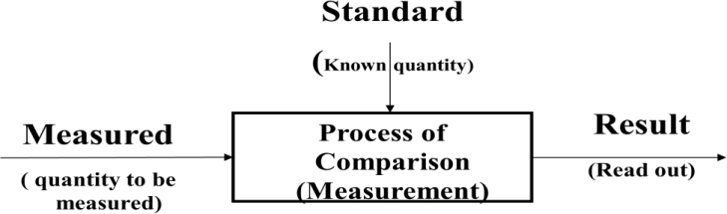
1.2 FUNDAMENTAL MEASURINGPROCESS
In order that the results of measurement are meaningful, the basic requirements are:
The standard used for comparison purposes must be accurately defined and should, be commonly acceptable.
The standard must be of the same character as the measurand (the unknown quantity or the quantity under measurement) and is prescribed and defined by a legal or recognized agency or organization like National Bureau of Standards (NBS) or the International Organization of Standards (ISO), the American National Standards institute(ANSI)
The apparatus used and the method adopted for the purposes of comparison must be provable.
  METHODS OFMEASUREMENTS:
    Direct Methods. The unknown quantity is directly compared against a standard. The result is expressed as a numerical number and a unit. The standard, in fact, is a physical embodiment of a unit.
      Direct methods are quite common for the measurement of physical quantities like length, mass and time.
      As direct measurement involve human factors are less accurate, less sensitive
      The direct methods may not always be possible, feasible and practicable.
      Hence direct methods are not preferred and are less commonly used.
    Indirect Methods:
The value of the physical parameter (measurand) is more generally determined by indirect comparison with secondary standards through calibration.
In direct method of measurement system consists of a transducing element which
converts the quantity to be measured into an analogous signal. The analogous signal is then processed by some intermediate means and is then fed to the end devices which present the results of the measurement.
1

Slide 5
Based upon the complexity of the measurement system the measurements are generally grouped into three categories.
Primary measurements
Secondary measurements
Tertiary measurements.
Primary Measurements. A primary measurement is one that can be made by direct observation without involving any conversion (translation) of the measured quantity into length. In this case, the change in the measured quantity stimulates a set of the observer's nerve endings, so that he can see or sense the change directly. The sought value of a physical parameter is determined by comparing it directly with reference standards.
Typical examples of primary measurements are:
  The matching of two lengths, such as when determining the length of an object with a meter rod,
  The matching of two colors, such as when judging the color of red hot metals.
Secondary Measurements:. The indirect measurements involving one translation are called secondary measurement. Involves only one translation.
Ex: The conversion of pressure into displacement by means of bellows. Conversion of force into displacement by means of spring. Therefore, a secondary measurement requires an instrument which translates pressure changes into length changes, and. A length scale or a standard which is calibrated in length units equivalent to known changes in pressure.
Therefore, in a pressure gauge, the primary signal (pressure) is transmitted to a translator and the secondary signal (length) is transmitted to observer's eye.
1

Slide 6
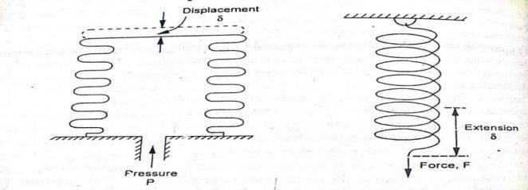
Fig-1: Bellow convert Pressure into displacement
Fig-2: Spring convert Force into displacement
When static pressure (input signal) is applied to bourdon tube, its free end deflects. The deflection which constitutes the secondary signal is very small and needs to be made larger for display and reading. This task is accomplished by arrangement of lever, quadrant, gear and pointer. The amplified displacement constitutes the tertiary signal and it is indicated by the movement of the pointer against graduated scale.
1

Slide 7
  PERFORMANCE CHARACTERISTICS OF AN INSTRUMENT:
Performance characteristics of an instrument are classified as STATIC CHARACTERISTICS
DYNAMIC CHARACTERISTICS
    STATIC CHARACTERISTICS:
The characteristics which describe the performance of measuring instruments when subjected to low frequency inputs or DC inputs are referred to as static characteristics
In some of applications the parameter of interest is more or less constant or varies very slowly with time. Measurement of such applications are called static
measurement
(i)
(ii)
(iii)
(iv)
(v)
(vi)
(vii)
Accuracy Error
Reproducibility
Drift Sensitivity Dead Zone Precision
Linearity
Threshold
Hysteresis
1

Slide 8
Resolution
Stability
Range and Span
Accuracy: Accuracy is de fined as the closeness with which the reading of the instrument approaches true value. The term accuracy describes how close the measurement is to the true measured quantity.
It is defined as ratio of difference between the measured value and true value to the true value.
The accuracy of the measuring system is expressed as Percentage of true value =
[(Measured value – True Value)/True Value]*100
Percentage of full scale deflection = [( Measured value – True Value)/Maximum
Scale value]
Ex- for accuracy: ± 1 % of accuracy of true value would mean that accuracy ± 1̊ C
when reading at 100̊ C and only ±0.25̊ C when reading 25̊ C on the instrument having scale range of 0 -100 ̊ C
Error:
Errors are unavoidable in any instrument system. Attempts can be made to minimize them by suitably designing the system by taking care of all sources of errors. The
accuracy of the instrument is measured in terms of its error.
Static error : is defined as the difference between the best measured value and the true value of the quantity.
Static Error = Measured value – True value
Reproducibility: Reproducibility represents the degree of closeness with
which a given value of a quantity (variable) may be repeatedly measured with in a close range.
Reproducibility is a measure of closeness with which a given input may be measured over and over again.
The reproducibility of an instrument is the ability to produce the same value of output (response) for equal inputs applied over a period of time.
Drift:
It indicates the change in the output of the instrument (transducer ) for a zero input Drift causes the measurement result to vary for given input quantity
Drift can be carefully guarded wit care, prevention, inspection and maintenance.
Sensitivity or static sensitivity :
It is the ratio of magnitude of the output to the magnitude of input signal being
1

Slide 9
measured.
Sensitivity = Change in output signal / Change in input signal
K = qo/qi where K =sensitivity qo = Value of output signal
qi = Value of input signal
Sensitivity can be re presented by slope of the calibration curve or input-output curve
Dead zone: Dead zone (Dead band) can be defined as the largest variation in
the value of input for which the instrument cannot respond and produces no output. Dead zone is the largest change in input quantity for which a noticeable change in the output is observed from zero reading. It may occur due to friction in the
instrument, which does not allow pointer to move till sufficient driving force is
developed to overcome the friction force. Dead zone is caused by back lash and hystereresis in the instrument.
Precision: The ability of the measuring system to reproduce the same output among several independent measurements under specified conditions or within a given accuracy is referred to as precision and is expressed in terms of deviation in measurement.
Let us consider an example in which an input of accurately known value is applied
to the transducer. With this known input if the measuring instrument produces its output which lies between ± 1%, then the precision of the measuring instrument can be ± 1%.
Linearity: Linearity can be defined as the closeness of actual calibration curve of the instrument to he idealized straight line with in a given range of full
scale output.
or
It can be stated as the deviation of output curve of measuring instrument from specified or idealized straight line as shown in figure
Threshold: Threshold of an instrument can be stated as the smallest quantity
of input below which the output will not be detected. It can be specified as percentage of maximum scale deflection or an absolute value in terms of units of input.
Hysteresis:
Hysteresis can be defined as maximum differences in output at any measured value within the specified range when approaching the point with increasing and then decreasing input.
Hysteresis can be noticed when the input/output characteristics for an instrument
10

Slide 10
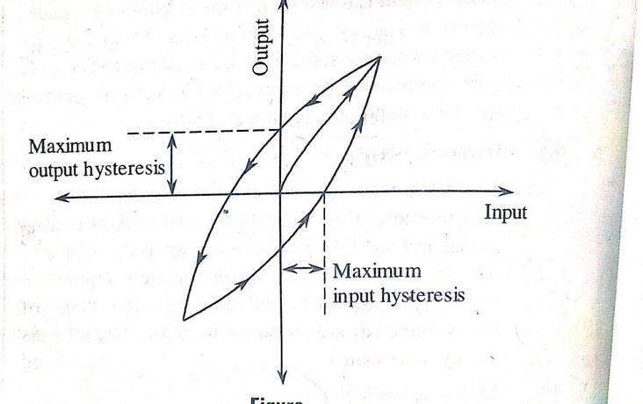
are not the same for the increasing values of inputs than for decreasing values of inputs.
The magnitude of input for a given input depend on the direction of the change in input, whether the input signal is ascending (Loading) or descending(Unloading)
ix) Resolution
Resolution of a measurement can be stated as any smallest increment in the measured variable that can be noticed or detected by that instrument with certainty.
If an instrument has higher resolution, ,then it can distinguish very small changes in the input quantity.
Decreasing value of input
Increasing input value of input
Stability:
It is the ability of the instrument to have the same standard of performance over a prolonged period of time.
The need for calibrating the instrument frequently is less for instrument having high
stability.
Range and Span:
The region between which the instrument is to operate is called range.
Range = Lc to Hc where Lc = Lower calibration value, Hc = higher calibration value Span is the difference between Upper and Lower limits of the instrument.
^{Sol:} Range of the Instrument = 500^{0Cto} 1000⁰c.
10

Slide 11
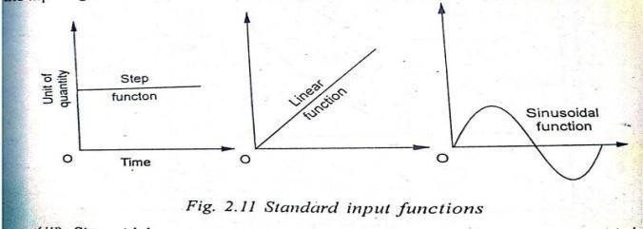
Span : Span is the algebraic difference between the higher calibration value and lower calibration value.
Span of the instrument = _{Hc} - _{Lc} = ₁₀₀₀0_{c - 500}0_{c = 500}0_{c}
  DYNAMIC PERFORMANCE CHARACTERISTICS OFINSTRUMENT
The dynamic characteristics of an instrument are as follows:
    Speed of response
    Measurement Lag
    Fidelity
    Dynamic error
    Dynamic range
    Bandwidth
    Setting time
    Time constant.
The dynamic behavior of an instrument can be determined by applying some form of known and predetermined input to its primary element and study the output ie., movement of pointer)
Generally the behavior is judged for 3 types of inputs.
Step change: In this case the input having changed remains constant.
Linear change: In this case the input changes linearly with time.
Sinusoidal change: In this case the magnitude of the input changes in accordance with a sinusoidal function of constant amplitude
i) Speed of response :
It is the rapidity with which an instrument responds to sudden changes in the measured quantity.
It is the quickness of an instrument with which it responds to sudden changes in amplitude of
the input signal.
Speed of response can also be stated as the total time taken by the system to come closer to steady state condition.
Speed of response of a system can be evaluated by knowing the “measurement Lag” of that system.
10

Slide 12
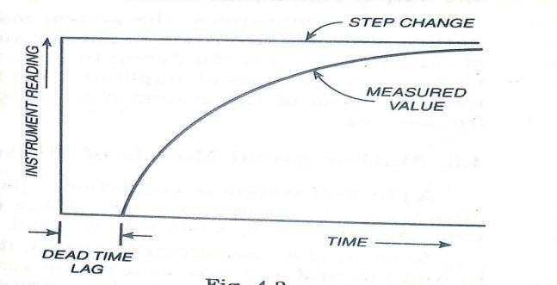
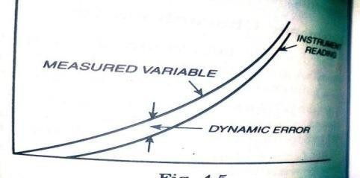
ii) Lag (measurement lag):
It is the retardation or delay in the response of an instrument to changes in the measured quantity. The measuring Lag can be either of the retardation type in
which case ,the response of the instrument begins immediately on change in measured variable or of the time delay type called dead time in which case the response of the instrument is simply shifted along the timescale.
It is the time delay in the response of the input signal to the changes in the input signal.
Fedelity:
It is determined by the fact that how closely the instrument reading follows the measured variable. Ie, It is the degree to which an instrument indicates the changes in measured variable with out dynamic error.
Dynamic error :
It is the difference between the true value of a quantity changing with time ie measured variable and the instrument reading if no static error is assumed.
v) Dynamic range: The range of values of certain quantity ( for example temperature, pressure, voltage,….. etc.) for which the measuring instrument can produce faithful response under dynamic conditions is known as dynamic range of the instrument. Dynamic range is represented as the ratio of the maximum value to minimum value for which the system can respond effectively.
10

Slide 13
Band width:
The range of frequencies with in which the dynamic sensitivity of the system lies
within a specified band ( for example ± 2% band) of static sensitivity of the system is
known as ‘band width’ of the system. The amplitude versus frequency characteristics of a system are flat with in the band width of the system.
Settling time:
The required by the response of the system (after the application of a step input to it), to reach and stay within close range of the steady state output value is known as ‘Settling time’. The settling time depicts the speed of response of the system. If the settling time
is small it can be inferred that the speed of response of the system is high.
Time constant:
Time constant is defined as the time required for the output of the system to reach 63.2% of the final output value.
It is preferred to have a low time constant in order to have high speed of response and Time constant depends on the parameters of the system
  FUNCTIONS OF INSTRUMENTS AND MEASUREMENTSYSTEMS
The three main functions are as shown below:
    Indicating function.
    Recording function.
    Controlling function.
  APPLICATIONS OF MEASUREMENT SYSTEMS.:
The applications of measurement system as follows.
    Monitoring of processes and operations.
    Control of processes and operations.
    Experimental Engineering analysis
10

Slide 14
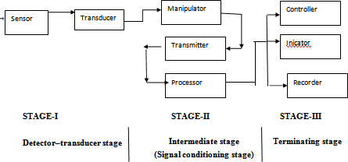
1.9 GENERALIZED MEASUREMENT SYSTEM AND ITS FUNCTONALELEMENTS:
Sensor : The function of sensor element is to sense the measurand ie physical parameter to be measured.
Transducer : the transducer element accepts the output of sensor and converts in to an electrical quantity without changing the actual signal (value of measurand)
Manipulator: Manipulator element is used to manipulate (modify) the output of variable conversion element such that it can be accepted by other element. For example; electrical amplifier which is a manipulator and it amplifies the signal applied to it. It increases its electrical signal of low magnitude to high magnitude signal. It also operates like addition, subtraction, integration, differentiation etc,.
Transmitter (Data Transmission element): the function of this element is to transmit the measured signal from one place to other (ie from the field to control station).
Processor (Data processing element): is an element that modifies the data before it is displayed or finally recorded. Corrections to measured physical variables to compensate for scaling, non-linearity, temperature error. Perform repeated calculations that involve addition, subtraction, multiplication or division. Collect information regarding average, statistical and algorithmic values. Convert the data
10

Slide 15
into useful form (calculation of engine efficiency from speed, power input & torque. Reducing error, generate information for display.
Controller: The controller element controls the parameter to be monitored within the operational limits.
Indicator: the indicating element is to indicate the specific value with an indicating hand over a suitably calibrated scale.
Recorder: this element produces a written continuous record of measurand with respect to time.
1.10 THE STAGES (PHASES) OF GENERALIZED MEASUREMENTSYSTEM
The most measurement system fall within the frame work of a general arrangement consists of three phases or stages.
Stage-I : A detector –transducer stage ( sensor stage) Stage-II : An intermediate stage (signal conditioning stage). Stage-III : A terminating or Read out stage:
Auxiliary power source
Basic detector Transducer Element
Intermediate modifying systems
Terminating Device
Input Signal
Each stage consists of distinct components that form required and definite steps in the measurement.
Stage-1: A detector-transducer stage or sensor stage: The prime function of the first stage is to detect or to sense the measurand. At the same time , ideally it should be insensitive to every other possible input. It detects the physical variable (input) and performs either a mechanical or an electrical transformation to convert the signal into a more usable form.
Stage-2 : An intermediate stage (Signal conditioning stage) : The purpose of second stage is to modify the transduced information, so that it is acceptable to the third or terminating stage. In addition it may perform one or more basic operations such as selective filtering, integration, differentiating, or telemetering as may be required. The common function of 2nd stage is to
10

Slide 16
increase either amplitude or power of signal or both, to the level required to drive the final terminating stage. It must be designed for proper matching characteristics between first and second and between second and third stages.
Stage-3: A ﬁnal or terminating stage: The stage provides the information sought in a form comprehensible to one of the human senses or to a controller. The output is presented as in one of the following form. As a relative displacement such as movement of indicating hand, displacement of oscilloscope trace or oscillograph light beam / in digital form as presented by a counter, or digital meters ( volt meter, automobile odometer) digital or analog.
Sensor transducer
Piston/ or cylinder (Pressure to Force) | Spring (Force to Displacement)
Read out (scale )
& index)
Input (Pressure)
Fig: Block diagram of tire gauge functions
In this example the spring serves as secondary transducer. It consists of a cylinder and piston, a spring resisting piston movement, and stem with scale divisions. - As air pressure bears against the piston, the resulting force compresses the spring until spring & air forces balance. The calibrated system which remains in place after the spring returns the piston indicates the applied pressure. The piston-cylinder combination constitutes a force summing apparatus, sensing and transducing pressure to force. As a secondary transducer, the spring converts the force to a displacement. Finally the transduced input is transferred without signal conditioning to the scale & index for readout
10

Slide 17
Example-2: Measurement of velocity for a input signal of Acceleration
Sensor detector stage STAGE-I
Intermediate (modifying stage ) STAGE-II
Terminating
stage STAGE-III
Accelerometer
Filter
Integration Circuit
Amplifier
Oscillo-graph
Voltage output of accelerometer
with unwanted noise
Increased power to drive oscillograph
Signal with removed
Time
noiseintegrated voltage analogous to velocity
10

Slide 18
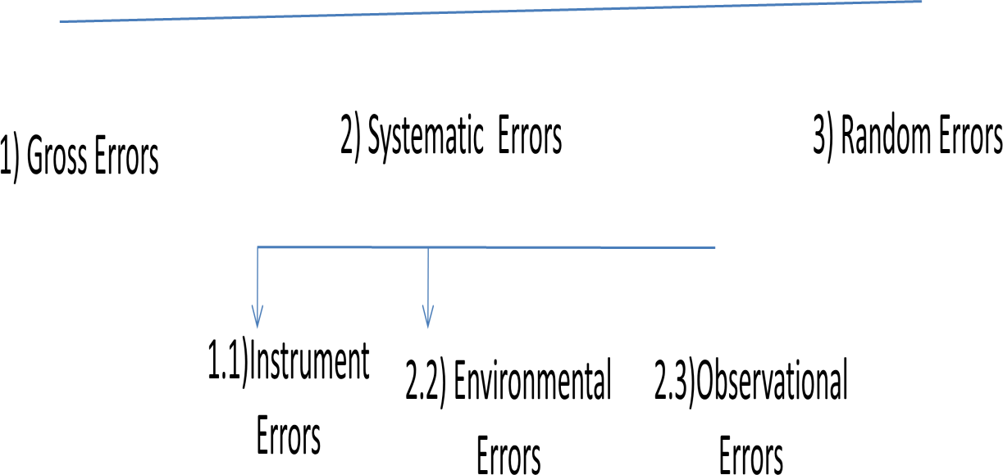
1.10 ERROR, TYPES OF ERRORS, CAUSES, REMEDIALMEASURES ERROR:
Error = Reading of standard value – measured value
The accuracy and precision of an instrument depends upon its design, the material
used and workmanship that goes into making the instrument. The choice of an instrument for a particular application depends upon the accuracy desired. If only a fair degree of accuracy is desired, it is not economical to use expensive meter and skill for the manufacture of the instruments. But an instrument used for an application requiring a high degree of accuracy has to use expensive and a highly skilled workmanship
No measurement can be made with perfect accuracy, but it is important to find out what accuracy actually is and how different errors entered into the measurement. Errors may arise from different sources and are usually classified as under.
ERRORS
1) GROSS ERRORS:
This class of errors mainly covers human mistakes in reading instrument
recording and calculating measurement results. The responsibility of the mistake normally lies with the experimenter.
18

Slide 19
CAUSES FOR GROSS ERRORS
The experimenter
may grossly misread the scale, for example due to an over sight, he may read
the temperature as 31.5⁰C while the actual reading may be21.5⁰C
He may transpose the reading while recording.
For example , he may read 25.8⁰C and record 28.5⁰C instead.
As long as human beings are involved, some gross errors will definitely be committed.
Although complete elimination of gross errors is probably impossible, one should try to anticipate and correct them.
MEANS OF AVOIDING GROSS ERRORS:
Great care should be taken in reading and recording the data.
Two, three or even more readings should be taken for quantity under measurement.
These readings should taken preferably by different experimenters and the
reading should be taken at a different reading point to avoid re-reading with same error.
SYSTEMATIC ERRORS:
Systematic errors are those which are repeated consistently with repetition of the experiment. The systematic errors are as follows
  Instrument Errors
  Environmental errors
  Observational errors
  Instrument errors:
These errors arise due to three main reasons.
    Due to inherent shortcomings in the instruments ii Due to misuse of the instruments:
iii.Due to loading effects of instruments:
Due to inherent shortcomings in the instruments:
  These errors are inherent in instruments because of their mechanical structure. They may be due to construction, operation of instruments
These errors may cause the instrument to read too low or too high. For
example: if the spring of a permanent magnet instrument has become weak, the instrument will always read high. Errors may be caused because of friction, hysteresis or even gear back lash.
18

Slide 20
Elimination & reduction
The procedure of measurements must be carefully planned.
Correction factors should be applied instrumental errors.
The instrument may be re-calibrated carefully.
after determining the
Misuse of instruments:
Too often the errors caused in measurements are due to the fault of the operator that of the instrument. Using good instruments in an
unintelligent way may give erroneous results.
Example: Failure to adjust the zero of instruments, poor initial adjustments, using a leads of too high a resistance etc.
Using the instrument contrary to manufacturer’s instructions and specifications ( over loading, over heating may ultimately result in failure
of the instrument).
Eliminate & reducing error:
Ensuring above instructions carefully while usage of instruments it possible to eliminate or reduce errors
Due to loading effects of instruments:
One of the most common errors committed by beginners is the improper use of an instrument for measurement work.
For example, a well calibrated voltmeter may give misleading voltage
reading when connected across a high resistance circuit. The same voltmeter when connected in a low resistance circuit may give a more dependable reading. Therefore errors caused by loading effects of the meters can be avoided by using them intelligently.
Eliminate & reducing error:
In planning any instrument, the loading effects of instrument should be considered and corrections for these effects should be made.
18

Slide 21
  ENVIRONMENTAL ERRORS:
These errors are due to conditions external to the measuring device including conditions in the area surrounding the instrument.
These may be effects of temperature, pressure, humidity, dust, vibrations, and external magnetic or electronic fields.
Corrective measures to eliminate & reducing error:
    Arrangement should be made to keep the conditions as nearly as constant as possible. Ex: temperature can be kept constant by keeping the instrument in temperature controlled enclosure.
    Using equipment which is immune to these effects. For ex: variations in resistance with temperature can be minimized by using resistance materials which have very low resistance temperature coefficient.
    Employing techniques which eliminate the effect of these disturbance.
    Ex: effect of humidity, dust etc. can be entirely eliminated by hermetically sealing equipment.
    In case it is suspected that external magnetic or electro static fields can affect the readings of the instruments, magnetic or electrostatic shields may be provided.
    Applying the computed corrections.
  OBSERVATIONAL ERRORS
There are many sources of observational error.
For an example: the pointer of a voltmeter slightly above the surface of the scale. Thus an error on account of parallax will be incurred unless the line of vision of the observer is exactly above the pointer. To minimize parallax errors, highly accurate meters are provided with mirror scales.
Eliminate & reducing error:
    Using the meters provided with mirror scales.
    Using instruments having digital display of output
  RANDOMERRORS
    Random errors are those which are accidental and whose magnitude and sign cannot be predicted from a knowledge of measuring system & conditions of measurement.
    It has been consistently found that experimental results show variation from one reading to another, even after all systematic errors have been
accounted for. These errors are due to a multitude of small factors which change or fluctuate from one measurement to another and are due surely to
18

Slide 22
chance. We are aware of and account for some of the factors influencing the measurement, but about the rest lie are unaware.
The happenings or disturbances about which we are unaware are lumped to get her and called Random or Residual error.
112 SOURSES OF ERRORS ( factors contributing for uncertainty of measurement)
Noise: it is defined as any signal that does not convey useful information. The noise or signal disturbances contribute to the uncertainty of measurement.
Noise may originate either at the primary sensing device
In a communication channel.
In the indicating element of the system.
Noise can be reduced to a maximum level through filtering, careful selection of components, shielding and isolation of the entire measuring system.
Response time: measuring system cannot immediately indicate the input signal applied to it. This factor contributes to uncertainty. ( mercury thermometer)
Design limitations: In the design of instruments there are certain inevitable factors which lead to uncertainty of measurement.
Effects of friction in the instrument movement:
Effect of resolving power: the ability of observer to distinguish between nearly equal divisions.
Energy exchanged by interaction : when ever energy required for
operating the measuring system is extracted from the measurand, the value of latter is altered to a greater or lesser extent.
Transmission: In the transmission of information from primary sensing element to Indicator.
Deterioration of measuring system: it is due to physical or chemical deterioration or other alterations in characteristics measuring elements.
Ambient influences on measuring system:
The changes in atmospheric temperature may alter the elastic constant of a spring, changes in resistance. Other factors like humidity, pressure.
x) Errors of observation and interpretation: mistakes in observing, interpreting recording the data.(Parallax errors,
p
18

Slide 23
1.13 DESIRED, MODIFYING AND INTERFERING INPUTS FOR A MEASUREMENT SYSTEM or (GENERAL INPUT-OUTPUT CONFIGURATION OF MEASUREMENTSYSTEM)
The general configuration of measuring instruments has three types of inputs. They are
Desired inputs
Interfering inputs iii Modifying inputs
Desired inputs:
The input quantities for which the measurement system is designed to measurand produce output are known as desired inputs.
If the transfer function of the system is G and the applied input is ‘r’ the Output will
be C= G.r
Let the desired input is represented as rD
According to the input-output relationship of mathematical model, the output (CD) produced due to the desired input rD is given as
CD= GD . rD where GD = Transfer function
i.e., it is a mathematical operation required to get the output from desired input.
From this we can understand that the transfer function is a constant, and it will be multiplied with input rD to produce output
CD= GD. rD.
it is because to get an amplified output in linear systems.
In non-linear systems , the transfer function will be represented by using algebraic or transcendental function.
If the inputs applied to the system are dynamic in nature, then its input-output relationship will be represented by differential function.
Interfering Inputs:
Interfering input quantities are those which make the measurement system or instrument unintentionally sensitive. The measurement system or instruments respond to the interfering inputs and produces an output through they are not desired to respond. This occurs because of its design, operating principle and some other factors like environments in which they are placed.
The interfering input is represented by rI and transfer function is GI is similar to producing output using desired input rD and transfer function GD
18

Slide 24
Modifying inputs:
The inputs which causes a change in the input-output relationship of a measurement system for both desired and interfering inputs or any one of the inputs alone.
Modifying input is represented by rM which modifies both GD GI or any one of these ( ie GD or GI)
The manner in which rM affects GD is represented by GMD And the manner in which rM affects GI is represented by GMI
The interpretation of these GMD and GMI is same as GD and Gr
The instantaneous output due to desired, modifying and interfering inputs is given to summer or summing point which produces the sum of the instantaneous values. The measurement system or instrument produces several output, if it is subjected to several inputs of each of these three types.
Output: It is the final response ( or result of measuring process).
Example-1. Differential pressure measurement of a gas using U-tube manometer. From the figure, we know that
P1, P2 are input pressures applied at the two ends of the monometer The differential pressure of manometer is explained as
Pdiff = P1 – P2 = ( ƿm - ƿf ) gh Where g = gravitational constant H= scale reading
ƿm = density of mercury ƿf = density of gas as the density of gas is very small
compared to the density of the mercury, ƿf can be neglected therefore Pdiff = P1 – P2
= ƿm gh
when the both pressures are equal ie P1 = P2 Then Pdiff= P1 – P2 = P1-P1 = 0
In this case the mercury levels in the two limbs of the manometer become equal and hence the scale reading ‘h’ will be zero.
In some cases, the scale readings does equal to zero, though both pressures are equal.
This is due to
  the improper position or angle of tilt of manometer
  The presence of acceleration , vibrations near the manometers
Any variation in the atmospheric conditions such as ambient temperature causes change in the length of the calibrated scale and also density of mercury. Due to this the proportionality factor relating the pressures and scale reading may gets modified or changed in this example.
18

Slide 25
Desired inputs are input pressures P1 andP2
Modifying inputs are ambient temperature , gravitational force.
Interfering inputs are Improper position or angle of tilt of manometer, the presence of acceleration, vibrations near the manometers
Output is scale reading ‘h’.
Example-2. Measurement of Strain using strain gauge- wheatstone bridge arrangement.
A strain gauge mounted on a cantilever beam is connected in one of the four arms of the wheatstone bridge. The other three arms of the bridge contains a resistor of same resistance
values (ie R2 = R3 = R4 = R )
When no strain is applied, the resistance of the strain gauge R1 – R and the bridge becomes balanced and hence, no voltage is produced at the output.
When force or strain is applied to the cantilever beam, the strain gauge element senses the strain due to which the length and hence, the resistance of the gauge changes.
When the resistance of gauge changes, the balanced condition of the bridge is disturbed.
( ie the bridge becomes unbalanced) and voltage is produced at its output. The resistance of the gauge element changes and voltage is generated at the output even though no force is applied to the cantilever. This is due to following
  Change in temperature of environment in which strain gauge is located.
  Electromagnetic field of 50HZ frequency of near by circuits or power lines.
The voltage supplied to the bridge circuit through a battery modifies proportionality factor relating the force and voltage or temperature and voltage.
    Desired input is force
    Modifying input is battery voltage (ei)
    Interfering inputs are Change in temperature of environment n which strain gauge is located. Electromagnetic fields of 50HZ frequency of nearby circuits or power lines.
1.14 CLASSIFICATION / TYPES OF MEASURING INSTRUMENTS:
Measuring instruments are classified as follows
Mechanical instruments
Electrical instruments
Electronic Instruments
Deflection and null type instruments
Analog and digital type instruments
18

Slide 26
Self generating and power operated instruments
Automatic and manually operated instruments
Contacting and non-contacting instruments
Remote indicating measuring instruments
Intelligent indicating measuring instruments
Mechanical instruments: Ex- Screw gauge
  simple in construction
  do not require external power
  Do not respond quickly to dynamic and transient conditions.
  Causes noise pollution.
  Do not give accurate results.
Electrical instruments: Example – Ammeters, voltmeters
The output indicated by these is quick in comparison to mechanical instruments
For indicating records, mechanical devises are used.
Electronic Instruments: Example- Cathode ray Oscilloscope
  These instruments respond quickly to dynamic and transient conditions.
  Light in weight Very compact
  Consume less power
  High sensitivity and flexibility
  Remote indication is possible
Deflection and null type instruments:
Deflection type instruments: example- Spring balance
Measured quantity generates an effect that is ultimately related by the deflection of a pointer. Null type instruments: Example- Beam balance
In null type instruments, the physical effect caused by the quantity being
measured is nullified deflection maintained at zero) by generating an equivalent opposing effect.
Analog and digital instruments:
Analog instruments: The signals of an analog unit vary in a continuous fashion and can take an infinite number of values in a given range.
Ex- Wrist watch, ammeters, volt meters
Digital instruments: example:- Digital voltmeters, digital Ammeters
A signal is said to be digital if it changes in a discrete manner it takes finite number of values in any specified range.
Self generating and power operated instruments:
18

Slide 27
Self generating instruments: Example: The motive power in mercury- in-glass thermometer. The output energy is supplied entirely by the input signal. It Do not require any external power source .Energy is met from input signal.
Power operated instrument: Example: multimeter
It require external power source such as compressed air, hydraulic supply etc. for their operation
Contacting and non-contacting instruments:
Contacting instruments: Example; Thermometer, thermocouple instrument comes in contact with measured medium.
Non-contacting instruments: ex: optical pyrometers for
temperature measurement. The instrument does not come in contact with medium.
Intelligent instruments: A microprocessor will be present along with basic element. It will enable pre-programmed signal processing and application of data-manipulation algorithms to the measured variable.
1.15 ZERO ORDER, FIRST-ORDER and SECOND-ORDERSYSTEMS: Consider an ideal measuring system ie a system whose output is directly proportional to input, no matter how the input varies.
The output is a faithful reproduction of input without any
distortion or time lag. The mathematical equation relating output to input is of form
Qo = KQi or where Qo = output
Qi = input
K= sensitivity of the system.
This equation of the Zero-order system is obtained when the power of ‘n’ is set equal to zero in the general equation for measurement system.
That gives : Ao Qo = Bo Qi
ϴo =
𝐁𝐨
𝐀𝐨
ϴi=
K ϴi Type equation here.
18

Slide 28
The static sensitivity is the ony parameter which characterizes a zero-order system and its value can be obtained through the process of static calibration.
A block diagram representation of Zero-order system is as follows:
ϴi
K
ϴo
Examples of Zero-order system are
Mechanical levers
Amplifiers
Potentiometer which gives an output voltage portioned to the displacement of wiper
1.16 CALIBRATION & CALIBRATIONPROCEDURE
CALIBRATION: A known input is given to the measurement systems and output is noted. If the system output deviates with respect to the given known input, corrections are made in the instrument so that the output matches the input. This process is called as calibration.
PROCEDURE OF CALIBRATION:
To calibrate an instrument initially adjust the instrument such that it produces null output when no input is applied.
Then apply an accurately known value of measurand and adjust the instrument again until its scale exactly indicates the value of measurand. This process of adjusting the instrument is called calibration.
The graphical representation of calibration record is called calibration curve. This curve relates standard values of input to the actual values of output throughout the operating range of the instrument.
CALIBRATION METHODS:
The calibration methods of instruments are as follows:.
Primary calibration: System is calibrated against a primary standard.
Example: While calibrating a flow meter, if the flow is determined by measuring the time and volume or mass of fluid, then it is called primary calibration.
Secondary calibration: A device that has been calibrated by primary calibration is used as a secondary standard for further calibration of other devices of lesser
accuracy.

Slide 29
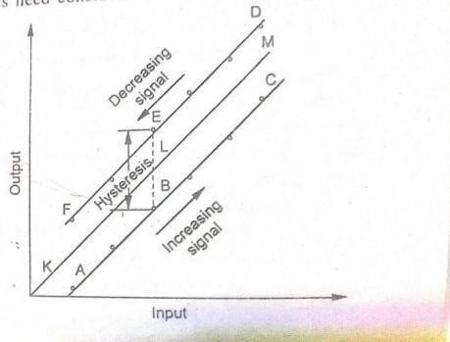
POINTS TO BE CONSIDERED WHILE CALIBRATING AN INSTRUMENT:
Calibration of the instrument is carried out in the same position (upright or horizontal) and subjected to the same temperature and other environmental conditions under which it is to operate while in service.
The instruments calibrated with values of measurand impressed both in the increasing and in the decreasing order.
The results are then expressed graphically output is plotted as ordinate and input as the abscissa.
.

Slide 30
At the end of the course students are able to :
Course Outcomes |  | Knowledge Level (Bloom’s Taxonomy)
CO 3 | Categorize the measuring instruments based on the principle of working with the physical parameters such as displacement, temperature and pressure. | Understand
CO 4 | Explain calibration of instruments for measurement of all types of mechanical parameters. | Understand
Program Outcomes (POs) |  | Strength | Proficiency Assessed by
PO 1 | Engineering knowledge: Apply the knowledge of mathematics, science, engineering fundamentals, and an engineering specialization to the solution of complex engineering problems. | 3 | CIE / Quiz / AAT
PO 2 | Problem analysis: Identify, formulate, review research literature, and analyze complex engineering problems reaching substantiated conclusions using first principles of mathematics, natural sciences, and engineering sciences | 3 | CIE / Quiz / AAT

Slide 31
UNIT-II
MEASUREMENT OF DISPLACEMENT
SYLLABUS: Theory and construction of various transducers to measure displacement. Piezo electric transducer, Inductive transducer, Capacitance transducer, Resistance transducer, Ionization transducer, Photo Electric transducer, Calibration procedure
  TRANSDUCER:
A transducer is a device which senses the physical variable to be measured and converts into a suitable signal ( voltage or current)
A device to convert the quantity or phenomenon to be measured into a voltage or current,
which can be observed on an oscilloscope, read on a meter or recorded on a chart Ex: - Pressure transducer: Pressure gauge
Temperature transducers ie RTD, Thermistor, Thermocouple, pyrometer
Displacement transducers: 1) Variable resistance transducer, 2)LVDT 3)Capacitive, 4) variable Reluctance displacement transducer, 5) Piezo electrictransducer, 6) Hall effect displacement transducer, 7) photoelectric transducer, 8)Ionization transducer, 9)LDR
  FACTORS ON WHICH TRASDUCER SELECTION DEPEND
    Fundamental parameters : These include
      Type of measurand (input)
      Range of measurement
      Required precision , which include
      Allowable non-linearity effects
      Allowable dead-zone effects
      Frequency response
      Resolution
    Environment:
This includes conditions of
      Ambient temperature
      Corrosive or non-corrosive atmosphere
      What shock and vibration to withstand
    Physical conditions: These are
      Room or available space to mount the transducer.
      Whether the measurement is static or dynamic.
      How much energy can be extracted from the input to do measurement without much loading.
    Compatibility with next stage:
Transducer should be so chosen so as to meet the requirements of next stage.
      Impedance matching.
      Excitation voltage matching.

Slide 32
c) Sensitivity tolerance matching.
General requirements:
  Ruggedness to withstand overloads
  Linearity
  Repeatability
  Stability and reliability
  Good dynamic response
  Convenient instrumentation.
  CLASSIFICATION OF TRANSDUCERS
Transducers are classified as follows:
    Active and passive transducer and Passive transducer.
1a. Active Transducer:
The transducers which do not require any external excitation energy to provide their output are known as active transducer.
Example: Piezo electric transducer, Photo voltaic cell, Thermocouple,
Moving coil generator
1b. Passive transducer:
The transducers which require external excitation energy to provide their output are known as passive transducers.
Examples: - Resistance transducer
Capacitive transducer Inductive transducer
Hall-effect transducer
Photo emissive cell (Photo electric type transducer)
On the basis of transduction principle used:
The input variable to the transducer is being converted into resistance, capacitance or
Inductance value.
2a) Resistive transducers:
Resistance thermometer, Potentiometer device, Resistance strain gauge, Thermistor , Photo conductive cell
2b) Capacitive transducers: Dielectric gauge, capacitor microphone, Variable capacitance pressure gauge
2c) Inductive transducers: Differential transformer type transducer (LVDT, RVDT), Reluctance type transducer.
Primary and secondary transducers:
3a) Primary transducer:
It is the first element in a measurement system and it senses the physical parameters (like
32

Slide 33
temperature, pressure, displacement, force etc.) and converts them into a mechanical parameter (usually displacement)
These are mechanical type and electrical type
Ex: -pressure sensing elements (diaphragm, bellows, and bourdon tube)
Solid rod expansion thermometers (Bimetallic strip).The cylindrical column of a load cell which converts displacement in to strain
3b) Secondary transducer:
A transducer which is used as the second element of a measurement system, to convert the mechanical output of primary transducer into an electrical quantity is known as secondary transducer. Generally these are electrical type transducers.
Example: -strain gauge, LVDT (Linear variable differential transformer).
4. Analog and Digital transducers:
4a) Analog transducer: It is a transducer which produces an output in analog form or a form which is a continuous function of time. .
Example: -Thermistor , Thermocouple, Strain gauge, LVDT
4b) Digital transducer: It is a transducer which produces an output in digital form or in the form of pulses.
Example: Turbine flow meter.
5) Transducers and Inverse Transducers:
5a) Transducer (Input transducers): a measuring device which measures and converts
non- electrical quantity into electrical quantity is known as transducer. Such transducers are usually used in the input stage of a system and hence they are also known as input transducers Example:
Thermocouple Potentio meter
LVDT
Moving coil generator
5b) Inverse Transducer (output transducers): A measuring device which measures and
converts an electrical quantity into non-electrical quantity is known as inverse transducer. Such transducers are usually placed at the output stage of a measurement system and hence they are also known as output transducers. Inverse transducers are used in feedback measuring systems like servo-mechanism etc.
Example: - Piezo electrical crystal, Data indicating and recording instruments ( Analog ammeter, Volt meter, pen recorders etc.)
2.3 ELECTRICAL TRANSDUCERS FOR LINEAR DISPLACEMENTMEASUREMENT
1a) Variable resistance transducer ( Potentio meter)

Slide 34
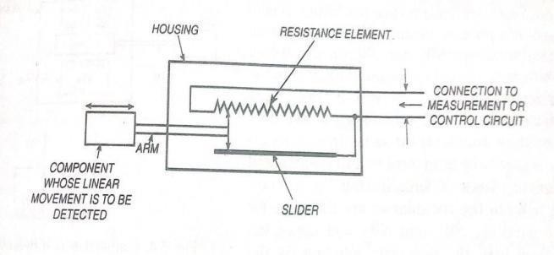
2a) Variable inductance transducer – LVDT (Linear Variable Differential Transducer) 3a) Variable reluctance displacement transducer.
4a) Linear Variable capacitance transducer
Piezo electric transducer
Light dependent Resistance(LDR)
Ionization transducer
2.4 ELECTRICAL TRANSDUCERS FOR ANGULAR DISPLACEMENTMEASUREMENT
1b) Angular potentiometric displacement transducer
2b) Variable inductance transducer-RVDT ( Rotary variable differential Transformer) 3b) Angular variable capacitance transducer
4) Hall-effect angular displacement transducer
2.3.1a) VARIABLE RESISTANCE TRANSDUCER (potentiometer)
Resistance of an electrical conductor varies according to the relation R=ƿL/A
where R = resistance in ohms
L = Length of the conductor
A = Cross sectional area of the conductor Ƿ = the resistivity of material in ohm cm
This device is a variable resistor whose resistance is varied by movement of a slider over its resistance element. The slider is connected to an arm which is moved by the component whose linear motion is to be sensed. The schematic arrangement is shown in fig below. When the component moves to the right, the resistance of the potentiometer is increased and the amount of
increase is a function of the amount of linear motion of the component. The direction of the movement of component is indicated by whether the resistance is increasing or decreasing. The resistance can be measured by employing a Wheatstone bridge circuit.

Slide 35
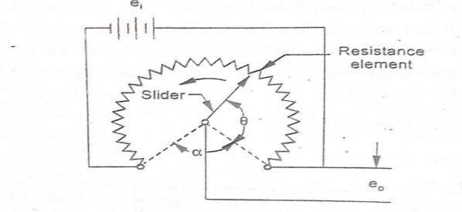
2.3.1 b) ANGULAR POTENTIOMETRIC DISPLACEMENT TRANSDUCER
Resistance of an electrical conductor varies where R = resistance in ohms
L = Length of the conductor
according to the relation R= ƿL /A
A = Cross sectional area of the conductor Ƿ = the resistivity of material in ohm cm
It resembles the linear motion potentiometer, except that the resistance element is circular instead of straight. The slider is mounted upon a shaft and as this shaft is rotated, the slider moves over the resistance element, cutting off a part of total resistance. The rotating component whose angular motion is to be sensed is coupled to this shaft. Thus the resistance of the potentiometer changes in proportion to the angular motion of the rotating component and the direction of rotation is determined by whether the resistance is increasing or decreasing. Generally this type of sensor is suitable only for angular motion not exceeding about 300 degrees.
2.3.2 a) VARIABLE INDUCTANCE TRANSDUCER (Example: Linear variable Differential Transformer–LVDT)
LVDT is one of the most useful of the variable inductance transducer which is as shown in figure. The device converts linear motion to a voltage signal. It consists of a primary winding (PW) and two identical secondary windings (SW1, SW2) and a soft iron core which is connected by means of an arm to the moving component and moves with it.The core is so positioned that normally, the voltage output from each secondary winding is the same. The secondary windings are symmetrically placed, are identical and are connected in phase opposition so that the emf induced in them is opposite to each other.

Slide 36
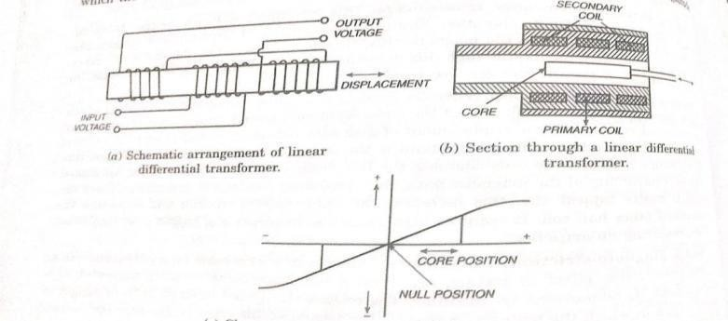
When the core is placed centrally, equal but opposite emf are induced in the secondary windings and zero output is recorded. This is termed as the balanced point or null position. A variation in the position of the core from its null position produces an unbalance in the resistance of the secondary windings to the primary windings, thus upon displacement of the core, the result will be a voltage rise in one secondary and a decrease in the other. The asymmetry in the core position thus produces a differential voltage ( Eo ) which varies linearly with change in the core position. Within the range limits on either side of the null position core displacement results in proportional output.
MERITS OF LVDT:
It produces linear output voltage
It can measure displacement of very high range from 1.25 mm to250mm
It has high sensitivity
Since it produces high output. it does not require amplification device.
It is simple and rugged in construction, ie it can with stand high degree of shock and vibration.
It has no sliding contacts,. Therefore there is no Problem of friction.
It has low hysteresis
It consumes less power (about <1w)
DEMERITS OF LVDT
  It is sensitive to stray magnetic fields.
  The performance of LVDT is affected by variations in temperature.
  It has limited dynamic response.
  To provide high differential output, it requires large displacements.
  It provides AC output. Therefore it requires a demodulator circuit.

Slide 37
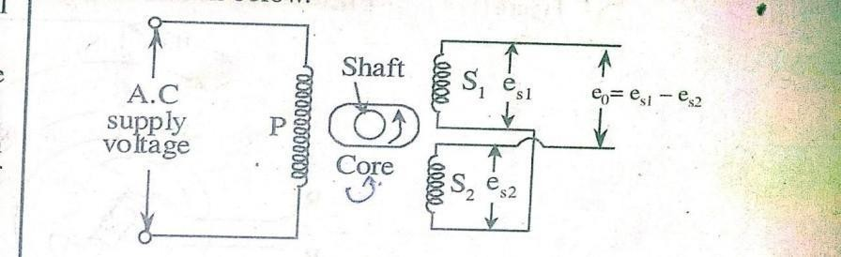
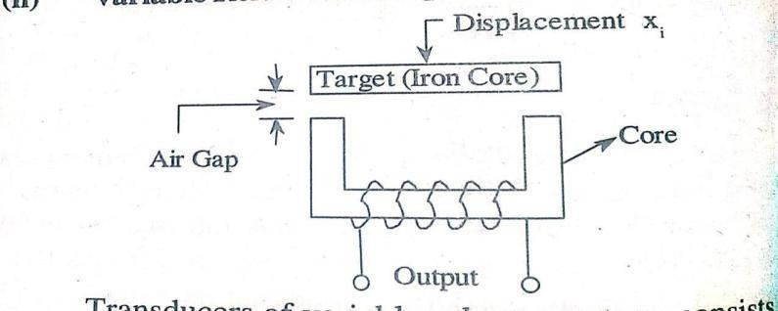
2.4.2b) ROTARY VARIABLE DIFFERENTIAL TRANSFORMER
This is similar to the LVDT, except that its core is cam shaped and may be rotated between the windings by means of a shaft coupled to the rotating component. The circuit is as shown in figure and its working is similar to that of LVDT.
At the null position of the core, the voltage output from the two windings SW1 and SW2 are equal through opposite in phase. Hence in that position, the net output is zero. Any rotary displacement from this null position results in a differential voltage output. Greater is the rotary displacement, the larger will be the differential voltage output.
2.3.3 VARIABLE RELUCTANCE DISPLACEMENT TRANSDUCER:
Inductance or self inductance: when a varying current is made to pass through a coil, an induced counter emf results due to magnetic flux intersecting the turns of the coil. This effect causes resistance to flow of current and it is called inductance or self–inductance.
Mutual inductance: The term refers to the set up of an emf in a coil or in a circuit element due to varying flux in neighboring coil or circuit element.
Inductance: The term refers to that characteristic of a magnetic circuit which determines the total
magnetic flux when a given magneto motive force is applied. Reciprocal of reluctance is termed as permeance.

Slide 38
Permeability: It is defined as the ratio of the flux lines set up in a coil under given conditions to the number of magnetic flux lines that would occur if the path were air ( other conditions remaining unchanged)
WORKING OF VARIABLE RELUCTANCE DISPLACEMENTTRANSDUCER:
Figure shows the variable reluctance transducer in which the variable air gap serves to alter the inductance of a single coil.The change in inductance may be calibrated in terms of the armature
movement. The variable reluctance principle is particularly applicable to the measurement of displacement and angular position.
The self inductance of coil is given by L = N² / ( Ri +Rg ) ---------------- eqn-1 Ri = reluctance of iron parts.
Rg = reluctance of air gap
As Ri <<Rg, L = N²/Rg
Ri =0
------- Eqn-2
--------- Eqn -2
L = N² / Rg
But the reluctance of air gap is given by Rg = lg / (A g ..uo)
where lg = length of air gap Ag = area of flux path
uo =permeability
As u0 and Ag are constants Rg ἀ lg
L ἀ 1/lg
ie., the self inductance of a coil is inversely proportional to the length of the air gap.
When the target is near the core, lg is small and hence ‘L’ is large.
Since, it is the displacement which changes the length of area, the variation in the self inductance is a function of displacement as
lg ἀ xi
L ἀ 1/ xi therefore the input, output relation is non-linear.
2.3.4) TRANSDUCER FOR MEASUREMENT OF LINEAR DISPLACEMENT Capacitive transducer operates on the principle of capacitance of a parallel plate capacitor which is given by
C = є. A/d where C = Capacitance of a capacitor in Farads) є = єrєo
є = Permittivity of medium ( F/m)
єr = Relative permittivity (dielectric constant)
єo= Permittivity of free space ( 8.54*10⁻¹²
F/m )

Slide 39
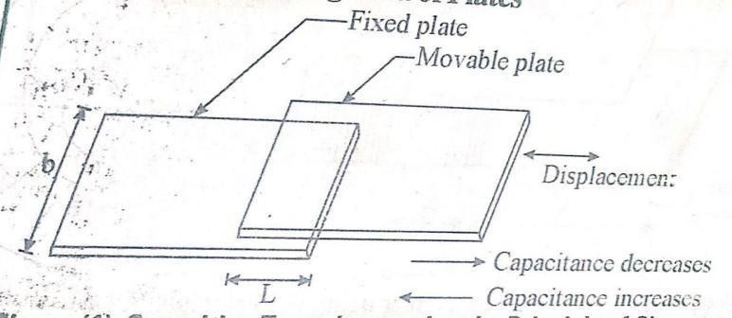
d = Distance between two plates (m² The capacitance of a capacitor varies when
the over lapping area (A) of the plates changes.
The distance between two plates (d)changes
The dielectric constant (єr )changes
)
2.3.4a) CAPACITIVE TRANSDUCER USING THE EFFECT OF VARIATION OF OVERLAPPING AREA OF PLATES.
C = є. A/d ------ equation-1
From the equation-1, it is clear that the capacitance e of the capacitor is directly proportional to the overlapping area of plates.
The area linearly Varies with the applied displacement. Therefore the capacitive transducer
using this principle is used to measure the linear displacements o about 1mm to 10 mm.
From the equation-1 , the capacitance of parallel plate capacitor is
C = є.A/d = є . L*b/d ,
l = length of overlapping area of plates, b= width of overlapping area of plates.

Slide 40
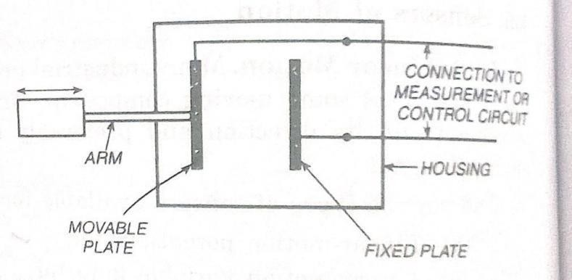
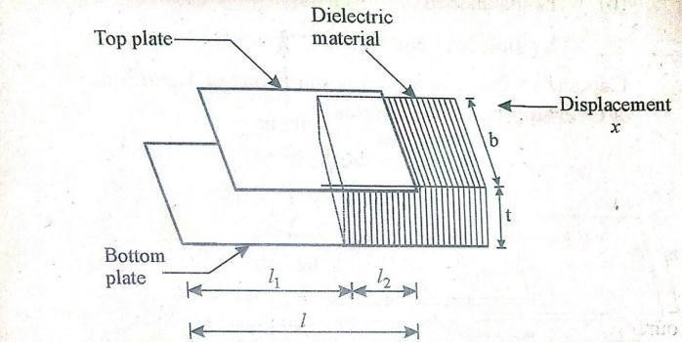
2.3.4b) CAPACITIVE TRANSDUCER USING THE EFFECT OF VARIATION OF DISTANCE BETWEEN PLTES.
The capacitor operates on the principle of variation of capacitance due to variation in distance between plates. Among two plates one is fixed and the other is movable . From the equation- 1, it is clear that the capacitance of the two plate capacitor is inversely proportional to the distance between the plates.
When the movable plate moves towards the fixed plate or moves away from the fixed plate w.r.t applied displacement, the distance between the plates and hence capacitance changes. In this case the response is non-linear; hence it is used to measure only small displacements.
2.3.4c) CAPACITIVE TRANSDUCER USING THE EFFECT OF VARIATION OF DIELECTRIC CONSTANT
The capacitive transducer working on the principle of change in capacitance due to
variation of dielectric constant w.r.t linear displacement is shown in figure.

Slide 41
The capacitive transducer working on the principle of change in capacitance due to variation of dielectric constant w.r.t linear displacement is shown in figure. it contains two fixed plates . A dielectric material with relative permittivity єr moves between two plates w.r.t applied displacement.
At initial condition the capacitance of the transducer is C = єo bL1 /t + єo єr bL2 / t = єo b( bL1 + єr L2) /t
C= єo b ( L1 + єr L2 )
When the dielectric material moves towards left by displacement x, the capacitance varies from C to C + ΔC.
When the dielectric material moves towards left by x,
it changes L1 = L1 -x and L2 = l2 єo єr b( l2 + x ) /t
+ x C+ΔC = - x) /t +
C+ΔC =
єo b(l1
єo b [l1 - x + єr ( l2 + x )] /t
C+ΔC = єo b [l1 - x + єr ( l2 + x )] /t
- 1) /
= єo b [l1 + єrl2)/t + єo bx [ єr
t C+ΔC = C
ΔC = єo bx [ єr - 1) /t
+ єo bx [ єr - 1) /t
The variation in capacitance is ΔC = єo bx [ єr - 1) / ΔC ἀ x The variation in the directly proportional to applied displacement.
2.4.3b)ANGULAR VARIABLE CAPACITANCE TRANSDUCER FOR MEASUREMENT OF ANGULAR DISPLACEMENT
The capacitive transducer working on the principle of change in capacitance due to change in overlapping area of plates can be used for angular displacement measurement.
The capacitive transducer used for measurement of angular displacement is shown in figure. The capacitive transducer contains two plates,. Out of these two, one plate is movable and the other is fixed.
When the angular displacement to be measured is applied to the movable plate, the overlapping area between the two plates changes, which in turn changes the capacitance
of the capacitive transducer.

Slide 42
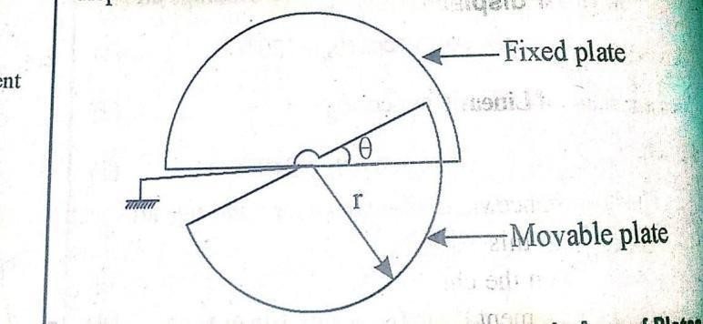
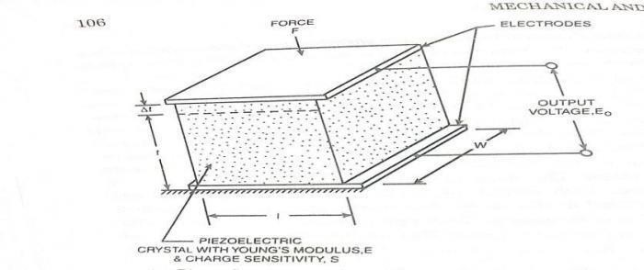
The capacitance will be maximum , when ϴ = 180⁰ Ie , when two plates overlap each other completely.
Considering the radius of capacitor plate = r
Area = π r² /2 Maximum capacitance = Cmax = є . A/d = π є r² /2d The value of capacitance at angle ϴ is given by
C = ( π є r² /2d ) * ( ϴ/ 2 π) = є ϴ r²
/2d Where ϴ= angular displacement ( in radians)
Now
Sensitivity S = ∂C/ ∂ϴ
∂C/ ∂ϴ = є
r² /2d S = є r² /2d
Differentiating C w.r.t ϴ
Therefore Sensitivity is directly proportional to area, since є and d are constant
2.3.5 PIEZO-ELECTRICTRANSDUCER:

Slide 43
Piezo-electric effect: When some pressure or stress is applied to the surface of the piezo- electric crystal, the dimensions of the crystal change and an electric charge voltage will be developed across certain surfaces of the pizo-electric crystal, conversely when an electric charge voltage or potential is applied to the crystal, the crystal get deformed and hence the dimensions (thickness change) of it will change. This effect is referred as Piezo-electric effect. All the piezoelectric transducers work on the principle of piezo-electric effect. The materials used in the construction of piezoelectric crystals are Quartz, Rochelle salt, Dipotassium tartrate, Lithium sulphate, Barium titanate, Potassium dihydrogen phosphate, Ammonium dihydrogen phosphate.
PIEZO-ELECTRIC TRANSDUCER WORKING:
A piezo-electrical crystal subjected to a force as shown in figure. A typical mode of operation of a piezo-electric device for measuring varying force applied to a simple plate.
Metal electrodes are attached to the selected faces of a crystal in order to detect the electrical
charge developed. The magnitude and polarity of the induced charge on the crystal surface is proportional to the magnitude and direction of the applied force and is given by
Q = K*F ------------- as per coulombs’ law Eqn--1
Where Q= is the charge in colomb F= impressed force in Newton
K= crystal sensitivity in C/N it is constant for a particular crystal
The relationship between the force F , and the change δt in the crystal thickness ‘ t’ is given by the stress-strain relationship
Young's modulus =
F = A.Y δt /t------Eqn - 2
The charge at electrode gives rise to voltage such that Vo = Q/C --------eqn-3 where C= Capacitance between electrodes
C = єr єo A/t farads -------- eqn-4
Substituting the values of Q, F, C in equation -3
Vo = Q/C = KF/C = KF/ (єr єoA/t) = K ( F/A)t / єr єo
Since P = F/A, Vo = K ( F/A)t / єr єo = K.P.t/(єr єo ) = [ K/(єr єo )]Pt = gPt Where g = K/(єrєo) g= crystal voltage sensitivity in Vm/N
P= applied pressure in N/m²
ADVANTAGES OF PIEZO-ELECTRICTRANSDUCER:
High frequency response
High output.
Rugged in construction
Negligible phase shift.
Small in size.

Slide 44
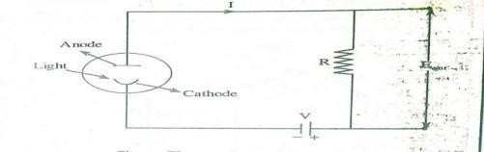
DISADVANTAGES
In cannot measure static conditions as its output is affected by changes in temperature.
Measuring system is increasingly expensive.
PPLICATION OF PIEZO-ELECTRIC TRANSDUCER:
  The small size of the transducer is especially useful for accelerometers
  Pressure cell.
  Force cells
  Used for dynamic force
    PHOTO ELECTRIC TRANSDUCER:
PRINIPLE: These transducers operate on the principle that when light strikes special combination of materials, a voltage may be generated; a resistance change may take place or electrons may flow.
APPLCATION: used in control engineering for precision measuring devices, Exposure meters used n photography
Used in solar batteries as source of power for rockets & satellites
TYPES OF PHOTO ELECTRIC TRANSDUCERS
      Photo-emissive (photo tube ) transducer
      Photo conductive transducer
      Photo-Voltaic transducer
i) PHOTO-EMISIVETRANSDUCER
The operating principle of photo-emissive transducer is that when a light beam exposed on to special combination of materials, electrons are emitted. Therefore , a current flow is produced in the circuit. (since the emitted electrons attracted towards anode).
The arrangement consists of a glass tube in which anode and cathode are enclosed. This glass tube is usually filled with an inert gas. The current produced in the circuit is proportional to the
intensity of radiation. The cathode of photo-emissive transducer is made with an oxidized silver base and is covered with a thin film cesiam. One of the most frequently used photo-emissive transducer is photomultiplier.

Slide 45
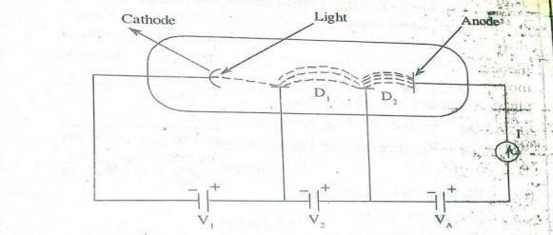
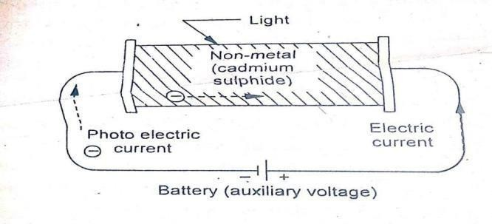
i) PHOTO MULTIPLIER: Most frequently used photo-emissive transducer is
The electrons emitted from the cathode of photomultiplier are not immediately drawn to the anode. But they are attached to another electrode called dynode D1 . When the incident electrons
strikes D1, it emits secondary electrons. The electrons from D1 are attached to the dynode D2 and at the end all are collected by anode, producing current(I)
ii) PHOTO-CONDUCTIVE CELL /TRANSDUCER
These are variable resistance transducers. They operate on the principle of photo- conductive effect, ie some special type of semi conductor materials change their
resistance when exposed to light.
Light information → resistance information.
It consists of a thin layer of material such as silenium or metallic sulphide of germanium is coated between electrodes on a glass plate. In this type, resistance of material is directly proportional to the light striking on it.
PHOTO VOLTAIC CELL (SOLAR CELL)
  In the photo voltaic cell there is a coating of certain oxide on a metal surface.
  When Light strikes the coating and generates an electrical potential directly proportional to intensity of light.
  Generally used in photo-graphic exposure meter.

Slide 46
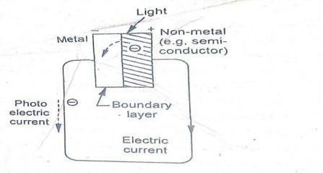
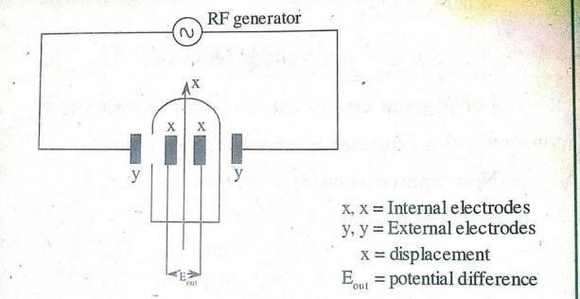
2.3.7 IONIZATION TRANSDUCER: to measure displacement
The operating principle of Ionization transducer is that when two electrodes are placed in an ionized gas, they produce potential difference ( Eout). The magnitude of this potential difference depends on the following factors.
Electrode spacing, ii) State of balance.
The gas is enclosed inside a glass tube under reduced pressure. In the above arrangement the
external electrodes are connected to a RF generator which produces an electric field. When the glass tube is subjected to this electric field, the potential difference is developed across the internal electrode. Therefore the gas inside the glass tube gets ionized. The potential difference is zero, when the electrode spacing is at null position. The potential difference is varied with the displacement of glass tube, since it is relative to the external electrodes.
APPLICATIONS:
  It is used for the measurement of displacement
  It can be used for detection of radiation.
2.4.4 HALL EFFECT DISPLACEMENTTRANSDUCER:
Hall Effect: relates to the generation of transverse voltage difference on a conductor which carries current and is subjected to magnetic field in perpendicular direction.

Slide 47
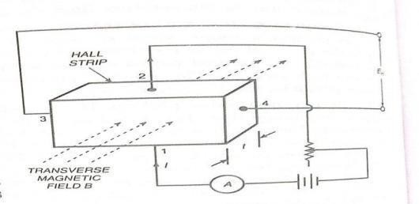
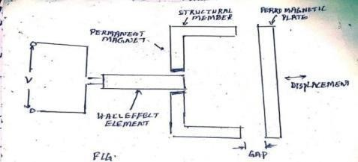
The fig. shows the schematic of a circuit which produces Hall effect. Here Hall strip carries a current ‘I’ in the x-direction and is subjected to magnetic field B in the Z-direction
The thickness of the strip is very small as compared to its length and width, the voltage E is setup in the transverse direction orY-direction. The voltage is directly proportional to the current I, field strength B and inversely proportional to thickness ‘t’ of the strip. That is
E = K. B.I/t => K= Et/(BI) ,
the unit o of K is V. m³ / (Wb . A)
WORKING OF HALL EFFECT DISPLACEMENT TRANSDUCER
The fig shows the arrangement of Hall effect transducer as used for the measurement of Linear displacement. This proximity pickup requires a ferrous target whose approach changes the reluctance of an internal magnet circuit. The Hall Effect element is located in the gap adjacent to the permanent magnet. When a plate of iron or other ferrow magnetic material is moved with respect to the structure, thee magnet field in the gap changes due to the permanent magnet. That produces the output voltage which is a measure of the displacement of ferrow magnetic plate with respect to the structure. This arrangement is successfully employed for measuring displacement as small as 0.025 mm.
USES OF HALL EFFECT TRANSDUCERS:
To measure whether a semiconductor is of N-type or P-type.
To measure either the current or strength of magnetic field.

Slide 48
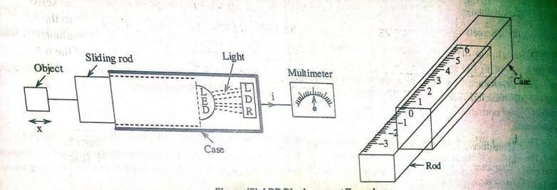
To measure the displacement
    LIGHT DEPENDENT RESISTOR (LDR) FOR DISPLACEMENT MEASUREMENT Operating principle of LDR is change in resistance corresponding to the change in the light energy falling on its surface that is the conduction of LDR depends upon
      The amount of light on its surface.
      Materials used for making LDR:
      Cadmium sulfide
      Cadmium solenoid
LIGHT DEPENDENT RESITOR (LDR): When LDR is subjected to light energy, electron- hole pair combination occurs within the material due to valence electrons. With the movement
of these charge carriers conduction takes place in the device. If more amount of light is made to fall
on the surface, more charge carriers will be generated which intern increases the conduction and decreases the resistance. Similarly less amount of light on the surface causes less current to flow in the device and hence the resistance will be high, ie the resistance is inversely proportional to the light on the surface.
MEASUREMENT OF DISPLACEMENT USING LDR:
The LDR consists of a square sectioned or circular sectioned case which accommodates a LDR at its sealed end. At the open end of the case, a rod is fitted which can slide into the case. A light source (say LED) is mounted on the inner end of the rod and the object whose displacement is to be measured is connected to the outer end of the rod. The displacement of the object causes the rod to slide either front or back inside the case, ie either towards or away from LDR. The inward movement of the rod decreases the distance between the light source (LED) and LDR. As a result more amount of light falls on the surface of LDR. Thus the increase in the amount of incident light decreases the resistance of LDR and consequently increases the flow of current through LDR. Whereas, the outward movement of the rod increases the distance between LED and LDR and hence decreases the amount of light incident on LDR. As a result, the resistance of LDR increases which in turn decreases the current flow through LDR. Thus the change in current of LDR is measured by using multi meter , which is calibrated in terms of displacement.

Slide 49
  MEASUREMENT OF TEMPERATURE
Temperature is an indication of intensity of molecular activity.
Definition of Temperature: “ A condition of a body by virtue of which heat is transferred to or from other bodies” and a quantity whose difference is proportional to the work from a
carnot engine operating between a hot source and a cold receiver.
TEMPERATURE:
Temperature may be defined as
    Degree of hotness or coldness of a body or an environment measured on a definite scale.
    Driving force or potential causing the flow of energy as heat.
    Measure of the mean kinetic energy of the molecules of a substance
  PHYSICAL PROPERTIES OF MATTER USED FOR MEASUREMENT OF TEMPERATURE
    Change in physical state : example : Bimetallic thermometer.
The temperature which is to be measured is applied to the bimetallic strip. As soon as the
bimetallic strip senses the temperature, it will expand or contract. When this happens, the pointer attached to the free end of the strip moves over the calibrated scale which indicated the value proportional to the applied temperature.
    Change in chemical state or properties: example: Liquid-in-glass thermometer.
The operating principle of liquid-in-glass thermometer is that differential expansion of liquid and glass on heating is used to indicate temperature.
    Change in physical properties ( or dimensions): Expl: gas thermometer.
The operating principle of gas thermometer is that the change in pressure of a gas corresponding to change in temperature.
    Change in the electrical properties: example; thermocouples, resistance temperature
detector (Resistance thermometer) The operating principle of resistance thermometer is that the resistance of conductor changes with the change in temperature.
iv) Change in radiation properties: example : Total radiation pyrometers, optical
pyrometers etc.
The process of measuring temperature using total radiation pyrometers makes use of total energy emitted by the hot body.

Slide 50
  CLASSIFICATION OF TEMPERATURE INSTRUMENTS
    CLASSIFICATION BASED UPON THE TYPE OF METHOD USED: as follows.
      Mechanical Instruments ( Non electrical method)
1a) Liquid-in-glass thermometer 1b) Gas thermometer
1c) Vapor pressure thermometer 1d) Bimetallic thermometer
1e) Solid rod thermometer
      Electrical Instruments( Electrical method)
2a) Resistance thermometer 2b) Thermistor
2c) Thermocouple
      Optical Instruments (Radiation method) 3a) total radiation pyrometers
3b) Infrared pyrometers
3c) Optical pyrometers. (Disappearing filament type pyrometers)
II) CLASSIFICATION OF TEMPERATURE INSTRUMENTS BASED EXPANSION
i) Expansion of solids: - bimetallic thermometer
- Solid rod thermometer
ii) Expansion of Liquids : -Liquid-in-glass thermometer
- Liquid-in-metal thermometer Expansion of gas : Gas thermometer
iii)

Slide 51
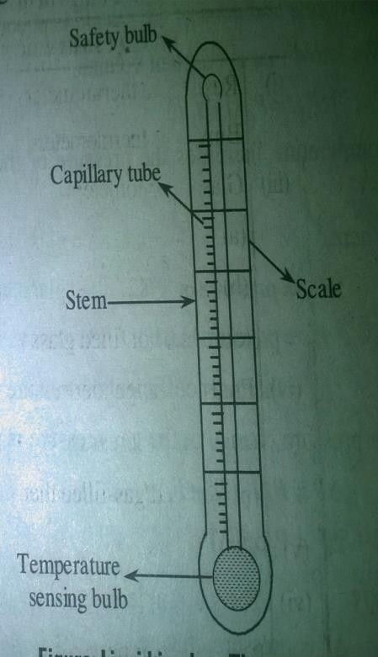
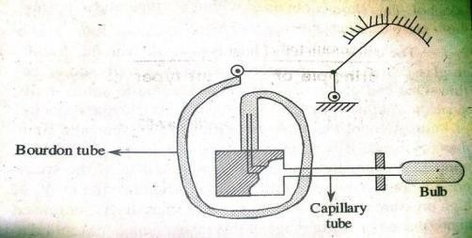
2.7.1a). LIQUID-IN-GLASS THERMOMETER
It consists of a temperature sensing bulb, responsive fluid and a scale. One end of the capillary tube is connected to safety bulb and other end is connected to temperature sensing bulb. The most widely used fluids in Liquid-in-glass thermometer is either mercury or alcohol.
The quick transfer of heat is possible with the liquid-in-glass, when the temperature sensing bulb walls should be thin.
As the temperature is raised, the greater expansion of liquid, causes it to rise in the capillary or stem of the thermometer and height is used as a measure of temperature.
The volume enclosed in the stem above the liquid may either contain a vacuum or filled with air or gas
For a higher temp ranges an inert gas at a controlled initial
pressure is introduced in this volume, thereby raising the boiling point of the liquid and increasing the total useful range
DESIRABLE PROPERTIES OF LIQUID USED IN A GLASSTHERMO
The temperature-dimensional relationship should be linear, permitting a linear instrument scale.
The liquid should have as large co-efficient of expansion as possible. For this reason Alcohol is better than mercury.
The liquid should accommodate a reasonable temp range without change of state.
The liquid should be clearly visible when drawn into a fine thread.
The liquid should not adhere to the capillary walls.
2.7.1b)GAS THERMOMETER
When the pressure of a gas is maintained constant: As temperature increases, the volume of gas

Slide 52
also increases. Therefore, in case of constant pressure thermometer, as temperature increases, the volume of the gas also increases. Here the pressure and mass of the gas are kept constant.
when the volume of the gas is maintained constant: As temperature increases the pressure of gas also increases. Therefore, in case of constant volume thermometer as temp increases the pressure of gas also increases. Hence the volume and mass of the gas are kept constant.
we know that constant volume
Pr = Po ( 1+ β1T) ( since temp increases, pressure of gas also increases) Pr = Po ( 1+β1T)
Pr = Pressure at T ⁰C , Po = Pressure at 0 ⁰C β1 = Thermal coefficient of pressure
The pressure change in gas pressure is given by ΔP = Po β1 (T2 - T1)
ΔP = Po β1 (T2 - T1)
ΔP = ΔP =
Po β1 ΔT
Po β1ΔT-----eqn-1
Where ΔP = pressure change, ΔT = T2 -T1 = change in temp Where ΔP = pressure change,
ΔT = T2 -T1= change in temp, From the eqn-1, it is
observed that ΔP = Po β1 (T2 - T1)
ΔP = Po β1 ΔT Where ΔP = pressure change, ΔT = T2 -T1 ΔP is proportional to ΔT
= change in temp
WOKING OF GAS THERMOMETER
If consists of a sensing bulb, a bourdon tube and a capillary tube.A bourdon tube is a pressure transducer which is used to measure the change in the pressure of a gas.The bourdon tube is calibrated directly on the basis of change in pressure corresponding to the temperature of a bulb. The volume of gas in the capillary is very small compared to that of volume of gas in the bulb, and this thermometer bulb is made large. Therefore, the effect of ambient temp is reduced; due to this the dynamic response of the gas thermometer for transient changes is also reduced.

Slide 53
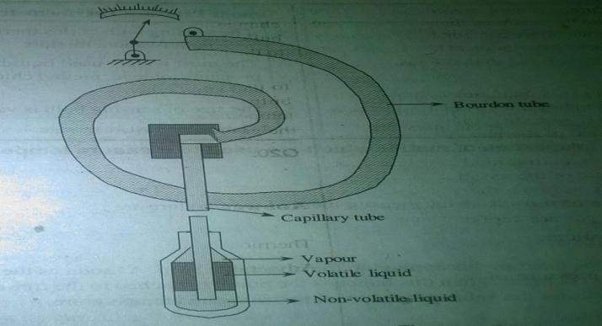
2.7.1 c) VAPOUR PRESSURE THERMOMETER
It contains a sensible bulb, a capillary and the bourdon tube. The most widely used liquids –in- filled system are propane, tolune, methyl chloride, sulphur dioxide and ethyl ether. In this type of thermometer the sensing bulb is filled with liquid vapour mixture. One end of the bourdon tube is connected to a capillary and the other end is connected to a pointer. The vapor liquid interface
lies in the sensing bulb. In this type of thermometers, the capillary tube and bourdon tube is filled with non- volatile liquid, where as the sensing bulb is filled with volatile liquid. The vapour pressure of the volatile liquid is increased due to the increase in temp of sensing bulb. This change in vapour pressure of the volatile liquid is transmitted to the pressure transducer (bourdon tube) through non-volatile liquid. If the non-volatile liquid used in vapour pressure thermometer remains in liquid phase, then the ambient temp effect is very small. The vapor pressure thermometer has a non-linear relation between temp and vapour pressure.
ADVANTAGES:
Its cost is very low
It has very fast response
The size of the sensing bulb is very small when compared to other thermometers.
2.7.1 d) BIMETALLIC THERMOMETERS
i ) Spiral shaped Bimetallic Strip thermometer
ii) Helical shaped Bimetallic strip thermometer
Bimetallic thermometers are of solid expansion type of thermometers. When two different materials which have different thermal expansion coefficient are joined together, then bimetallic thermometer or bimetallic sensor is formed.
The two types of materials used are brass and Invar. Of these two brass has high thermal

Slide 54
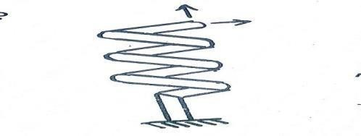
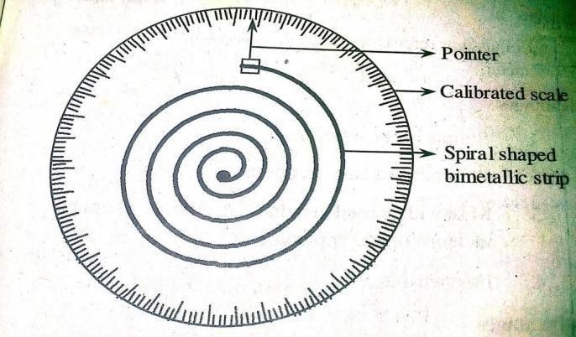
expansion coefficient and invar has low thermal expansion coefficient. The bimetallic strip can be available in helical, cantilever, flat type or also in spiral shape.
WORKING:
One end of the helical shaped bimetallic strip is fixed and other end is left out free. A
pointer is attached at the free end f the bimetallic strip. The temperature which is to be measured is applied to the bimetallic strip. As soon as the bimetallic strip senses the temp, it will expand or contact
When this happens the pointer attached to the free end of the strip moves over the calibrated scale, which indicates the value proportional to the applied temperature.
When it is subjected to temperature change, the free end of the bimetallic spiral deflects proportional to the change in temperature. This deflection becomes a measure of change in temperature
SPIRAL SHAPED BIMETALLIC STRIL THERMOMETER:
One end of the spiral shaped bimetallic strip is fixed and the other end is left out free. A pointer is attached at the free end of the bimetallic strip. As soon as the bimetallic strip senses the temperature, it will expand or contact. When it is subjected to temperature change, the free end

Slide 55
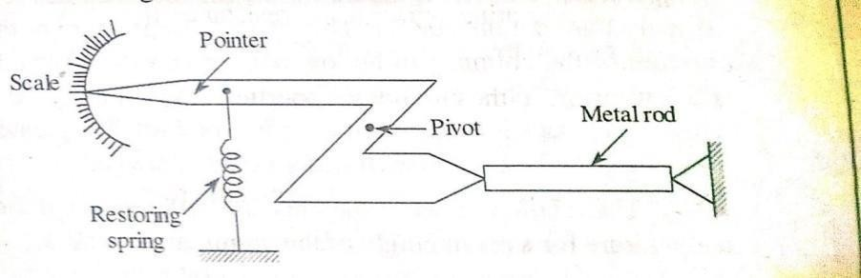
of the bimetallic spiral deflects proportional to the change in temperature. This deflection becomes a measure of change in temperature.
WORKING OF SPIRAL SHAPED BIMETALLIC THERMOMETE
One end of the spiral shaped bimetallic strip is fixed and the other end is left out free.
A pointer is attached at the free end of the bimetallic strip. As soon as the bimetallic strip senses the temperature, it will expand or contact. When it is subjected to temperature change, the free
end of the bimetallic spiral deflects proportional to the change in temperature. This deflection becomes a measure of change in temperature.
APPLIATIONS OF BIMETTALIC THERMOMETERS
These are used in control devices in a process
A spiral shaped strips finds application in A.C thermostats
Bimetallic shaped strips (helical type ) are widely used in oil burners, refineries, tyre vulcanizes
MERITS OF BIMETALLIC THERMOMETERS
Since the scale is calibrated in terms of temp, we can take readings easily and directly
These are available in various types, so can choose any one type depending on requirement.
Simple in construction
Simple in operation
Fast response
Light weight
Cost is less
DEMERITS OF BIMETALLIC THERMOMETERS
  Can not be used for measurement of high range of temperature.
  Measurement of temperature at remote areas is not possible.
  Low accuracy
2.7.1 e) SOLID ROD THERMOMETER
A solid rod thermometer is a temperature measuring device, which is based on the

Slide 56
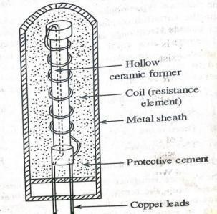
principle of linear expansion of the metals due to changes in temperature. A solid rod thermometer consists of a metal rod. One end of the metal rod is fixed and the other end is movable, so as to allow the expansion of the metal. To measure the expansion of the metal rod, its movable end is connected to the pointer and scale arrangement. A spring is attached to pointer so as to restore the deflection of pointer
2.7.2 a) RESISTANCE TEMPERATURE DETECTOR (RTD) or RESISTANCE THERMOMETER
The principle of operation of RTD: is that the resistance of the conductor varies with the variation in temperature. The amount of change occurred in the resistance can be given
by R = Ro ( 1+ α1 T + α2 T² +α3T³+ + αnT^{n}) Where Ro is the resistance at zero temperature and α1, α2 , α3.............. αn are constants
The value of change in resistance is measured with the help of wheatstone bridge circuit. The output voltage of the bridge gives the measure of the change in resistance of RTD and hence the change in temperature when properly calibrated. Generally temperature sensitive materials such as platinum, copper, tungsten and nickel which has a positive temperature coefficient of resistance are used as temperature sensing element. Example:
Platinum resistance thermometer, in which platinum metal is used as the sensing element,
because of its ability to with stand high temperatures (600⁰ C ) , maintaining excellent stability, and high degree of accuracy.
CONSTRUCTION OF RTD:
The construction of the resistance thermometer, the temperature sensitive resistance element platinum or copper which is in the form of wire is wound around a hallow
insulating ceramic former. Protective cement is applied over this ceramic former. The ends of coil are welded to copper leads. To measure change in resistance of the coil,
when it is subjected to temperature, the thermometer is connected in one of the arms of the wheatstone bridge. To provide mechanical strength and rigidity and to protect the resistance

Slide 57
thermometer assembly from contamination due to high temperatures, the whole assembly is placed in a protective metal shield.
The linear resistance temperature relationship over a temperature range around 0⁰ C (ie 273⁰ K) is given as
Rt = Ro ( 1+ α T ) …… eqn--1
Where Ro = Resistance at 0⁰ C T= temperature
relative to 0⁰ C
α = temperature Coefficient of resistance of material in (Ω/ Ω)/ 0⁰ C for a change in temperature from t1 to t2 the following relationship is used R1 = R0 + R0 αt1 --------- eqn-2
R2 = R0 + R0 αt2-----------eqn-3
R2 - R1 = R0 α (t2–t1) subtracting eqn—2, from eqn—3. R2 = R1 + R0 α (t2 –t1)
R1 = resistance at temperature 1 R2 = resistance at temperature 2
IMPORTANCE OF PROTECTION NEEDED FOR SENSING ELEMENT
The sensing element of a RTD requires protection in order to prevent from harmful chemicals and gases.
It is usually coated with a thin layer of glass.
Resistance element leads are protected to avoid damage.
The resistance wire can be protected by providing suitable protections and coatings to the sensing element.
27.2b) THERMISTOR
Thermistor or thermal resistors are made up of sintered mixtures of metallic oxides like copper, nickel, cobolt, iron, manganese and uranium. when there is any variation in the
temperature applied to the thermistor, then the resistance of the thermistor varies. This
variation in the resistance value of thermistor gives the measure of the change in the temperature. Most of the thermistors have the property of negative temperature coefficient
of resistance. Therefore, the resistance of thermistor increases with decrease in temperature and decrease in resistance with increase in temperature. The changes in resistance values ( with respect to temperature) can be known with the help of wheatstone bridge measuring circuit.

Slide 58
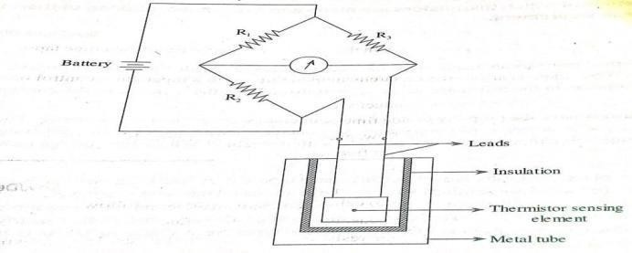
CONSTRUCTION OF THERMISTOR
The sensing element of the thermistor is enclosed in a metallic tube and an insulating material is placed between these two (thermistor and metal tube). Two leads are connected
to the thermistor sensing element. The leads, metal tube and sensing element all together is known as a temperature measuring device called thermistor.
Thermistors are made in different sizes and forms (shapes) such as beads, discs, rods and probs .
WORKING OF THERMISTOR:
The temperature-resistance function for a thermistor is given by
R = Ro e^{k}
K = β ( 1/T - 1/To ) Ro
R = the resistance at any temperature T in ⁰ K Ro = the resistance at reference temp To in ⁰ k
E = the base of Naperian logarithms. , β = a constant
The constant β generally has a value between 3400 and 3900 depending on thermistor formulation.
Working: The circuit used to measure temperature using a thermistor is shown in figure. Here the
thermistor is connected to one of the four arms of the wheatstone bridge. At the start of measurement process, some current whose magnitude is known is made to pass through the sensing element of the thermistor and its initial resistance value is determined with wheatsone bridge.
when the temperature of the process increases, the thermistor sensing element will be heated which causes its resistance to decrease. Similarly when the temperature of the process decreases the resistance of the thermistor sensing element increases. The variation of resistance sensin element is determined by wheatstone bridge. Here the change of resistance is displayed by the output device and the displayed signal gives the measurement of the temperature of the process when calibrated. The resistance-temperature characteristics of thermistor are illustrated in figure

Slide 59
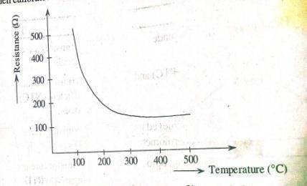
MERITS OF THERMISTOR:
exhibits high sensitivity
provides fast response
can be used to measure high temperature. 4 sze is small and cost is low.
lead wire compensation is not required
high accuracy and can with stand electrical and mechanical stresses
can be used with simple resistance measuring circuits.
DEMRITS OFTHERMISTOR:
exhibits non-linear characteristics
stability is low
problem of a ‘Gain effect’ ( increase in the resistance of thermistor when time lapses)
APPLICATIONS OF THERMISTOR:
These can be effectively used for the measurement of variations in temperature, control of temperature.
These can be used to measure thermal conductivity
These are used in electrical circuits to provide time delay.
These can be applied to measure vacuum flow, pressure and level of liquids. 5)These can be used to measure power at high frequencies.
CALIBRATION PROCEDURE OF THERMISTOR:
The general procedure employed in laboratories to calibrate a thermistor is as follows:
  Place the thermistor at ice point ie at 0⁰ C and measure its resistance.
  Construct a wheatstone bridge circuit with four resistors of same resistance.
  Now replace any one resistor of the ridge with thermistor. Therefore the bridge gets unbalanced. Hence adjust the resistance value of thermistor such that the bridge become rebalanced.
  Then subject the thermistor to a temperature of say 50⁰ C. with increase in temperature,

Slide 60

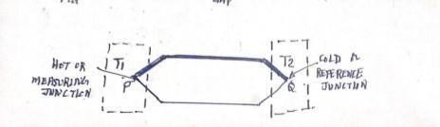
the resistance of thermistor decreases due to which the bridge becomes unbalanced again. Now readjust the resistance of thermistor to make the bridge balanced.
5) With this the thermistor is calibrated between 0⁰ C to 50⁰ C and it can measure any temperature ranging 0⁰ C to 50⁰C.
DISTIGUISH BETWEEN RTD &THERMISTOR
THERMISTOR
RTD
RTD are made of pure metals
It has +ve tep. Coefficient
Rtd has low accuraccuracy
Used for greater temp range upto 600⁰ C
RTD allow smaller cable lengths
Slow output response
Used in industrial installation application
Good stability
These areexpensive
Thermistors are made up of ceramic or plymer materials.
It has –ve temp.coefficient
Thermistors have good accuracy
Used for lower temp range upto 130⁰C
It allows larger cablelength
Fast outputresponse
Used in homeappliances
Less stable thanRTD
These are inexpensive
Low amount ofheating
It possesses good linearcharacteristics
High amount of selfheating
It possesses non-linearcharacteristics
    c) THERMOCOUPLE:
Basis for thermocouple:
In 1821 I.J. Seebeck discovered that an electromotive force exists across a junction formed of two unlike materials. Later it was shown that the potential actually come from two different sources
      that (e.m.f) resulting from contacts of the two dissimilar metals and junction temperature. This is called Peltier effect.
      and that due to temperature gradients along the conductors in the circuit. This is called Thomson effect.
In most cases Thomson emf is quite small relative to the peltier emf and with proper selection of materials may be disregarded. These effects form the basis for temperature measuring element, the thermocouple.
ELEMENTARY THERMOCOUPLE CIRCUIT:
If a circuit is formed including thermocouple as shown in figure. A minimum of two conductors will be necessary resulting in two junctions P,Q.

Slide 61
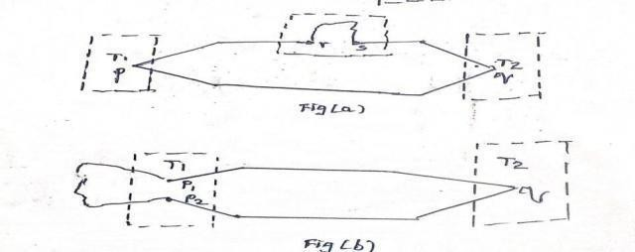
If we disregard the Thomson effect, the net emf will be result of the difference between the two Peltier e.m.f accuring at the two junctions.
If the temperatures T1 and T2 are equal he two emfs will be equal but opposed and no current will flow. However if the temperatures are different, the emf will not balance and a current will flow. The net emf is a function of the two materials used to form the circuit and the temperatures of the two junctions. Note that two junctions are always required Hot or measuring juncti The junction whichsenses the desired or unknown temperature. Cold junction or reference junction: The junction which is usually maintained at a known fixed temperature.
APPLICATION OF LAWS OF THERMOCOUPLES:
In a addition to the Seebeck effect, here are certain laws by which thermo-electric circuits abide are as follows.
Laws of Intermediate metals
Laws of Intermediate temperature
i) Laws of Intermediate metals: Insertion of an intermediate metals into a thermocouple circuit will not affect the net emf, provided the two junctions introduced by the third metal are at identical temperature. As shown in fig(a), if the third metal ‘C’ is introduced and if the new
junctions ‘r’ and ‘s’ are both held at temperature T3, the net potential for the circuit will remain unchanged. This of course permits insertion of a measuring device or circuit without upsetting the temperature function of the thermocouple circuit.
As shown in fig(b), if the third metal ‘C’ may be introduced at either a measuring or reference junction, so long as couples P1 and P2 are maintained at the same temperature T1. This makes possible the use of joining metals, such as soft or hard solder in fabricating the thermocouples.

Slide 62
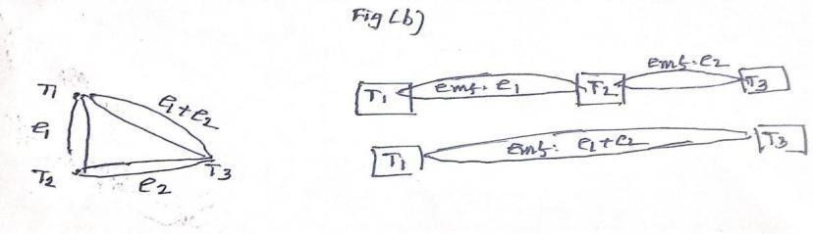
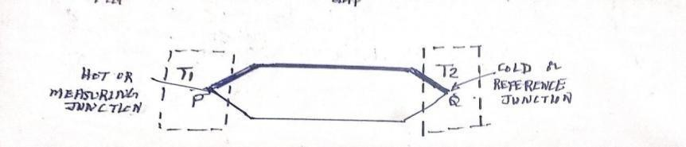
ii) LAW OF INTERMEDIATETEMPARATURES:
If a simple thermocouple circuit develops an emf e1 when its junctions are at temperatures T1 and T2, and an emf e2 when its junctions are temperatures T2 andT3. It will develop an emf ( e1 + e2), when its junctions are at temperatures T1 andT3.
THERMOCOUPLE PRINCIPLE & THEORY:
When two metals which are made up of two different materials are joined together to form two junctions. One junction senses the desired or unknown temperature, this junction is called hot or measuring junction. The second junction will be usually be maintained at a known or fixed temperature and is called cold or reference junction. When the measuring junction is heated up with respect to other junction, the emf developed at the junction is proportional to the applied temperature and the junction temperature is known as thermocouple.
THE DIFFERENT TYPES MATERIALS USED TO CONSTRUCT THERMOCOUPLES:
Chromel–constantan
Iron– Constantan (type-J ) 3)
4)
5)
= 200 ⁰ C to 850⁰ C
= - 200 ⁰ C to 850⁰ C
= - 250 ⁰ C to 400⁰ C
= - 200 ⁰ C to 1100⁰ C
=0 ⁰ C to 2600⁰ C
Copper – constantan(type-I) Chromel–Alumel (type-K) Rhenium– Tungsten

Slide 63
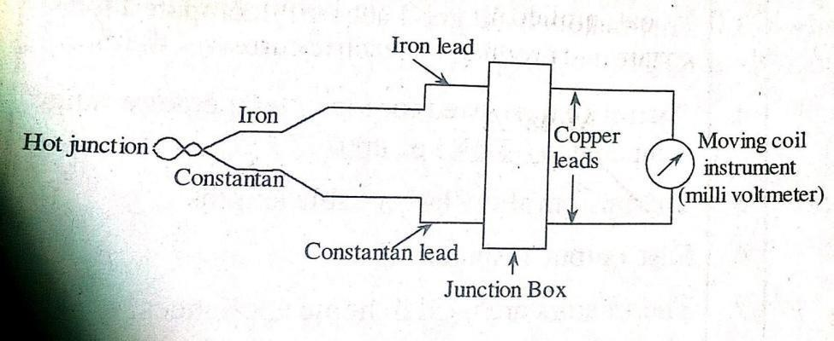
CONSTRUCTION & WORKING OFTHERMOCOUPLE
The thermocouple hot junction will be exposed to the process or media where the temperature has to be measured. The thermocouple since the two junctions are at different temperatures a voltage is setup at the free ends and since the free ends are connected to a milli voltmeter the emf setup will establish a flow of current which can be measured directly by using the milli volmeter.
Since the reference junction is kept at 0 ⁰ C the emf measured is a function of the temperature of the hot junction. The milli voltmeter is calibrated to indicate the readings in terms of temperature.
The emf developed in a thermocouple depends upon the difference in temperature between the hot junction and cold junction. cold junction will be maintained at a constant reference
temperature. The temperature of the cold junction is purposefully kept at 0 ⁰ C, to avoid errors which may be introduced on account of change in room temperature. Two dissimilar metals used for thermocouples may be twisted, screwed, clamped or melted together. Thermocouple do not used bare conductors except in applications, where atmospheric conditions permits their use. Usually protective sealing is used to surround the junction and a portion of the external leads. The leads and junction are in turn insulated from the sheath using various oxiides.
The thermocouples are usually installed inside the protective walls so that they can be easily removed or replaced without interruption to the plant.Since the two junctions are at different temperatures a voltage is setup at the free ends and since the free ends are connected to a milli voltmeter the emf setup will establish a flow of current which can be measured directly by using
the milli voltmeter. Since the reference junction is kept at 0 ⁰ C the emf measured is a function of

Slide 64
the temperature of the hot junction. The milil voltmeter is calibrated to indicate the readings in terms of temperature. The emf developed in a thermocouple depends upon the difference in temperature between the hot junction and cold junction.
ADVANTAGES OF THERMOCOUPLE:
Can measure fast changes in the temperature.
Produces electrical outputs.
It is an active transducer ie no need of any excitation to operate.
Can be used to measure wide ranges of temp from 0 ⁰ C to 1400 ⁰C
The temperature of a particular point can be measured.
DISADVANTAGES:
Produces low output voltage in terms of milivolts
Accuracy of measurement is low
The output voltage is affected by stray magnetic field.
The extension wires should be made of those materials which are used in the construction of thermocouple.
APPLICATIONS OF THERMOCOUPLE
  used to measure thermal conductivity
  Can be used in the measurement of pressure, level, and flow of liquids and to know the composition of gases.
  Can be applied to measure vacuum.
  Applied in the measurement of voltage and currents.
WHAT IS A MBIENT TEMPERATURE COMPENSATION IN THERMOCOUPLE SET UP:
The thermocouple consists of one hot junction and another reference junction or the cold junction at ambient temperature. The instrument which is under process deals with both hot
junction and cold junction temperature. Thermocouples computes this temperature difference between the hot and cold junctions. But the measuring instrument has a tendency to vary because of variations in ambient temperature. For this reason, the ambient temperature compensation is required which is called cold junction compensation. This can be achieved by using electromechanical or electronic devices.

Slide 65
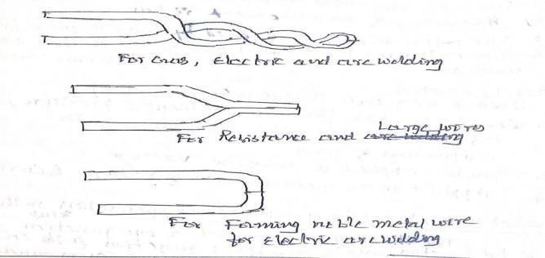
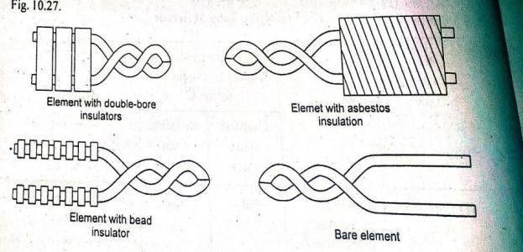
COMMON FORMS OF THERMOCOUPLE CONSTRUCTION:
COMMON METHODS FOR SEPARATING THERMOCOUPLE WIRES
Prob: let us assume an arrangement as shown in fig using type –T (copper-constant) thermocouple, a reference temperature of 20oc, determined as described above and a potentiometer reading of 2.877 mv. Find the temperature sensed by the measuring couple.
Soln: because our readout is reffered to 20 ⁰ C and thermocouple tables are referred to 0 ^{0 C .} We must use the law of intermediate temperatures to convert our emf value as follows.
Ex o = Ex 20 + E2o 0
Where Ex o = emf corresponding to the unknown temperature referred to 0 ⁰ C Ex 20 = emf corresponding to the unknown temperature referred to 20 ⁰ C E2o 0
= emf corresponding to 20 ⁰ C temperature referred to 0 ⁰C Table: values of thermal emf in milli volts
For type-T thermocouple and at reference temp 0 ⁰C
 | 0 | 5⁰ C | 10⁰ C | 15⁰C | 20⁰ C
0⁰C | 0 | 0.195 | 0.391 | 0.589 | 0.789
75⁰C | 3.131 | 3.357 mv | 3.584 | 3.813 | 4.044

Slide 66
Given Ex o =2.877mv
From table E2o 0 = 0.789 mv Using above table, Ex o = Ex 20 + E2o0
= 2.877 + 0.789 = 3.666 mv
Temperature corresponding to 3.666 mv from the above table = 85 + 1.55 = 86.55 ⁰ C WORK_OUT: For 3.584 ----------------- > 85 ⁰ C
( 3.666 – 3.584) = 0.102 =
Voltage difference for 15 and 10 ⁰ C = 3.813- 3.584 = 0.329 That is for o.329 mv → 5 ⁰ C
For 0.102 mv → 0.102* 5/0.329 = 1.55mv
    PHYROMETRY:
From the Greek words phyros means fire. Metron means measure, The term phyrometry means temperature measurment.Phyrometry is concerned with primarily of various forms of thermal radiation measurements.
PHYROMETRY THEORY: all bodies above absolute zero temperature radiate energy. Not only they radiate or emit energy , but also receive and absorb it from other source. We all know
that when a piece of steel is heated to about 550 ⁰ C, it begins to glow ie visible light being radiated from its surface. As the temp is raised, the light becomes brighter or more intensive. In addition there is a change in colour, it changes from dull red, through orange to yellow and
finally approaches to an almost white light at the melting temperature 1430 ⁰ C to 1540 ⁰ C. The energy of which is transmitted as electromagnetic waves travelling at the speed of light. It is known that all the substances emit and absorb radiant energy at a rate depending on the absolute temperature and physical properties of the substance.
CLASSIFICATION OF PYROMETERS:
      Total radiation pyrometers
      Infrared pyrometers
      Optical pyrometers ( Disappearing filament type of pyrometers )
2.7.3 a).TOTAL RADIATIONPYROMETERS
W = O * e *T⁴
where
W = Radiant energy BTU/sq. feet /hour
O= Stefan constant = 1.71 * 10 BTU/ Sft /hour

Slide 67
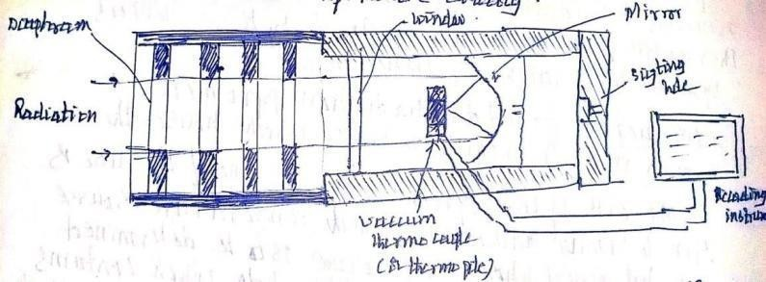
e = emissivity of the surface, dimensionless number between 0 to 1 (0.90 for steel) T= absolute temperature
Operating Principle: of this pyrometer is that , the total radiation of a hot body is made to fall on the devices which receives the radiation such as thermocouple, thermopile etc., and the emf developed by these devices give the temperature of the hot subject.
TOTAL RADIATION PYROMETER (MIRROR TYPE) :construction & working:
The total radiation pyrometer consists of a radiation receiving element and a measuring device to indicate temperature directly. Here diaphragm unit along with a mirror is used to focus the radiation on a radiant energy sensing transducer. The lens to transducer (a vacuum thermo couple or thermopile) distance is adjustable for proper focus.
The mirror type of radiation receiver shown in fig is so arranged that the image of the front diaphragm is focused on the thermocouple by mirror. Therefore the temperature measurements are independent of distance of the target.
Presence of any absorbing media present between target and the transducer reduces the radiation received and therefore the pyrometer reads low. Substances like smoke, dust and gases absorb radiation and causes – ve static errors. On the other hand presence of heat sources like hot gases, high temp particles and flame causes the meter to read high.
MERITS OF TOTAL RADIATION PYROMETER:
These can be used to measure high range of temperatures
These can measure temperatures of those objects which are fixed at some place and objects which are moving.
These are non-contact type of pyrometers.
It produces fast response
5.

Slide 68
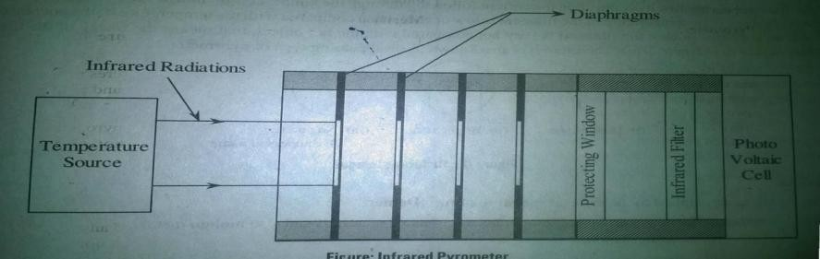
DEMERITS OF TOTAL RADIATION PYROMETER:
It shows decreased performance if any dust particles or gas are present between the hot object and the receiving mirror.
Some times it requires some cooling arrangement to remove the over heating of the instrument.
There is a problem in focusing the total radiation on to the thermocouple if the mirror is not placed properly
It cannot be used to measure low temperatures.
It is expensive.
APPLICATIONS OF TOTAL RADIATION PYROMETER
  it is used to measure temperatures in bright annealing furnace.
  It is used to measure temperature of hot objects with in a furnace.
  It is used in conditions where thermocouples fail to operate.
2..7.3b) INFRARED PYROMETER
fig: infrared pyrometer
Infrared pyrometers are also known as selective or partial radiation pyrometers. These pyrometers utilize infrared radiations emitted by a heated source. As temperature of the source increases the emission of infrared radiation from the source increases
proportionally. ( if the temp of source is beyond 550⁰ C , then the source emits both visible light and also infrared energy). This phenomenon of proportional increase of infrared radiation makes this pyrometry possible by including some electronic circuitry, an indicating and controlling unit and a suitable detector. The infrared radiation from the temperature source is made to fall on the photo voltaic cell through radiant energy receiver.(set of diaphragms). The passage of this radiation to the cell depends on the area of the first diaphragm.

Slide 69
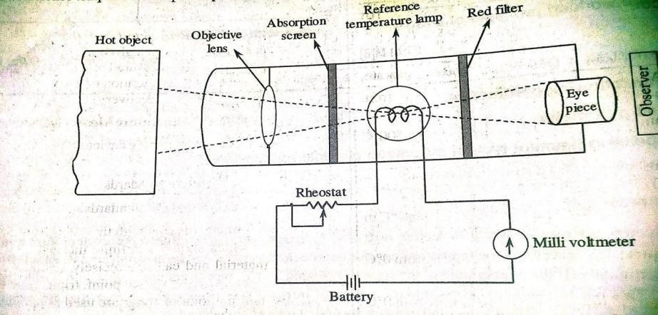

To prevent the cell from overheating a filter is used ahead of it which allows ( the
radiations of 1000⁰ C to 1200⁰ C to fall on the cell in order to prevent the cell from overheating.To prevent this filter from physical damage a protecting window is used. The source whose temp is to be measured is not in direct contact with the detector When the infrared radiations falls on the cell, it generate an emf which becomes the measure of
temp of source. This emf can be read from the output meter or digital display.
2.7.3 c). OPTICAL PYROMETER (Disappearing Filament type of pyrometer).
Operating principle : of optical pyrometer is based on the comparison of image’s brightness generated by hot object with reference temperature lamp.
WORKING: The radiation emitted by hot body whose temperature is to be measured is made to focus on the reference temperature lam filament through an objective lens. By properly adjusting the eye piece a sharp focus can be obtained.
A dark image figure 2(i) of the filament is obtained by controlling the current flowing through the lamp. Abrightimageshowninfig-2(ii) of the filament is obtained if the temp of the filament is low or cool when compared with the temp of hot object. No image will be appeared in case the filament is very hot compared with hot object, that means the image of the filament disappears as shown in figure-(iii). Therefore it is also called as disappearing type of pyrometer.

Slide 70
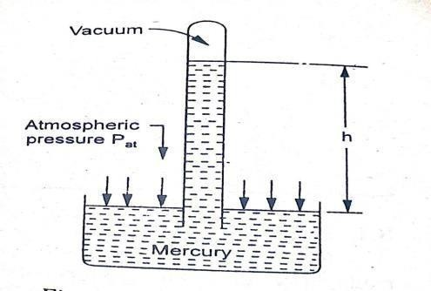
APPLICATIONS OF OPTICAL PYROMETER (Disappearing Filament type of pyrometer)
These are applied to measure temperature of furnaces.
Applied in the measurement of temperatures of heated materials and also molten materials
MERITS OF OPTICAL PYROMETERS
operation is simple
This instrument measures temperature with out contacting the hot object. Therefore it is a non-contact type.
High accuracy is obtained.
iii)
DEMERITS:
Can not be used in the continuous measurement of temperature..
Exhibits less sensitivity at low temperatures
Requires cooling arrangement
  MEASUREMENT OF FPRESSURE:
Pressure: is the average force exerted by a medium usually a fluid on a unit area. Pressure is usually expressed as the force per unit area
Pressure = force/area , the force exerted in direction perpendicular to the surface of unit area
    It differs from normal stress only in the mode of application
    Commonly expressed in terms of Pascal (Pa) or mm of Hg column or mm of water column.
    Pascal (Pa ) is equal to Newton per square meter
PRESSURE MEASUREMENTTERMS:
      Atmospheric pressure (Pat ) : this is the pressure exerted by the envelope of air surrounding the earth surface.
Pat - Pvp = gh
Pvp = mercury vapour pressure

Slide 71
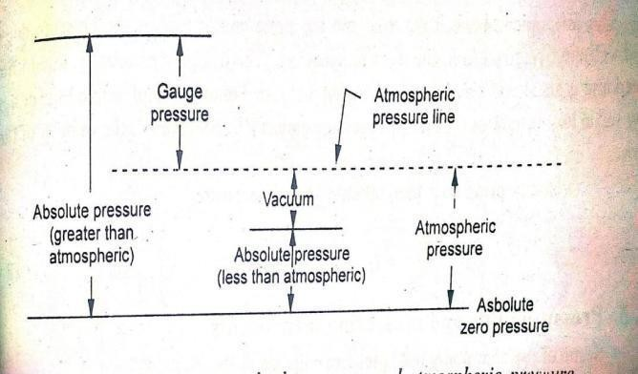
h= mercury level
Pat = Atmospheric pressure
𝔭= density of mercury
Since mercury has a low vapor pressure Pvp = 0 Pat = gh
ii) Absolute Pressure ( Pab ) : It is defined as the algebraic sum of atmospheric pressure and gauge pressure.
Pabs = Patm +Pgauge ( for positive gauge pressure) Pabs = Patm + (- Pgauge)
=Patm -Pgauge ( for negative gauge pressure)
3) Gauge Pressure (Pgauge ): The pressure above atmospheric pressure is called gauge pressure.
When the unknown pressure is more than atmospheric pressure, the pressure recorded by the instrument is called gauge pressure
2.8.1 PRINCIPLES USED TO MEASURE PRESSURE:
Pressure-1: Pressure can be measured by balancing a column of liquid against the pressure which has to be measured. The height of the column which is balanced becomes a measure of the applied pressure when calibrated.
Example: Manometer

Slide 72
Principle-2: When the pressure is applied on the elastic element, the shape of the elastic element changes which intern moves the pointer with respect to scale. The pointer reading becomes a measure of the applied pressure when calibrated.
Example : Bourdon tube
Example-3: When electrical current flows through a conducting wire, it gets heated. Depending up on the conductivity of the surrounding media, the heat is dissipated from the wire. The rate of change in the temperature of the wire becomes a measure of the aplied pressure.
Example: Pirani gauge
    CLASSIFICATION OF PRESSURE MEASURING INSTRUMENTS:
      Gravitational transducers:
        A dead weight tester/gauge
        Manometers
          well type manometer
          U type manometer (differential manometer)
          Barometer
          Inclined manometer
          Micro manometer.
      Elastic transducers :
  Bourdon pressure gauge
  Elastic diaphragm gauge
    Flat type diaphragm gauge
    Corrugated type diaphragm gauge
  Bellow gauges
Strain gauge Pressure cell:
  Pinehead tube
  Cylindrical tube pressure cell
  Flattened tube pressure cell
Mcleodgauge
Thermal conductivity gauges:
  Thermocouple gauge
  Pirani gauge
Ionization gauges:
Electrical resistance pressure gauge:

Slide 73
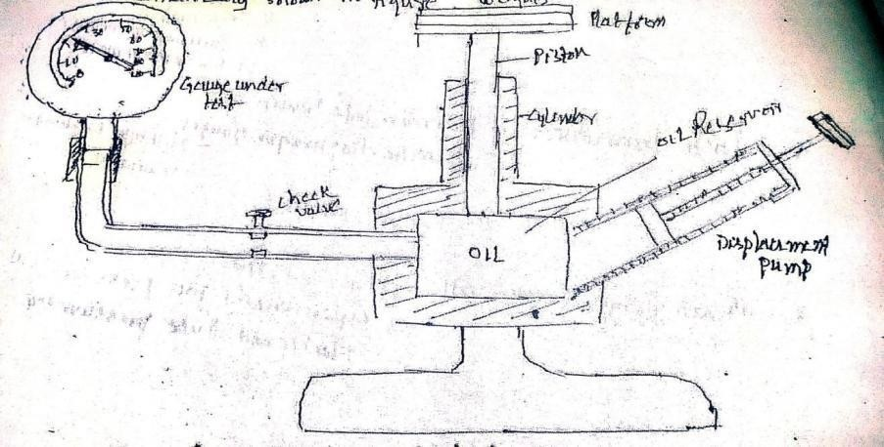
1a). DEAD-WEIGHT TYPE TESTER or GAUGE ( Pistongauge):
Working: a dead weight or piston gauge is commonly used as source of standard pressure for calibration purposes. It is basically a pressure producing and pressure measuring device.
It consists of a accurately machined bored and finished piston which is inserted into a close fitting cylinder. The cross-section area of the both the piston and cylinder are known.
At the top of the piston is provided a platform on which standard weights of known accuracy can be placed. An oil reservoir with a check valve at its bottom is also provided.
The oil from the reservoir can be sucked by a displacement pump on its upward stroke and forced into the system on the downward stroke of the displacement pump.
For calibration purposes first a known calculated ) weight is placed on th platform and the fluid pressure is applied to the other end of the piston until enough force is developed to lift the piston-weight combination and the piston floats freely.
fluid pressure= P=
thus the pressure caused due to the weigh placed on the platform is calculated by using the above equation. To achieve high accurate results, frictional force between the cylinder and piston must be reduced which is generally accomplished by rotating the piston while the reading is taken.

Slide 74
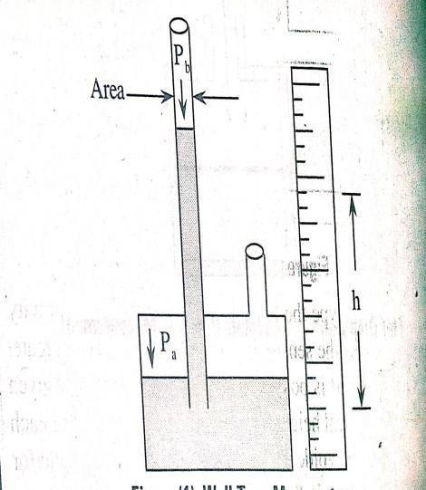
MERITS OF DEAD-WEIGHT TYPE TESTER / GAUGE:
Its construction is simple and is very easy to operate.
It is used as standard for calibration of wide range of pressure measuring devices.
Fluid pressure can be varied easily either by adding piston or by changing the piston cylinder.
DEMERITS:
Friction between the piston and cylinder effects the accuracy of the gauge.
Gravitational force also effects the accuracy of the gauge.
APPLICATIONs:
It is used to measure pressure.
Used to calibrate all kinds of pressure gauges
1b) DIFFERENT TYPES OF MANOMETERS:
b. 1) well type manometer
2) U type manometer (differential manometer b .3) Barometer
  Inclined manometer
  Micro manometer.
1b.1) WELL TYPEMANOMETER:
it consists of a well and a tube . The area of the well is much larger than the area of the tube. So when pressure Pa is applied on well, and pressure Pb is applied in a monometer. The pressure difference will be indicated by the height of the liquid column in the tube.
Pressure difference = Pd= Pa - Pb= ƿ h g Ƿ= density of fluid
h= net column height
g = local gravity acceleration
The height becomes a measure of he applied pressure when calibrated.
The accuracy of the instrument is low.

Slide 75


BAROMETER:
A barometer is a single leg instrument in which one end of the liquid column is kept at zero absolutepressure.
Pat - Pvp= ƿ gh
Pvp= mercury vapour pressure, Pat = atmospheric pressure H= height of liquid column
g = local gravity acceleration
Mercury has a low vapour pressure and thus can be neglected in comparison to Pat
Pat - 0 = ƿ gh => Pat = ƿ gh
Then the height of the liquid column is a measure of the absolute pressure.
To achieve high accuracy, the zero level of the well is set at the zero level of the scale before taking each reading.
Fig: BAROMETER:
INCLINED MANOMETER: In this type, the tube is tilted with respect to gravity. This increases the sensitivity of the manometer as a grater motion of liquid is possible along the tube for a given change in vertical height .( as the inclined tube will have more graduations per unit vertical height. The inclination of tube is arround 10degrees.

Slide 76

U-TUBE MANOMETER ( DIFFERENTIALMANOMETER)
U tube manometer is the most simple and most commonly used manometer for measurement differential pressure between two points.
A U-tube manometer consists of two vertical columns as shown in figure. The manometer tube is filled with a liquid (usually mercury)
Before application of pressure the liquid in the two columns is at same level, because both the columns are subjected to atmospheric pressure at ideal state.
1
WORKING OF U-TUBE MANOMETER ( DIFFERENTIALMANOMETER)
when pressure is to be measured, one of the columns is subjected to the pressure to be measured and the other column is subjected to atmospheric pressure (reference pressure)
Due to the difference in the pressures in both the columns, the liquid levels in the columns will be different. In this way , the liquid in the column is balanced against the unknown pressure.
The difference in the liquid levels Δh between the two columns is taken as a measure of
the difference between the pressures in the two columns. where P = un known pressure
P = unknown pressure Patm = atmospheric pre Δh = difference in liquidlevel
Ƿ = mass density ofliquid
g = gravitationalconstant Δh = ( P - Patm )/ (ƿg)
Pat - Pvp= ƿ gh
P - Patm = ƿg Δh => P = Patm + ƿgΔh
The U tube can be used to measure gauge Pressure and differential pressure. It is given as Gauge pressure
Gauge pressure = Pg = P - Patm = ƿgΔh
Differential pressure= Pdif = P1 - P2 = ƿgΔh If p = P1 and Patm =P2

Slide 77

MICROMANOMETER:
Small pressure differences can be accurately measured using a micro manometer. The construction of a micrometer is as shown in fig.The meniscus of the inclined tube is adjusted at a reference level as shown in figure, which is given by a fixed hair line by viewing through a magnifier. This is done for Pa= Pb
The adjustment is done by moving the well up and down by a micrometer. Now the micrometer is noted..When an unknown pressure difference is applied, meniscus moves away from the hair
line. The well is lowered or raised by micrometer so that the meniscus is restored in its initial position.The initial and final readings of the micrometer difference gives the height of the liquid. This height becomes a measure of the applied pressure when calibrated.
VARIOUS TYPES OF ELASTIC PRESSURE SENSING ELEMENTS USED IN ELECTRICAL TRANSDUCERS:
The different types of elastic pressure sensing elements used in electrical transducers are
Diaphragms
Bellows
Bourdon tubes
  DIAPHRAGMS:
Any thin material whose ends are fixed between two parallel plates is referred to as
diaphragm.It is one of the pressure measuring elements. The operating principle is that the
applied pressure is converted into proportional displacement. The materials used to make diaphragm are phosphor bronze, nickel, berryllium copper, stainless steel etc. The
77

Slide 78


diaphragms can be in the form of flat, corrugated, dished plates.
•
m
CORRUGATED DIAPHRAGM:
When two corrugated diaphragms are joined together, at their ends a capsule is formed. When
compared to flat diaphragms, corrugated diaphragms produce greater displacement. Since the capsule is a combination of two diaphragms, it generates more displacement which is twice that
of single corrugated diaphragm. The generated displacement is proportional to applied pressure.
SECONDARY TRANSDUCERS USED WITH DIAPHRAGM PRESSURE PICKUP
a) Use of resistance strain gauge with flat diaphragms:
Principle: a obvious approach is to simply apply gauges directly to a diaphragm surface and calibrate the measured strain in terms of pressure.

Slide 79


In this strain gauges are applied directly to a diaphragm surface either at centre on diametrically opposite faces as shown in fig. In this set up one gauge is subjected to tension while the other gauge senses compression. When pressure is applied to the side opposite the gauges, the central gauge is subjected to tension while the outer gauge senses compression. The two gauges are used in adjacent bridge arms, thereby adding individual outputs and simultaneously providing temperature compensation.
b) Use of inductive type transducer with flat diaphragms:
Variable inductance is used as a form of secondary transducer used with a diaphragm. In inductive type of secondary transducer the flexing of the diaphragm is utilized to change
the relative induction of two coil is placed in the magnetic field. The device consists of
two E-shaped magnetic pieces placed equally around a diaphragm. Two coils are wounded around these E-shaped pieces

Slide 80

When pressures difference exists across the diaphragm, the flexing of the diaphragm causes it to move toward one pole piece and away from the other, thereby altering the relative inductance. The coils used in inductance bridge circuit is as shown in fig, the output of which is measured by oscilloscope or electronic voltmeter as well as recorders.
These are available in various ranges from 0 - 1 and 0 - 100PSI
DIAPHRAGM PRESSURE GAUGE:
The fig. illustrates the principle of operation of a diaphragm pressure gauge.
Because of pressure differential, the diaphragm deflects.
The mechanical linkages arrangement shows the deflection of indicator on the pressure scale and corresponding pressure ismeasured.
ii) BELLOWS:
Bellows, the pressure measuring elements are formed by the series combination of capsules. The working principle of bellow is same that of diaphragms; ie the
applied displacement is converted into proportionate mechanical displacement. The materials used to construct bellows are brryllium copper, brass, monel, stainless steel and nickel. Whenever the pressure to be measured is applied to the
sealed end of bellow, suffers displacement. The generated displacement can be
known by attaching a pointer scale arrangement to the sealed end by transmitting the displacement to the secondary transducer.

Slide 81


BOURDONTUBES:
The bourdon tubes are available in different shapes such as spiral, helical, twisted and c shaped. However all the tubes have non-circular cross-section. The
materials used in the construction of bourdon tubes are brass, steel and rubber.
REASONS FOR THE POUPLARITY OF BOURDON TUBE ELEMNT FOR PRESSURE MEASUREMENT:
it is inexpensive
Simplicity and ruggedness
It gives accurate results
It can be used to measure absolute, differential and gauge pressures
It can be used for high pressure measurements
It can be easily adapted for designs for obtaining electrical outputs.

Slide 82

BELLOW TYPE GAUGES (BELLOW GAUGES):
The bellow is a longitudinally expandable and collapsible member consisting of
several convolutions or folds. Most common materials chosen for bellows fabrication are trumpet brass, stainless steel, phosphor bronze and beryllium copper. These are the elastic pressure sensing elements for measurement of pressure.
THE ARRANGEMENT OF BELLOW TYPE PRESSURE GAUGE FOR INDICATING GAUGE PRESSURE.:
Pressure is applied to one side of the bellows and the resulting deflection is counter
balanced by a spring. By suitable linkages, the bellows displacement is magnified
and the gauge pressure is indicated by a pointer on the scale. Therefore, the value of applied pressure is directly read from the calibrated scale
THE ARRANGEMENT OF BELLOW TYPE PRESSURE GAUGE FOR INDICATING DIFFENENTIAL PRESSURE.
The differential pressure bellow gauge makes use of two bellows. Each bellow has a sealed end and open end to receive the pressure to be measured. The open ends are fixed and sealed ends are free to move along the length of the bellow. Thus, when pressures are applied to the bellows from their open ends, then sealed ends get deflect (Expand). This deflection of bellow is a function of the pressure applied to the bellow. The free ends of the bellows are connected to to the ends of the opposite sides of an equal-arm lever. The centre of the lever is linked to the pointer and scale assembly through a link-sector- pinion arrangement. The scale is calibrated in terms

Slide 83

of pressure in order to obtain a direct indication of the pressure.
The arrangement of bellow type pressure gauge for indicating differential pressure
Let PAand PB be the two pressures whose difference is to be measured. The pressures
PA and PB are applied to the bellows A and B respectively. On application of pressures, the free end of the bellows expand (deflect) in proportion to the pressure applied. Due to the expansion of the bellows, the two ends of the lever get displaced angularly in opposite directions, thereby causing the lever to rotate in clock-wise or anticlock-wise direction. The resultant displacement of the lever corresponds to the difference in the deflection of the two bellows. As the deflection of the bellow is a function of applied pressure, the displacement of the lever is a function of the difference between the two input pressures. Resultant displacement of the lever is amplified by
the sector and pinion arrangement and is fed to the pointer. This causes pointer to deflect over the pressure calibrated scale. The pointer indication on the scale corresponds to the differential pressure. Pdiff = PA -PB

Slide 84

ARRANGEMENT OF BELLOW TYPE PRESSURE GAUGE FOR GAUGE PRESSURE MEASUREMENT
For measuring gauge pressure
no of the bellows (bellow-B) is applied with atmospheric pressure input. Then the pressure input to bellow-A serves as the absolute pressure.
^{P}A ^{=P}abs ^{P}B ^{= P}atm
^{P}diff ^{= P}A ^{- P}B
^{P}gauge ^{= P}abs Example: -100
^{-P}atm
to +1== pressure calibrated scale is used so
as know whether the gauge pressure is + ve or -Ve
ARRANGEMENT OF BELLOW TYPE PRESSURE GAUGE FOR ABSOLUTE PRESSURE MEASUREMENT:
•
For measuring absolute pressure, one of the bellow (bellow-B) is evacuated (ie PB = 0 ). Therefore, the gauge reading corresponds to the absolute pressure ( ie PA) , provided absolute pressure (P) is applied to bellow A.
DIAPHRAGM TYPE GAUGES
ELASTIC DIAPHRAGAM TYPE PRESSUREGAUGE
In this elastic pressure sensing elements are used for measurement of pressure. A thin circular plate whose ends are fixed between two parallel plates is known as diaphragm. The diaphragm elements are either flat type, or corrugated type diaphragm. The figure shows the corrugated type diaphragm. Corrugated diaphragms

Slide 85
are frequently used when deflection is measured by using mechanical type of devices. A boss shown in above arrangement is fixed at the top portion of the corrugated diaphragm. The connecting link, sector and pinion is attached to a boss of negligible weight. A pointer scale arrangement is attached to the pinion of the elastic diaphragm gauge.
The pressure to be measured is applied at the bottom end of the elastic diaphragm gauge. The applied pressure causes a deflection in the diaphragm. This deflection is proportional to the applied pressure. Therefore, the applied pressure is directly read from the calibrated scale.
ADVANTAGES OF DIAPHRAGM PRESSURE GAUGES
They have god dynamic response characteristics.
They exhibit linear characteristics over a wide range of pressures.
They undergo low amount of hysteresis.
Diaphragms possess excellent stability and reliability.
LIMITATIONS OF DIAPHRAGM GAUGES
  Not suitable for measurement of high pressures
  They are susceptible to vibrations and shocks
APPLICATIONS:
    Widely used for measurement of moderate pressures and low pressures including vacuum.
    Diaphragms are employed in absolute pressure gauges, differential pressure gauges, draft gauges etc.

Slide 86

WORKING OF BOURDON GAUGE:
Bourdon gauge is a primary transducer for the measurement of pressure. It makes use of bourdon tube ( a pressure sensitive primary device) which gets deflected or deformed when subjected to pressure. It converts the applied pressure into a proportional displacement. This displacement is a function of pressure and it can be measured by a secondary transducer of mechanical or electrical type. It consists of C-shaped bourdon tube and a mechanical means of measuring the deflection of the bourdon tube is shown in above figure.
CONSTRUCTION OF BOUDON GAUGE:
The C-shaped bourdon yube is a flat elastic tube having a elliptical/oval cross
section. This tub is bent in such a way so as to form arc of 250⁰ C - 300⁰ C . The tube is sealed at one end and provided with an opening at the other end to receive the input pressure. The opened end is fixed and the sealed end is suspended freely so that the bourdon tube deflects at free end when it is subjected to pressure from fixed
end. The free end of the bourdon tube is connected to a sector and pinion arrangement through a mechanical link. This mechanism amplifies the deflection of the tip and converts into angular displacement. A pointer and scale assembly is attached to the sector and pinion mechanism. A pressure calibrated scale is used to indicate pressure measured by the gauge.

Slide 87

FLATTENED TUBE PRESSURE CELL
(how can a strain gauge be used to measure pressure with the help of flattened tube pressure cell)
Flattened tube pressure cell is a type of strain gauge pressure cell. A stain gauge pressure cell works on the principle that any container will undergo strain (change
in its dimensions) , when it is subjected to internal pressure. As strain is proportional to the applied pressure, the measure of strain provides the measure of the applied pressure. Pressure cell is shown in figure..
Construction: the flattened tube pressure cell is made up of a flat elastic tube. This flat tube is pinched at its end. Hence it is also called as “pinched tube pressure cell”. The tube has an opening at one of its ends to receive the pressure and a sealing at the other end. Two strain gauges are mounted opposite to each other on the flat portion of the tube.
Operation: when the pressure to be measured is applied to the flattened tube pressure cell, the pressure tends to change the dimensions of the tube. Due to this the flat portion of the tube acquires a round shape. The flattened tube cell experiences stain in proportion to the amount of applied pressure. The change in dimensions of the pressure cell due to pressure, changes the resistance of the stain gauges. Thus, the strain produced due to pressure is sensed by strain gauges are measured by wheatstone bridge. The measure of change in resistance of strain gauge gives the measure of the strain which in turn pressure.

Slide 88
MEASUREMENT OF LOW PRESSURES:
Pressures below atmospheric may be called low pressures or vacuums. A common units of low pressure is the micron.
One micron = one millionth of a meter (0.001mm) of mercury column. Very low pressure may be defined as any below 1mm of mercury
Ulra low pressure as less than a milli micron (10⁻³micron)
MEASUREMENT OF LOW PRESSURES
Direct measurement methods (lowest pressure value of about 10mm of mercury )
Spiral bourdon tube
Flat and corrugated diaphragms
capsules
Various foms of manometers
Indirect or inferential methods (For measurement of pressures below 10 mm of mercury)
Mecleod gauge
Thermal conductivity gauge
  Pirani type
  Thermocouple type iii)Ionization gauges.
I) MCLEOD GAUGE: This is the device used for measurement of very low pressures.
The operation of the Mcleod gauge is based on Boyles fundamental relation P1V1 = P2V2
P1 =( P2 V2 )/ V1
Where P1 = Pressure at initial condition P2 = pressure at final condition
V1 = volume of gas at initial condition V2 = volume of gas at final condition
By compressing a known volume of low pressure gas to a higher pressure and measuring the resultant volume and pressure, one can calculate the initial pressure.
Ie, a known volume of V1 of gas whose pressure P1 is to be determined compressed to pressure P2 and volume V2. By measuring the final volume V2 final pressure P2 , the value of P1 can be determined by the relation.
is
,

Slide 89

P1 =( P2 V2 ) / V1
THERMAL CONDUCTIVITY GAUGE:
The temperatureofagivenwirethroughwhichanelectriccurrentisflowingwill depends on following
three factors.
The magnitude of the current ( I )
The resistivity ( R)
The rate at which the heat is dissipated.
The temperature of the wire can be determined in two ways
The Pirani type thermal conductivity gauge.
Thermocouple type conductivity gauge.
a) The Pirani -type thermal conductivity gauge:
In this the temperature of the wire is determined by measuring the change of resistance of wire. The pirani gauge employs a single platinum filament enclosed in a chamber.
The chamber is subjected to medium whose pressure is to be measured. As the surrounding pressure changes, the filament temperature and its resistance also changes.
A compensating cell is also employed to minimize variations caused by ambient temperature changes.
Platinum filament for compensating cell is exactly identical to one used in measuring cell.
The resistance change of filament in measuring cell is measured by use of
resistance bridge which is calibrated

Slide 90

MERITS:
They are rugged & more accurate
They are very sensitive to pressure changes
They have linear relationship between pressure and resistance.
We can measure from 5*10⁻³ to10⁻¹ mmHg
Remote reading can be possible with pirani gauge
LIMITATIONS:
Electrical power is required for operation of Pirani gauge.
Need frequent calibration for different gases.
IIB) THERMOCOUPLE TYPE CONDUCTIVITY GAUGE:
In this gauge the temperature of the filament is determined by employing thermocouples. Thermocouples are directly welded the platinum filaments.
PRINCIPLE: the principle of thermocouple gauge is that the conducting ability of gas in vacuum or low pressure depends on the pressure.
WORKING: the thermocouple and heater elements are placed inside the chamber whose vacuum is to be measured. When the supply voltage is applied to the circuit using a battery, some current will flow in the circuit which heats the heater element. Since the thermocouple is attached to it, the developed heat will be sensed by thermocouple. Here the presence of vacuum causes changes in temp of element, which is measured by thermocouple.

Slide 91


IONIZATION GAUGE FOR MEASUREMENT OF VERY LOW PRESSURE
The hot filament ionization gauge consist of a heated filament, grid and anode plate). These elements are housed in an envelope which communicates with the vacuum system under test. The grid is maintained at a positive potential of 100-350V. While anode plate is maintained at a – ve potential about 3—50 v with respect to cathode.
Thus the cathode is a +ve ion collector and anode plate is an electron collector.
When electrons are emitted by the heated cathode, the high +ve charge on the grid accelerates the stream of electrons away from the cathode. Because of their speed and relatively wide spacing between the turns of the grid, most of the electrons continue moving past the grid. These electrons collide with gas molecules thereby causing ionization of gas atoms. Ionization is the process of knocking of f an electron from the atom and thus producing a free electron and + vely charged ion. Since anode plate is maintained at – ve potential, the + ve ions in the space between the grid and the

Slide 92

anode migrates towards the anode and a current I1 , is produced in the plate circuit. The electrons and –ve ions are collected by the grid and a current I2 is produced in the grid circuit.
The rate of ion production is proportional to the number of electrons available to
ionize the gas and amount of gas present. Thus the ratio +ve ions ie the anode current I1 , to --ve ions and electrons ie grid current I2 is a measure of gas pressure P
The relation is P = (I1 / I2 )* 1/S where S= sensitivity of the gauge
HIGH PRESSURE MEASUREMENT BY BRIDGMAN GAUGE OR BULK MODULUS
PRESSURE GAUGE):
Bridgman gauge is a type of electrical resistance pressure
Principle: +The electrical resistance gauge works on the principle that when an electrical resistance wire is subjected to pressure, the resistance of the wire changes. This change in resistance is proportional to the applied pressure. The gauge which is used for measurement of high pressures (usually for pressures above 7000 atm.
The resistance of the wire exhibits linear characteristics with respect to pressure. The linear relationship between resistance and pressure is given by the following equation.
R = R ( 1+bP ) where P = applied pressure (atm),
R0 = Resistance of wire at1atm. R= Resistance of wire at Patm b= Pressure coefficient of resistance, b=2/E

Slide 93
WORKING OF BRODGMAN GAUGE:
The bridgman gauge consists of a sensing element (ie a resistance coil of fine wire)
which is immersed in a pressure transmitting medium (ie a bellow filled with kerosene). This bellow is enclosed in a chamber having an opening an opening at one end of its ends for the inlet of the pressure to be measured. The chamber in turn is kept in a housing. In order to measure the resistance of the sensing element, one end of the coil is insulated and is brought out of the housing as an output terminal of the gauge and the other end of the coil is grounded to the housing. The pressure sensing element is made up of Manganion ( an alloy of Cu, Ni and Mn ) or an alloy of Gold-Chrome, because these metal alloys exhibit linear characteristics in response to pressure . When the high pressure to be measured is applied to bridgman gauge, the bellow undergoes bulk compression. As a result the fluid in the bellow also undergoes bulk compression effect. This bulk compression effect produces a biaxial stress on the sensing element and thus changes its resistance. The change in resistance is proportional to the applied pressure. Hence a measure of change in resistance of sensing element by means of a wheatstone bridge gives the measure of pressure.
DERIVE AN EQUATION FOR DIFFERENTIAL PRESSURE BASED ON THE MOVEMENT OF LIQUID IN THE INCLINED COLUMNONLY:
Inclined Manometer is a well type manometer having an inclined column. It is also known as draft gauge. In an inclined tube manometer, the limb having a large cross sectional area is known as well and the limb having small cross sectional area is known as column. Therefore, it is considered as a single-column manometer. The column of this manometer is inclined at an angle ϴ with respect to the horizontal. The tube is filled with manometer liquid. When no pressures are applied or when equal pressures are applied to the limbs of the manometer, the liquid in both limbs (well and column) will b same level (ie 0 - 0level). When two different pressures are applied to the limbs, the liquid level decreases in the well, while the liquid level increases in the inclined column. This leads to a difference between the liquid levels of the two limbs.

Slide 94

Fig : inclined manometer
In an inclined tube manometer, the limb having a large cross sectional area is known
as well and the limb having small cross sectional area is known as column. The column of this manometer is inclined at an angle of Ө w.r.to horizontal.
When no pressure s are applied or when equal pressures are applied to the limbs of
the manometer, the liquid in both limbs will be same level (ie 0—0 level)
When two different pressures are applied to the limbs, the liquid level decreases in the well, while the liquid level increases in the inclined column.
This leads to a difference between the liquid levels of the two limbs.
The difference in the liquid levels is given as Δh= h1 + h2 where h1 = level of liquid from 0—0 level in well
h2= level of liquid from 0—0 level in column
The relationship with (P1 - P2 ) pressure difference & Δh P1 - P2 = Δh .ƿ.g ----eqn-1
P1 - P2 = (h1 + h2 ) ƿ.g ---------eqn-2
h1 + h2 = (P1 - P2)/ƿ.g ------eqn-3
Where P1 = pressure applied to well P1 = pressure applied to well P2 = pressure applied to column
due to increase and decrease in liquid level of column and well respectively, the

Slide 95
displacement in volume of the limbs are equal.
ie
V1 = V2
A1 h1 =A2 h2 ------------ eqn-4
h1 = = ( A2 / A1 ) h2------ eqn-5
sinѲ = h2/ l /L -------eqn 6
h2 = LsinѲ
where L = slant height of the liquid in inclined column A1 = cross sectional area of well
From the equation-3 , we have P1 - P2 = ƿ.g (h1 + h2 )
Substituting the value of h2 = lsinѲ , h1 = ( A2 / A1 )h
P1 - P2 = ƿ.g (h1 +h2 )
• == ƿ.g[ (A2 / A1 )h2 + h2 ) ]= ƿ.g h2 [(A2 / A1 ) + 1]
we know h2 = L sinӨ
If A1 >>A2
P1 - P2 = ƿ.g L sinѲ (0 + 1)
P1 - P2 = ƿ.g.L sinѲ --- eqn-7
P1- P2 = ƿ.g h2-----------eqn-8
The equations 7 and 8 represent the equations for differential pressure based on thr movement of the liquid in the inclined only.
That is the differential pressure is determined by measuring h2 or L
ADVNTAGES OF INCILNED TUBE MANOMETER
It can measure very small differences in pressure.
It can be able to measure pressure variations in low velocity gas flow.
Its reading is directly proportional to the differential pressure.
It has high sensitivity.
LIMITATIONS:
As the inclination is low, it is difficult to find the exact position of the meniscus. Therefore probability of taking incorrect reading is high.
SOURCES OF ERRORS ANFD THEIR CORRECTIONS (IN MANOMETERS)
The sources of errors that affect the performance of manometers are as follows:
1) Effect of Capillary tube: the diameter of the capillary tube should be according to the type of application in which it is to be used. The increase or decrease in
the free surface of the fluid present inside the tube cause capillary errors.

Slide 96

Capillary errors are reduced by:
using the tubes of large diameters (over10mm)
applying same fluid to both the tubes or legs of manometer
Effect of temperature: if the temperature surrounding the manometer changes the density of the fluid present inside it decreases due to which the fluid expands more thereby indicating fault reading.
correction: Therefore, the temperature of the atmosphere in which the manometer is placed should be maintained constant.
Effect of fluid mixture: if the fluid used in the tube contains different types of gases or liquids, causing increase in specific weight of the mixture.
Correction: These errors can be reduced by using the fluid free from contamination.
Effect of Variable Meniscus: Errors also occur due to the improper reading of the meniscus. Meniscus is defined as the recent shaped top surface of the liquid column.
As the mercury has high surface tension and also does not stick to it or wet the walls of the tube, its meniscus is convex. Ie it is to be seen higher in the center with its two edges depressed as shown in fig-(a). Similarly , as the water has low surface tension and sticks or wets the walls of the tube., its meniscus is concave ie it is to be seen lower at the center with its two edges turned up as shown fig-(b). Therefore the readings should be taken from the center of the meniscus. Any variation in the shape of the meniscus is due to dirt contamination), causes errors.

Slide 97
At the end of the course students are able to :
Course Outcomes |  | Knowledge Level (Bloom’s Taxonomy)
CO 5 | Categorize the measuring instruments based on the principle of working with the physical parameters such as displacement, temperature and pressure. | Understand
CO 6 | Explain calibration of instruments for measurement of all types of mechanical parameters. | Understand
CO 7 | Make use of appropriate instrument for measuring Speed, Acceleration and Vibration by considering different aspects. | Apply
Program Outcomes (POs) |  | Strength | Proficiency Assessed by
PO 1 | Engineering knowledge: Apply the knowledge of mathematics, science, engineering fundamentals, and an engineering specialization to the solution of complex engineering problems. | 3 | CIE / Quiz / AAT
PO 2 | Problem analysis: Identify, formulate, review research literature, and analyze complex engineering problems reaching substantiated conclusions using first principles of mathematics, natural sciences, and engineering sciences | 3 | CIE / Quiz / AAT

Slide 98
UNIT-III MEASUREMENT OF LEVEL
  INTRODUCTION:
In the modern manufacturing industries which uses many solvents, chemicals, steam and other liquids. Power plants use vast amount of water , the accurate measurement of liquid is very essential.
  METHODS OF MEASURING LEVEL:
    DIRECT METHODS:
Direct method uses the varying level of the liquid as a means of obtaining the measurement. The response of the device indicates the changes in liquid level directly.
A1) sight glass level gauge
A2) Bob and tape method A3) hook type level gauge A4) Float level indicator
A5) float and shaft liquid level gauge
A6) Displacer type liquid level measuring instrument
      Torque tube displacer
      Spring balance displacer
    INDIRECT METHODS:
In indirect methods of level measurement methods, uses a variable (resistance,
capacitance, inductance, buoyancy force, hydrostatic pressure ) that changes with the liquid level to actuate measuring mechanism. Thus the change occurred in these parameters gives the measure of liquid level. Indirect methods of level measurements are as follows:
B1) Capacitive type level indicator.
B2) Float operated potentiometer(Electrical resistance B3) Ultrasonic level measurement instrument.
B4) Bubbler (Purge) type level indicator
B5) Magnetic type level indicator
B6) Radioactive method for level measurement.

Slide 99

B7) cryogenic fuel level indicator.
A1) SIGHT GLASS LEVEL GAUGE:
A graduated glass tube mounted on the side of liquid container, provides visual indication of the liquid level. The rise or fall of the liquid level in the tank results in a corresponding change of level in the tube. A scale is fixed to the gauge glass . The calibrated scale shows the raising and falling level of the liquid inside the gauge glass which in turn gives the level of the liquid inside the tank.
APPLLICATION: used to measure liquid level in a closed tank. MERITS:
Simple in in construction.
In expensive .
We can read the readings directly on the calibrated scale.
DEMERITS:
  Accuracy in measurement is achieved provided the liquid is clean.
  It cannot be used to measure level of hot liquids
  Cannot be used for dirty, viscous a, slurry and corrosive liquids.
  It does not lend itself to automatic readings.
A2 ) BOB AND TAPE METHOD:
In this method bob is fixed to one end of the tape. The bob fixed tape is allowed to touch level of the liquid and reading on tape is observed. Also noted the

Slide 100


total depth of the liquid of the tank. The difference of these readings indicate the actual level of the liquid in the tank.
A3) HOOK TYPE LEVEL GAUGE:
It consists of a wire rod of corrosion resisting alloy, bent into a ‘U’ shape with one arm longer than the other. The shorter arm is pointed with a 60⁰ taper,
while the longer one is attached to a slider, having a vernier. The hook is pushed below the surface of the liquid and gradually raised until the point is just near the surface to be measured and the level can be read from scale.
10

Slide 101


A4) FLOAT TYPE
LEVEL INDICATOR:
This type of level measurement uses float and pulley arrangement. The float is dipped in the water tank whose level is to be measured. Float is connected to the pulley through a stainless steel cable. A pointer scale arrangement is also attached to the pulley. As the level of the liquid varies, the position of the float varies. The arrangement is as shown in figure., the float is used to move a magnet. As the magnet moves, it attracts a follower magnet connected by a cable to the indicator, thus providing a reading of liquid level measurement. A float guide tube is inserted downward into the vessel and the lower end of the tube is closed and sealed. The float guide tube is used to keep concentricity of float and to ensure vertical motion and proper magnetic relationship between inner & outer magnets. The follower magnet inside the tube seeks a position corresponding to that of the float, thus moving the cable. When the level increases, the float will be lifted up and the cable which is wound around the pulley makes the pulley to rotate.
10

Slide 102

With this pointer attached to the pulley moves over a calibrated scale and indicates the present level of the tank.
APPLICATION: used to know the level of liquids in sumps, reservoirs and in open tanks
MERITS:
This arrangement is available in different number of designs.
Possible to read from the ground level, the level of underground tanks
Can be used for liquids of high temperatures.
liquids in
DEMERITS:
Wear and tear problems due to movable parts.
These are used for liquids only with moderate pressures.
A5) FLOAT & SHAFT LEVEL GAUGE:
As shown if fig, at a low liquid level, the ball float position corresponds to ‘A’. The float rises to position ‘B’ with increase in the liquid level. The float movement rotates a shaft which operates the pointer on an appropriate scale.
APPLICATION:
suitable for wide range of liquids and semi-liquids.
suitable for level measurements both in open & pressure-vessels.
A6 ) DISPLACER TYPE LIQUID LEVEL MEASURING:
The working principle of displacer type liquid level measuring instruments depend on Archimede’s principle. According ti this, an object or mass when
10

Slide 103

dipped in a liquid is buoyancy up by an amount of force which is equal to the weight of the displaced liquid. The object dipped in the water is referred as displacer. The widely used displacer type liquid level instruments are
Torque tube displacer
Spring balance displacer
i) TORQUE TUBE DISPLACER:
The torque tube contains an inner torque rod, one end of which is welded to torque tube and the other end is free. One side of the torque tube has a knife edge and is attached to the displacer via torque arm (which ends in a block) and the other end has a flange and is anchored at the tank wall depending on the level of liquid the displacer moves up and down. Due to this movement
torque is exerted on the torque tube This exerted torque is transmitted to torque rod. Therefore angular displacement of rod takes place and is about 5⁰ to 6^{0.} This displacement of rod is linearly proportional to apparent weight of displacer and
hence to the level of the liquid. The flapper-nozzle transducer pneumatically magnifies the angular displacement of rod into large pressure differentia; signal provided the rod displacement is applied to the flapper.
10

Slide 104

iii)
SPRING BALANCE DISPLACER:
In this arrangement, the displacer is attached to a spring loaded rod whose end contains a magnetic ball. Depending on the liquid level the displacer moves up and down and causes the spring to expand or contract, which intern causes the magnetic ball to move up and down around 25mm. This movement of magnetic ball is sensed by magnetic needle attached to the pivot. This sensed displacement is pneumatically magnified by flapper nozzle transducer which is attached to the pivot of magnetic needle with the help of eccentric disc. By connecting the magnetic needle to the potentiometric arrangement; the movement of displacer can be converted into electric signal.
10

Slide 105

B: INDIRECT METHODS OF LEVEL MEASUREMETS
B1) CAPACITIVE TYPE LEVEL INDICATOR.
Capacitive level indicator operates on the principle of parallel plate capacitor, which can be stated as the capacitance of two parallel plate capacitor varies or changes, if the over lapping area or dielectric constant changes.
CONSTRUCTION & WORKING:
Two parallel insulated metal electrodes are held firmly at a known fixed distance apart The dielectric constant between the electrodes varies with the liquid level and so does the capacitance of the system. Greater the level, the larger will be the capacitance, and less the level, the smaller will be the capacitance The capacitance
between the electrodes thus provide a measure of the liquid level in the tank.
MERITS:
This method is very sensitive
This method can be used for small systems
No problem of wear and tear since it does not contain any movable parts.
It can be used with slurry fluids.
10

Slide 106

DEMERITS:
The performance will be affected by the change in temperature.
The connection & mounting of metal tank with the meter should be proper, other wise some errors may occur.
B2) FLOAT OPERATED POTENTIOMETER (ELECTRICAL RESISTANCE) LEVEL INDICATOR):
The float position changes with a change in the level of the liquid in the tank. The float displacement then actuates an arm which causes a slider to move over the resistance element of a rheostat. The circuit resistance changes and this resistance change is inversely proportional to the liquid level in the tank.
B3) ULTRASONIC LEVEL MEASUREMENT INSTRUMENT:
Principle: This method works based upon the utilization of the law of the reflection of ultrasonic oscillations from the air-liquid boundary. The principle of operation is based on the application to the medium, the level of which it is required to measure,
the sharply directed impulses of elastic oscillations at an ultrasonic frequency.
working: the schematic arrangement of liquid level measurement by ultrasonic level gauge is as shown below. The transmitter (T) sends the ultrasonic waves towards the free surface of the liquid. The waves get reflected from the surface. These reflected waves are received by the receiver (R), The time taken by the transmitted wave to travel to the surface of the liquid and then back to the receiver gives the level of the liquid. As the level of the liquid changes, the time taken to reach the surface of the liquid and then back to the receiver also changes. Thus the changes in the level of the liquid are determined accurately.
10

Slide 107


ADVANTAGES:
Operating principle is very simple
It can be used for various types of liquids and solid substances.
DISADVANTAGES:
  for level measurement requires very experienced & skilled operator.
  It is very expensive
B4) BUBBLER (PURGE) TYPE LEVEL INDICATOR:
In this technique of level measurement, the air pressure in the pneumatic pipe line is adjusted and maintained greater than the hydrostatic pressure at the lower end of the
10

Slide 108
bubbler tube. The bubbler tube is dipped in the tank such that its end is at zero level ie reference level and the other end is attached to a pressure regulator and a pressure gauge. Now the supply of air through the bubbler tube is adjusted so that the air pressure is slightly higher than the pressure exerted by the liquid column in the vessel or tank. This is accomplished by adjusting the air pressure regulator until a slow discharge of air takes place ie bubbles are seen leaving the lower end of the bubbler tube. (In some cases a small air flow meter is arranged to control an excessive air flow if any). When there is a small flow of air and fluid has uniform density, the pressure indicated by the pressure gauge is directly proportional to the height of the level in the tank , provided the gauge is calibrated properly in units of liquid level
B5) MAGNETIC TYPE LEVEL INDICATOR:
Magnetic type level indicator is used to measure the level of liquids which contain corrosive and toxic material. In this a float containing a magnet is placed inside a sealed chamber as shown in figure. The float is free to move and follows the liquid
level. An indicator consisting of a series of small wafers which are free to rotate 180⁰ is mounted outside the chamber. As the level changes, the float moves along with magnet up and down. Due to this movement of magnet the wafers rotate and present a black colored surface for the movement of flow in one direction and an
yellow coloured surface for the movement of float in opposite direction. Black indicates liquid and yellow indicates the vapour space.
10

Slide 109

B6) RADIOACTIVE (NUCLEAR RADIATION) METHOD FOR MEASUREMENT OF LEVEL:
The operating principle of radioactive type liquid /solid level indicator involves the detection of gamma rays received at the outside of the tank. The Radioactive method is based on the principle of dependence of absorption of radioactive radiation upon the height of the liquid level. In this method, radioactive isotopes are used as the source of the radioactive emission. Generally cobalt-60 is the source of radiation used , which is placed in a carriage on one side of the tank and the receiver a halogen counter is placed in another carriage on other side of tank just opposite to the radiation source. The carriages carrying the radiation source and counter an move up and down in a vertical direction in respective columns. The radiation source can be moved synchronously in terms of height by means of selsyns. Working: if the centre of the counter is at the boundary of the partition of two media, the signal which is obtained from the counter is compensated in the electronic unit ‘E’ by reference voltage and the system is again in equilibrium. When the liquid level changes, the absorption of the gama-radiation changes and as result, the equilibrium between the signal and the reference is destroyed and a signal of the appropriate sign
, which will cause the selsyn pick-up ‘S’ to revolve will be fed to the actuating mechanism. The selsyn receivers move the source and the radiation receiver till the
source and the radiation receiver reach a new level, the equilibrium is restored and the movement ceases. The revolution of the actuating mechanism is transmitted to the pointer of the indicating instrument.
10

Slide 110

B8) CRYOGENIC FLUEL LEVEL INDICATOR:
Cryogenic fuel: a gas which changes its state ( gaseous state into liquid state), when cooled to very low temperature is known as cryogenic fuel. A cryogenic fluid exists in liquid state at very low temperatures, which are usually less than the temperature levels at which as super conductor exhibits zero resistance characteristic. Hence the level of a cryogenic fuel can be determined by making use of the characteristic of super conductor to exhibit zero resistance at low temperatures and by utilizing the basic relation between the resistance and length of an element
R ἀ l
R = ƿl/A
CONSTRUCTION: A cryogenic fuel level indicator consists of high temperature semiconducting wire as the level measuring element. The semiconductor wire is immersed in the cryogenic fuel container such that the wire touches the base of the container and a part of the wire remains above the level of cryogenic fluid. since the temperature of the cryogenic liquid is less than the temperature of zero electrical resistance of super conductor, the part of the super conductor loop which is immersed gets cooled and exhibits zero electrical resistance. Since the non cooled part of the super conductor loop is in conducting state, the over all resistance of the loop corresponds to the length of the non-cooled part of super conductor wire. The length of this non-cooled loop can be determined from the measure of the corresponding resistance. The resistance of the super conductor loop is measured using a high impedance ohm meter.
11

Slide 111
let Rnc = resistance of non-cooled part of the super conductor loop lnc= length of non-cooled part of super conductor loop
Rnc = ƿ lnc / A --------eqn-1
lnc = Rnc
A / ƿ
----------- eqn-2
when the super conductor loop is not subjected to cryogenic fluid temperature, its over all resistance corresponding to the resistance offered by the entire length of the loop.
R = ƿ L/ A where L = total length of super conductor loop
L =
R A / ƿ
lnc = length of non-conducting part of loop
L = lc + lnc
lc = length of conducting part of loop
lc = l
lc = l level of cryogenic fluid
L = l + lnc from the equations 1, 2, 3 , the level of cryogenic fluid is
l = L - lnc = ( R A / ƿ - Rnc l = (R - Rnc ) A / ƿ )
A / ƿ )
MEASUREMENT OF FLOW
3.3 IMPORTANCE OF CALIBRATION OF FLOW
MEASURING
INSTRUMENTS:
The flow measurements are required to be carried out in various types of applications in various fields such as in process industries, laboratories, irrigation and domestic areas etc. In almost all the applications it is desired to obtain accurate measurement of flow of fluids in order to implement a proper control of flow and
hence achieve the requirements of application. for example , in industrial processes, the flow of various quantities need to be measured accurately hence even a small error in measurement of flow will affect the quality and efficiency of the process and
11

Slide 112
ther by incur a financial loss. Hence in order to obtain accurate measurement of flow the flow measuring devices should be calibrated.
A flow measuring device need s to be calibrated when it is used for various measuring applications because every application (industrial process) has different environmental conditions. (ie operating temperature and pressure)
3.4 FLOW MEASURING INSTRUMENTS:
1)
2)
3)
4)
5)
6)
1.
Rotameter (Variable area flow meter) Magnetic flow meter
Turbine flow meter
Hot wire anemometer ( Thermal method_ Ultrasonic flow meter
Laser Doppler Anemometer (LDA) ROTAMETER:
It is a liquid flow measuring device, whose indication is essentially linear with flow rate. Ii is also called as variable area flow meter.
Construction: Rotameter consists of a vertical, slightly tapered transparent tube, which consists of a float. The float is free to rise or fll in the tapered glass tube due to variation in the flow of fluid.
the float must be heavier than the liquid it displaces. As flow takes place upward through the tube , four forces act on the float.
downward gravity force
An upward buoyancy force
Pressure
Viscous drag forces
11

Slide 113

WORKING:
For a given rate of flow, the float assumes a position in the tube, where the forces acting on it are in equilibrium. Through Careful design, the effect of changing viscosity or density may be minimized leaving only the pressure as variable.
The position of float is dependent on flow rate and annual area between float and tube.
The basic equation for the rotameter has been developed as given form.
11

Slide 114
Q = A C { 2g Vf (ƿf -ƿw ) /( Af ƿw ) } ^{½ Where} Q = the volumetric rate of flow
Vf = the volume of float
g = Acceleration due to gravity Ƿf = the float density
Ƿw = the liquid density
Af = the area of the float
C = the discharge coefficient.
A = area of the annual orifice = π[ ( D + by )² – d ² ]/4
D= the effective diameter of the tube depending on the position of the float.
B= the change in tube diameter per change in height. d = the maximum diameter of the float
Y == the height of the float above zero position.
ADVANTAGES OF ROTAMETER:
there is a uniform flow scale over the range of the instrument.
The pressure loss is fixed at all flow rates.
The capacity may be changed with relative ease by changing float and or tube.
Many corrosive fluids may be handled with out complication.
It is simple in construction and is inexpensive
DISADVANTAGES OF ROTAMETER:
the meter must be installed in a vertical position.
The float may not be visible when opaque fluids are used.
It cannot be used with liquids carrying large percentage of solids in suspension.
For high pressures and temperatures, it is expensive
11

Slide 115


APPLICATIONS:
Used in bulk drug industries
Used in fermenters to control the supply of air
Used for gases and liquids at low pressures
2.
MAGNETIC FLOW METER:
11

Slide 116
PRINCIPLE: the measurement of flow rate using an electromagnetic flow meter depends on Faraday’s law of electro magnetic induction.
The induced voltage is expressed by the relation
e = B L V * 10⁻⁸ where
e = the induced voltage in volts
L = the length of the conductor in cm V = velocity of the conductor in cm/sec
Working: when a pipe or tube carrying electrically conductive fluid is placed in a
transverse magnetic field an emf will be induced across the electrodes contacted to it.
This voltage gives the measure of velocity of the fluid or flow rate of the fluid. The basic magnetic flow meter arrangement is as shown in figure. The flowing medium is passed through a pipe, a short duration of which is subjected to a transverse magnetic flux. The fluid motion relative to the field causes a voltage, to be induced proportional to the fluid velocity. This emf is detected by electrodes placed in the conduct walls. Either an alternating or direct magnetic flux may be used .
First type magnetic flow meter: in this fluid need be only slightly electrically conductive, the conduit must be of glass or similar non-conducting material. The electrodes are placed flush with the inner conduit surfaces making direct contact with the flowing fluid. The output voltage is quite low and an alternating magnetic field is used for amplification and to eliminate polarization problems.
second form of magnetic flow meter: is primarily intended for use with highly conductive fluids such as liquid materials. This meter operates on the same basic
principle but may uses electrically conducting materials for the conduit. Stainless steel is commonly used. A permanent magnet supplies the necessary flux, and the electrodes may be simply attached to diametrically opposite points on the outside of the pipe. This provides for easy installation at any time and at any point along the pipe. The output of this type is sufficient to drive ordinary commercial indicators.
11

Slide 117

3.TURBINE FLOW METER:
PRINCIPLE: the permanent magnetic attached to the body of rotor is polarized at 90⁰ to the axis of rotation. When the rotor rotates due to the velocity of fluid
, the permanent magnet also rotates along with the rotor. Therefore a rotating magnetic field will be generated, which is then cut by the pick-up coil. Due to this AC voltage pulses are generated whose frequency is directly proportional to the flow rate.
CONSTRUCTION: The turbine flow meter contains a hydraulically supported turbine rotor to which a permanent magnet (polarized at 90⁰ to the axis of rotation ⁾ is joined. This assembly is placed inside the pipeline whose volume flow rate is to be decided. The pickup coil is located on the outside of the meter housing and the output terminals of the pickup coil are connected to the counter or frequency meter.
WORKING:
When the fluid flow through the pipe line , it strikes the rotor. Therefore the rotor along with permanent magnet rotates. Due to this a rotating magnetic field is generated during rotation, when the magnet passes the pickup coil, the coil cuts the
magnetic field and generates an AC voltage pulse. As the rotor rotates continuously a series of voltage pulses will be generated and fed to the frequency meter or counter, which totalizes pulses and indicates the frequency.
11

Slide 118
This indicated frequency gives the measure of fluid flow rate (when calibrated).
From the displayed output (total number of pulses) the volume flow rate can be calculated
using the formula
Q = F/C where Q = Volume of flow rate
F= total number of pulses C= Flow coefficient
ADVANTAGES TURBINE FLOW METER:
Electrical output is available.
Recording and controlling of flow is possible from the remote location.
Accuracy is high and also provides good dynamic response.
Installation and maintenance is easy
Less pressure drop in the fluid.
DISADVANTAGES
  The bearing of the rotor may be subjected to corrosion.
  There is a problem of external frictional forces , wear and tear.
APPLICATIONS:
    These are used to determine the fluid flow in pipes and tubes
    This can be applied to know the flow of water in streams and also in rivers.
    This can be used to determine the wind velocity in weather
solutions.
11

Slide 119

4.HOT WIRE ANEMOMETER:
PRINCIPLE: when a fluid (gas or liquid) flow over an electrically heated surface or heated wire, heat transfer takes place from the surface of wire to the fluid. Hence the
temperature of the heated wire decreases, which causes variations in its resistance. The change that occurred in the resistance of the wire is related to the flow rate.
Flow measurement using hotwire anemometer is down in two methods
Constant current method
Constant temperature method
11

Slide 120

4.1) CONSTANT CURRENT METHOD OF HOT WIRE ANEMOMETER:
The circuit arrangement for flow measurement using hot wire anemometer in constant current method is illustrated in following figure..
WORKING: The hot-wire anemometer is placed inside the pipe to measure the flow rate of the gas flowing through it. The leads of the anemometer are connected to one of the arms of the wheatstone bridge and a constant magnitude of current is made to flow through the anemometer. Therefore , the voltage across the bridge will not change but remain at a constant value. When the gas flows through the pipe, it absorbs heat from the sensing element or the heat is transferred from the anemometer to the gas. Due to this the temperature of hot wire anemometer decreases which intern changes its resistance. This change in resistance causes bridge to become unbalanced and galvanometer deflects indicating the value of flow rate of gas.
12

Slide 121

4.2) CONSTANT TEMPERATURE METHOD OF HOT WIRE ANEMOMETER:
The circuit arrangement for flow measurement using hotwire anemometer in constant temperature method is illustrated as shown in below figure.
WORKING: the hot wire anemometer is placed inside the pipe to measure the flow rate of the gas flowing through it. The leads of the anemometer wire are connected to one of the arms of the Wheatstone bridge and some amount of current is made to flow through the anemometer. Now the flow d of gas through the pipe absorbs heat from the sensing element or heat is transferred from the anemometer to the gas. Due to this the temperature of hot wire anemometer decreases which in turn changes its resistance.
Since it is a constant temperature method, temperature and hence the resistance of
hotwire anemometer are required to be maintained at a constant value. For this purpose the value of current flowing through the sensing wire is increased in order to get back to its initial temperature and hence resistance state. Hence the amount of current needed to maintain the temperature and resistance of sensing wire at initial values flow of gas.
12

Slide 122
ADVANTAGES OF HOT WIRE ANEMOMETER:
it can be used for measurement of flow velocity of gases as well as liquids.
It provides an electrical output and hence allows flexibility of having analogue or digital indication.
It possess good measurement accuracy of 0.1%
it has very good dynamic characteristics.
The measurement of low velocity using this
neither introduce any pressure
drop in the flow nor causes any disturbance to the flow because of the small size of the its prob.
6) It can measure a wide range of velocities ( ie very low velocities to super sonic velocities).
DISADVANTAGES OF HOT WIRE ANEMOMETER:
It is not suitable for measurement of unclean fluids (such as slurries, corrosive fluids) because
  The hot wire breaks down when dust particles present in the fluid strikes the hotwire.
  The sensitivity decreases due to the deposition of dirt on hot wire. As a result, it requires to
be calibrated at frequent intervals.
It possesses high non-linear input output characteristics.
APPLICATIONS:
In research applications, they are extensively used to study varying flow conditions.
12

Slide 123

5) LASER DOPPLER ANEMOMETER (LDA):
BASIC PRINCIPLE: Laser Doppler Anemometer works on the principle of Doppler effect. It states that whenever a laser beam passes through the moving fluid,
frequency shift takes place in the light scattered by the small particles present in that fluid. This shift in the frequency of beam is directly proportional to the velocity of the fluid flow.
CONSTRUCTION: It consists of He-Ni laser source, beam splitter, focusing and receiving lenses, photo detector, signal processing and recording circuit. The beam splitter can be an optical prism or rotating optical grating or half silvered mirror. The beam splitter is placed at 45⁰ to the laser beam. The schematic arrangement of Laser Doppler Anemometer is illustrated in above figure.
12

Slide 124
WORKING: The schematic arrangement of Laser Doppler Anemometer is illustrated in figure. The laser beam from laser source passes through the beam splitter which splits the beam into two parts. These two parts of the beam then passes through focusing lens L1 , which focus the beam at a point in the flow stream, where the velocity is to be determined. At this focal point the two parts of beam cross each other. Therefore an interference fringe is formed. This fringe pattern contains alternate areas of low and high intensity. If the flow stream containing tiny particles such as microscopic dust or dust particles passes through the high intensity area, the particles scatter the light. Due to this frequency shift occurs in the scattered light. When this scattered light falls on the photo detector circuit which shows the varying electrical signal. The frequency of this signal is proportional to the rate at which the dust particles crossing the interference fringes.
The spacing between the fringes can be expressed as x = (λ/2 ) sin (Ѳ/2)
where λ = wave length of laser beam,
Ѳ = Angle between two converging beam
Assume that the tracer particles having velocity V, equal to that of flow, then the detected signal would have Doppler shift in the frequency and is given by
Δf= (2v/λ ) sin (Ѳ/2)
This is different from the wave length of vacuum by a factor equal to the index of refraction.
Δf= (2nv/ λo ) sin (Ѳ/2)
where λo = wavelength of laser in vacuum n = index of refraction of the fluid.
12

Slide 125

ADVANTAGES OF LASER DOPPLER ANEMOMETER:
This method does not disturbs the fluid flow.
It does not require any calibration to determine flow.
It does not require any physical contact with the fluid whose flow rate is to be determined.
Accuracy is very high ( + or – 0.2%)
It can be used to measure both liquid and gaseous flows.
DISADVANTAGES:
1.
2.
3.
4.
It is suitable for measurement of flow through transparent channel only. It is suitable for flow of clean fluids.
A skilled operator is required to uses this instrument. Cost I is very high.
5). ULTRASONIC FLOW METER:
12

Slide 126

The arrangement of flow measurement using ultrasonic transducer contain two piezoelectric crystals placed in the fluid (gas or liquid) whose flow rate is to be measured. Among these two crystals, one act as a transmitting transducer ( Transmitter, T) and the other acts as a receiving transducer ( Receiver R). The transmitter and receiver are separated by some distance ‘ L’. Generally transmitter transducer is placed in the upstream and it transmits ultrasonic pulses when an electric oscillation energizes by the receiving transducer placed at the downstream flow.
The travel time of vibration between the two transducers is given by.
t = L/(Vs +V ) where l= distance between transducers
Vs = velocity of sound in the fluid , V= flow velocity in the pipe.
Methods for determining flow rate
Travel time difference method
Frequency difference method.
12

Slide 127


1. Travel time difference method:
In this 100KHZ frequency is supplied to the transmitter which transmits these signals to the receiver. With the help of commutating switch the function of both transmitter and receiver are reversed.
Therefore Downstream travel time t1 = L/ (Vs +V )
Upstream travel time t2 = L / (Vs - V )
Time difference Δt _{= t2 – t1 =}
L / (Vs - V ) -- L / (Vs +V )
2 2
Δt = 2 LV / ( Vs – V )
For any reasonable flow rate in liquids , the relationship
2
Neglecting the term V
V <<<Vs holds.
Δt = 2L V/ Vs thus an output signal proportional to Δt is linear in V for constant Vs
2
12

Slide 128


2. FREQUENCY DIFFERENCE METHOD:
In this method the flow rate measurement is based on frequency.
A pulse is emitted by the transmitting transducer T1 and is received by the receiving transducer R1 after time t1 . Thi s pulse is amplified and instantaneously fed back to the transmitting transducer for retransmission. This generates a train of pulses in each path whose period equals to acoustic travel time.
The repetition frequencies and frequency difference between loop are
frequency loop -1 = f1= 1 / t1 = (Vs +V ) / L frequency loop- 2 = f2 = 1 / t2 = (Vs --V ) / L
frequency difference = f = f1 - f2 = 2 V/ L
The frequency difference is thus proportional to V with no dependence on
12

Slide 129
sonic velocity ( Vs )
frequency difference we can measure flow quantity.
ADVANTAGES OF ULTRASONIC FLOW METER
Not required any obstruction to the flow.
It is not affected by change in density , viscosity and temperature.
Useful for both liquids and gases
The output is linearly proportional to the input.
Effectively used in bi-directional flow measurements.
High accuracy and fast response
DISADVANTAGES OF ULTRASONIC FLOW METER
  The circuit arrangement is difficult.
  Cost of arrangement is high
--- END OF SYLLABUS FOR CIE-1 ---
12

Slide 130
MEASUREMENT OF SPEED, VIBRATION AND ACCELERATION
-------------------------------------------------------------------------------------------
3.10 MEASUREMENT OF SPEED
Speed is a rate variable defined as the time-rate of motion. Common forms of speed :
Linear speed : Rate of changes of linear displacement expressed in meters/sec (m/s)
Angular speed: Rate of change of angular displacement (rotational speed)
expressed in
radians/second (rsd/s) or revolutions per minute (rpm). Angular measurements are made with a
device called tachometer.
TACHOMETER: An instrument used to measure angular velocity of shaft by registering, the number of rotations during the period of contact, or by indicating directly the number of rotations per minute. An instrument which either continuously indicates the value of rotary speed or continuously displays a reading of average speed over rapidly operated short interval of time.
Tachometers
.
Mechanical tachometrs
  Hand speed indicator
    revolution counter & timer
    Tachoscope tachometer
    Hand speed indicator
  Centrifugal force tachometer
  Vibrating read tachometer
  slipping clutch tachometer
a
Electrical Tachometers
  Drag cup tachometer(eddy current)
  Tacho generators
    DC tachometer generator
    Ac tachometer generator
  Commutated capacitor tachometer
  Contactless tachometer (non-contact type)
    Inductive pickup tachometer
    capacitive type pickup tachometer
    Photo electric tachometer
    Stroboscope
13

Slide 131

1.1.1. REVELUTION COUNTER:
Revolution counter is mechanical tachometer used for measurement of speed.
Principle: Mechanical tachometers operate on the principle of movement of
mechanical parts for speed measurement. The mechanical movements give rise to the revolutions of the shaft, which is counted by a counter. These evolutions made by shaft are directly proportional to the speed.
Construction: The revolution counter or speed counter consists of worm gear with shaft attachment, dial on frame, lock, handle and an input shaft or speed source.. The worm gear and the shaft attachment is driven with the help of speed source. The spur gear is attached to the worm gear and also to the pointer of a calibrated scale, to indicate the measured speed ie number of revolutions made by the shaft input.
Working: the input shaft is provided to the tachometer. This causes the shaft
attachment to rotate. The rotations of the shaft , rotates the worm gear which inturn rotates the spur gear. The pointer which is attached to the spur gear sweep over a dial as it sense the rotations. The pointer calibrates the angular velocity or speed which indicates the number of revolutions made in a particular length of time by the input shaft. Revolution counter gives an average rotational speed instead of immediate (instantaneous ) rotational speed. These ar limited to low speed engines. The speed ranges from 2000 to 3000 rpm.
13

Slide 132

1.1.2 TACHOSCOPE:
The schematic diagram of a tachoscope is shown Is shown in figure
Construction: the tachoscope consists of three main parts ie; a revolution counter, a timer and a contact shaft. Tachoscope eliminates the difficulty of starting a counter and a timer simultaneously. The counter and timer are placed accordingly in order to
start the operation at the same time and exact time.
fig: Tachoscope
Working: the contact point is made to coincide with the rotating shaft, whose rotational speed is to be measured. Then the two devices ie revolution counter and timer starts operating simultaneously. The instrument will continue to work until the contact point is deviated from the rotating shaft. The speed of the shaft is calculated as it makes the number of revolutions in a fixed interval of time with the help of a pointer placed in a counter and timer. Tachcoscopes are used to measure rotational speed up to 5000 rpm.
13

Slide 133

1,1,3 Hand speed indicator:
fig: Hand speed indicator
The indicator has an integral stop watch and counter with automatic disconnect. The spindle operates when brought in contact with the shaft, but the counter does not function until the start and wind button is pressed to start the watch and engage the aromatic clutch. After fixed time interval (usually 3 or 6 seconds), the revolution counter automatically gets disengaged. The instrument indicates the average speed over the short interval and the dial is designed to indicate the rotational speed directly in rpm. It hs an accuracy of about 1% of the full scale and have been used for speed with in the range 20,000 to 30,000 rpm.
1.2 CENTRIFUGAL FORCE TACHOMETER ( FLY BALL TACHOMETER):
This type of tachometer is also known as fly ball tachometer.
Principle: This device operates on the principle that centrifugal force is directly proportional to the speed of rotation.
Construction & working: two fly balls (small weights) are arranged about a central spindle as shown in figure-. Centrifugal force developed by these rotating balls works to compress the spring as a function of rotation speed. A grooved collar or
sleeve attached to the free end of the spring, then slides on the spindle and its
position can be calibrated in terms of the shaft speed. Through a series of linkages, the motion of the sleeve is usually amplified and communicated to the pointer of the instrument to indicate speed.
13

Slide 134


Advantages: it indicate speed whether or not speed remains constant. Disadvantages: the drawback of this tachometer is over speed which seriously damage the instruments.
His type of tachometers are frequently used to measure rotational speed upto 40,0000 rpm with an accuracy about ± 1% of full scale.
1.1.3: VABRATING REED TACHOMETER:
Principle: the basic principle of vibration reed tachometer is that vibration and speed of a body are interrelated.
13

Slide 135

The instrument consists of a set of vertical reeds, each having its own natural frequency of vibration. The reeds are lined up in the order of their natural frequency and are fastened to a base plate at one end, with the other end free to vibrate. When the tachometer base plate is placed on mechanical contact with the frame of rotating machine, a reed tuned to resonance with the machine to vibrations responds most frequently. The indicated reed vibration frequency can be calibrated to indicate the speed of the rotating machine.
Advantages:
These tachometers need only a firm contact with the machine and no shaft connection. This aspect suggests their use when shafts are inaccessible or sealed such as those of a hermitically sealed refrigerating compressor.
Further , the unit does not require measurable power to drive it and hence may be used advantageously on very small machines and devices with out affecting their
speed.
It is used for the speed range of 600 to 10,000 pm with an accuracy of ± 0.5% of full scale.
Application: These tachometers are frequently used for general monitoring.
1.1.4 SLIPPING CLUTCH TACHOMETER:
The speed of the rotating shaft is measured by using this tachometer. The friction
material is placed between slipping clutch and input shaft. The spiral spring is placed between slipping clutch and indicator shaft. The speed of the rotating shaft is indicated by the pointer which is placed on the indicator shaft.
In this type of tachometer, the indicating shaft is driven by the rotating shaft through
13

Slide 136
slipclutch and hence, named as slipping clutch tachometer. The speed of the rotating shaft is indicated by the pointer which is connected to the indicator shaft. Therefore the shaft speed is indicated by the pointer position of the tachometer.
ADVANTAGES OF HAND SPEED INDICATOR OVER CENTRIFUGAL FORCE TACHOMETER
Hand speed indicator | centrifugal force tachometer
1.These are simple in design & operation compared to centrifugal speed indicator. In this the revolution counter will automatically gets disconnected after fixed interval of time. Because of its simple design, it requires less care compared to centrifugal force speed indicator. Accuracy In both indicators are same ie 1% of the full scale is achieved | In this there is no revolution counter. Through it has high speed range ie upto 40000 rpm, care is to be taken in selecting speed range as the device can get damage due o over speed. but change from one range to another should not be made in centrifugal speed indicators as it can reduce the accuracy or even damage the system.
.ELECTRICAL TACHOMETERS:
Electrical tachometer depend for its indications upon an electrical signal generated in proportional to the rotational speed of the shaft. Depending on the type of the transducer, electrical tachometers have been constructed in a variety of different designs.
  Drag cup tachometer (eddy current tachometer):
In an drag cup tachometer or eddy current tachometer, the test-shat rotates a permanent magnet and this induces eddy currents in the drag cup or disc held close to
the magnet.
13

Slide 137

The eddy currents produce a torque which rotates the cup against the torque of a spiral spring. The disc turns in the direction of the rotating magnetic field until the torque developed equals to that of the spring. A pointer attached to the cup indicates the rotational speed on a calibrated scale. The automobile speedometers operate on this principle and measure the angular speed of the wheels. The rotational measurements subsequently converted into linear measurement by assuming some average diameter of the wheel and the scale is directly calibrated in linear speed units. Eddy current tachometers are used for measuring rotational speed upto 12,000 rpm with an accuracy of ± 3%.
2.2 Tacho generators: these tachometers employ small magnet type DC or AC
generators which translate the rotational speeds into DC or Ac voltage signal.
Principle: The relative perpendicular motion between a magnetic field and conductor results in voltage generation in the conductor. Magnitude of this voltage is a direct function of the strength of the magnetic field and the speed with which the conductor moves perpendicular to it.
13

Slide 138


2.2.1 AC tachometer generator:
It comprises a stator coil with multiple pole pieces (generally four). A permanent magnet is installed in the shaft whose speed is to be measured. The stator coil with multiple pole pieces is placed around the shaft. As the magnet on the shaft rotates, it induces voltage in the stator coil every time it passes the pole pieces. The induced voltage is measured by a permanent magnet moving coil device which is calibrated in terms of speed.
2.2.2 DC tachometer generator:
Fig: DC tachometer generator
13

Slide 139
In DC tachometer generator, the shaft (whose speed is to be measured) rotates in a permanent horse shoe type magnet. As the shaft rotates, a pulsating DC voltage proportional to the speed of shaft is produced which is measured by voltmeter. In such instruments, for a greater accuracy, the air gap of the magnetic paths must be maintained as uniform as possible. The DC tachometer being sensitive to direction of rotation due to change of polarity, can be used to show the direction of rotation also.
Working: DC Tachometer consists of a small armature which is coupled to the machine whose speed is to be measured. This armature revolves in the field of a permanent magnet. The emf generated is proportional to the product of flux and speed. Since the flux of the permanent magnet is constant, the voltage generated is
proportional to speed.
The polarity of the output voltage indicates the direction of rotation. This emf is measured with the help of moving coil voltmeter having uniform scale and calibrated directly in terms of speed.
  COMMUTATED CAPACITOR TACHOMETER:
The operation of this tachometer is based on alternately charging and discharging of a
capacitor. These operations are controlled by the speed of the machine under test The instrument essentially consists of
    Tachometer head containing a reversing switch, operated by a spindle which
reverses twice with each revolution.
    Indicating unit containing a voltage source, capacitor, milli ammeter and a calibrating circuit.
Working: When the switch is closed in one direction, the capacitor gets charged from DC supply and the current starts flowing through the ammeter. When the spindle
operates the reversing switch to close it In opposite direction, capacitor discharges through ammeter with the current flow direction remaining the same. The instrument is so arranged that the indicator responds to the average current. Thus, the indications are proportional to the rate of reversal of contacts, which intern are proportional to speed of the shaft. The meter scale is graduated to read in rpm rather than in milli amperes. This tachometer s used with in the range 200 to 10,000 rpm.
13

Slide 140

Fig: Commutated capacitor tachometer:
  CONTACTLESS TACHOMETER (NON-CONTACT TYPE):
Tachometers of this type produces pulse from a rotating shaft without any physical
contact between speed transducer and the shaft.
    Inductive pickup tachometer:
The unit consists of a small permanent magnet with a coil wound on it. This magnetic pickup is placed near metallic toothed rotor whose speed is to be measured. As the shaft rotates, the teeth pass in front of the pick-up and produce a change in the reluctance of the magnetic circuit. The flux expands or collapses and voltage is induced in the coll.
14

Slide 141

The frequency of the pulses depends upon the number of teeth on the wheel and the speed of rotation. Since the number of teeth is known, the speed of rotation can e determined by measuring the pulse frequency.
To accomplish this task, pulse Is amplified and squared and fed into a counter of frequency measuring unit.
Let T be the no of teeth on the rotor N; be the revolutions per second
P= be the number of pulse per second.
Speed= N= pulses per second/ no. of teeth = P/T rps. N=( P/T) *60 r.p.m
If the rotor has 60 teeth, the counter counts the pulses in one second, then the counter will directly display the speed in revolutions per minute (rpm)
14

Slide 142

2.4.2 capacitive type pickup tachometer
The device consists of a vane attached to one end of the rotating machine shaft. The capacitor plates are arranged such that the vane passes in between capacitor plates. When the shaft rotates between the fixed capacitive plates , there occurs a change in capacitance. The capacitor forms a part of an oscillator thank so that number of frequency changes per unit of time is a measure of the shaft speed . the pulses produced are amplified and squared and is fed to frequency measuring unit or to a digital counter so as to provide a digital analog of the shaft rotations.
2.4.3 Photo electric tachometer:
14

Slide 143


i) Methos-1: Photo electric pick-up tachometer:
These pick-ups utilize a rotating shaft to intercept a beam of light falling on a photo- electric or photoconductive cell. The shaft has an intermittent reflecting (white) and non-reflecting (black) surface. When a beam of light hits the reflecting surface on the rotating shaft, light pulses are obtained and the reflected light is focused on to the photoelectric cell. The frequency of light pulses is proportional to the shaft speed and so will be the frequency of electrical output pulses from the photo electric cell.
ii) Method-2: Rotating photo-electric tachometer:
2.4.4 Stroboscope: The periodic or rotary or rotary motion can be measured by using a device known as stroboscope. A stroboscope is a device that consists
14

Slide 144

of a source of variable frequency flashing brilliant called strobotron. The flashing frequency of strobotron is controlled by a variable frequency oscillator.
Principle: the principle involved in measurement of speed through stroboscope is to make the moving objects visible only at specific interval of time by adjusting flashing frequency. The speed of the shaft using a stroboscope is measured as follows.
Working: an identification mark is made directly on the shaft or on a disc mounted in a shaft. The flashing light from stroboscope is made to fall n the mark. The frequency of flashing is adjusted so that the mark appears to be stationary. Under that condition, the speed of rotation is equal to the flashing frequency. The speed can be read directly from the scale of the stroboscope which is calibrated in terms of speed.
i. Mechanical disk-type Stroboscope:
This type stroboscope consists of a whirling disk attaching a motor whose speed can be varied and measured. A reference mark on the rotating shaft is observed through an opening in the rotating disk. The speed of disk is adjusted until the mark on the shaft appears to be stationary. For this condition, the shat speed equals to that of the rotating disk, or some even multiplier of this speed and is given by
_{Shaft speed = disk speed *} (𝑁𝑜.𝑜𝑓 𝑜𝑝𝑒𝑛𝑖𝑛𝑔𝑠 𝑖𝑛 𝑡ℎ𝑒 𝑑𝑖𝑠𝑘)
𝑁𝑜.𝑜𝑓 𝑖𝑚𝑎𝑔𝑒𝑠
The number of images referes to the number of times a single mark on the shaft
14

Slide 145

appears, when viewed through all the holes in the disk when the images appear motion less.
ii) Electrical Stroboscope or Flash light Stroboscope: (for measurement of shaft speed by stroboscope)
Stroboscope is a device used to measure rotational speed. It uses variable frequency
flashing light as source. The user needs to set the flashing frequency of stroboscope. The flashing frequency is controlled by the variable frequency oscillator, with help of variable frequency oscillator by varying the frequency , speed is measured.
In this method a disc having distinctive marks (one or more) on it is mounted to the shaft of the object whose speed of rotation is to be measured.
ADVANTAGES OF STROBOSCOPE:
In this arrangement no load is imposed on the shaft.
It is suitable in those conditions where making contact with shaft is not possible.
DISADVANTAGES OF STROBOSCOPE
Accuracy is low, since it is not possible to stabilize the variable frequency oscillator t give fixed frequency.
It can not be suitable in those condition where ambient light is greater
than a particular level.
MEASUREMENT OF ACCELERATION AND VIBRATION
Measurement of motion may be defined in terms of various parameters as list listed
14

Slide 146
in following table( displacement, velocity, acceleration, jerk). One or more of the values may be constant with time, periodically varying or changing in a complex manner.
vibration: If the displacement time variation is of a generally continuous form with some degree of repetitive nature, it is thought of being a vibration.
Shock: If the action is of a simple event form , a transient, with the motion generally decaying or damping out before further dynamic action takes place, then it may be referred to as shock.
Motion parameter | Defining relationships
 | For linear motion | For angular motion
Displacement | S= f(t) | Θ = g(t)
Velocity | V = ds/dt | Ω = d Θ/dt
Acceleration | A= dv/dt = d²t/ dt² | α = dΩ/dt = d²t/dt²
Jerk | da/dt | dα/dt
A basic measurement normally consists of applying the necessary instrumentation to obtain a time based record of displacement, velocity or acceleration. Subsequent analysis can then provide such additional information as the frequencies and amplitudes.
Vibration: vibration refers to the repeated cyclic oscillations of a system. The oscillatory motions may be simple harmonic (sinusoidal) or complex (non- sinusoidal).
Disadvantages of vibration:
14

Slide 147
Temperature. For example a 10⁰ c increase in temperature of a ball bearing is said to abnormal vibrations in machine cause accelerated wear. Even a small in-significant increase in the level of vibration causes a sharp increase in bearing wear as result of raising reduce the service life of bearing by half.
Vibrations in peripheral machine parts can cause permanent damage attributable to fatigue in welds and bolted joints.
Increased vibrations levels in a machine will lead to operational difficulties
sooner or later.
Common causes of vibration:
Imbalance of machine
Resonances : occurs when the speed of machinery equals to its natural
frequency of vibration. This can be eliminated by decreasing or increasing the mass or the spring constant.
Misalignment.
Mechanical & electrical asymmetry
Use of wrong ball bearing
Slippage Characteristics & units of vibration:
Frequency in Hz
The amplitude of measured parameter (ie displacement, velocity, acceleration )
Assuming vibrating motion as simple harmonic form Displacement x= A Sin wt
Velocity V= dx/dt = Aw cos wt
Acceleration a = dv/dt = - Aw² Sin wt Where w = 2πf rad /sec
f = frequency of vibration in Hz
Displacement amplitude = A Velocity amplitude = Aw Acceleration amplitude = Aw²
14

Slide 148
A1 be the measured amplitude A0 = reference amplitude
Vibration level = Z0 log10 (A1/A0 )
Vibrometer: A vibrometer is a device used for measurement of vibrations.
Accelerometer: An accelerometer is a device used for measurement of acceleration.
Comparison of VIbrometer and Accelerometer:
 | Vibrometer | Accelerometer
1 | A vibrometer is a transducer that produces a voltage as a function of displacement | Accelerometer is a transducer whose output is a function of acceleration
2 | Vibrometer provides direct measure of displacement and velocity | It provides a acceleration | direct | measure of
3 | Acceleration can be determined by differentiating the output of vibrometer | Displacement and velocity can be determined by integrating the output of accelerometer,
4 | It is an indirect means of measuring acceleration | It is a direct acceleration. | means | of measuring
5 | dary transducer | It is a primary transducer
Elementary Vibrometers:
i. Vibration wedge:
It is an instrument which is designed o measure the displacement or vibrations of a vibrating machine part is called a vibrometer. A simple wedge fixed to a vibrating member as shown in fig-1 can be used for the measurement of amplitude, displacement and hence can be referred as vibrometer
14

Slide 149


Construction: The wedge is made of paper or other thin material of contrasting tone with black in color, the wedge is attached to the vibrating member such that, its axis of symmetry should be at right angles to the motion.
When no vibration or displacement is applied to member, the wedge is at rest as shown in fig-1. When vibration or displacement is applied , the member vibrates and wedge successively assumes two extreme positions as shown in fig-2. Due to this a double image appears at the centre position . now an observation is made at distance ‘x’. at this distance, the wedge thickness is equal to two times the amplitude of the motion.
The amplitude of the motion can be expressed as a= x tan(Θ/2) Where Θ = total angle of the wedge
Thus vibrometer measures the amplitude of vibrations or displacement applied. The
vibrometer described above can be used for the measurement of large amplitude motions ( ie for a = 0.8mm).
ii) Cantilever or Reed type vibrometer:
This type of vibrometer consists of calibrated scale, flexible and a knob. The flexible
14

Slide 150
reed shown in fig is mounted onto the mechanism whose vibration characteristics has to be known. A knob is used to adjust the length of a flexible reed so that the natural frequency of the reed is equal to the frequency of the vibrating surface. In this case we can obtain maximum amplitude of reed vibration, the calibration of flexible reed length indicates directly in frequency units, hence gives the frequency of the vibrating surface
ELEMENTARY ACCELEROMETERS:
  Acceleration level indicator:
There are different forms of this instrument, but they are all of the yes-or-no variety, indicating that a predetermined level of acceleration has reached or not. The figure shows a schematic diagram of one such instrument which makes use a preloaded electrical contact.
When the effect of inertia forces acting on the spring and mass exceeds the preload setting, contact will be broken and this action may be used to trip some
form of indicator.
  One shot type acceleration level indicator:
In this acceleration level is determined by whether or not a tension member fractures. Strictly brittle materials should be used for the tension member other
wise cold working caused by previous acceleration history will change the physical properties and hence the calibration.
3.0 TYPES OF ACCELEROMETERS USED FOR MEASUREMENT OF ACCELERATION:
There are two types of accelerometers generally used for measurement of acceleration.
Piezo-electric type accelerometer
Seismic type accelerometer
15

Slide 151

i) Piezo-electric accelerometer:
Principle : the operation of piezo-electric accelerometer depends on the principle of piezo-electric effect. When some stress or mechanical force is applied to the piezo-electric crystal, an emf or voltage will be generated across the crystal. This generated voltage becomes the measure of applied force.
If the applied force is due to acceleration of a body, then the output voltage gives the measure of acceleration. Thus a piezo-electric crystal with some arrangement as shown in figure acts as piezo-electric accelerometer. The sensor consists of a piezo- electric crystal sandwitched between two electrodes and has a mass placed onit. The unit is fastened to the base whose acceleration characteristics are to be obtained. The can threaded to the base act as a spring and squeezes the mass against the crystal. Mass exerts a force on the crystal and certain output voltage is generated. If the base is now accelerated downward, the inertial reaction force onthe base acts upward against the top of the can. This relieves stress on the crystal.
From Newton’s second law
Force = mass * acceleration ➔ F = m. a F 𝖺 a
Since mass is a fixed quantity, the decrease in force is in proportion to the acceleration. Like wise , an acceleration in the upward direction
15

Slide 152
would increase the force on the crystal in proportion to the acceleration. The resulting change in the output voltage is recorded and correlated to the acceleration imposed on the base.
Advantages:
Rugged & inexpensive device
High output impedance
High frequency response from 10 Hz to 50 Hz
High sensitivity
Capability to measure acceleration from a fraction of ‘g’ to thousands of ‘g’
Very small in size.
Disadvantages:
variations in temperature affect its performance.
Subject to hysteresis errors’
When it is used for applications of small frequency ie < 10Hz, provides poor
response
1.0 Seismic accelerometer( displacement sensing)
In a seismic accelerometer, the displacement of mass resulting from an applied force is measured and correlated to the acceleration.
15

Slide 153

The fig shows the schematics of the the common spring-mass-damper system, which accomplish this task. The mass is supported by a soring and a damper is connected to the housing frame. The frame is rigidly attached to the machine whose acceleration characteristics are to be determined. When the acceleration is imparted by the machine to the housing frame, the mass moves relative to the frame and this relative displacement between mass and frame is sensed and indicated by electrical displacement transducer.
Theory of seismic accelerometer:
The spring-mass-damper system of the seismic accelerometer can be represented by an equilibrium equation through newton second law.
C(𝑥2̈− 𝑥1̇ )
m
m = seismic mass
K= stiffness of the spring C= damping coefficient
15

Slide 154
A = amplitude of displacement of vibrating body
X1 (t) = displacement of vibrating body (input displacement) W= frequency of excitation
X2 (t) = the absolute displacement of the mass (m) measured from the static equilibrium condition.
Applying the newtons second law to the free body diagram of the mass.
The total force in thre acceleration of motion of the mass = inertia force F = m a
For a simple harmonic vibratory motion applied th the housing frame Displacement x1 = A cos wt --------- eqn-1
Velocity V= dx1/dt = - wA sin wt -------- eqn-2 Acceleration a = dv/dt = - w²A cos wt------- eqn-3
Where w = 2πf rad /sec
f = frequency of vibration in Hz
from these, expression for the instaneous values of different parameters are
Displacement amplitude = A
Velocity amplitude = Aw Acceleration amplitude = Aw²
A solution to the equation-1 would show that the relative displacement ( x2
– x1), between the mass and housing is given by
15

Slide 155


15

Slide 156
Acceleration measurement: let the input frequency ω be much smaller than the natural frequency ωn , then
(x2 - x1) ={ Aω² / (ωn)²} = { 1/(ωn)²}* maximum acceleration And this ratio remains valid for ω /ωn <= 0.4.
If the pck-up isto be used for acceleration measurement, ωn sholud be large, ie., the system should have a stiff spring and small mass.
TRANSDUCERS USED FOR MEASUREMENT OF SEISMIC INSTRUMENTS OUTPUT
The various transducers used to measure the related displacement between the seismic mass and the housing frame are
  Strain gauge accelerometer
  Variable resistance vibration sensor
  Piezo-electric accelerometer’
  LVDT accelerometer
  Capacitive vibration sensor
  Inductive vibration sensor
Strain gauge accelerometer:
Principle: when acceleration to be measured is applied to a cantilever beam whose movable end is attached to a seismic mass, the mass vibrates , which causes the cantilever beam to deflect and get strained. This strain is proportional to the vibrational displacement of the seismic mass and hence the c applied acceleration.
15

Slide 157

Construction and working: a strain gauge accelerometer employs cantilever bear, seismic mass, two bonded strain gauges and damping fluid. One end of the cantilever beam is attached to the frame of he accelerometer and the other end is ( movable end) is attached to a seismic mass. Two strain gauges are placed on the cantilever beam near to the fixed end, one above and one bellow the beam. Then the housing is placed with some viscous fluid in order to provide damping. Now the accelerometer is attached to the device or object whose acceleration is to be known. In the presence of vibration or acceleration, vibrational displacement of seismic mass takes place due to which cantilever beam deflects and get strained. When the beam gets strained, the strain gauges are also strained. Therefore the resistance of the strain gauge will change. This change in resistance is measured by connecting the strain gauges by means of leads in the wheatstone bridge circuit. The output of the bridge gives the value of change in resistance which intern gives value of strain and hence the acceleration & vibration.
1.2. Variable resistance vibration sensor( a simple potentiometric vibration sensor)
It consists of a seismic mass, spring, damper and a potentiometer which are connected as shown in figure.
Working: when the housing frame is connected to a vibrating body, seismic mass and the slider attached to the mass moves along with body thereby changing the resistance of the circuit. The change in the resistance is
15

Slide 158
calibrated interms of vibration to facilitate direct measurement.
  Piezo-electric accelerometer:
piezo-electric accelerometer consists of a seismic mass, spring, damper and a piezo-electric crystal along with electrode attachment which are connected as shown in figure
Working: when the housing frame is connected to the vibrating body, a force is exerted on the piezo-electric crystal by the mass spring attachment. Due to this force , a voltage is generated , which is a measure of vibration.
  LVDT Accelerometer:
Principle: when the acceleration to be measured is applied, vibrational displacement of core takes place due to which differential output voltage will be produced as the output of LVDT. This output-voltage gives the
measure of acceleration.
Construction & working:
The LVDT accelerometer consists of one primary winding and two secondary winding is having equal number of turns. In between the
primary and secondary windings a core is replaced which acts a sensing mass. This core is connected to the housing of the accelerometer by the
means of two flexible reeds. This accelerometer is attached to the object whose acceleration is to be known. In the presence of acceleration the
vibrational displacement of core occurs. Depending on acceleration the core moves up and down with respect to two secondary coils. Therefore
differential output voltage will be generated at the output terminals. The magnitude of output voltage is proportional to the displacement of core
and hence gives the amplitude of vibration.
Advantages:
i. They have good resolution
15

Slide 159

ii. They offer very low resistance to displacement of sensor compared to potentiometer.
They can be used to measure high frequencies vibrations. Capacity sensor ( Capacity accelerometer):
iii.
1.5.
The figure of capacitance accelerometer is shown below.
Construction: the capacitance accelerometer consists of a reed, frame and a parallel plate capacitor. The free end of the reed is connected to a mass and the other end is fixed to the frame. The movable plate is connected to the mass and the stationary plates is kept in the frame.’
Working: the capacitance accelerometer is used for measurement of acceleration. In te presence of vibration, the displacement of mass takes place with respect to the frame of the instrument. The displacement of mass results the change in the gap between the movable plate and stationary plate. Therefore the capacitance of a parallel plate capacitor changes. This changes in capacitance gives the values of vibration and hence the acceleration.
1.6. Variable Induction type accelerometer: basic schematic diagram of variable induction type accelerometer is shown in figure
15

Slide 160

From the figure it is noted that, at the centre of the flexible reed a permanent magnet is connected. Below the below the permanent magnet a set of field coils are placed.
This accelerometer type falls in the same general category of LVDT in which an inductive principle is employed. In this case, the test mass is usually a permanent magnet. The measurement is made from the voltage induced in a surrounding coil, as the magnet mass moves under the influence of an acceleration. This acceleration is used in vibration and shock studies only, because it has an output only when the mass is in motion. Its natural frequency is < 100 Hz. This type of accelerometer often used in coil exploration to pick up vibrations reflected from the under ground shock stratum.
16

Slide 161
At the end of the course students are able to :
Course Outcomes |  | Knowledge Level (Bloom’s Taxonomy)
CO 8 | Demonstrate the concepts for measurement of Stress, Strain, Humidity and their application for finding stress, strain, and humidity. | Understand
CO 9 | Describe the principles of measurement of force, torque and power and their application in industries for finding force, torque and power. | Understand
Program Outcomes (POs) |  | Strength | Proficiency Assessed by
PO 1 | Engineering knowledge: Apply the knowledge of mathematics, science, engineering fundamentals, and an engineering specialization to the solution of complex engineering problems. | 3 | CIE / Quiz / AAT
PO 2 | Problem analysis: Identify, formulate, review research literature, and analyze complex engineering problems reaching substantiated conclusions using first principles of mathematics, natural sciences, and engineering sciences | 3 | CIE / Quiz / AAT
16

Slide 162

UNIT-IV
STRESS & STRAIN MEASUREMENTS:
Various types of stress and strain measurements - electrical strain gauge - gauge factor - method of usage of resistance strain gauge for bending, compressive and tensile strains - usage for measuring torque, Strain gauge Rosettes.
--------------------------------------------------------------------------------------------------
4.1 Stress & Strain: Measurement of stress involves the measurement of some quantity (Strain) which in turn can be related to stress by some computation .
STRESS: load/area
Usually strain is the quantity measured for finding the stress at any point. Axial Strain = ξ a = change in length / original length
= (L 2 - L1 )/L1 = ΔL/L1
Whereξ a = axial strain
L1 = Linear dimension or gauge length L 2 = Final strained linear dimension
The stress strain relation for a uni-axial condition: when specimen subjected to simple
tension test
Youngs modulus = E = σa / ξ a ----- Eqn-1 Where E = Youngs modulus
σa = uniaxial stress
ξ a = the strain in the direction of stress
16

Slide 163
The relation between σa and ξ a is linear
Ie ., E is a constant for most of the materials so long as the stress is kept below the proportional limit.
ξ a = (l2 - l)/l = Δl/ l
The lateral lateral strain =ξL = ( D– D2 )/ D = ΔD/D Where D1 = Initial diameter of specimen before load D2 = final diameter of specimen
When a member is subjected to simple uniaxial stress in the plastic range ( as
shown in fig),
The lateral train results in accordance with the following relation. μ = - ξL / ξ a where μ = Poisson's ratio
When a round bar is subjected to a simple tensile loading, there occurs an increase in
length of the bar in the direction of load.
Strain is expressed in units of mm per mm ie dimensionless.
    Strain gauge: A strain gauge is a strain transducer, ie., device for measuring dimensional changes on the surface of a structural member under test.
    Importance of strain measurement:
1.
2.
As a means of determining maxi. stress values
To avoid the use of large factor of safety in the design of aircraft, automatic
control equipment due to mass/inertia considerations.
3. For experimental verification of strain in complex physical systems.
4.1.3 strain measuring techniques:( Instruments) I: Mechanical Strain gauges (Extensometers)
are used in applications where long gauge lengths and robust instruments are required. (Ex: in standard tensile testing and in structural steel work
-they work satisfactorily for static and quasi-static extension.
- Lever mechanisms amplify the small extensions & this magnified extension is easily and accurately displayed.
Electrical strain gauges: mechanical strain gauges are replaced with electrical
strain gauges . The capability to measure dynamic conditions at very frequencies.
photo-elastic :
4.1.4 Requirement of strain gauge: While designing any strain gauge the following points are need to be considered for an accurate measure of strain
Extremely small size and negligible mass
Simple and easy attachment to the specimen under test
16

Slide 164
High speed of response.
High sensitivity in the direction of measured strain.
Capability to indicate static, dynamic strain.
In sensitive to ambient conditions (temp, humidity, vibration)
Inexpensive.
Availability in various types & sizes.
All above are fulfilled by the bonded resistance strain gauges.
4.1.5 Bonded resistance strain gauges: Applications:
used to measure force, pressure, acceleration, torque. Measurement at remote location is possible.
Used in control engineering applications.
Advantages:
Requirements of Strain gauge: are as follows Extremely small size and negligible mass
Simple and easy attachment to the specimen under test
High speed of response.
High sensitivity in the direction of measured strain. Capability to indicate static, dynamic strain.
In sensitive to ambient conditions (temp, humidity, vibration) Inexpensive.
Availability in various types & size
i.
ii.
iii. iv.
i.
ii.
iii. iv.
v.
vi.
vii. viii.
4.1.6 bonded type wire resistance gauge:
In 1938, Edward Simmons made uses of bonded wire gauge in a study of stress
strain relations under tension impact.
His application consists of 14feet of No.40 contantant wire.
A preassembly of the gauge by mounting the wire between thin piece of paper.
4.1.7 Forms of bonded resistance type gauge
This type Strain gauges exists in three forms
1) Grid type strain gauge : a length of fine metal wire which is formed in a grid pattern to reduce the length of the gauge and maintaining the sensitivity.
16

Slide 165



2) Foil type strain gauge: the metal foil grid element on a thin epoxy support. Epoxy filled with fiber glass is used for high temperatures. This gauge is manufactured using printed circuit techniques, hence permits for production of complicated
configurations.
3) Semiconductor gauge or Piezo-resistive gauges: these gauges are produced in wafers from silicon or germanium crystals in which exact amount of special impurities such as boron have been added to impart certain desirable characteristics. The process is called doping
Negative or n-type : whose resistance decreases in response to tensile strain as shown fig (a)
positive or p-type : whose resistance increases in response to tensile strain. As shown in fig-b.
4.1.8 Selection and installation factors for bonded metallic strain gauges (Factors influencing metallic gauge characteristics and application)
16

Slide 166
1) Grid material & construction: the grid material should have the following properties
i.
ii. iii. iv.
v.
vi.
vii. viii. ix.
x.
High gauge factor High endurance limit High resistivity High yield point Good workability Low temp sensitivity
Good solderability/ weldability Low hysteresis
high electrical stability Good corrosion resistance
2) Backing material: the strain gauge grid is normally supported in some of backing material. This provides electrical insulation between grid and tested material and forms handling un-mounted gauges. The required characteristic are
minimum thickness High mechanical strength High dialectical strength
Minimum temp restrictions Good adherence property.
i.
ii.
iii. iv.
v.
3) Bonding material: The strain gauges attached to the test item by some form of cement or adhesive. The strain gauge adhesives are i) cellulose ii) phenolic iii) epoxy
iv) cyanoacrylate etc,.The required characteristic of strain gauge adhesives are high mechanical strength
High creep resistance High dielectric strength
Minimum temp restrictions Good adherence
Minimum moisture attraction Ease of application
The capacity to set up fast.
i.
ii.
iii. iv.
v.
vi. vii. viii.
4) Gauge protection: The strain gauge has to be protected from ambient
conditions..Protection from moisture, oil , dust and dirt.
5) Gauge configuration:
The single element gauge is applied to the uni axial stress conditions.
i.
Two-element gauge is applied to the biaxial conditions ( when either the principleaxes or the axis of interest are known)
The three element rosette is applied when a biaxial stress …???????
16

Slide 167
4.1.9 General relation between electrical & mechanical properties of electrical resistance strain gauge (gauge factor, strain, resistance)
When a length of wire or foil is mechanically stretched, a longer length, reduced area of sectioned conductor results and hence the electrical resistance changes.
If the length of resistance element is intimately attached to a strained member in such a way that the element will also be strained, then the measured change in resistance can be calibrated in terms of strain.
Assume an initial conductor length = L Cross sectional area A= CD²
D will be a sectional dimension, C= proportionality constant
If section is square C=1
If section is circular c= π/4
if the conductor is strained axially in tension thereby causing an increase in length, the lateral dimension should reduce as a function of Poisson’s ratio.
R = ρL/A whre ρ = resistivity of conductor R = ρL/A-------Eqn-1
whre ρ = resistivity of conductor Substituting the value of A= CD² in Eqn-1
R= ρL/(CD² ) -------Eqn-2
Connsider R = ρL/A Taking logarithm on both sides
loge R = loge ρ+ logeL - logeA Upon differentiation
dR/R = dρ/ρ + dL/L – dA/A-----Eqn.-3
consider A= CD²
Taking logarithm on both sides logeA = logeC + 2 logeD
Up on differentiation dA/A = 0 + 2.dD/D ------ eqn -4
Substituting the value of dA/A = 2. dD/D in eqn-3 dR/R = dρ/ρ + dL/L – 2.dD/D-----Eqn.-5
Dividing on both sides by dL/L
We know that Poisson’s ratio µ = -
𝑑𝐷/𝐷
𝑑𝐿/𝐿
Gauge factor F = ( dR/R)/(dL/L) = (dρ/ρ)/ρ) F= Gauge factor =
We know that ξ0 = dL/L F = ( dR/R )/ (dL/L)
+ 1 + 2 µ
16

Slide 168

ξ0 = dL/L _{F =} dR/R
ξ0
_{ξ0 =} 1 . 𝑑𝑅
𝐹 𝑅
F represents the fractional change in resistance divided by the unit strain. It is called
strain sensitivity factor or gauge factor.
For metals the resistivity does not vary with strain
F= 0 + 1 +2 µ since the value of µ = 0.3, the value of F = 1+2*0.3=1.6
4.1.10 STRAIN GAUGE BRIDGE
The two ways of using wheatstone bridge technique
Balanced condition (Null condition)technique: it is more accurate means of measuring resistance changes, but can be only used for static strains
Unbalanced (deflection condition): more useful in practical situations since both static & dynamic quantities can be measured.
1) balanced (null) condition :how to measure strain
With no strains, the resistances are so arranged that the potential at ‘B’ equals to potential at ‘D’ and the galvanometer gives zero deflection ie, no current is indicated on a
galvanometer connected between bridge poi As no current is flowing through branch ‘BD Voltage at ‘B’ = Voltage at ‘D’
Voltage drop from ‘A’ to ‘B’ = voltage dro I1 R1 = I2 R3 ----------------------------Eqn—1
Similarly I1 R2 = I2 R4 ----------------------------Eqn
Dividing eqn-1 / eqn—2 =>^{R1} =^{R3}
R2 𝑅4
In the measurement of strains, generally
R1 is the strain gauge, R2 is variable resistor R4 are fixed resistances.
When strained, the resistance of R1 of the strain gauge changes an amount dR1. This change would obviously unbalance the bridge resulting into deflection of the galvanometer.
nts.
’
p from A to D
—2
_{or} R1 ₌R2
R3 𝑅4
and R3&
The balanced condition gives => For strained condition R1 = R1 + dR1,
R1 = R2 (R3/R4 ) -------- eqn- 3 R2 = R2 + dR2
The equation -3 becomes R1 + dR1 = ( R2 + dR2 ) R3/R4
16

Slide 169

= ( R2 . R3)/R4 + dR2 .((R3/ R4 )
Replacing R1 = R2 .(R3 / R4 ) in the above equation
R1 + dR1 =
dR1 =
If all the limbs of
R1 + dR2 . R3/ R4
dR2 . R3/ R4 ---------------- eqn--4
the wheatstone bridge have
equal resistances, ie
R1 = R2 = R3 = R4 = R then dR2 = dR1
In terms of strain, the change in gauge resistance dR1 is dR1 = F ξ R ( we know dR/R = F ξ )
dR2 = F ξ R
evidently the changes in the values of resistance R2 is a direct measure of strain.
Unbalanced (deflection) condition: or deflection mode:
Initially the bridge resistors are so adjusted that the bridge is balanced. After gauges are strained, the equilibrium gets disturbed. However the bridge is allowed to stay
unbalanced and the galvanometer output V0 is observed.
a. Quarter bridge ( finding strain using one strain gauge)
Strain gauge R1 is under tension R2 , R3, R4 are fixed resistors
Let it be presumed that the measuring instrument (galvanometer) has infinite impedence
and therefore no current flows through it. then I1 = current flowing in thelimbs AB and BC
= Vs/ (R1 + R2)
Vab = Voltage drop in limb AB or voltage at terminal B
= I1 R1 = R1 . Vs / (R1 + R2
similarly I2 = current flowing in thelimbs AD and DC
= Vs / (R3 + R4)
Vad = Voltage drop in limb AD or voltage at terminal D
= I2 R3 = R3 . Vs / (R3+ R4 ) = [R3 / (R3 + R4)]Vs
) = [R1 / (R1 + R2)]Vs
16

Slide 170
Initially all the four limbs constituting the bridge have resistance of equal magnitude Ie., R1 = R2 = R3 = R4 = R
Therefore Vab = [ R/(R+R) ] Vs = vs/2
Vad = [ R/(R+R) ] Vs = vs/2 Vab = Vad = Vs/2
and the output voltage is
Vo = Voltage across the terminal BD
= Vab - Vad = (Vs/2 - Vs/2 ) =0
Evidently the bridge is balanced under unstrained conditions
When the gauge is strained, the resistance of R1 change by an amount dR. dR then
R1 = R1 +
𝑅1+𝑑𝑅
₍ +𝑑𝑅
) *Vs =( ^{𝑅+𝑑𝑅} )*Vs
V V
s =
^{ab = (} 𝑅1+𝑑𝑅+𝑅2 ^{) *} 𝑅+𝑑𝑅+𝑅
2.𝑅+𝑑𝑅
Vad = ( ³ )*Vs = ( ^{𝑅} ) *Vs = Vs /2
𝑅3+𝑅4 𝑅+𝑅
The changed output voltage is
V0 + dV0 = Vab - Vad = [( ^{+𝑑𝑅} )- ½ ] Vs
2.𝑅+𝑑𝑅
V₀ + dV₀ = V_{ab} - V_{ad =} (^{2𝑅+2𝑑𝑅−2𝑅−𝑑𝑅}) V_{s} =(
𝑑𝑅
) Vs
2(2.𝑅+𝑑𝑅) 2(2𝑅+𝑑𝑅)
V0 + dV0 = ( ^{𝑑𝑅} ) Vs
2(2𝑅+𝑑𝑅)
The change in the value of resistance is quite small dR<< R
Further V0 =0 (the output voltage is zero under unstrained condition)
0 + dV0 = ( ) Vs
𝑅
4𝑅+0)
dV0 = (^{𝑉𝑠})*(^{𝑑𝑅}) , we know dR/R = F ξ
4 𝑅
therefore the change in output voltage , when the gauge is strained dV0 = (^{𝑉𝑠})*(^{𝑑𝑅})
4 𝑅
in terms of the applied strain(ξ ) and the strain gauge factor (F)
dV0 = (^{𝑉𝑠})*Fξ
4
evidently the change in output voltage is directly proportional to the applied strain.
b). Half bridge (when two gauges are used for strain measurement)
In this bridge two arms are sensitive to strain
For a beam section symmetrical about the neutral axis, we know that the tensile and compressive strains are equal except for sign.
17

Slide 171

In this case two gauges 1 & 2 may be used for strain measurement. That is two of the bridge elements are strain gauges and the other two are fixed resistors.The gauge R1 is bonded to the upper surface of the cantilever beam, and a second gauge R2 is bonded to the lower surface and located precisely underneath the first gauge. These gauges are connected electrically to form adjacent limbs f the Wheatstone bridge circuit.
When no strain is applied Vab = Vad = Vs /2
The terminal B and D are at the same potential. The bridge is then balanced and the output voltage
V0 = Vab - Vad = 0
I1 = current flowing in thelimbs AB and BC
= Vs / (R1 + R2)
Vab = Voltage drop in limb AB or voltage at terminal B
= I1 R1 = R1 . Vs / (R1 + R2
similarly I2 = current flowing in thelimbs AD and DC
= Vs/ (R3 + R4)
Vad = Voltage drop in limb AD or voltage at terminal D
) =
/
+
[R1 (R1
R2)]Vs
= I2 R3 = R3 . Vs / (R3+ R4 ) = [R3 / (R3 + R4)]Vs
Initially all the four limbs constituting the bridge have resistance of equal magnitude
Ie., R1 = R2 = R3 = R4 = R
Vab = (R/2R)Vs = Vs/2 Vad = (R/2R)Vs = Vs/2
Output voltage =V0 = Voltage across terminal BD V0 = Vab - Vad = Vs /2 - Vs /2 = 0
when load is applied to the beam, the resistance of the gauge R1 increases due to tensile load, while the resistance of R2 decreases due to equal compressive strain.
Resistance of gauge R1 = R1 + dR
Resistance of gaugeR2 = R2 - dR
17

Slide 172

Potential at terminal B is (voltage drop in the limb AB)
Vab=[R1/(R1+R2)]Vs
= [(R+dR)/ (R+dR+R-dR)]Vs = [(R+dR)/ (2R)]Vs
Potential at terminal D is (voltage drop in the limb AD)
Vad = = [R3 / (R3 + R4)]Vs here
= [R/2R]Vs = Vs /2
The changed output voltage is V0 + dV0 = Vab - Vad
R3
=
R4
= R
V0 + dV0 = [ (R + dR)/(2R)]Vs - Vs /2=
= (Vs/2) (dR/R)
The output voltage V0 = 0 under unstrained conditions
And therefore change in output voltage due to applied strains becomes
dV0 = (Vs/2)(dR/R) -----eqn—1
=( Vs/2) Fξ = 2[(Vs/4)* Fξ ] = (Vs/4)* 2dR/R ------ eqn-2
Which is twice the output of wheatstone bridge using one gauge only. With little
manipulation the equation-2 can be written as
dv0 = Vs[ dR/R - (-dR/R)]/4
= Vs[ fractional change in resistance of gauge in limb AB - fractional change in resistance of gauge in limb BC]/4
The negative sign with fractional change in resistance of gauge in limb BC is due to the fact that compressive and tensile strains are of opposite sign.
In general for the two gauges connected in the adjacent limbs of a bridge circuit\ dv0 = Vs[( dR1/R) - (-dR2/R)]/4
c. Full bridge ( when four gauges are used for strain measurement)
In this all the four elements of the bridge are considered as strain gauges.
17

Slide 173
When no strain is applied Vab = Vad = vs/2
The terminals at B and D are at same potential.
The bridge then said to be balanced and the output voltage V0 = 0
when load is applied to the beam, the resistance of the gauges R1& R4 increases due to tensile load whilestthe resistances increases due to tensile load, while the resistance of R2 and R3 decreases due to equal compressive strain.
When strained, the resistances of various gauges are
Resistance of gauges R1 =R4 = R+ dR ( tension) Resistance of gaugesR2 = R3 = R- dR (compression) Potential at terminal B is (voltage drop in the limb AB) Vab = I1 R1
I1 = Vs /(R1 + R2)
Vab = = [R1 /
= [(R+dR)/{(R+dR)+ (R-dR)}]Vs = [(R+dR)/ (2R)]Vs
Potential at terminal D is (voltage drop in the limb AD)
Vad = I2 . R3
I2 = Vs / (R3 + R4 ) Vad =[ R3 / (R3 + R4)]Vs
(R1 + R2)]Vs
Vad = = [(R – dR)/ (R-dR +R +dR)]Vs = (R - dR)/2R) *Vs
The changed output voltage is V0 + dV0 = Vab - Vad
V0 + dV0 = [(R + dR)/(2R)]Vs - {(R-dR)/(2R)}Vs = Vs (dR/R)
The output voltage V0 = 0 uder unstrained conditions and therefore change in output voltage due to applied strain becomes
dV0 = Vs(dR/R)------eqn—1 , we know dR/R = Fξ
=( Vs) Fξ = 4[(Vs/4)* Fξ ] = --------eqn-2
Which is four times the output of wheatstone bridge using one gauge only.
REMARKS:
i.Re;lations derived in the preceeding paragraphs pertain to the conditions where in
a) equal. b)
The values of the resistance of all the four limb of the bridge are initially
The galvanometer has infinite impedence so that no current flows through it.
When more than one strain gauges are active, the bridge output and the thereby the system sensitivity increases. In general a bridge circuit uses a ‘n’ active strain gaugesthe output voltage is given by
dV0 = n. (Vs/4) (dR/R) = n. (Vs/4) Fξ
High gauge sensitivity is attained with:
17

Slide 174

- High gauge factor
--Large exciting voltage
4. 1.11 Strain gauge torsion meter
A general configuration of a strain gauge bridge circuit widely employed for torque measurement from a rotating shaft is shown in figure.
Fig: Strain gauge torsion meter
Four bonded-wire strain gauges are mounted on a 45⁰ helix with the axis of rotation, and are placed in pairs diametrically opposite. If the gauges are accurately placed and have matched characteristics, the system is temperature compensated and insensitive to bending and thrust or pull effects.
Any change in the gauge circuit then results only from the torsional deflection. When the shaft is under tension, gauges 1 and 4 will elongate as a result of tensile component of a pure shear stress on one diagonal axis, while gauges 2 and 3 will contract owing to compressive component on the other diagonal axis. These tensile and compressive principal strains can be measured and shaft torque can be calculated.
The torque of the strain gauge torque transducer is given by
T= π G (R0 - Ri )φ/ 2l Where T= torque in Nm G = Modulus of rigidity
Nm
R0 = outer radius of the shaft Ri = Inner radius of the shaft Φ = Angular deflectionof shaft L = length of the shaft
The angle made by the gauges with shaft is 45⁰
Therefore the strain is given by ξ45 = ± T Ri / [π G ( R0⁴ – R ⁴)]
i
17

Slide 175
The main problem of the system is carrying connections from the strain gauges (mounted on the rotating shaft) to a bridge circuit which is stationary. For slow shaft rotations, the connecting wires are simply wrapped around the shaft. For continuous and fast rotations, leads from the four junctions of the gauges are led along the shaft to the slip rings. Contact with slip rings is made with the brushes through which connections can be made to the measuring instrument.
Advantages of Strain gauge Torsion meter
i.
ii. iii.
The system is temperature compensated
Automatic compensation is offered by this meter for bending and pull effects. Maximum sensitivity is provided by this system for a particular torque.
4.1.12 STRESS STRAIN RELATIONSHIPS AND GAUGE ROSETTES
Sigle gauges are used where the loading is uniaxial and the direction is known, ie when
the test member is loaded either in tension or in compression or due to bending stress (σ) is then related to strain (ξ ) by relation
Modulus of elasticity (E) = Stree (σ)/ strain (ξ)
ξ Stree (σ) = strain (ξ) * Modulus of elasticity (E)
for biaxial stress fields, two are more gauges are used in different directions.
Consider two stresses σ1 and σ2 acting at right angles to each other.
Taking the effect of σ1 alone, it will introduce a strainσ1/E in the x-direction and a strain - μσ1/E in the y-direction.
Like wise, the stress σ2 will introduce a σ2/E in the y-direction and strain - μσ2/E in the x- direction. The resultant strains in the X and Y-directions are then obtained by
superimposition.
ξ1 = (σ1 - μσ2 )/E
ξ2= (σ2 - μσ1 )/E from these equations σ1 = E (ξ1 + μξ2) / ( 1- μ²)
thus under the assumed biaxial loading system, the values of stress σ1
and
σ2 be
computed from the strain values ξ1 and ξ2 found with the help of strain gauges.
multiple-grid rossets:
17

Slide 176

Are a group of gauges bonded to the same supporting material in definite relative positions. Depending on the arrangement of grids, we have the rectangular, delta and T- delta rosettes.
The formulae for calculation of principle strains and stresses are as shown below.
The gauges are to be aligned I principle direction, and Ө is the angle of reference measured positive in counter-clockwise direction from 1-axis to the axis of the algebraically larger principle stress.
Two-element rosette:
Principle strain ξ1 or ξ2
Principal stressσ1 = E (ξ1 + μξ2) / ( 1- μ²)
i.
σ2 = E (ξ2 + μξ1 ) / ( 1- μ²) Maximum stress Ƭmax = E (ξ1 - ξ2) / 2( 1- μ)
ii.
Three-element rectangular rosette:
Principal strain
ξmax , ξmin = ¹[ ξ1 + ξ2) √2(ξ1 −
2
ξ2)² + 2(ξ2 − ξ3)²
Principal stress
ξ ξ
𝐸[ (ξ1 + ξ3)
±
1 √2(ξ1 − ξ2)² + 2(ξ2 − ξ3)²
max ,
min = ₂
( 1− μ)
( 1+ μ)
Maximum shear stress Ƭmax = ^{𝐸} √2(ξ1 − ξ2)² + 2(ξ2 − ξ3)²
2( 1+ μ)
Location of principal stress axis
_{tan2ϴ =} (2 ξ2−ξ1−ξ3)
(ξ1−ξ3)
17

Slide 177
iii.
Three =element delta rosette:
Principal strain
ξmax , ξmin = ¹[ ξ1 + ξ2+ξ3 ) ±√2(ξ1 −
3
ξ2)² + 2(ξ2 − ξ3)² + 2(ξ3 − ξ1)²
Principal stress
ξ ξ
𝐸[ (ξ1+ ξ2 + ξ3)
±
1
√2(ξ1 − ξ2)²2(ξ2 − ξ3)² + +2(ξ3 − ξ1)²
max ,
min = ₂
( 1− μ)
( 1+ μ)
Maximum shear
= ^{𝐸} √2(ξ1 − ξ2)² + 2(ξ2
3( 1− μ)
stress
− ξ3)² + +2(ξ3 − ξ1)²
Ƭmax
Location of principal stress axis
tan2ϴ =√3
(ξ3−ξ2)
(2 ξ1−ξ2−ξ3)
4.2 MEASUREMENT OF HUMIDITY
4. 2 Humidity:
Humidity refers to dampness, ie., water vapour content of air
Humidity is an important process variable that affects the human comforts and efficient operation of many industrial processes.
4.2.1 Importance of humidity measurement & control
Maintenance of comfortable conditions of humidity and temperature for human comforts.
Requirement of low humidity to prevent withering of food products and spoilage of dried eggs or dried milk.
Requirement of low humidity to prevent dry-out and cracking of leather , mildewing of canvas and leather
Protection of cargoes on ships from condensation damage.
Requisite moisture conditions for drying process. The drying process gets retarded if the humidity is too high. At too low a humidity the material surface may over dry.
Requirements of low humidity for minimizing the surface leakage effects in electrical installations. Effect of humidity on the nature and characteristic of synthetic fibres and paper pulp. Under dry conditions, the fibres are brittle and hard to manage. Under excessive moisture conditions, the cotton fibres are likely to mildew.
Proper control of moisture I in the growing of bacteria in the manufacturing of pharmaceuticals.
4.2.2 Important terms pertaining to humidity and its measurement:
Moist air & standard air:
17

Slide 178
Dry air: when there is absence of water vapour in the atmosphere, it is called dry air.
Saturated air is the moist air wherein the partial pressure of water vapour equals the saturation pressure of stream corresponding to the temperature of air.
Humidity: humidity refers to the dampness ie water vapour content of air
Absolute humidity: absolute humidity represents the amount of water-vapour actually present in the air. Expressed as gm per cubic meter of air.
Humidity ratio or specific humidity: this is the ratio of themass of water-vapour to the mass of dry air in a given volume of air-water vapour mixture.
Relative humidity: it compares te humidity of air with the humidity of saturated air at the same temperature and pressure. For a saturated air, relative humidity equals 100%, which implies that the air contains all the moisture it can hold.
Dew point temperature: when the temperature of air is reduced by continuous cooling at constant pressure, the water vapor in the air starts condensing at a particular temperature which is referred to as the dew point temperature.
Dry-bulb temperature: it refers to the temperature of air-water vapor mixture as indicated or recorded by a thermometer whose bulb is exposed to te mixture. The dry bulb temperature is unaffected by the moisture content of air and it merely registers the air temperature in a normal manner.
Wet-bulb temperature: it refers to the temperature of air-water vopour mixture as registered by a thermometer whose bulb is covered by a wick maintained continuously wet. When the air passes over the wet wick, the moisture contained in the wick tends to evaporate and a cooling effect is produced at the bulb.
The wet-bulb temperature is lower than the dry-bulb temperature. The difference is called wet-bulb depression.
4.2.3 Psychrometric charts:
A key to humidity calculations is the psychrometric chart, which graphically describes the relationship the properties of moist air, ie., the dry bulb, the wet bulb and dew pint
temperatures of the mixture and its humidity. The chart is as shown below
17

Slide 179

The ordinate and abscissa of the chart are respectively the specific humidity and the dry-bulb temperature
The wet-bulb temperature lines run diagonally to the right and their values are read at the left where these lines meet the 100% relative humidity line, these lines are inclined and straight but not uniformly spaced.
The relative humidity lines curve upwards to the right with the percent value indicated on the lines themselves.
This chart can be used to obtain humidity values known readings of the wet and dry bulb temperatures.
4.2.4 Classification of instruments used to measure moisture and humidity
The instruments that are used to measure moisture and humidity in gases are classified into following types.
a)
b)
c)
d)
Sling psychrometer
Gravimetric hygrometer Absorption hygrometer
  Mechanical humidity sensing absorption hygrometer
  Electrical humidity sensing absorption hygrometer Resistive hygrometers
Capacitive hygrometers
Microwave refracto meter Crystal hygrometer Aluminum oxide hygrometer
e)
f)
g)
h)
i)
a)
Sling psychrometer:
17

Slide 180

A sling psychrometer consists of two identical mercury-in-glass thermometers mounted on a suitable frame and arranged with a swivel mounted handle. The temperature sensing bulb of one of the thermometer is covered with knitted or woven cotton wick which is moistened with pure clean water. For better and accurate measurements, fast movement of air past the moistened wick is necessary. This to ensure that surrounding air does not cling to the moistened wick and that the air at the wet-bulb temperature is always in immediate contact with the wet wick.
Sling psychrometer measures both dry and wet bulb temperatures. These measured
temperatures give the measure of humidity present in air. This instrument uses two thermometers, one is dry bulb thermometer and the other is wet bulb thermometer. These two thermometers are held in a frame which is covered by glass casing. To this glass casing a swivel handle is attached. This is to ensure that th air present at the sensing bulb of wet
bulb thermometer is in immediate contact with wet cotton wick. The process of measurement of dry and wet bulb temperatures needs the psychomotor frame-glass
covering thermometer arrangement to be rotated at 5 m/s to 10 m/s in order to obtain necessary air motion.
Disadvantages:
With too short a rotation period, the temperature will not be depressed to its
proper value. If the swinging period is too large, the wick will dry and the wet-bulb temperature will not remain at minimum value.
The sling psychomotor is not particularly suitable to automation or continuous recording requirements.
Application: the instrument is used for spot checking of air-conditioning installations
b) Recording type wet and dry bulb sychtrometer:
18

Slide 181

The instrument consists of two pen-recording thermometers using filled-in system thermometers. The two thermometers are mounted adjacent to each other so that substantially the same air stream is sampled. One thermometer is kept dry and the bulb of the other thermometer is covered by a cotton wick which is maintained wet by dipping this thermometer in water reservoir whose level is controlled. Necessary draft of air across the wet bulb is provided by a motor driven blower. Cooling of the wet bulb is sometimes provided by replacing the wick by a porous ceramic sleeve. The bulb is enclosed in the sleeve and water is pumped into the annular space at a constant rate. The psychrometers are normally useful for wet bulb temperatures between 0ºc ans 180⁰ C. The conditions for proper operation of psychomotor:
Wick should be made of woven cotton
Wick should be kept thoroughly wet with pure clean water Wick should be kept free from dirt and greases
The stiff wick should be replaced or reconditioned by boiling in hot water Air velocity across the wick must be adequate ( = 5m/s)
i.
ii.
iii. iv.
v.
vi.Readings of the wet bulb should be made periodically say every 30 s, until duplicate readings are obtained.
B. Absorption hygrometer:
Humidity measurement by absorption hygrometers is based on the fact that a change in moisture content causes a change in the physical and chemical characteristics of certain materials.
18

Slide 182

Operating principle: the operating principle involves the change of liner dimension of some hygroscopic materials like wood, paper, human air, animal membrane etc.., when they absorb moisture from the atmosphere.. This absorption is dependent on the temperature and partial pressure of atmosphere, and hence its humidity. This variation in linear dimension is used to measure the humidity present in the atmosphere in this arrangement an animal hair is used as humidity sensor. The hair is separated from one another and arranged parallel. This hair arrangement is attached to an arm which is pivoted at one end , where as the other end is attached to a mechanical link. The link carries a pointer which moves over a scale calibrated in terms of humidity.
When the hygrometer is placed in the atmosphere in which the humidity of air is to be known, he hair arrangement absorbs the humidity from its surrounding air. Due o this the length of hair increases or decreases. This increase or decrease of hair arrangement is transmitted to the arm and link and g=hence to the pointer. Therefore the pointer moves on the calibrated scale there by indicating the humidity content present in the atmosphere.. Such mechanical hygrometers are recommended for use ., in the temperature range 0 -75 ⁰ C and in the relative humidity range 30-95%.
If the hygrometer employs membrane as a humidity sensing element, then it is called as membrane hygrometer.
C. Electrical humidity sensing absorption hygrometer:
Principle: the operating principle of this hygrometer depends on the variation of resistance with variation in humidity. The schematic arrangement of electrical humidity
sensing absorption hygrometer is shown in figure.
Construction & working: the two electrodes are coated with hygroscopic salt. It is a lithium chloride conductor and acts as humidity sensing element. The leads of the two electrodes are connected in one of the four arms of a balanced Wheatstone bridge circuit.
18

Slide 183

The two electrodes are placed in the atmosphere whose humidity is to be measured. When the humidity of the atmosphere changes, the lithium chloride absorbs or losses moisture. Therefore the resistance of lithium chloride conductor changes. When the humidity in the atmosphere increases the resistance decreases and vice versa. Due to his the balance condition of wheatstone bridge will get disturbed and the bridge produce some output voltage which gives the measure of relative humidity present in the atmosphere.
Dew point meter (Laboratory unit):
Principle: dew point measuring instruments depend on the appearance of moisture on a polished meteal plate as the dew point is reached. The air sample to be analyzed is made to impinge upon a polished metal target which is cooled either by a water-ice mixture or by the evaporation of volatile substance like ether. The provision is made to control the temperature of bath by blowing air or by stirring the bath. This reduces the partial
pressure of either and causes cooling by evaporation. The temperature at which the first droplet appears on the surface is taken as the dewpoint.
18

Slide 184


Dew point meter(Industrial type)
Construction: The schematic arrangement of a dew pint meter is shown bellow. In this
arrangement, the thermocouple is attached to a mirror ( a shiny surface). A light source is placed such that the rays coming from the light source constantly focused on to the mirror. A photocell is used to receive and detect the light rays reflected from the mirror. A nozzle is placed in front of the mirror, to provide jet of air on to the mirror, the cooling
medium is kept at constant temperature and is used to cool the mirror.
Working: Initially the light rays from the source are made to focused on the mirror and the reflected rays from the mirror are directed by photocell. Now the air jet is supplied to the mirror. Therefore, the moisture content present in the air will start to condense on the surface of the mirror. Thereby appearing as a dew or small drops on the mirror. Due to the formation of dew, comparatively less amount of light will be reflected by the mirror and falls on the photocell. Now the photocell detects the amount of light reflected by the mirror.
The change in the amount of reflected light for the first time gives the indication of formation of dew. At the instance of formation of dew for the first time, the temperature measured by the thermocouple is the dew point temperature.
18

Slide 185

4.2.5 Measuring Moisture content:
The water content of solids, granular of liquid materials is referred to as the moisture content. Its measurement is quite important in paper and textile industries. The weight
and quality of paper depends on the moisture content. Like wise in textile industry uniform weaving and better finish are attained by proper moisture conditions
In gravimetric method of moisture determination:, the sample is weighed when wet and subsequently when dry. Drying operation is done by driving off the moisture by dessication.
The moisture content is then calculated from
% of Moisture content = (W-D)*100/W %
Where W = the weight of the sample before drying D= the weight when completely dried.
Disadvantages :
i. The process is slow and not suitable to continuous processing.
Electrical methods for moisture determination:
Principle : this method for moisture determination is based on the variation in electrical resistance or capacitance of the material due to change in the moisture content.
The illustrates the schematic set up of such method commonly employed for continuous measure of a textile web or paper sheet.
Working: the instrument consists of two metallic rollers called detector roll and main roll. The main roll is electrically grounded (made dead) and the detector roller communicates with a sourc of direct voltage. When the test material is made to pass between the rollers, the resistance to flow of current between the roller varies. This variation is inversely proportional to the amount of moisture in the material. The circuit current can then be measured by a suitable bridge circuit and correlated ti the moisture content.
18

Slide 186

MEASUREMENT OF FORCE, TORQUE AND POWER
Elastic force meters, Load cells, Torsion meters, Dynamometers
    Force: force represents the mechanical quantity which changes or tends to change the relative motion or shape of the body on which it acts. Force is a vector quantity specified by its magnitude, point od application, line of action and direction.
The relation between ship between motion and force is provided by the law of dynamics. Newton second law of motion states that force is proportional to the rate of change of momentum.
Force 𝖺 rate og change of (mass * velocity )
𝖺 mass * rate of change of velocity
𝖺 mass * acceleration F 𝖺 ma
F= ma/gc where m = mass a = acceleration
gc = proportionality constant
SI units of force is Newton (N), which represents the force required to accelerate 1 kg
mass with an acceleration of 1 m/s² 1 N = ( 1 kg * 1 m/s²)/gc
gc = 1 kg m/(N s²)
    TORQUE: it represents the amount of twisting effort and numerically it equals to
the product of force and the momentum arm or the perpendicular distance from the point of rotation ( fulcrum) to the point of application of force.
Consider a wheel rotated by the fore F applied at radius ‘r’. Torque or twisting movement is given by T = F. r
    POWER : power is the rate of doing work and is obtained by dividing the work done by time.
Power = work done per unit time
18

Slide 187
The unit of power is watt., kilowatt
Watt represents a work equivalent of one joule done per second w = 1. J/s = Nm /s
the work done by the wheel from A to B is W = force 8 distance moved
= force * length of arc AB
= force * r θ = ( F * r ) θ = T . θ
Thus the work done by torque is given by the product of torque and angular displacement.
In one rotation θ = 2 π
If the wheel rotate N revolutions per minute, Then the angular displacement per sec = 2π N/60
Work done = T * 2π N/60 watt 1 H.P = 736 w = 0.736 Kw
4.3.4 FORCE MEASUREMENT METHODS WITH RELEVANT PRINCIPLE:
Scales and balances: Balancing the force against a known gravitational force on standard mass.
Hydraulic and pneumatic load cells: translating the force to fluid pressure andthen measuring the resulting pressure.
Prving ring : Appying the force to some elastic member and then measuring the
resulting deflection.
Applying the force to known mass and then measuring the resulting acceleration.
iv.
v.Balancing the force against a magnetic force developed by interaction of a magnetand current carrying coil.
4.3.4.1 Scale and balances:
Force or weight is indicated by making a comparison between the force due to gravity acting on a standard mass and the force due t gravity acting on the unknown mass.
a) Equal arm beam balance:
18

Slide 188


It consists f a beam pivoted on a knife –edge fulcrum at he centre. Attached to the centre of the beam is a pointer which points vertically downwards, when the beam is in equilibrium.
The equilibrium conditions exist when the clock wise rotating moment equals the anti- clock wise rotating moment
.m1 l1 = m2 . l2
Since the two arms of the beams are equal, the beam would be in equilibrium again when
.m1 = m2
Further for a given location, the earth attraction acts equally on the both the masses and
therefore at the equilibrium conditions
.w1 = w2
ie, the unknown force or weight is equal to the known force or weights.
b. Unequal arm beam balance:
18

Slide 189

Figure shows the typical arrangement , where a tensile force Ft has been applied to test specimen. The lower end of the vertically mounted test-specimen is attached to a form of
loading flat form, while the upper end is gripped by a swivel and attached to the beam. This arrangement is extensively used in material testing machines and can be suitably modified to apply compressive , shearing and bending forces too.
From the balance of moments Ft * a = F * b
Ft = F * (b/a) = mg * (b/a) = constant * b
The force Ft = is thus proportional to the distance ‘b’ of the mass from the pivoted knife edge.
The right hand side of the beam can be suitably calibrated in force units.
b) Pendulum scale:
it is a self balancing and direct reading force measuring device of multiple lever type. The weights are , however mounted on the bent levers and the movement of the pendulum lever is magnified and transmitted to the indicator pointer.
When the unknown pull P is applied to the load rod, sectors tend to rotate due to
unwinding of the loading tapes and consequently the counter weight W swing out. Equilibrium conditions are attained when the counter weight effective moment balances the load moment. The resulting linear movement of the equalizer bar is converted to indicator movement by a rack and pinion arrangement. An electrical signal proportional to the force can also be obtained by incorporating an angular displacement transducer that would measure the angular displacement θ.
18

Slide 190

4.3.4.2 Elastic force meters:
These force measuring units measure the force by applying it to an elastic element and then measuring the elastic deformation. With in the elastic rang of the materials, the
deflection of the element is exactly or nearly proportional to the force. The figure illustrates the shapes of the more common elastic members used for force estimation. The corresponding relations for the elastic deflection ‘x’ are outlined below.
The value of the material deflection constants defined by
Ki = F/x are given
Simple bar x= FL/(AE) , K = AE/L
Simple supported beams x= 1/48 * (FL³/EI)
Cantilever x= 1/3 ( FL³/EI) , K = #EI/L³
K = 48EI/L³
Springs x=FD³m N/ (CD⁴w) , K = CD⁴w /(8D³mN)
- Thin ring = 1/16* (π/2 – 4/ π ) * (FD³ /EI) , K = [ 16/(π/2 – 4/ π )]* *(EI/D³)
These desirable properties of the materials used for construction of elastic-force meters are
A large and proportional elastic range
Freedom from hysteresis
3a. Proving ring:
An elastic ring whose physical dimensions and mechanical properties are known and used for measurement of compressive or tensile force is referred as proving ring.
Principle: when the force to be measured is applied across the diameter of proving ring,
the ring deflects and its diameter changes. This change in diameter or deflection of ring is proportional to the applied force.
Construction and working:
The arrangement of measurement of force using proving ring is as shown below.
19

Slide 191
The circular ring of rectangular cross-section (proving ring) is attached with internal and external bosses. A micrometer is mounted on a vibrating rred which is attached with a internal boss. When ever the force to be measured is applied to the external bss, the ring deflects and its diameter changes. The amount of deflection is proportional to the forcr applied on the external boss. When the ring deflects, the vibrating reed is plucked. Therefore the reed vibrates and the micrometer contact moves in a forward direction until damping of the vibrating reed is observed. At this stage the reading of the micrometer gives the measure of deflection of the steel ring which intern gives the amount of force applied.
In order to obtain the force in terms of deflection of the ring, the instrument should be calibrated before starting the actual measurement process. Instead of micrometer wheel
arrangement a LVDT can also be used to measure the deflection of the ring. This method can measure the deflection with in the range of ±0.5 μm.
Mechanical Load cell:
The term load cell is used to describe a variety of transducers which may utilize the deflection or strain of elastic member, or the increase in pressure of enclosed fluids. The resulting fluid pressure is transmitted to some form of pressure sensing device such as manometer or bourdon tube pressure gauge. The gauge reading is identified and calibrated in units of force.
a. Hydraulic lod cell
a.
b.
Pneumatic load cell Strain gauge load cell
4a. Hydraulic load cell:
Principle: the principle of operation of hydraulic load cell is , when the force is applied in a liquid medium, the pressure of the liquid increases. This increase in pressure is a measure of the applied force when calibrated.
Construction & working: the figure shows the basic schematic of hydraulic load cell. Hydraulic oil is filled in a closed chamber. the force to be measured is applied on the
diaphragm. The applied force moves the diaphragm downwards and thus closes the chamber from te top. The pressure of the liquid increases due to applied force. This
increase in pressure of the liquid is measured by employing mechanical or electrical pressure gauge.
When full load is applied the maximum of 0.05mm deflection occurs. These cells have been used to measure loads up to 2.5 MN with accuracy of the order of 0.1 percent of full scale.
4b) Pneumatic load cell:
Principle: pneumatic load cell method of force measurement works on the force balancing principle.ie the applied pressure gauge. Unknown downward force is balanced
by upward force of air pressure. He pressure at which the downward force is balanced by
19

Slide 192

upward force indicates the amount of applied force.
Construction & working: A pneumatic load cell arrangement uses a flapper –nozzle system, a flexible diaphragm, an air supplying regulator and a pressure gauge. When the unknown force is applied to the top of the diaphragm, the diaphragm deflects towards down. Therefore the flapper moves downwards and closes the opening of the nozzle. Air is supplied through an air pressure regulator to the other side of the diaphragm. Since the flapper shut off the nozzle opening, the back pressure increases in the system. This increased back pressure also acts on the diaphragm. Now the air pressure valve is regulated until the diaphragm comes back to its pre-loaded position. At this balanced stage of diaphragm, the pressure indicated by pressure gauge gives the amount of force applied. This method can be used to measure forces or loads up to 2.5*10³ kgf with an accuracy of 0.5% of maximum scale.
4c) Strain gauge load cell:
Load cell primary device that enable measurement of both static and dynamic forces are known as load cell.
This type of load cell use elastic member as primary devices and strain gauge as a secondary devices in the measurement of static and dynamic forces. The strain gauge load cell converts weight or force into electrical outputs which are provided by the strain gauges, these outputs can be connected to various measuring instruments for indicating, recording and controlling the weight or force.
Working: a simple load cell consists of a steel cylinder which has four identical strain gauges mounted on it, the gauges R1 and R4 are along the direction of applied load and gauges R2& R3 are attached circumferential at right angles to the gauges R1 and R4. These four gauges are connected electrically to the four limbs of a Wheatstone bridge circuit.
19

Slide 193
When there is no load on the cell, all the four gauges have the same resistance. Then the terminals B & D are at the same potential, the bridge is balanced and the output voltage is zero
Vab = Vs/2 Vad = Vs/2
V0 = Vab – Vad = Vs/2 - Vs/2 == 0.
When a compressive load is applied to the unit, the vertical gauges R1& R4 undergo compression and so decrease in resistance. Simultaneously the circumferential gauges
R2& R3 under go tension and so increase in resistance.
In the poisons arrangement, the positive and negative strains ( and so changes in
résistance) are related to each other by the poisons.
Thus when strained , the resistance of the various gauges are
R1 compression = R-dR R4 compression = - R-dR R2 tension = = R+ μdR R3 tension = R + μdR
when load is applied to the beam, the resistance of the gauge R1 decreases due toc compression load, while the resistance of R4 decreases due to equal compressive strain.
Resistance of gauge R1 = R1 - dR Resistance of gaugeR4 = R2 - dR R2 = R + μdR
R3 = R + μdR
Potential at terminal B is (voltage drop in the limb AB) Vab = = [R1 / (R1 + R2)]Vs
= [(R-dR)/[ (R–dR)+R+μdR)]Vs = [(R - dR)/ (2R-dR(1- μ)]Vs
Potential at terminal D is (voltage drop in the limb AD) Vad = = [R3 / (R3 + R4)]Vs
Here R2 = R + μdR R3 = R + μdR
Vad = = (R+μdR)/ [(R+μdR) + (R-dR)] * Vs = Vs /2 Vad = =[ (R+μdR)/ {(2R-dR(1-μ) }] Vs
The changed output voltage is V0 + dV0 = Vab - Vad
V0 + dV0 = [ (R - dR)/(2R-dR(1- μ) - (R + dR)/(2R-dR(1- μ)] Vs = -dR(1 +μ)/ ( 2R – dR(1-μ)
= [ (R-dR-R-μdR)/(2R-dR(1-μ)]Vs = -dR(1 + μ )/ (2R-dR(1-μ)
19

Slide 194
V0 + dV0 = - dR(1 + μ )/ (2R-dR(1-μ)
The output voltage V0 = 0 under unstrained conditions The change in the value of resistance is quite small dR <<< R and further V0 = 0
0+ dV0 = - dR(1 + μ )/ (2R-dR(1-μ)
Multiplying both numerator & denominator with 2 dV0 = 2 dR(1 + dR(1 + μ )/ (2R-dR(1-μ))/ 4R
= 2(1+ μ) { dR/R . Vs/4}
Apparently this output voltage is a measure of applied load. The use of four identical
strain gauges, one in each arm of the bridge provides full temperature compensation and also increases the bridge sensitivity 2(1+ μ) times.
Advantages:
Strain gauge load cells are excellent force measuring device, particularly when the force is not study
They are generally stable.
They are generally accurate.
Uses:
Extensively used in industrial applications
Draw bar and tool force dynameters
Crane load monitoring
Road vehicle weighing device etc,.
  MEASUREMENT OF TORQUE
Measurement of torque may be necessitated for its own sake measurement for a rotating shaft.
Methods of Torque measurement
    Gravimetric method
    Torque measurement of rotating machines
    Mechanical torsion meter
    Optical torsion meter
    Electrical torsion meter
    Strain gauge torsion meter
or as a prt of power
19

Slide 195


4.1.1 Gravimetric method:
In this method , known mass (m) is moved along the arm so that the value of torque ( F*r) equals the to he Torque (T) which is to be moved.
T = F * r
Where F = force
R = perpendicular distance
Alternatively, the magnitude of mass may be varied keeping distance ‘r’ constant for the two arrangements
.r 𝖺 T ( mass and g are constant)
.m 𝖺 T ( r and g are constant)
Torque transmission through a shaft usually involves a power source , a power transmitter (shaft) and a power sink ( also called the power absorber or dissipater).
4.1.2 Torque measurement of rotating machines:
Torque measurement is accomplished by mounting either the source or the sink in
19

Slide 196
bearing and measuring the reaction force and the arm length ‘L’. This concept bearing mounting is called cradling and this forms the basis of most shaft power dynamometers. Torque relation : the following relation holds good for the angular deflection of a shaft subjected to a torque with in elastic limits.
T/ Ip = fs/r = Cθ/l
where T = torque transmitted by the shaft
Ip = polar movement of inertia of the shaft
fs = maximum induced shear stress at the outside surface.
.r = maximum radius at which maximum shear stress occurs C = modulus of rigidity of the shaft material
Θ = angular twist
.l = length of shaft over which the twist is measured
Considering the relation T/ Ip = C θ/l
T = (Ip/l ) C θ = (Ip.C/l )* θ T = constant * θ
T/ = fs/r = c θ/l Considering the relation
T/ Ip = fs/r
T = Ip .fs/.r = ( Ip/r) * .fs/.r T = constant * fs
Thus torque for any given system can be calculated by measuring either the angle of
twist or maximum shear stress
4.1.3 Mechanical torsion meter:
Mechanical torsion meter contains a shaft mounted between two drums and two flanges.
One drum is provided with a torque calibrated scale and other has a pointer, a stroboscopic light source is used to note down the readings on the rotating shaft. One end of the rotating shaft is mounted on the driving engine where as the other end is attached to the driven load.
19

Slide 197


In this angular deflection of parallel length of shaft is used to measure torque. The angular twist over fixed length of the bar is observed on a calibrated disk (attached to the rotating shaft) by using the stroboscope. The angular displacement ( angular twist ) of the shaft over a fixed length is proportional to the torque exerted on the shaft. The system gives a varying angle of a twist between the driving engine and driven load as the torque changes. This angle of shaft gives the amount of torque applied and is indicated by the movement of the pointer on the calibrated scale. Since the calibrated scale is marked on the rotating drum it is difficult to note the readings directly. To overcome this difficulty the flash light from the stroboscope is focused on to the calibrated scale and the flashing frequency is varied and adjusted until a stationary image is applied. The movement at which the stationary image appears, the reading on the calibrated scale is taken.
Disadvantages:
Low sensitivity
Less accuracy
Can not be used on shafts rotating at variable speed.
4.1.4. Optical torsion meter:
19

Slide 198

This meter uses an optical method to detect the angular twist of rotating shaft
Shaft. The unit consist of two castings ‘A’ and ‘B’ which are fitted to the shaft at a known distance apart. These castings are attached to each other by b a tension strip ‘C’
which transmits torsion but has little of resistance to bending. When the shaft is transmitting a torque, there occurs a relative movement between the castings which results in partial inclination between the two mirrors attached to the castings, the mirrors are made to reflect a light beam on a graduated scale, angular deflection of the light ray is then proportional to the twist of the shaft and hence to the torque.
For constant torque measurements from a steam turbine, the two mirrors are arranged
back to back and there occurs a reflection from each mirror during every half revolution . a second system of mirrors giving four reflections per revolution is desirable when used with a reciprocating engine whose torque varies during a revolution.
4.1.5 Electrical torsion meter:
This method of measurement of torque of a rotating shaft employs two slotted discs ( or multi toothed wheels) and two transducers which can be photo electric or magnetic pick- up transducers. The two discs are mounted on a shaft as shown in above figure. When no torque is applied on the shaft the teeth of both wheels are correctly aligned with each other. Under this condition the voltage pulses induced in both the transducers are in phase ie tye time interval between pulses is zero.
When the shaft is subjected to torque to be measured, a relative displacement between two multi toothed wheel takes place due to which the teeth of both the wheels will not align. This causes voltage pulses to induce in the two transducers with a time difference. This time difference or time interval betwee3n pulses is proportional to the torque applied n the shaft.. here the time intervals measured by connecting the output of transducer to an electronic circuitry using leads
Advantages:
A perfect sinusoidal out-put is available at the output of pick-ups
This method can be suitable for measurement of torque on rotain shaft,
19

Slide 199

The problems due to signal leakage and noise are eliminated.
This method is more effective than single toothed flange metod and hence is more often used.
4.1.6 Strain gauge torsion meter:
Strain gauge torque transducers are frequently used for measurement of torque. A general configuration of a strain bridge circuit widely employed torque measurement from a
rotating shaft is as shown in figure.
Four bonded strain gauges are mounted on 45⁰ helix with the axis of rotation and are placed in pairs diametrically opposite. If gauges are accurately placed and have matched characteristics, the systems is temperature compensated and insensitive to bending and thrust or pull effects. Any change in the gauge circuit then results only from tensional deflection.
When the shaft is under torsion, gauges-1 and 4 will elongate as a result of tensile
component of a pure shear stress on one diagonal axis, while gauges 2 and 3 will contract owing to compressive component on the other diagonal axis. These tensile and compressive principal strains can be measured, and shaft torque can be calculated.
Gauges
Disadvantages: a main problem of the system is carrying connections from the strain gauges (mounted on the rotating shaft) to a bridge circuit which is stationary. For slow
shaft rotations, the connecting wires are simply wrapped around the shaft. For continuous and fast shaft rotations, leads from the four junctions of the gauges are led along the shaft to the slip rings. Contact with the slip rings is made with the brushes through which
connections can be made to the measuring instrument.
19

Slide 200
  SHAFT POWER MEASUREMENT (DYNAMOMETERS)
The dynamometer is a device used to measure the force being exerted along a rotating shaft so as to determine the shaft power input or output of power-generating, transmitting
, and absorbing machinery,.
    Classification of Dynamometers: Absorption dynamometers Transmission dynamometers Driving dynamometers
      Absorption dynamometers: in which the energy is converted into heat by friction whilst being measured. The heat is dissipated to the surroundings where it generally serves no useful purpose. Absorption dynamometers are used when the test-machine is a power generator such as an engine, turbine and an electric motor.
i.
ii.
iii.
Examples of absorption dynamometers are Ia. Mechanical brakes
  block type prony brake
  band type prony brake
  rope brake
1b. Hydraulic or fluid friction brake 1c. Eddy current dynamometers
      Transmission dynamometers: in which energy being transmitted either to or from the dynamometer is not absorbed or dissipated. After measurement, the energy is converted to the surroundings in a useful mechanical or electrical form. A small amount of power may however be lost by friction at the joints of the dynamometers.
EX: 2a. Torsion and belt dynamometers 2b. Strain gauge dynamometers
      Driving dynamometers: This may be coupled to either power absorbing or power generating devices; since it may operate either a motor or generator. These instruments measure power and also supply energy to operate the tested devices. They are essentially useful in determining performance characteristics of such machine as pumps and compressors. Example : cradled dynamometer.
20

Slide 201

i.
Block type prony brake :
It consists of two blocks of wood each of which embraces rather less than one half of the pulley rim. One block carries a lever arm to the end of which a pull can be applied by means of dead weight or spring balance. A second arm projects from the block in opposite direction and carries a counter weight to balance the brake when unloaded.
When operating, friction between the blocks and the pulley tends to rotate the blocks in the direction of the rotation of the shaft. This tendency is prevented by adding weights at
the extremity of the lever arm so that it remains horizontal in action of equilibrium.
Let W be the weight in Newton ,
L be the effective length of the lever arm in meter
N be the revolutions of the crankshaft per minute. Then
Torque T = Wl
Power P = (2πN/60) * T
in Nm in Nm/s
=(2πN/60)/1000 * Wl in kW
This may be noted that the power absorbed by this type of dynamometer is independent of the size of the brake and the coefficient of friction,
20

Slide 202

ii: Band type prony brake :
As shown if figure , it consists of an adjustable steel band which are fastened wooden blocks which are in contact with the engine brake drum. The frictional grip between the band and the brake drum can be adjusted by tightening or loosening the clamp. The torque is transmitted to the knife edge through the torque arm. The knife edge rests on a platform or communicates with a spring balance.
Let F be the frictional force at the brake drum surface, W be the scale or spring balance reading
.l be the effective lever arm
.r be the brake drum radius
N be the revolutions of the crank shaft Then frictional torque at the drum = F *r Balancing torque = w* l
Under equilibrium condition: T = F.*r = W * l in Nm
Power P = (2πN/60) * T in Nm/s
= (2πN/60)/1000 * Wl in kW
Disadvantages:
Inherently unstable
i.
In accuracy and capacity of power measurement being affected by following factors
The blocks wear out and a variation results in the coefficient of friction between block & pulley
The unit is subject to oscillations which may result from fluctuations in power of the machine or from differences in the coefficient of friction.
Due to dissipation of heat, temperature rises. This results in a decrease in coefficient of friction and a consequent brake failure.
from the arrangement of prony brake, it may be noted that the scale reading is equal to
frictional force , plus the unbalanced weight of b the lever arm and any pedestal used.
20

Slide 203

iii: Rope brake dynamometer:
It consists of one or more ropes wrapped around the fly wheel of an engine whose power is to be measured,. The ropes are spaced evenly across the width of the rim by means of U-shaped wooden blocks located at different points of the rim of the fly wheel. the upward ends of the rope are connected together and attached to a spring balance, and the downward ends are kept in place by a dead weight. The rotational of fly wheel produces frictional force and the rope tightens. Consequently a force is induced in the spring balance, generation of heat is enormous that necessities cooling arrangement for the brake, the rim is made through shaped internally. Water is run in to the trough and and kept in place by the centrifugal force.
Let W be the dead weight
S be the sping balance reading, D be the brake drum diameter
And d be the rope diameter
Then the effective radius of the brake drum Reff = (D+d)/2 Brake load or net load = (W –S) in N
Braking torque = (w-S) Reff
in Nm
Brake power = (2πN/60) * T in Nm/s
= [(2πN/60)/1000] *(W- s) in
Advantages of Rope brake dynamometer: easier to make
suitable for wide range of powers
i.
ii.
20

Slide 204
requires no lubrication
can be used for long trials with little danger of overheating and without requiring adjustment.
Applying equation T1/T2 = e^{θ µ}
the tension T2 of the slack side of the rope to which the spring balance is fixed can be reduced to a negligible value compared to T1 of the tight side by increasing the value of θ. This can be done by winding the rope over the rim of the pulley several times. Rope and band brakes may be used for the range of 75 to 36800 W and for speeds upto 400 rpm.
1b. Fluid-friction (hydraulic) dynamometer: ‘A hydraulic dynamometer uses fluid-
friction rather than dry friction for dissipating the input energy. The unit consists essentially of two elements namely a rotating disk and a stationary casing. The rotating disk is keyed to the driving shaft of the prime-mover and it revolves inside the stationary casing, the casing is mounted on antifriction bearings and has a brake arm and a balance system attached to it. Such a bearings allow the casing to rotate freely except for the restraint imposed by the brake drum. Further, the casing is in two-halves; one of which is placed on either side of thr rotating disk. Semi-elliptical recesses in the casing match with the corresponding grooves inside the rotating disk to form chambers through which a stream of water flow is maintained. When the brake is operating, the water follows a helical path in the chamber. Vortices and eddy-currents are set-up in the water and these tend to turn the dynamometer casing in the direction of rotation of engine shaft. This tendency is resisted by the brake arm balance system that measures the torque.
Brake power = WN/K
Where W is the weight at lever arm, N is speed in revolutions per minute K is dynamometer constant.
The amount pof braking action can be controlled by varying the amount of water and its pressure,or distance between the rotating disk and the stationary casing. Maximum
absorption is obtained with the casing full, and the minimum absorption with the minium amount of water required to keep the shaft sels lubricated.
1c: Eddy current dynamometer: this is electrical absorption dynamometer operates on the principle that when an isolated conductor moves through a magnetic field, voltage is induced and local currents flow in a short circular path within conductor. These currents , called eddy currents get dissipated in the form of heat.
20

Slide 205

The figure shows the basic components comprising and illustrating the principle of operation of an eddy current dynamometer. A toothed steel rotor is mounted onto the shaft of the test-engine and it rotates insides a smooth bored cast-iron stator; the clearance between the rotor tooth and stator being very small. The stator carries an exciting coil which is energized with a direct current supplied from an external source. Further, the stator is cradled on antifriction bearings and is provided with a brake arm to which a scale pan or spring balance is attached.
When the dynamometer is under operation, the rotor turns and it causes a constant
change in in the flux density at all points of the stator. Consequently eddy currents are induced in the stator which oppose the rotation f the rotor,. The amount of resistance is measured by the brake arm, and so the torque and shaft power can be estimated.
Mechanical power supplied to the dynamometer shaft is converted ino heat which is carried away partly by air circulation induced by the rotor tooth as blwr vanes , and partly by water circulated through cooling channels formed in the stator.
1d. Electric motor-generator dynamometer:
The unit is essentially a D,C shunt wound machine which may be operated either as a
motor or as an electric generator. This characteristic allows its use both as an absorption and as a drivig dynamometer in capacities to 4,000 kW.
1d) Electric motor-generator dynamometer:
20

Slide 206

This dynamometer consists of essentially two main elements
an armature which is a low resistance element made of relatively large conductors with a short path for electric current to flow.
The field which is high resistance elements made of many turns ( long length) of comparatively small diameter wires.
The figure shows elementary wiring diagram of the dynamometer arranged for both driving and absorption systems
The following sequence is adopted when it is required to operate as a motor to drive a pupor fan, or start an engine.
i.
ii.
Open all the switches;
Move the armature rheostat to low speed position, thereby putting maximum
resistance in the circuit. This is done to reduc4e the current flow in this element to a safe value.
iii. Move the field rheostat to the low speed position, with no resistance in the field circuit, a high current flow then exists in he field circuit resulting in a high flux and a high torque. Is a must to start the motor.
iv.
v.
Close the field reverse switch
Place the armature switch in motor position(M), this will connect armature to the
min line,
vi. Close the circuit bracer manually and then close the main switch line.
The dynamometer then starts and run as a motor. With rise in motor speed, the back emf builds up and this controls the current flow in the circuit. Control of motor speed is affected by removing resistance from the armature circuit so that full voltage is applied. A circuit breaker is incorporated to protect the armature from the current overloads, in case the circuit opens, all the machine controls are returned to the initial starting position.
Case-2: for absorbing energy from the engine , the machine is operated as a generator by following the sequence.
Open all the switches;
i.
Set the armature and field rheostats to their respective high speed position, thiswould introduce maximum resistance in both the armature and field circuits,
Close the circuit breaker switch
20

Slide 207
iv. Set the armature switch in b generator position G and then v.Close the field switch. The resistance in the armature and
vi.
field circuits can be reduced when the load on the machine increases.
When the machine runs as a motor and is used as an absorption dynamometer then
Power = (absorbe ) = Kilowatts/efficiency = (VI/100) * 1/ η
When the machine runs as a generator and is used as driving dynamometer, then Power (input) = kilowatts * efficiency = (V I/100)* η
Where v is volt meter reading in volts, i is ammeter reading in amperes.
*** END OF UNIT-IV ***
20

Slide 208
At the end of the course students are able to :
Course Outcomes |  | Knowledge Level (Bloom’s Taxonomy)
CO 10 | Apply relevant control systems for speed, position and control processes in practical applications. | Apply
Program Outcomes (POs) |  | Strength | Proficiency Assessed by
PO 1 | Engineering knowledge: Apply the knowledge of mathematics, science, engineering fundamentals, and an engineering specialization to the solution of complex engineering problems. | 3 | CIE / Quiz / AAT
PO 2 | Problem analysis: Identify, formulate, review research literature, and analyze complex engineering problems reaching substantiated conclusions using first principles of mathematics, natural sciences, and engineering sciences | 3 | CIE / Quiz / AAT
20

Slide 209

UNIT-V
ELEMNTS OF CONTROL SYSTEMS
Introduction, importance, Classification-open and closed systems, Servomechanisms- Examples with block diagrams-Temperature, speed and position control systems
-------------------------------------------------------------------------------------------------------------
5.0 Introduction:
A system is an assemblage of devices and components connected or related by some form
of regular interaction or interdependence to form an organised whole and perform specified tasks. The system produces an output corresponding to a given input.
Thermometer and the mass-spring damper system can be classified as systems.
The thermometer has the input x= θ (temperature) and the output y = l (length of the mercury column in the capillary).
In the mass spring arrangement, the force and the position of the mass constitute the input t and output from the system, respectively.
In a rotational generator of electricity, the input would be the rotational speed of the prime-mover shaft and the output would either be the induced voltage at the terminals ( with no load attached to the generator) or the unit of electric power ( with load attached to the generator).
Control : the term control implies to regulate, direct or command,.
5.1 Control system: a control system may be defined as “ an assemblage of devices and components connected or related so as to command, direct or regulate itself or another system. In a control system manipulation is employed to maintain a system variable
20

Slide 210

at a set point or to change it according to a preset programme.
  Requirements of control system:
Basically there three main requirements of a control system. They are
    Accuracy
    Stability
    Speed of response
Accuracy: a accuracy of a system is defined as the difference between the measured output and the true input.
Accuracy = measured output- true input
In many systems accuracy is expressed as percentage Accuracy % = ( measured output- true input)/true input
Stability: A system said to be stable if it produces bounded output for a bounded input also the output reaches to zero state in the absence of the input, independent of initial conditions.
Speed of response:
……..
5.3 Example of control systems:
i. An electrical on-off system: an electrical switch which serves to control the flow of electricity in a circuit.
The input signal (command) is the flipping of the switch on or off, and the corresponding output (controlled) signal is the flow or non-flow of electric current.
21

Slide 211

ii. A thermal system
A thermal system where it is desired to maintain the temperature of hot water at a prescribed value. Before the operator can carry out his task satisfactorily, the following requirements must be met:
The operator must be told what temperature is required for the water. His temperature is called the set point or desired value, constitutes the input to the system. The operator must be provided with some means of observing the temperature (sensing element). For that a
thermometer is installed in the hot water pipe and it measures the actual temperature of water. This temperature is output from the system and is called the controlled variable, the operator watches the thermometer and compares how the measured temperature compares with the desired value.
This difference between the desired value and the actual measurement value is error or actuating signal.
E = r – c
Where r refers to the set–point or reference input and c denotes the controlled
variable.
The operator must be provided with some means of influencing the temperature (control element ) and must be instructed what to do to move the temperature in a desired direction. (control function).
21

Slide 212


The sign of the error signal ‘e’ indicates whether the controlled temperature is too high or too low, and his determines the direction of the corrective action required: whether o open up he valve or close it down. The size of error signal determines the amount of corrective action necessary. When the valve is turned in the correct direction by correct amount, the water will acquire the desired temperature value..here the operator is able to reduce the error signal to minimum by changing the ream supply to water,
iii) A driving system of an automobile ( accelerator, carburetor and an engine vehicle): where command signal is the force on the acceleration pedal and the automobile speed is the controlled variable,. The desired change in engine speed can be obtained by controlling pressure on the accelerator pedal.
iv) An automobile steering system : where the driver is required to keep the the automobile in the appropriate lane of the road ways. The eye measure the output , the brain and hands react to any error existing between the input ( appropriate lane) and the output signals , and act ti reduce the error to zero.
21

Slide 213


v) A biological control system: where a person moves his finger to point towards an object. The command signal is the position of the object and the output is the actual pointed direction.
5.4 Classification of control system.
There are two basic types of control systems, i) open loop system ii) closed loop system
, i) open loop system (Unmonitored control system):
The main features of an open loop system are
There is no comparison between the actual (controlled) and the desired values of a variable.
For each reference input, there corresponds a fixed operating condition ( output) and this output has no effect on the control system. Ie \., the control action is independent of output.
For the given set-input, there may be a big variation of the controlled variable depending upon the ambient conditions
Since there is no comparison between actual output and the desired value, rapid changes can occur in output if there occurs any any change in the external load
Examples of open-loop system are:
  Trying to guide a car by setting the steering wheel, together with the a pattern of subsequent changes of direction, at the beginning of a journey and making no
alternation enroute as and when the car deviates from the desired path.
21

Slide 214
Hitting the golf ball where the player knows his goal to get the ball into particular hole. To achieve it, the the player hits the ball correctly at the beginning of its flight. Once the moment of impact is passed , he loses his control on any further flight of the ball.
A washing machine in which soaking, washing and rinsing operations are carried out on a
time basis. The machine does not measure the output signal, namely the cleanliness
of the
cloth.
An automatic toaster where the toasting time and temperature are pre-ser quantities. The quality of the toast ( darkness or lightness) are determined by the user and not by the toaster,
The automobile traffic control signals at roadway intersections are the open loop systems. The red and green light travels ( input to the control action) are predetermined by a calibrated timing mechanism and are in no way influenced by the volume of traffic (output).
Electrical on-off system: the flipping of the switch is independent of the flow of current through electrical on-off system.
4) Driving system of an automobile : no correspondence is shown between the vehicle
speed
(controlled variable) and the force (command signal) on the pedal are also open-loop system.
Advantages of open loop system:
Simple construction and ease of maintenance.
No stability problems
Convenient when the controlled variable is either difficult to measure or it is economically
not feasible.
Disadvantages:
  system affected by internal and external disturbances: the output may differ from the desired value
  Needs frequent and careful calibrations for accurate result.
21

Slide 215

ii) Closed loop system (monitored control system):
The main features of a closed loop system are :
There is comparison between the actual (controlled ) and desired values of the variable. To accomplish it, the output signal is fed back and the loop is completed.
The error signal (deviation between the reference input and the feedback signals) then
actuates the control element to minimize the error and bring the system output to the desired value.
system operation is continually correcting any error that may exist. As long as the
output does not coincide with the desired goal, there is likely to be some kind of actuating signal.
3) Closed loop systems are also called as feedback control systems or monitored systems or automatic control systems.
The performance of such a system is evaluated with reference to following desirable characteristics
Minimum deviation following a disturbance
Minimum time interval before return to set-pint,
Minimum off-set due to change in operating conditions.
Examples of Closed-loop systems are
i.
The control of the thermal system: is a closed loop system. When the operator detects that the output temperature is different from the desired or reference temperature, he initiates an action to reduce the discrepancy by operating a valve that controls the steam supply to water.
21

Slide 216

ii.
The automobile driving system: would become a closed-loop system, when the driver makes a visual observation of the speed indicated by a speedometer and compares his mentally with th desired speed.
Based on the deviation between the actual and the desired speed values, the driver would take the decision either to increase or decrease the speed. The decision is implemented by affecting a change in the pressure of his foot on the accelerator pedal. The driver’s eye and the brain act as the error detectors.
iii) the traffic control system at a roadway intersection : is a closed-lop system, when the traffic policeman allows a greater time-interval to cope with a greater traffic volume coming from a particular direction
sl no | open loop system | closed loop system
1 | does not contain a feedback | it consists of a feedback control system
2 | the output of the system is not compared with the reference input | the output of the system is compared with the reference input.
3 | the controller of the open loop system is independent of the output and is dependent only on the reference input | the controller of this system produces a control action based on the error signal. .the control action generated causes the system output to reach the desired value.
4 | the variation in environmental conditions or change in external load may introduce a large change in the controlled variable. | the variation in the output of the closed loop system produced due to external disturbances are also corrected and reduced by te effect of feedback.
21

Slide 217

  Manual closed loop system (manual feedback system): The closed loop systems listed above involve a continuous manual control by human operators and are classified as manual feed back or manual closed-loop systems.
  Automatic control system: A close-loop system operating without human is called as automatic control system.
Examples of automatic control system|
The automatic systems are the one controlled automatically ( ie., not manually). One
among the automatic control systems is the feedback controlled thermal system. the human operator has been replaced by an automatic controller. This system is as shown in figure.
i) The thermal system comprises of a system control valve, an automatic controller, a heating element and a thermometer. Cold water is passes in the thermal system through the inlet shown in the figure. Depending upon the temperature of the water desired, the steam valve is opened and steam is supplied into the tank. Due to this the temperature of water increases. The thermometer employed is used to measure the temperature of hot water. His measured value is given as feedback to the automatic controller (generally a regulator). The controller compares the measured temperature with the desired temperature. If any difference is encountered then an error signal is generated by the controller and is given to the control valve. Finally depending upon the type of error signal the control valve performs the operation and hence desired hotness of the water is obtained.
21

Slide 218

ii) Water level control system: is an automatic control system: Automatic control systems are employed for controlling water level in a boiler. The schematic diagram is as shown in figure. The boiler is provided with inlet, specified flow flow of water in o he tank. A pneumatic valve is employed at the inlet for adjusting the flow of water. This valve is opened or closed so as to obtain the desired water level in the tank. Depending upon the position of water gets accommodated in the tank. This obtained level of water in the tank is measured, and applied to automatic controller. Here any increase and decrease in the water level moves the ball up and down respectively. The up and down movement of ball gives the status of liquid level to the controller. The controller compares the obtained level with the desired level. If any difference occurs then an error signal is generated by the controller and is given as a feedback to pneumatic valve. Depending upon the error signal the operation is performed and desired water level in the boiler is obtained.
Pressure control system: (control of pressure in a furnace): where the pressure inside the furnace is automatically controlled by affecting a change in the position of the damper. The control system for controlling pressure in furnace consists of pressure gauge, actuator and a damper mechanism. The damper is placed inside the chimney in between the path of the flow of gases. The damper mechanism regulates the flow of gases. The pressure inside the furnace is measured through a pressure gauge and compared to the set-point pressure. If there is a deviation from the set-point, the corresponding correction signal (electrical signal) is applied to the actuator. The actuator converts the electrical signal into a physical signal and applies it to the damper mechanism. The displacement of the damper either increases or decreases the pressure inside the furnace, according to the correction signal. Thus in this way the pressure in a furnace is controlled.
21

Slide 219

If the system does not contain feedback arrangement, the error signal will not be applied to the damper through the actuator. Therefore any changes in pressure inside the furnace will not be controlled and desired pressure will not be achieved actually.
Advantages of automatic control system:
Suitability and desirability in the complex and fast acting systems which are beyond the physical abilities of a man.
Relief to human beings from hard physical work, boredom and drudgery which normally result from a continuous repetitive job
Economy in the operating cost due to elimination of the continuous employment of
human operator.
Increased output or productivity.
Improvement in the quality and quantity of the product
Economy in the plant equipment, power requirement and in the processing material. The feed back permits to initiate precise control by using relatively in expensive components.
Reduced effect of non-linearities and distortion.
Satisfactory response over a wide range of input frequencies.
5.6 Distinguish between manual control system & automatic control system:
sl no | Automatic control system | Manual control system
1 | a system in which the output has an effect on the input is called as closed loop system or automatic control system. | a system in which the output has no effect on the input is called as open loop control system or manual control system.
2 | due to the presence of feedback element, closed loop system is more accurate. | accuracy of this system depends upon the calibration of the input.
21

Slide 220
3 | the stability of these systems depends on the design of feedback elements. | generally these systems are stable in operation.
4 | these systems are complex in construction | these systems are simple in construction
5 | time constant of the this system is less. Hence speed of response is very high | the time constant of manual control system is more. Hence, speed of response is less
6 | bandwidth of these system is comparatively high | bandwidth of these system is comparatively low
7 | these systems are highly reliable | these systems are unreliable
8 | these systems require more components and hence they are expensive | these systems require less components and hence they are economical
9 | these systems exibit low sensitivity to the variations in the environmental conditions and also to the noise. | they exibit high sensitivity to the variations in the environmental conditions and also to the noise
10 | applications are i. Simple control system Automatic steering systems’ Transportation systems robotics | few applications of this system are traffic control system automatic washing machines driving system of automobile bread toaster
  Control systems terminology:
A closed loop consists essentially of a process, error detector and control elements. Some
of the terms related to these basic components are defined s follows:
    Process, Plant, Controlled system (g2): a body , process or machine of which a particular quantity or condition is to be controlled, eg., a furnace , reactor or a spacecraft, etc.
22

Slide 221

Controlled variable (c): the quality or condition ( temperature, level, flow rate etc) characterizing a process whose value is held constant by controller or is changed according to certain law.
Controlled medium: the process material in the controlled system or flowing through it in which the variable is to be controlled.
Command: an input that is established or varied by some means external to and independent of the feedback control system.
Manipulated variable (m): the quality or condition that is varies as a function of the actuating signal so as to change the value of the control element (g1 ).
Actuating signal ( e ): an algebraic sum of the reference input ‘r’ and the
primary feedback ‘b’. The actuating signal is also called the error or control action.
Primary feed-back signal (b): a function f the controlled output ‘c’, which is compared with the reference input to obtain the actuating signal.
Error-detector: an element that detects the feed-back: essentially it is a summing point which gives the algebraic summation of two or more signals. The direction of flow of information is indicated by arrows and the algebraic nature of summation by
plus or minus sign.
Negative feedback occurs when the feedback signal subtracts from the reference signal.
22

Slide 222


e = r - b
Positive feedback:
If the feedback signal adds to the reference signal, the feedback is said to be positive
.e = r + b
Negative feedback tries to reduce the error, whereas positive feedback makes the error large.
Disturbance ( u ): an undesirable variable applied to the system which tends affect adversely the value of the variable being controlled. The process disturbance may be due to changes in set point, supply, demand, environmental and other associated variables.
Feed-back element ( h ) : an element of the feed-back control system that establishes a functional relationship between the controlled variable ‘c’ and the feedback signal ‘b’.
Control element ( g1 ): an element that is required to generate the appropriate control signal ( manipulated variable) ‘m’ applied to the plant.
▪
22

Slide 223

Forward and backward paths: the transmission path from the actuating signal ‘e’ to to the controlled output ‘c’ constitutes the farward path. The backward path is the transmission path from the controlled output ‘c’ to the primary feed-back signal ‘b’.
  Servomechanism Process control and Regulators:
A servomechanism: is an automatic control system in which the controlled variable is mechanical position (displacement_, or a time derivative f displacement such as velocity and acceleration. The output is designed to follow a continuously changing input or desired variable ( demand signal). The servomechanisms are inherently fast acting ( small time lag with response time in the order of milliseconds) and usually employ electric or hydraulic actuation. These systems are essentially used to control the position or speed of mechanism which is either too heavy or too remote to be controlled manually, e.g., power assisted steering and control in large cars, aircrafts, hips etc. The complete automation of machine tools together with programmed instruction is another notable example of servomechanism.
  Position control system with servomechanism:
The position control system with servomechanism is depicted below.
In above figure, the generator ‘G’ is used to power the servomotor. To the shaft of servomotor a load is connected through gear wheels. Here we need to obtain the desired position of the load. Electrical signals obtained are converted to mechanical motion by means of potentiometers. The input potentiometer is used to set desired load position ‘θd’
22

Slide 224
and feedback potentiometer is used for actual load position ‘θa ’. the difference between the two angular positions ie., ‘θd’ and ‘θa’ generates the error signal which is amplified and fed to the generator. The generation circuit drives the servomotor. The motor stops rotating if the error signal is zero. Ie, if the desired load position is obtained.
5.10 A process control: refers to the control of such parameters as level, flow, pressure, temperature and acidity of a process variable. A particular parameter has usually only one optimum desired value (set point ) and the control system is required to ensure that the process output is maintained ar this level in spite of changes in external conditions ( load disturbances) which affect the process.
The load disturbances could be
( i) a change in boiler steam pressure affecting a temperature control system.
(ii) a change in raw materials affecting a mixing process.
The process control system are usually slow acting (large time lags ) and usually employ pneumatic actuation.
5.11 A Regulator: is a feed-back control system in which the output ( controlled variable) is maintained at a preset value irrespective of external load on the plant. The reference input or commands signal, although adjustable, is held constant for a long periods of time. The primary task id then to maintain the output at the desired value in the presence of disturbances ( change in load on the system or changes in the environment or changes in the system itself). Examples of an automatic regulator are :
i). Regulation of steam supply in steam engines by the fly ball governor; the thermostat
control of home heating system; control of pressure and of electrical quantities such as voltage, current and frequency.
In general a control system that regulates a variable in response to a fixed command signal
is known as a regulator system, whereas control system that accurately follows changes in the command signal is transferred to s as follow up system.
5.12 comparison of Servomechanism, Process control and regulator.
sl.no | servomechanism | process control | regulator
22

Slide 225
1 | ervo mechanism is an utomatic feedback control ystem whose function is to ake the output of the ystem to follow/track the ontinuously varying input ariable or desired variable | is a feedback control system which operates in order to maintain the value of a certain parameter of the process to the desired value, irrespective of the external disturbances acting on the process | regulator is also a eedback control system hich maintains the utput at the desired value n spite of the variations n load of the system.
2 | he reference signal ( desired variable) is not constant., it varies continuously | signal is kept at a particular set point value depending on the requirement of the process. | the reference signal in a egulator is kept constant or long duration.
3 | he parameter (output) controlled by a servo mechanism is a mechanical position (displacement) and its time derivatives.( v, a) | controlled by a process control system are process parameters such as pressure, temp, flow, level | a regulator can be used to ontrol either physical arameters ( like flow etc) r electrical parameters ( ke voltage, current etc)
4 | t produces a response after small time lag. ie it is a fast- acting system | response after a large time lag ie., it is a slow-acting system.
5 | examples: power assisted steering and control in huge automobiles like cars, ships, aircraft etc. | ex: control of process parameters of various industrial processes like in chemical, textile, petrochemical industries. | ex: domestic voltage egulator, flyball governor n regulating thr supply of eam in steam engine.
22

Slide 226

Temperature control system:
The above diagram represents a closed loop temperature control system. The relay circuit in the block diagram operates as a switch, which is automatically controlled by a computer or microprocessor. The time slot during which the relay behaves as a short circuit ( ie., ON switch), in order to generate heat by coil is the critical parameter for obtaining desired temperature.
The reference input (set point) is fed in the controller with the help of a key board or any other input device. The temperature in the electrical furnace is sensed by the sensor. The output of sensor is an analog signal and is converted to digital by means of analog to digital converter and finally given to the computer. The computer compares this signal with the reference input. If any difference occurs then the computer sends an error signal. This error signal is converted into analog with the help of DAC (Digital to Analog Converter) and applied to relay circuit through amplifier. Depending on error signal the relay circuit changes its state ( switches ON or OFF). This process continues until desired temperature is obtained. When temperature is at desired point no error signal is generated by the controller.
Position control system: position control is a plant with zero integration between the control input and plant input. It indicates the proportionality between the input or displacement of the control and the plant output. It controls the position directly with the help of a human operator control. It is a zero order transfer function because the transfer function from the operator control to the displacement is constant.
22

Slide 227


There are no integrations between the input and output. So, a step input results oin a step output. The proportional relation between the input and output is calculated by the proportional gain and the gain in position control is equal to one.
Example: mouse control
There is a proportional relation between the positions of the cursor and the mouse. This means if the mouse makes some movement, the cursor also moves and if it stops the
position of cursor also stops. The scale of both the movements results to the gain of the
system. High gain produces small displacement of mouse thereby causing large displacement of the cursor how gain produces large displacement of mouse, thereby causing small displacement of the cursor onto the screen.
Acceleration control:
Acceleration control is a plant with two integrations between the control input and plant output. It indicates the proportionality between input or displacement of the control and
the acceleration of the plant output. It is a high order control which provides high-order gains to the algorithms of position control. It operates on high order derivatives of the controlled parameter ie., position or displacement.
Acceleration control is very useful for pneumatic systems for improving and controlling
the motion. It is a second order transfer function because the transfer function from the input to the object movement is double integral.
There is a double integrations between the input and the output. So a step input results in a output which double integrated of position control or step input. The proportional relation between the input and acceleration of the plant output is calculated by the proportional gain and the gain in acceleration control is double differential gain.
22

Slide 228

Acceleration control is more difficult than the position (zero order) control system and rate (velocity or first order) control system.
Example: automobile control: consider a car to be move from ‘stop’ position to one corner. For this drivers should initiate acceleration towards the corner. Then they must initiate deceleration. The amount od displacement applied results in the same amount of
acceleration larger the displacement, larger will be the acceleration and vice versa. Other examples for acceleration control is video games, planes
Sequence control:
A sequence control is a special type of open loop system which has the following main features:
The finish of one action initiates the start of the next.
The acts take place in certain fixed sequence.
There is no comparison of desired and actual value.
Figure illustrates the block diagram of such system involving mechanical handling and packing. The various actions are performed by pneumatic or hydraulic components and the completion of the operation is signed by mechanical trip valves.
The cloth –washing machine too is a sequence control where the various operations as a). Filling of the tub b) washing c) draining the tub
d) rinsing e) spin drying are controlled by timer switch.
The sequence of operations on a production mahine may be i). Jon in position ii) guard in position iii) tool in position
iv) tool motion v) tool withdraws vi) job withdraws
logic control devices are used to control each of these operations.
22

Slide 229
MANUAL AND AUTOMATIC CONTROL SYSTEMS:
Manual control systems: manual control system involve a human operator who
Takes decision about the required output
Ensures that necessary input ( the reference input) is applied to the system.
Observes the output and compares it with the desired value.
Readjust the control elements if the output is not what he wants.
Automatic control system: automatic control system has become obligatory in a wide variety of engineering problems as s evident from the following examples:
Control of temperature, pressure, humidity, viscosity and flow rate etc. In the process industries like synthetic yarn production, oil refining and chemical plants.
Control of heat treatment, tooling, handling and assembling of mechanical parts in the manufacture of articles like refrigerator, radio and automobile parts.
Control of position, speed and power in machine tools, pumps and compressors, electrical and mechanical power apply units.
Speed regulation of devices like grinding wheel for precision grinding, tape recorders, strip rolling and wire drawing.
Transportation systems such as ship steering and rolling stabilization, aircraft flight control, automatic landing of aircraft etc. The positioning systems, radar travel
systems and other military equipment are necessary based on feed control systems.
Three electrical devices used at home which are equipped with suitable controls to achieve the desired purpose and mentioning control category to which they belong Solution: some common electrical devices used at home are
  Radio ;:one can adjust the volume, the tone, the station
  Television set : one can adjust the volume, the channel, the brightness
  Oven : one can adjust the temperature
a. In each of these arrangements, the human operator forming a part of the control loop. He provides the feedback path, makes adjustments with the controls and corrects for the errors so as to get the desired performance from the device. Evidently these electrical devices constitute the manual close-loop control systems.
22

Slide 230
IDENTIFICATION OF OPEN-LOOP AND CLOSED-LOOP ASPECTS OF COOKING:
Solution: most of the cooking done in an oven by the novice cook is essentially an open loop because:
The quantities of the ingredients are specified by the recipe
The mixing of the ingredients is as per instructions.
The oven settings and the cooking time are also according to the instructions
If every act is in accordance with the instructions listed in the cookery book, the meal would emerge as required. Indeed, if the cook tries to add a little feed back to the process by opening the oven to take a look (presumably to make adjustments if things are not
going right), he can make things worse. However the experienced cooks use their judgment and modify the open-loop instructions with feedback and achieve the required target rather more accurately.
*** END OF UNIT-V ***
23

